Slide 1
What did THE ROMANS do for us?

Slide 2
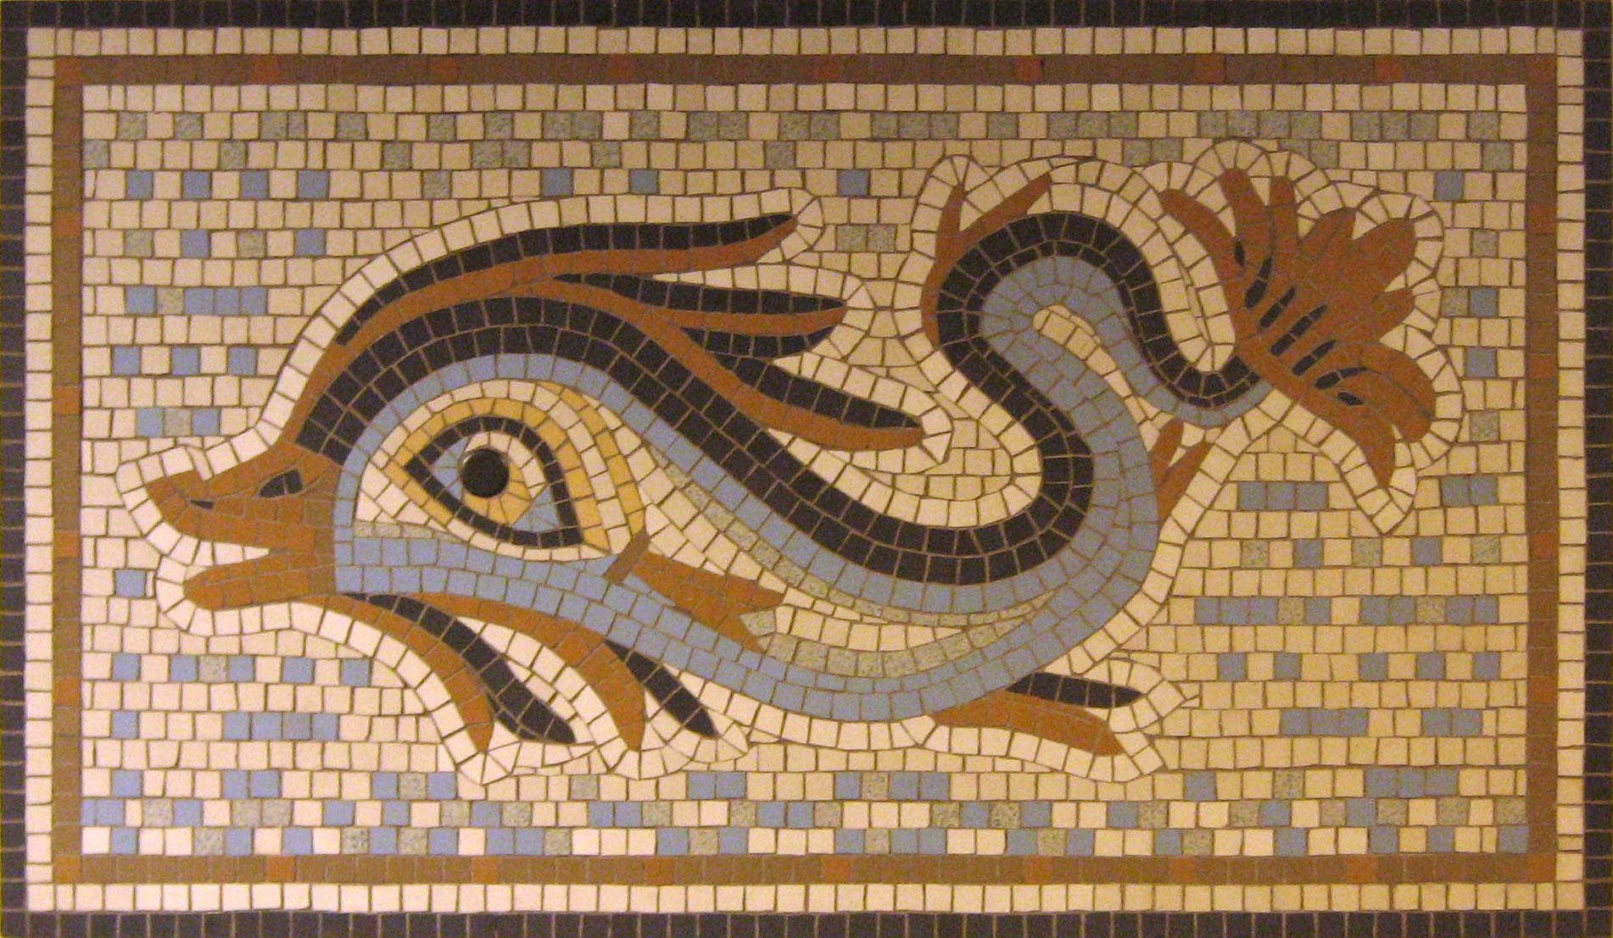
Lesson 1

Slide 3
What do you know already?
Go around the room and find 8 people to tell you something they already know about the Romans.
Once everybody has filled their chocolate bar, we will check whether are ideas are fact or fake!

Slide 4
What is a civilisation?
civilisation

Slide 5
What is a civilisation?
civilisation
the society, culture, and way of life of a particular area.

Slide 6
Let’s watch
https://www.bbc.co.uk/programmes/p00hdldw

Slide 7
Let’s compare and contrast
Use the sentences below to help you.
The Roman boy was/had/ did…………….. whereas I…………………
Both the Roman boy and I……………

Slide 8
Was there anything on your mind map that you were correct or incorrect about?
Edit in purple polishing pen.

Slide 9
What are mosaics?

Slide 10
Mosaics
The invention of concreate allowed the Romans to create huge pieces of art work call mosaics. They were made from 1000s of tiny tiles being placed together to create a pattern or a picture. Archaeologist use Mosaics to find out about Roman life as the designs would often show how the Romans hunted and lived.

Slide 11
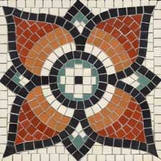
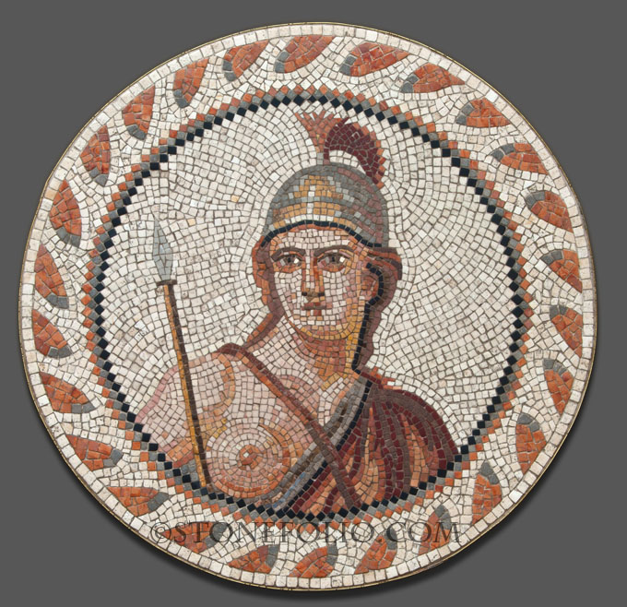
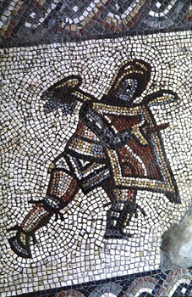
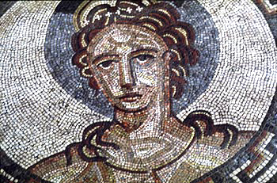
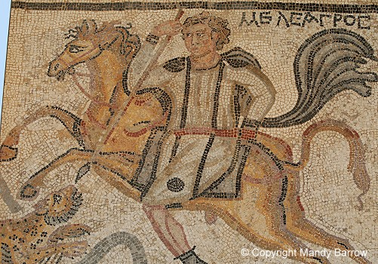
Roman Mosaics People still use mosaics today to decorate their homes and places of work. Have you seen any?

Slide 12
Here is the Recent Roman Mosaic discovery in Leicester, next to the John Lewis car park, in the winter of 2016/17.
https://www.youtube.com/watch?v=t-FDnhKSt5I

Slide 13
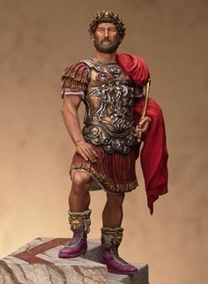
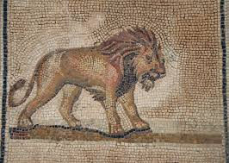
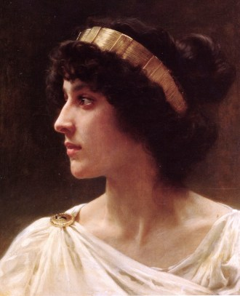
The Romans were huge show offs and created elaborate mosaics in their houses to show off how rich and powerful they were. The bigger and more detailed the mosaic, the more powerful you were!

Slide 14
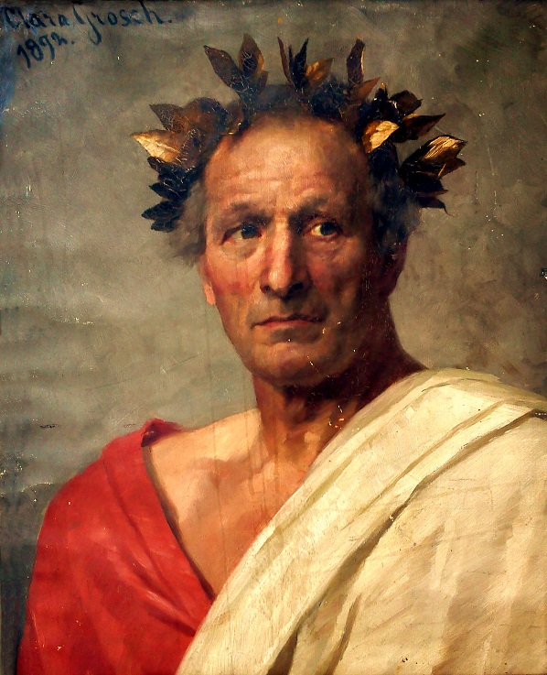
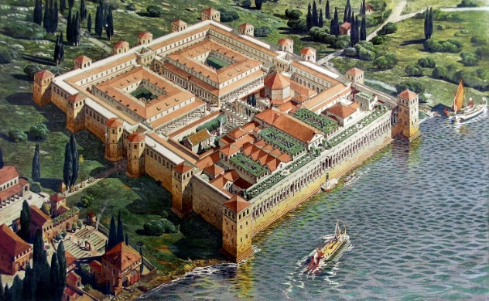
LC: Why did the Romans have mosaics?
Julius Caesar
The most important emperor of the Rome, needs your help!
In his new palace he needs a mosaic to show to the whole world that he is the most wealthy, fearsome, powerful emperor of all time.
Can you help him and design an elaborate mosaic for the palace floor?
EXT: Read fact file.

Slide 15
Plenary
Julius Caesar will now judge your mosaics.

Slide 16
So what did THE ROMANS do for us?

