Slide 1
Community
Year 4

Slide 2
Lesson 1

Slide 3
Christian Meditation

Slide 4
Opening Prayer
Jesus open our ears to hear your voice
Open our eyes to see your face
Open our mouths to speak your words
Open our hearts to your love
Open our hearts to your love

Slide 6
Blessing Song
We call on you O God
and on Jesus Christ your Son
through the power of the Spirit
that makes us truly one.
We ask you to bless us
and lead us in your ways
as you guide us on our journey
everyday.

Slide 8
Jesus chooses people to work with him
Jesus proclaimed God the Father’s love by what he said and did. People who followed Jesus in the early Church began to be called Christians. They formed a Christian community called the Church.
At the beginning of his ministry on earth, Jesus chose certain people to follow him and share in his work. They were to be apostles and would be sent out to spread the Good News.

Slide 10
What happened next?
What was their mission?
How can we spread the Good News?

Slide 11
Will You Come And Follow Me
If I But Call Your Name?
Will You Go Where You Don’t Know
And Never Be The Same?
Will You Let My Love Be Shown,
Will You Let My Name Be Known,
Will You Let My Life Be Grown
In You And You In Me?
Will You Leave Yourself Behind
If I But Call Your Name?
Will You Care For Cruel And Kind
And Never Be The Same?
Will You Risk The Hostile Stare
Should Your Life Attract Or Scare?
Will You Let Me Answer Prayer
In You And You In Me?
Will You Let The Blinded See
If I But Call Your Name?
Will You Set The Prisoners Free
And Never Be The Same?
Will You Kiss The Leper Clean,
And Do Such As This Unseen,
And Admit To What I Mean
In You And You In Me?
Will You Love The ‘You’ You Hide
If I But Call Your Name?
Will You Quell The Fear Inside
And Never Be The Same?
Will You Use The Faith You’ve Found
To Reshape The World Around,
Through My Sight And Touch And Sound
In You And You In Me?
Lord, Your Summons Echoes True
When You But Call My Name.
Let Me Turn And Follow You
And Never Be The Same.
In Your Company I’ll Go
Where Your Love And Footsteps Show.
Thus I’ll Move And Live And Grow
In You And You In Me.
https://www.youtube.com/watch?v=o469PRLdbHU

Slide 12
Jesus chooses people to work for him
How do you think the apostles felt when Jesus chose them to be his special helpers?
Why do you think he needed to choose people to help him?
How do people serve God in their parish community today?
How can we live out our lives as apostles of Jesus?

Slide 13
I can discuss and describe the actions of Christians living out their lives as ‘apostles’ of Jesus, giving reasons for what they say and do
Stick in a meditation sticker, then begin your work:
St Clare – design a ‘Code of Conduct’ of how we/they can lead our/their lives as ‘apostles’ of Jesus, giving some reasons for your choices. Link to the hymn.
Example:
We should help others who are sick because that is what Jesus did when he helped the blind man.
St Francis - Draw a picture of people living out their lives as ‘apostles’– provide description with some reasons. Try to link to the hymn.

Slide 14
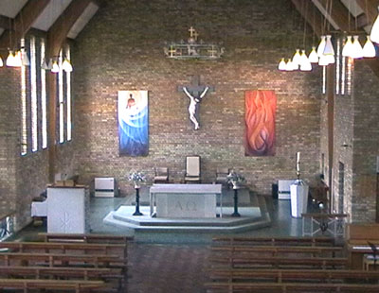
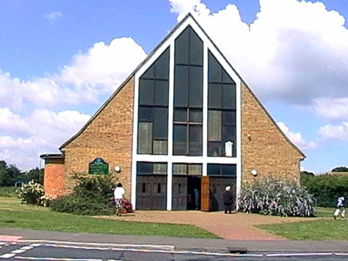
What do you think we might be learning about in this lesson?

