Slide 1
This is our new novel. Today we will make some predictions from just looking at the front cover.

Slide 2
Which genre do you think this book is? Science fiction? Historical? Fantasy? Factual? Traditional tale?

Slide 3
What can we tell about this book from the front cover? What do you think it is about? Who is in it? What will happen? Why do you think that? When is it set?

Slide 4
Monday 25th January
I can make predictions about a book
Stick the image in your book and write what you predict about the book around it.

Slide 5
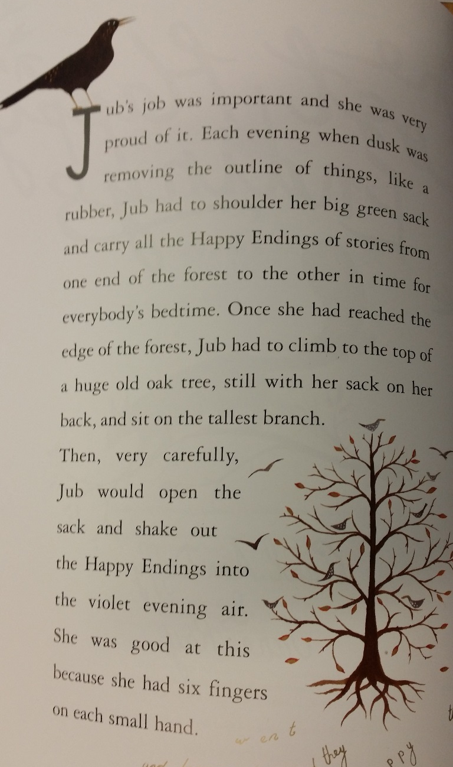
Let’s read the first page

