Slide 1
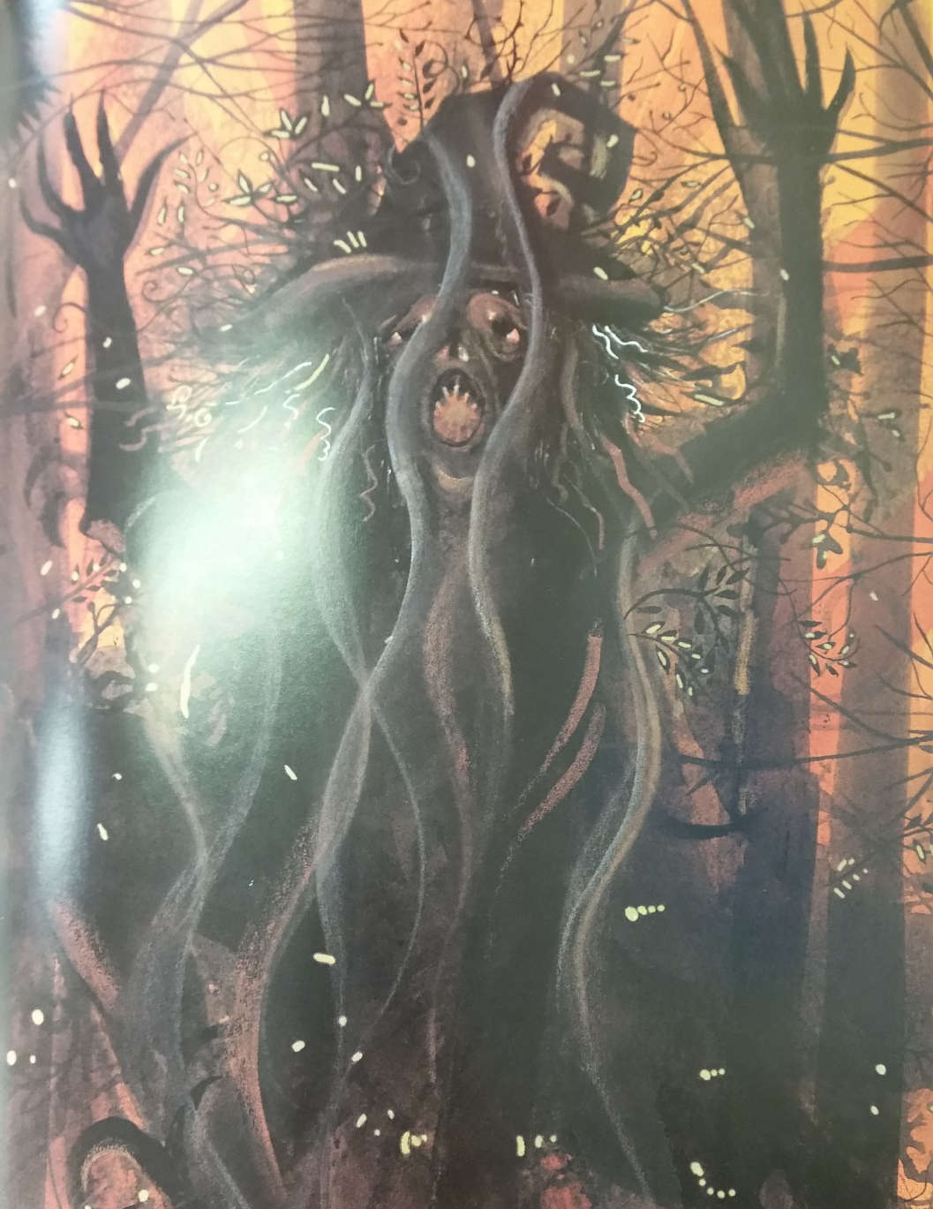
I can identify and use adverbs

Slide 2
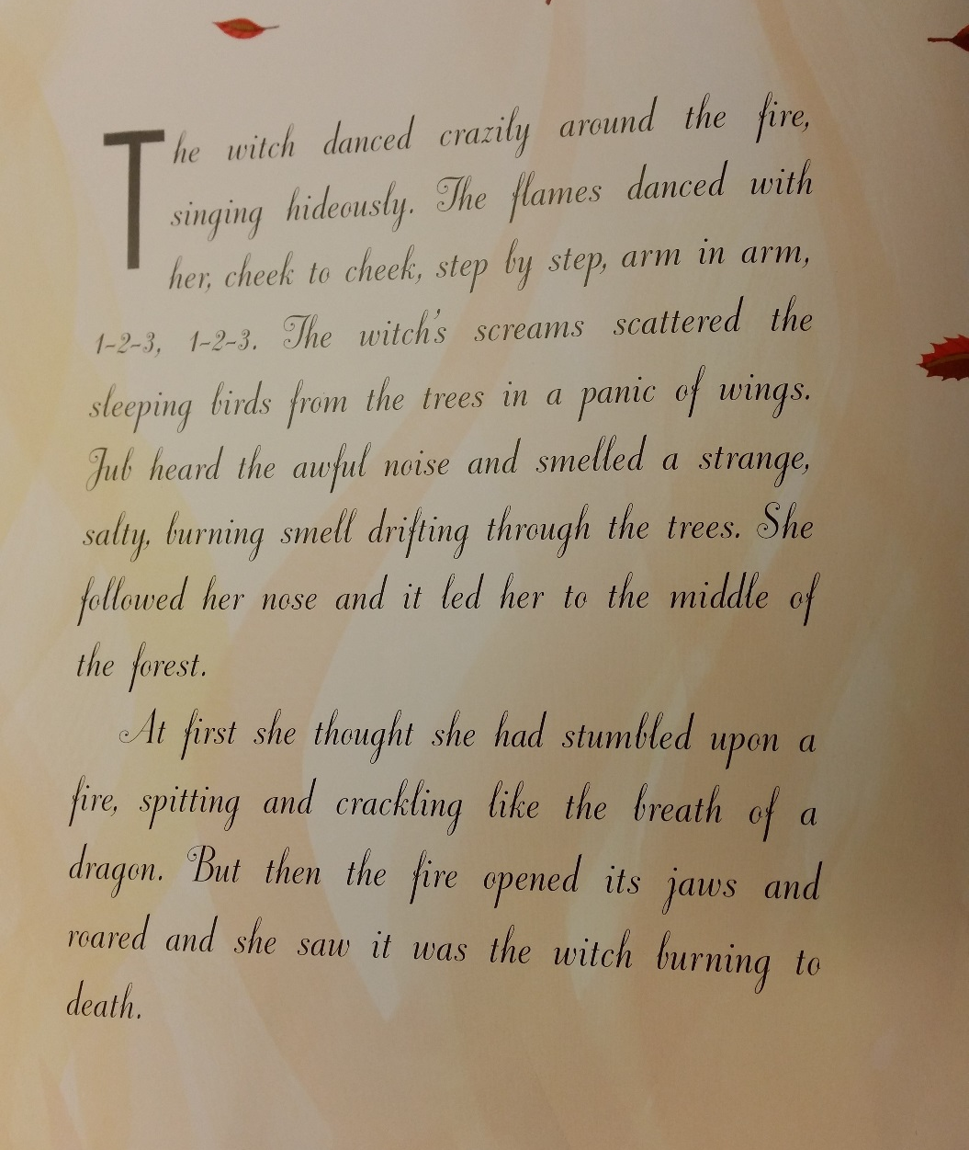
Let’s read. Put your hand up when you hear an adverb.

Slide 3
What is an adverb?

Slide 4
It describes a verb.
It tells us ____, ______ or ______ something happened.

Slide 5
It describes a verb.
It tells us when, where or how something happened.
The man ran slowly.
Unfortunately, the door was shut.
Yesterday, I went to the shop.

Slide 6
What is an adverbial?

Slide 7
What is an adverbial?
A few words that tell us when, where or how something happens.
The man walked as slow as a snail.
In the middle of the night, the moon shone.

Slide 8
Can I identify and use adverbs?
Write 3 sentences using adverbs and circle the adverbs.
Write 3 sentences using adverbials and circle them.
Use the sheet of adverbs and adverbials to help you. Check your capital letters and full stops.

