Slide 1
What did THE ROMANS do for us?

Slide 2
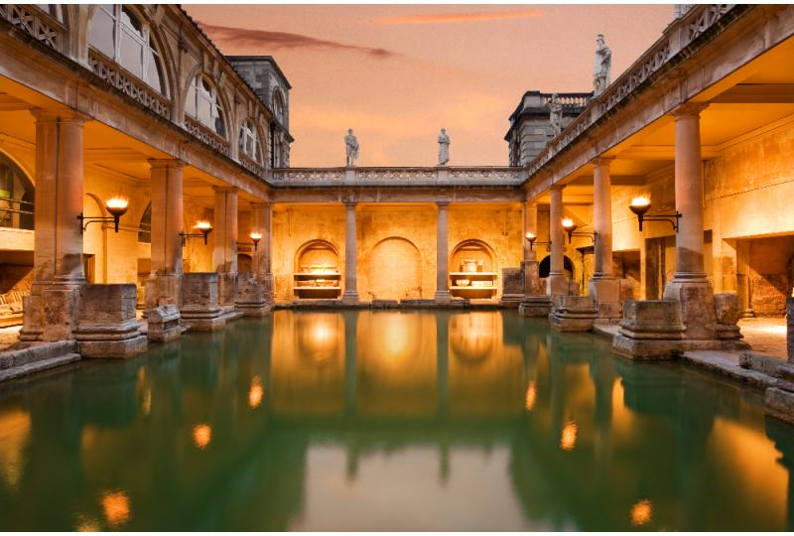
Lesson 2

Slide 3
What did the Romans do for fun?
Have a think!

Slide 4
Let’s watch
https://www.youtube.com/watch?v=-JWK1k_FecA

Slide 5
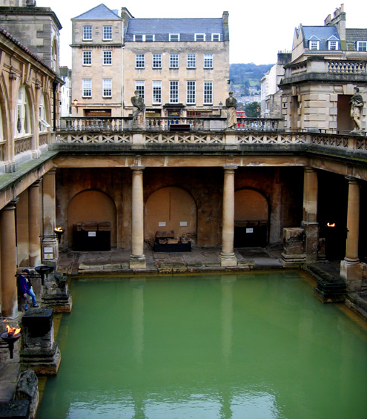
Roman Baths
The Romans loved to keep clean and bathing was a sociable experience that the Roman people enjoyed to share together.
The Romans also built their baths in the countries they conquered.
There are many examples of Roman Bath Houses in Britain.
This picture shows the Roman Baths at Bath, Somerset.

Slide 6
Let’s look in our Atlas.
Where is Bath in the UK?

Slide 7
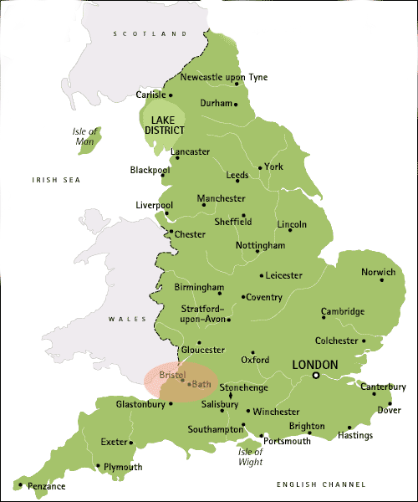

Slide 8
Let’s go on a tour!

Slide 9
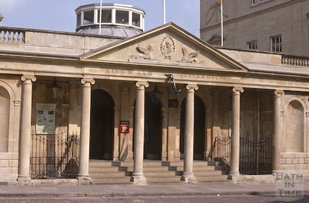

Slide 10
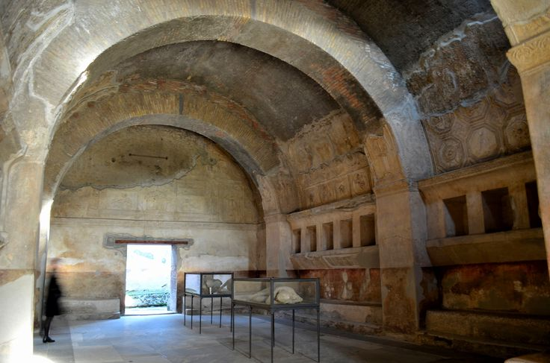
First stop, the changing rooms!

Slide 11
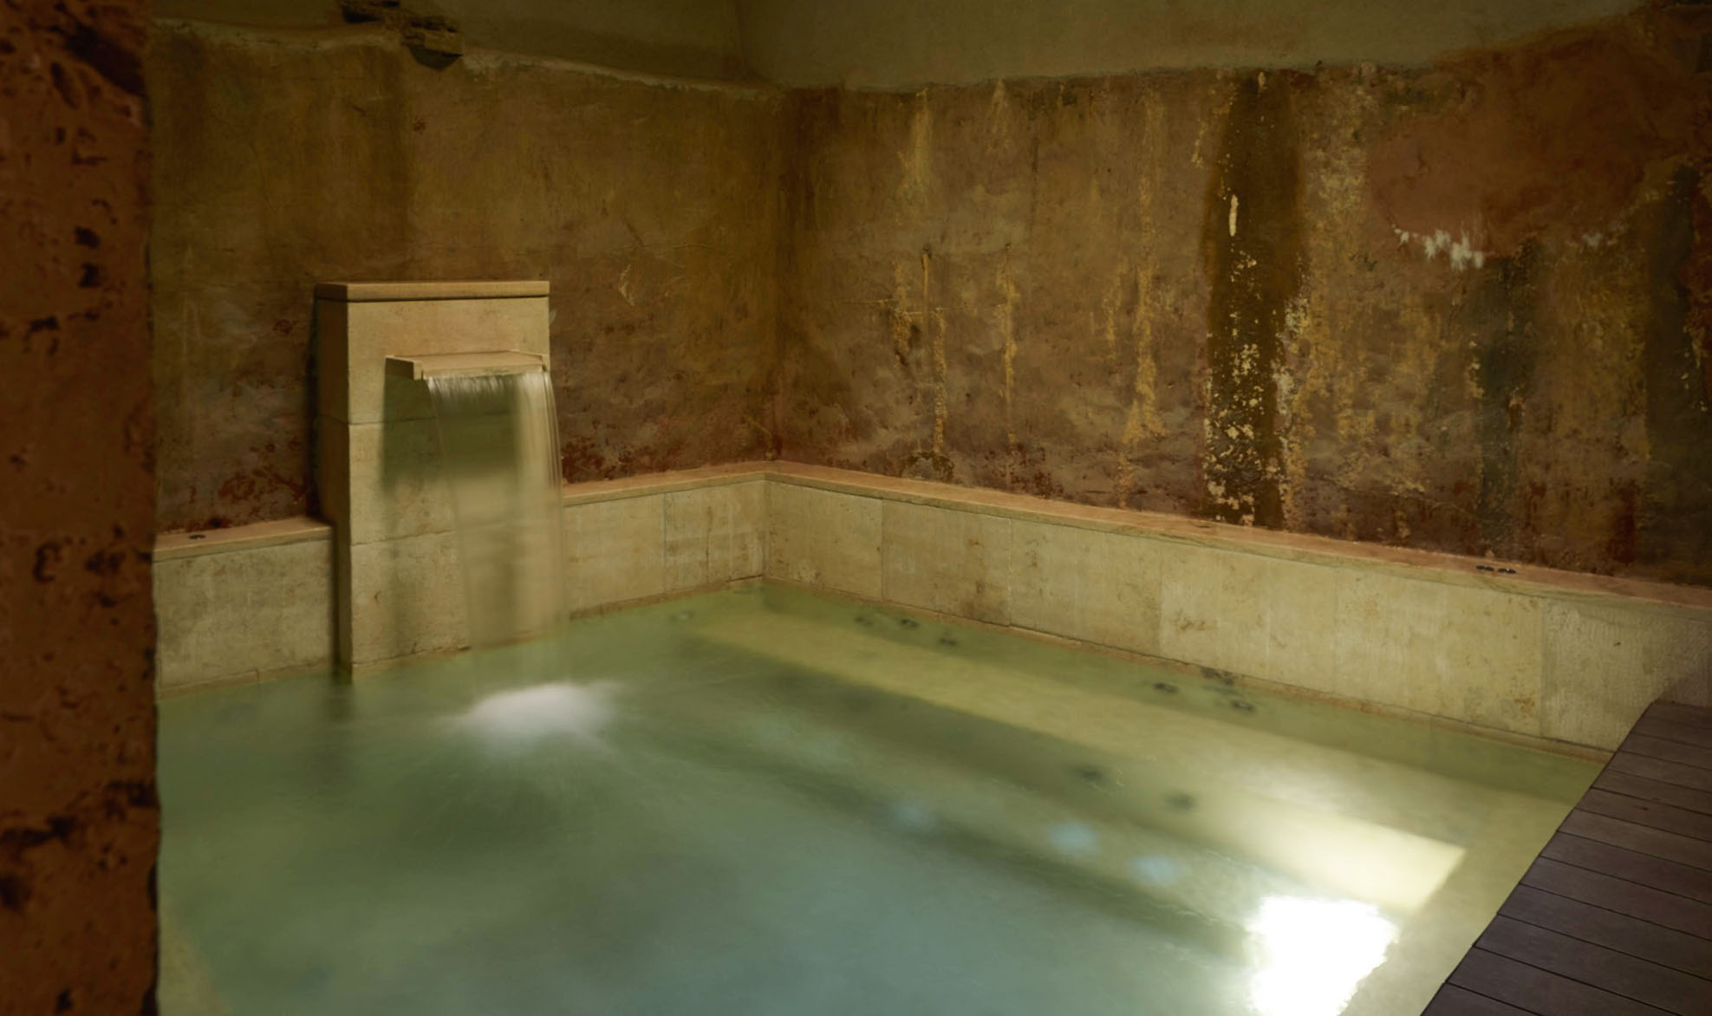
The Tepidarium
What could have this room been used for?
Look at the root word and suffix: tepid + arium

Slide 12
The Tepidarium
What do you think this room was for?
Look at the root word + suffix.
tepid = warm
arium = place
The water in this room was nice and warm in order to allow the Romans to relax their muscles and prepare their body temperature for the next room.

Slide 13
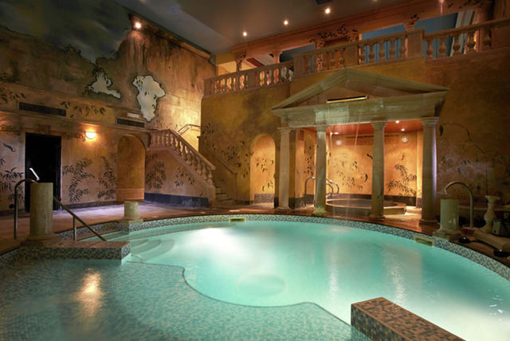
The Caldarium
What could have this room be used for?
Look at the root word and suffix: cald + arium

Slide 14
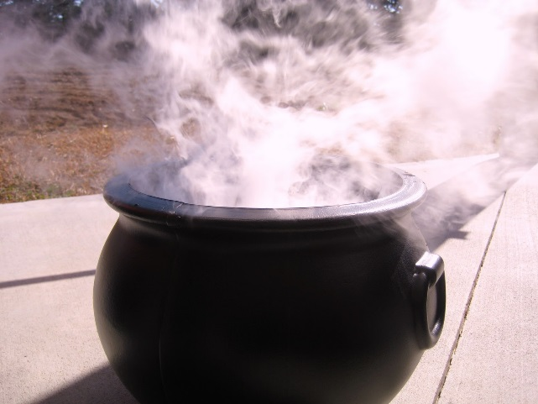
The Caldarium
What do you think this room was for?
cald = hot
arium = place
cauldron

Slide 15
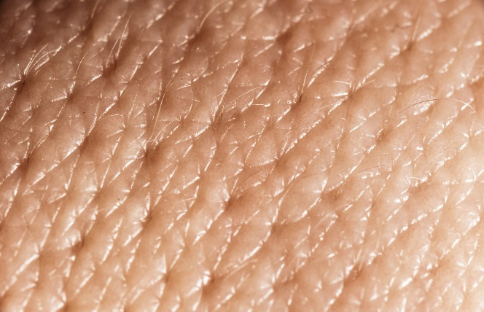
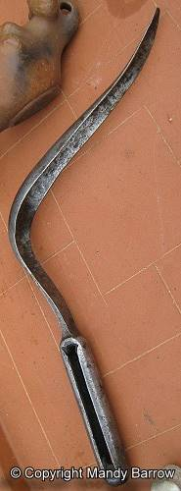
The Caldarium
This room had hot water so there was lots of steam.
The steam opened up the pores on their skin.
Slaves would then rub the skin with oils which smelled nice.
The slaves would have then used a strigil to scrape off the dirt that was in the pores.
The job of this room was to clean your skin.

Slide 16
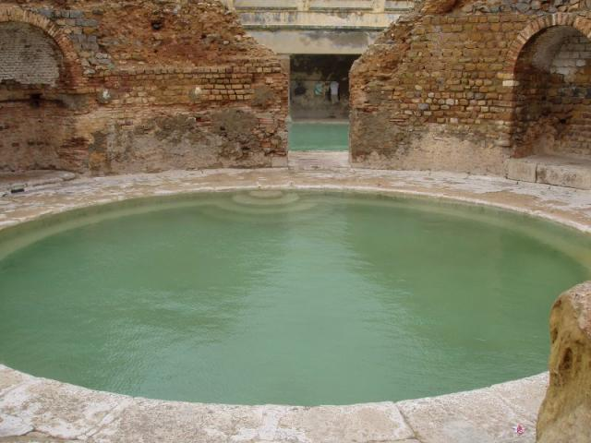
The Frigidarium
What do you think this room was for?
Look at the root word and suffix: frigid + arium

Slide 17
The Frigidarium
What do you think this room was for?
frigid, this comes from the Latin word frigidus which means cold.
frigid = cold
arium = place
The cold water in this room closed the pores so that no dirt could get back into the skin.
This bath was also big enough to swim in.

Slide 18
I can explain why the Roman baths had different rooms
Create a guide leaflet that promotes the Roman baths.
This leaflet needs to give visitors information about what the different baths do, what you can do there and the different rooms you can visit.

Slide 19
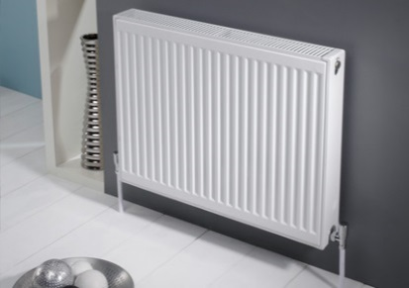
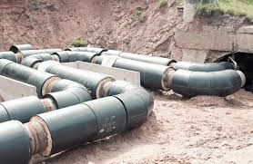
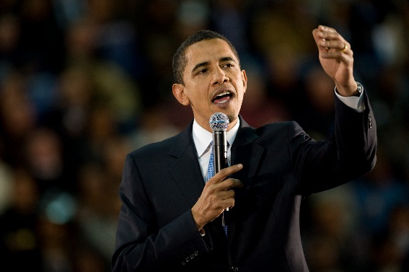
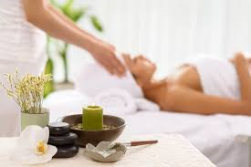
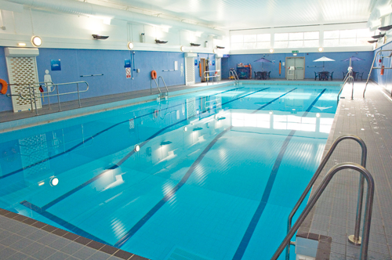
Plenary
Impact on our lives today!
From our lesson today can you think of how the Roman baths have changed our lives today?
Central heating
Water pipes
Language
Spa
Swimming pools

Slide 20
So what did THE ROMANS do for us?

