Slide 1
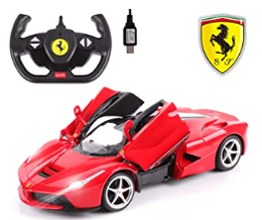
Watch this: https://www.youtube.com/watch?v=UaheQsvZK8g

Slide 2
What is the purpose of an explanation text?

Slide 3
What is the purpose of an explanation text?
To explain how something works, how something happened or how to do something

Slide 4
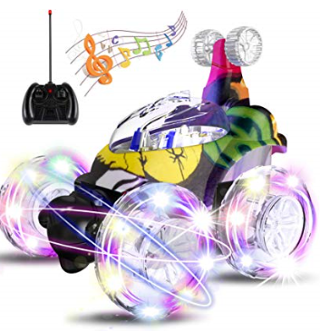
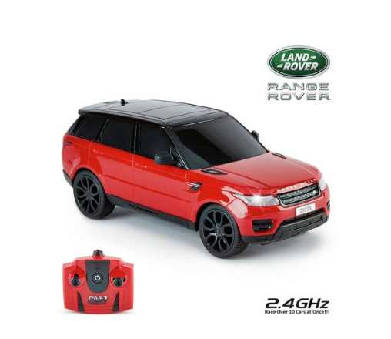
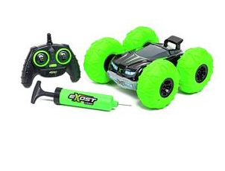
Watch again: https://www.youtube.com/watch?v=UaheQsvZK8g

Slide 5
So… How does a remote controlled car work?

Slide 6
Write an explanation text about how a remote controlled car works. Don’t worry if you don’t know – just make up some facts.
You should write at least half an A4 sheet.

