Slide 1
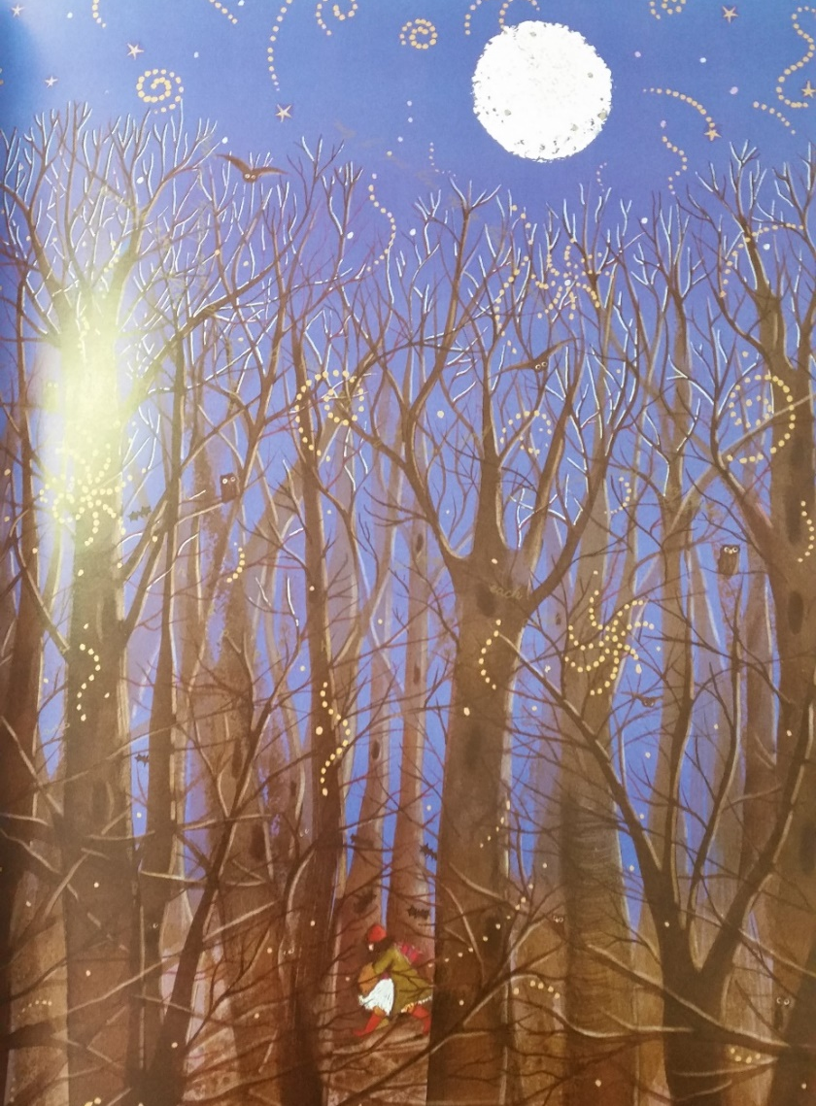
Tuesday 26th January
I can use similes and metaphors?

Slide 2
How many expanded noun phrases can you write about this picture?
Examples:
the giant trees with the lanky branches
the crystal blue cloudless sky
Write down five noun phrases like this about the picture

Slide 3
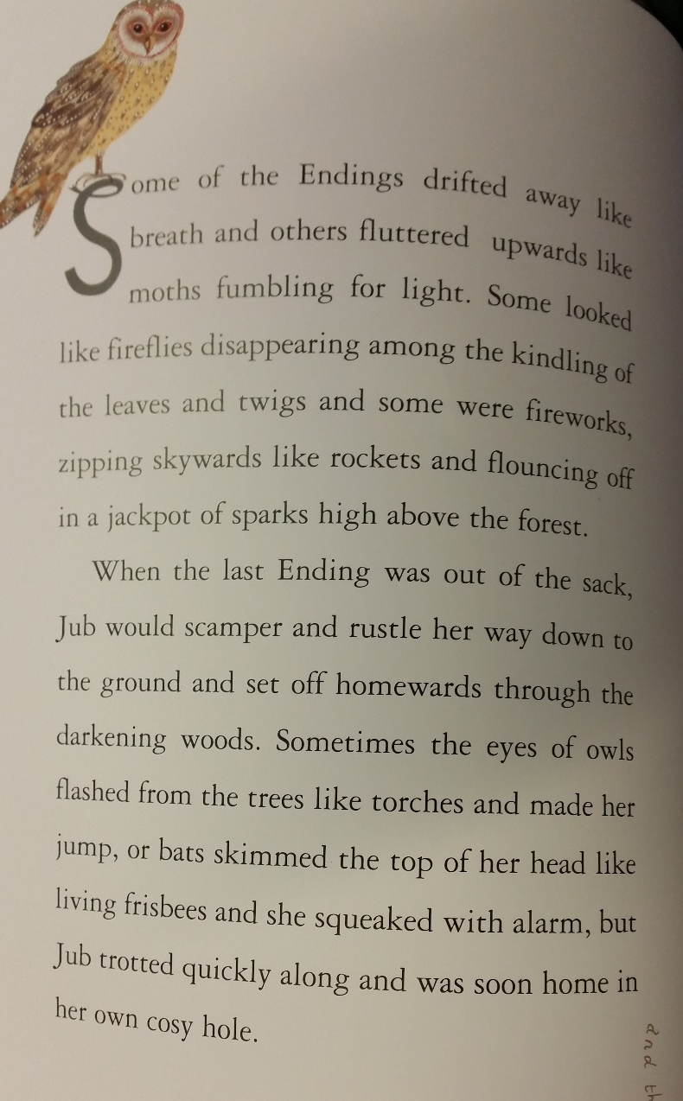
Let’s read

Slide 4
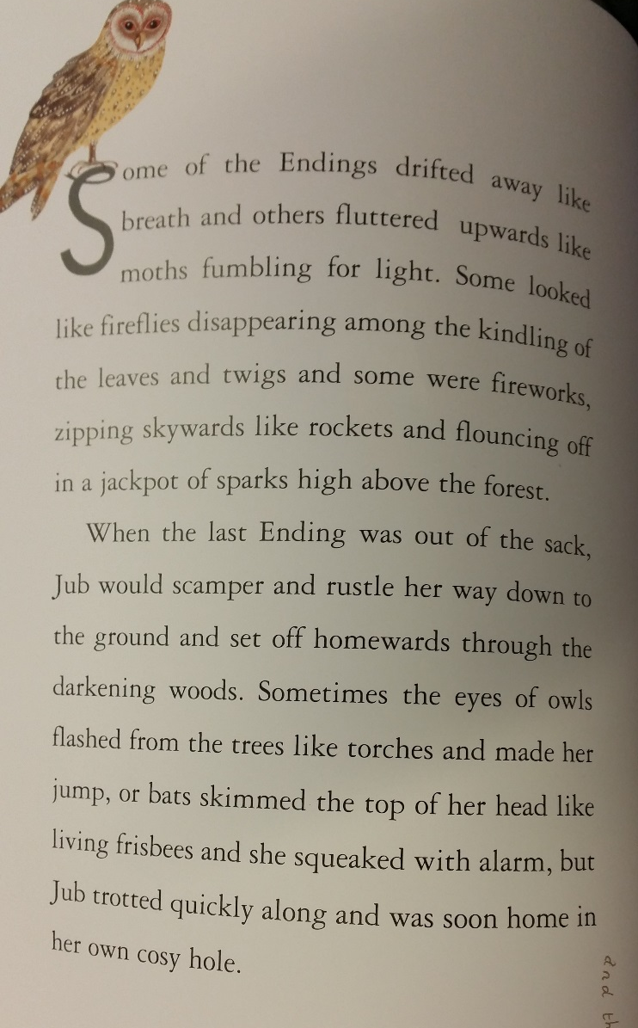
What strategy does the author use to describe?

Slide 5
Similes and metaphors

Slide 6
What is a simile?

Slide 7
What is a simile?
When you compare one thing with another thing of a different kind, to make a description clearer
Examples:
As brave as a lion
As flat as a pancake

Slide 8
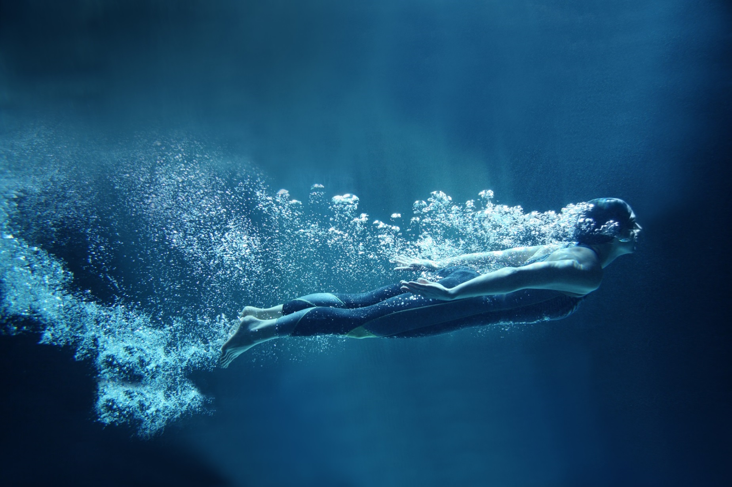
What is a metaphor?

Slide 9
What is a metaphor?
When you use one thing to describe another, even though they are not the same
Examples:
The dragon’s teeth were sharp daggers.
The river was a wriggly worm.

Slide 10
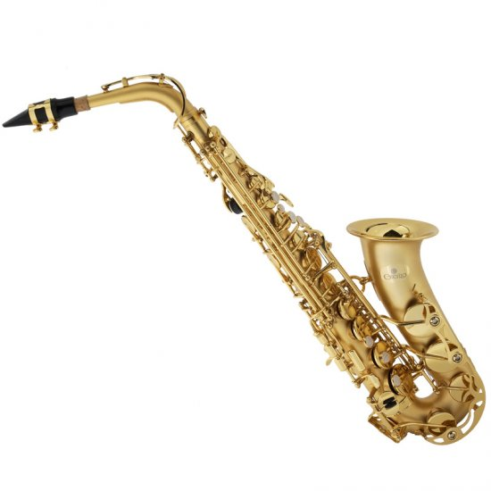
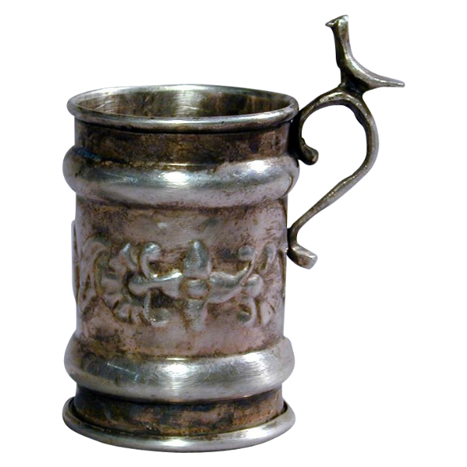
Can I use similes and metaphors?
Your job:
Describe each object on the sheet with a simile or metaphor. Write in full sentences.
Challenge: Use fronted adverbials and expanded noun phrases too.

Slide 11
Plenary
Self-assess your work. Copy this list and tick those you have used in your work today.
Used similes
Used metaphors
Used expanded noun phrases
Used fronted adverbials

