Slide 1
What did THE ROMANS do for us?

Slide 2
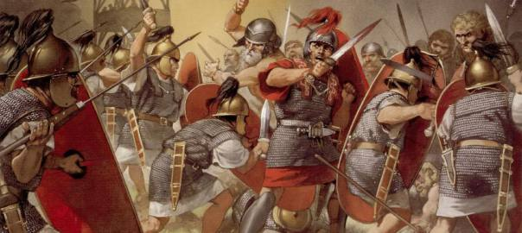
Lesson 3

Slide 3
True or false? How do we know?
Rome was founded in April 21 753BC by its first king, Romulus. It grew into a rich and powerful city during the next few hundred years.
To bring water to their cities, the clever Romans built aqueducts – a system of channels and bridges – to transport water for public baths and toilets!
Roman legend says that Romulus had a twin brother called Remus. As babies they were abandoned in the area which later became Rome. A she-wolf found and raised them, but when they grew up, Romulus fought and killed Remus and became the first ruler of Rome!

Slide 4
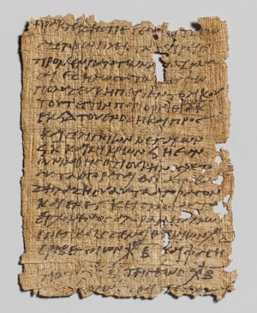
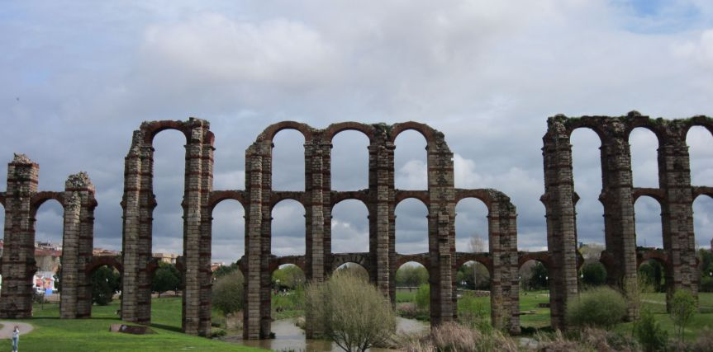
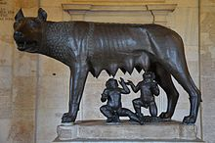
Sources of evidence. Can we be sure they are true, based on the evidence?
ruins
Romans kept good records of feast days.
Word of mouth/legend.

Slide 5
Sources of evidence. Can we be sure they are true, based on the evidence?
Founded on 21st April = very likely
Evidence = Romans kept good records of feast days (this was a festival day to Pales, the goddess of Shepheard)
Founded in 753 BC = unknown
Evidence = no record found (the Romans that lived later on estimated this)
Aqueducts = very likely to be true
Evidence = ruins.
Romulus and Remus raised by wolves = unknown
Evidence =Word of mouth/legend.

Slide 6
I can explain why the Romans wanted to invade Britain
Suggestions?
What do you think?

Slide 7
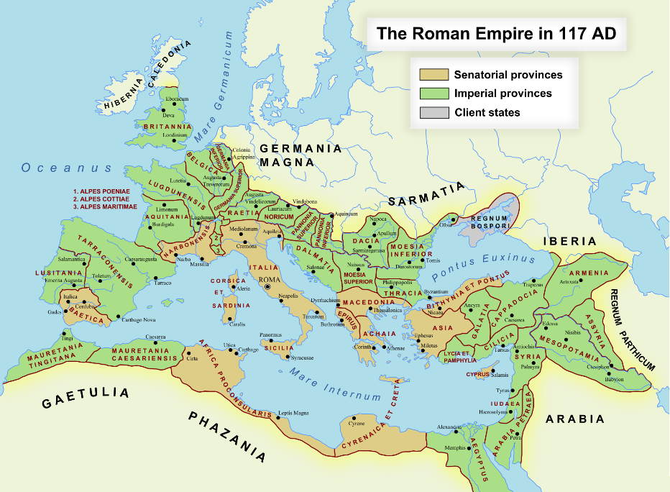
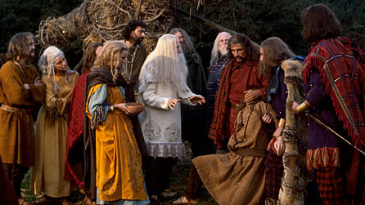
Why did they invade?
People. Why would they want them?
To make the Roman empire bigger. Why would they want to?
Resources. Why would they want them?

Slide 8
Let’s watch
http://www.bbc.co.uk/schools/primaryhistory/romans/invasion/
Click on: Why did the Romans invade?
Then Videos, Then Find out why Ceasar came to Britain.

Slide 9
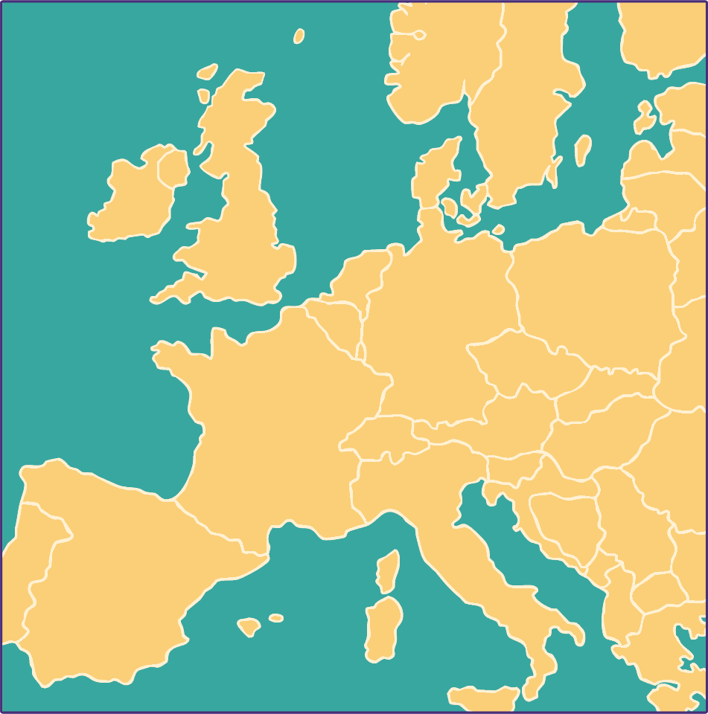
In 55BC, the Romans already ruled the country that we know today as France. The Romans called it Gallia and were just across the English Channel.
Britain
The Romans
The English Channel

Slide 10
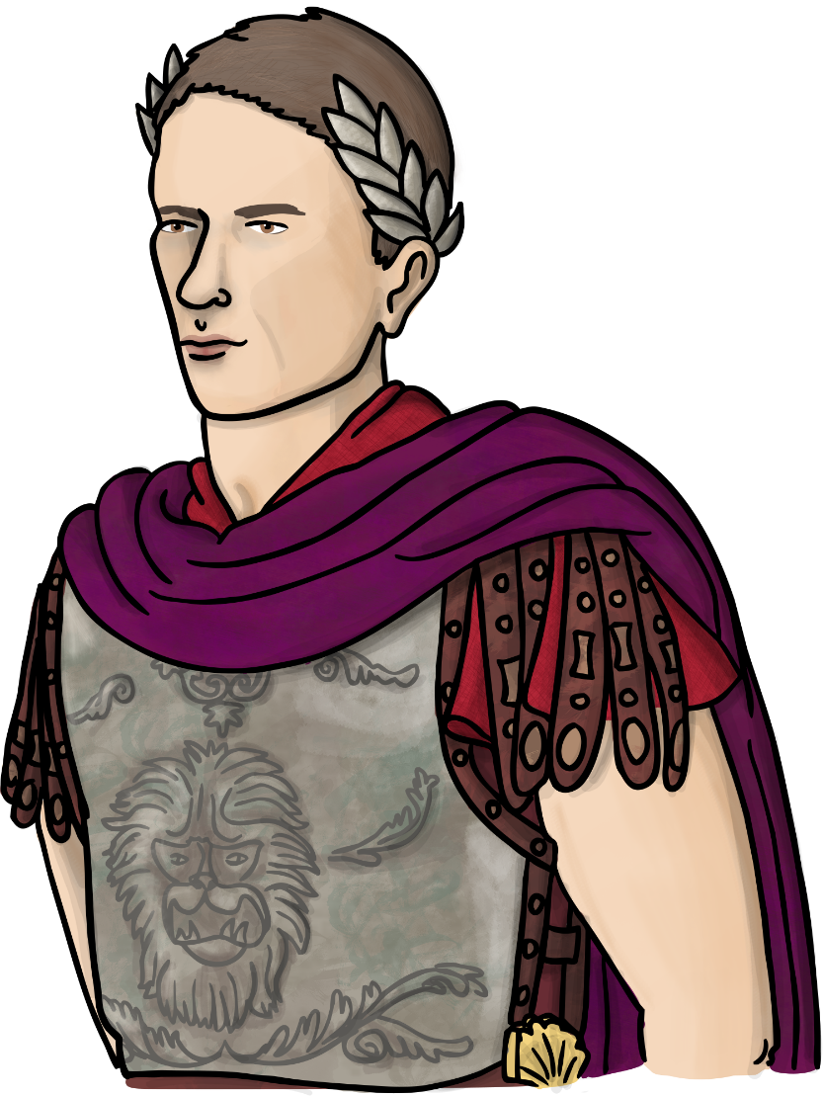
55BC: The First Raid
The Roman General Julius Caesar came across the sea to Britain. He wanted to make Britain a part of the Roman Empire. He brought with him two Roman legions.
The Celts were living in Britain. They fought back bravely and despite the Romans winning several battles they returned to France.
Roman legions: there were around 5000 soldiers in a Roman Army legion.

Slide 11
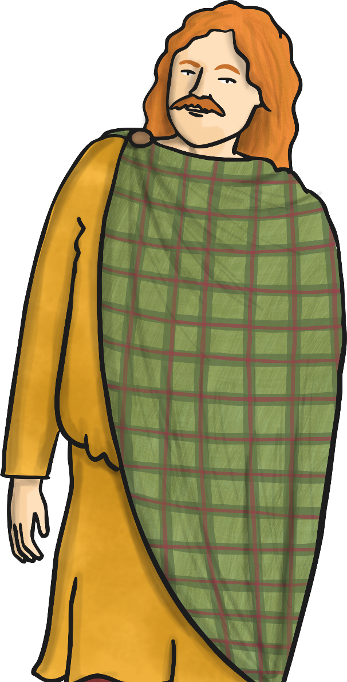
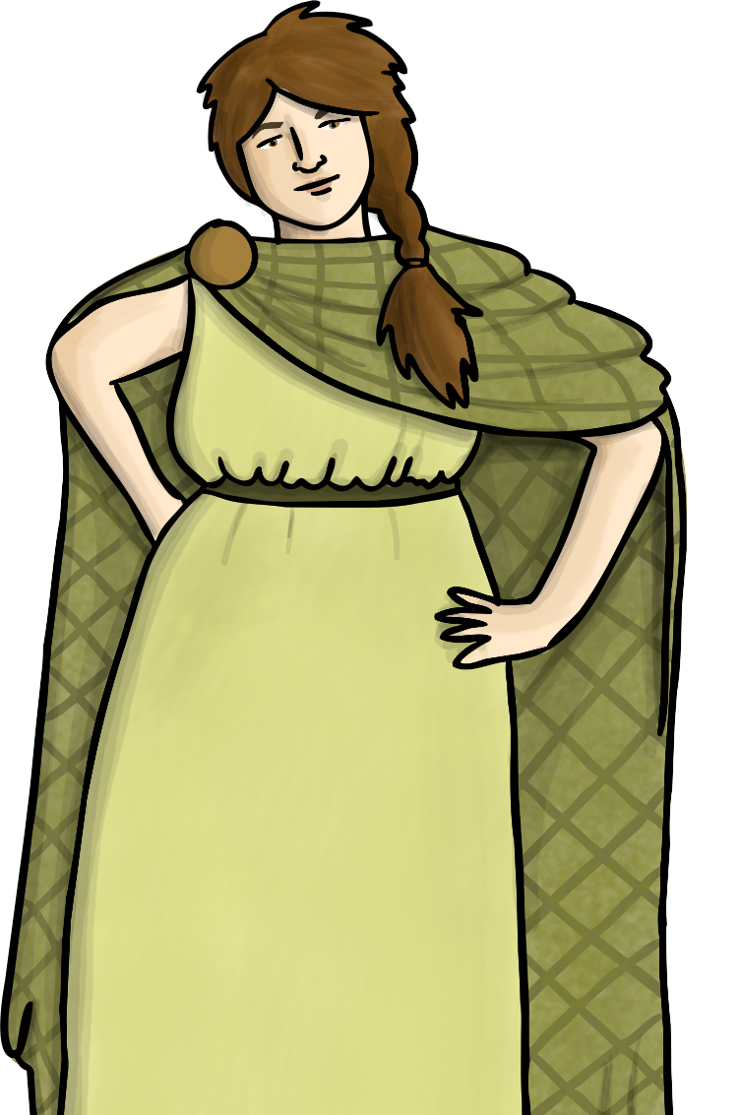
54BC: The Second Raid
One year later, Julius Caesar came back across the sea. This time he brought with him 5 legions and 2,000 cavalrymen.
The Roman army fought in South East England and this time got to the other side of the River Thames.
The British tribes agreed to pay tributes to Rome and were left in peace. Caesar did not think Britain was worth a long war and he had other problems in the Empire to deal with. The Celts opened up trading links with the Romans.
cavalrymen: soldiers on horseback.

Slide 12
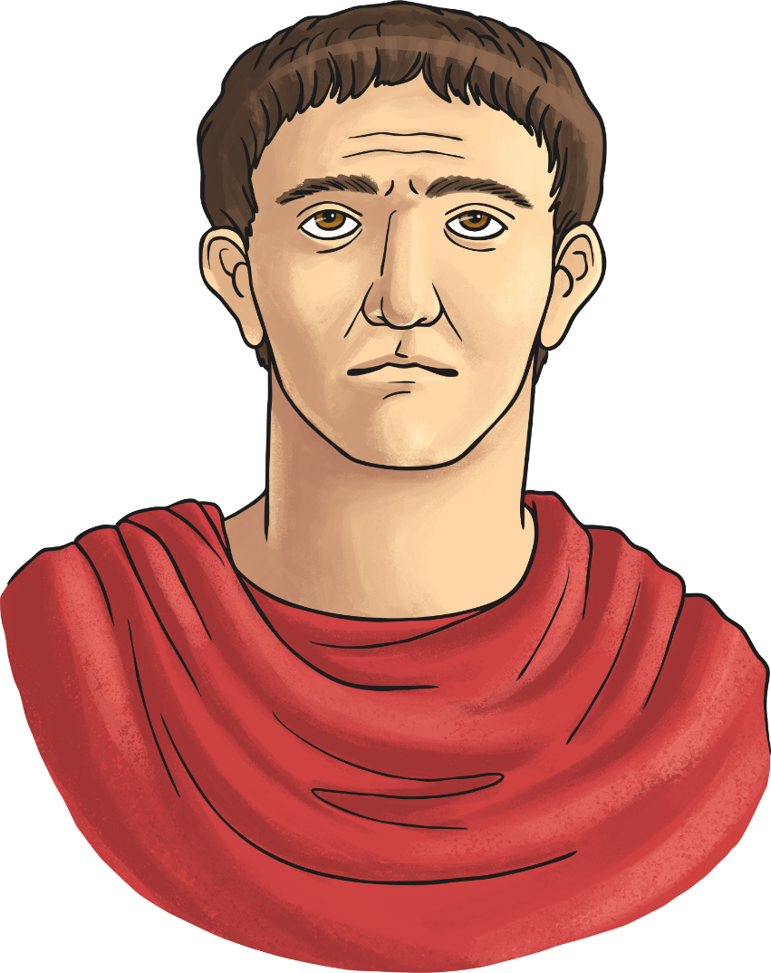
43AD: The Third Attempt
Nearly one hundred years later, the Romans returned. Emperor Claudius was now in charge and he was determined to make Britain part of the Roman Empire. He sent General Aulus Plautius and four legions of soldiers, plus about the same number of auxiliary soldiers. They were split into 3 divisions.
Many Celtic tribes realised how strong this Roman army was and made deals to keep the peace. They agreed to obey Roman laws and pay taxes. In return they were allowed to keep their kingdoms.
Auxiliary soldiers: recruited from non-Roman tribes to reinforce the army or provide a specific skill. The Latin word ‘auxilia’ means help.

Slide 13
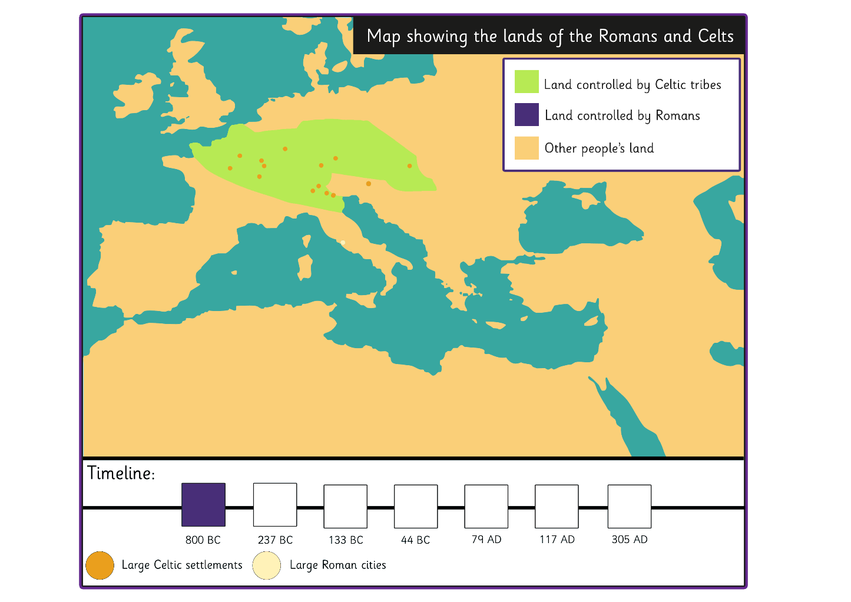
The Spread of the Roman Empire
What features do you notice on this map?
What can you say about who owned land in 800BC?

Slide 14
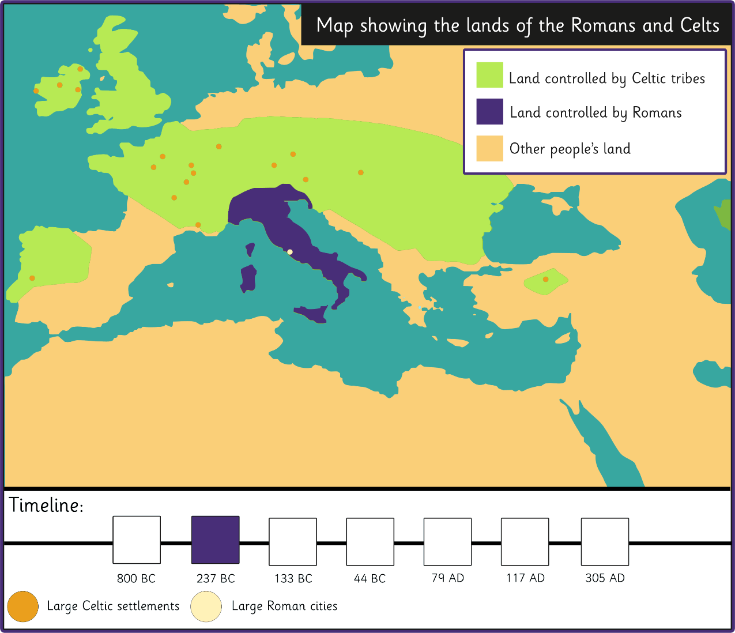
The Spread of the Roman Empire
What do we notice now in 237BC?

Slide 15
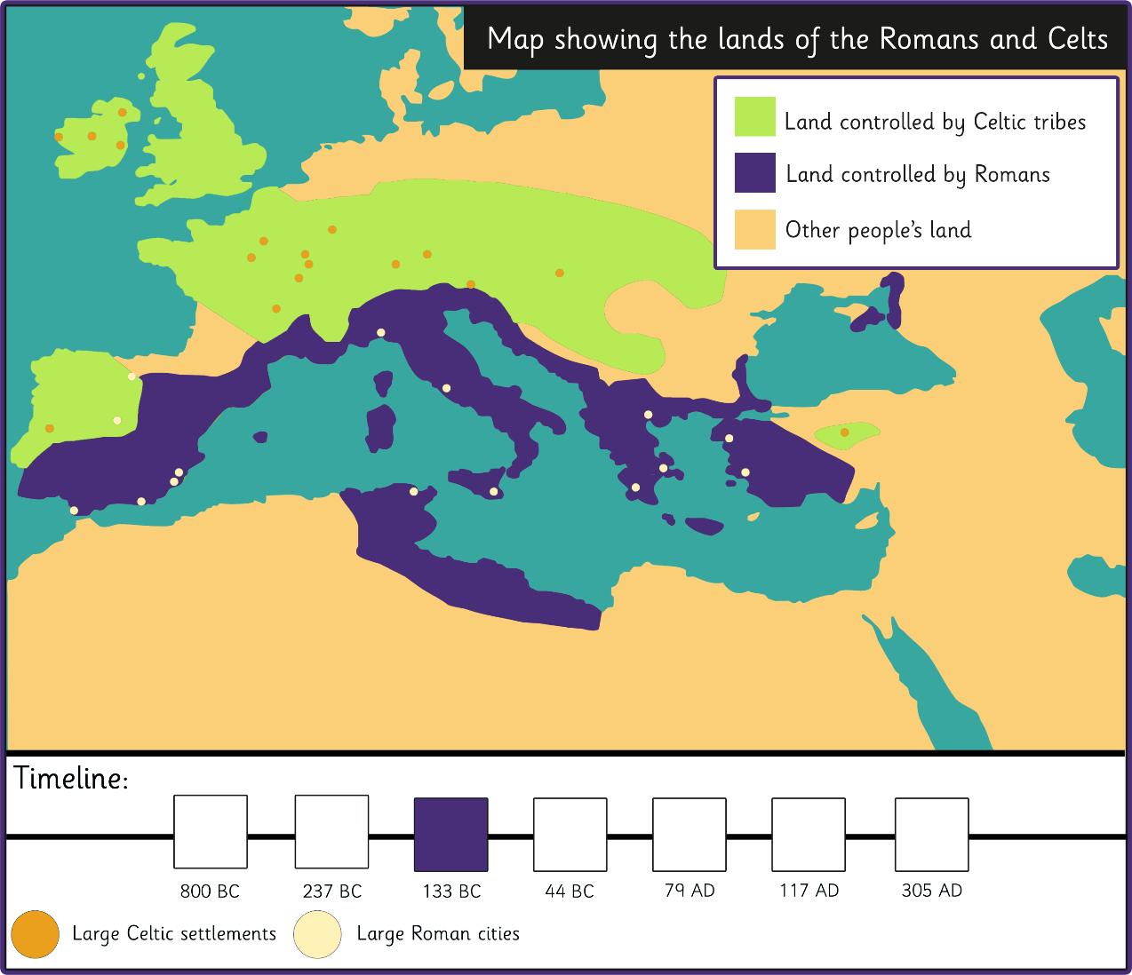
The Spread of the Roman Empire
What has changed by 133BC?

Slide 16
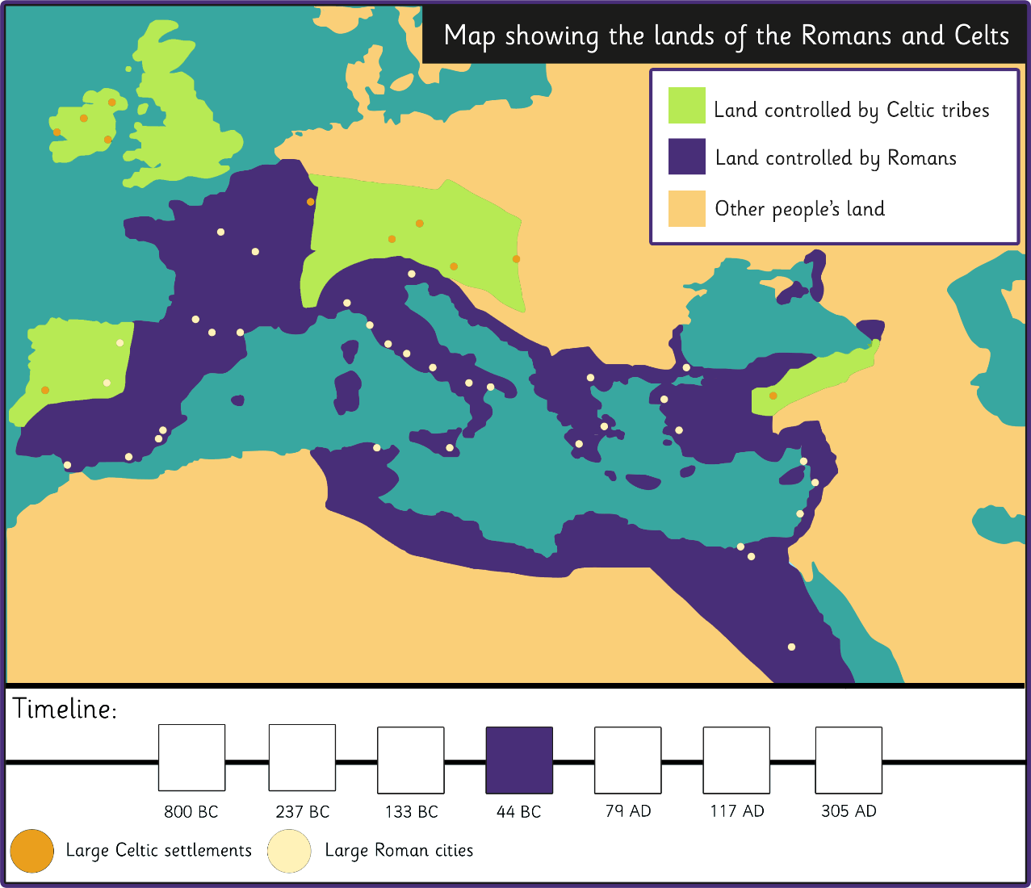
The Spread of the Roman Empire
What do you think is most significant about this map?

Slide 17
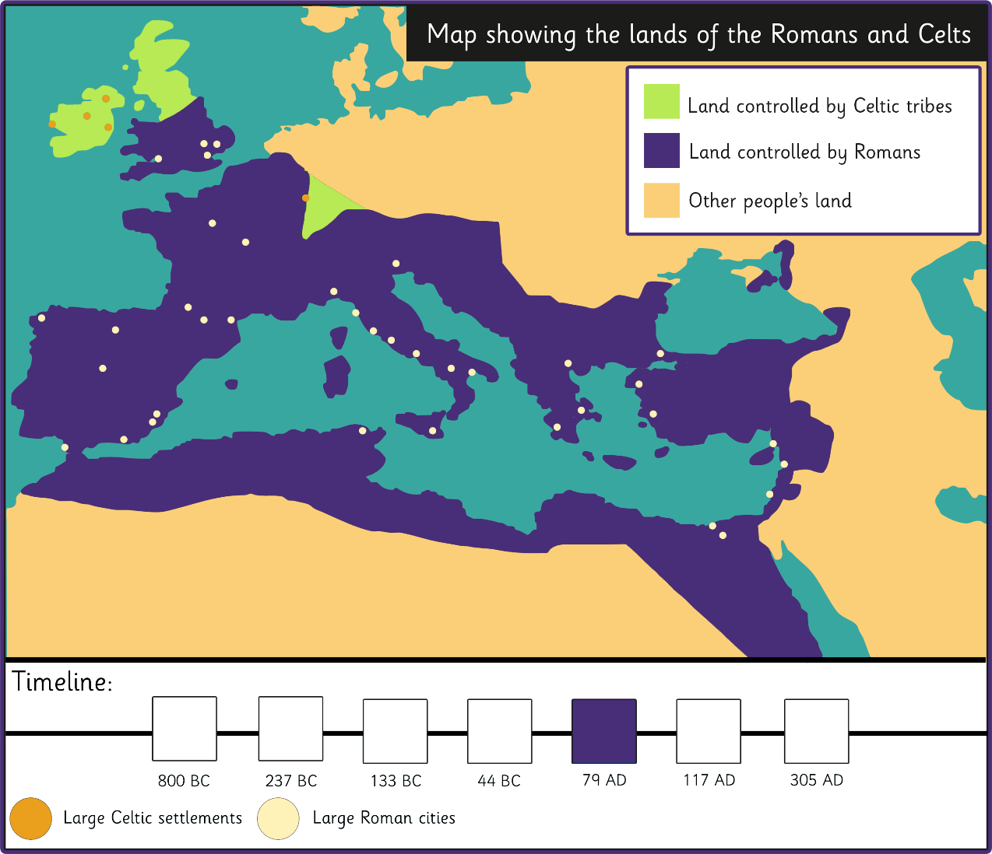
The Spread of the Roman Empire
What can we say about the Celts in 79AD?

Slide 18
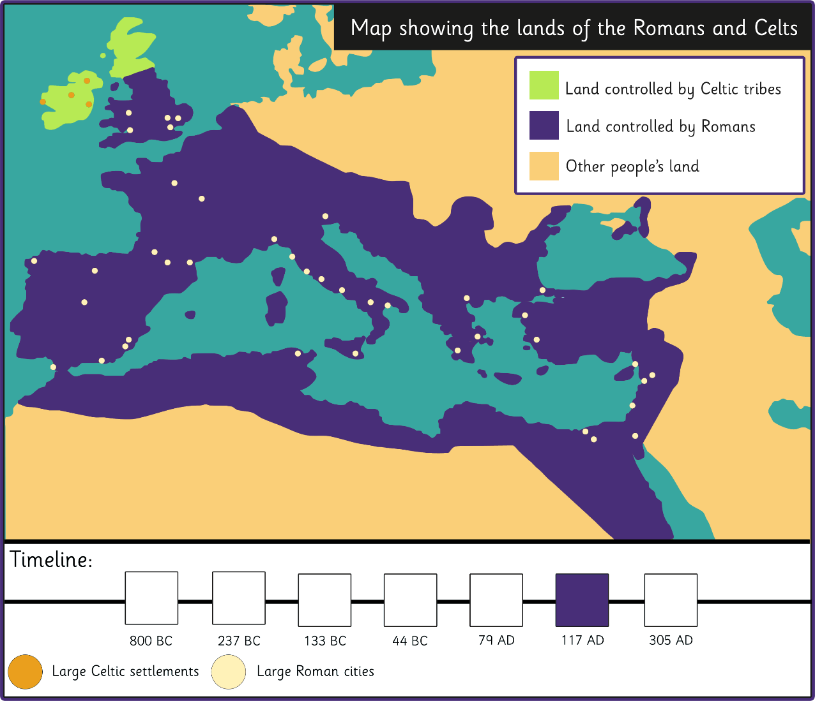
The Spread of the Roman Empire
What can we say about the Celts in 117AD?

Slide 19
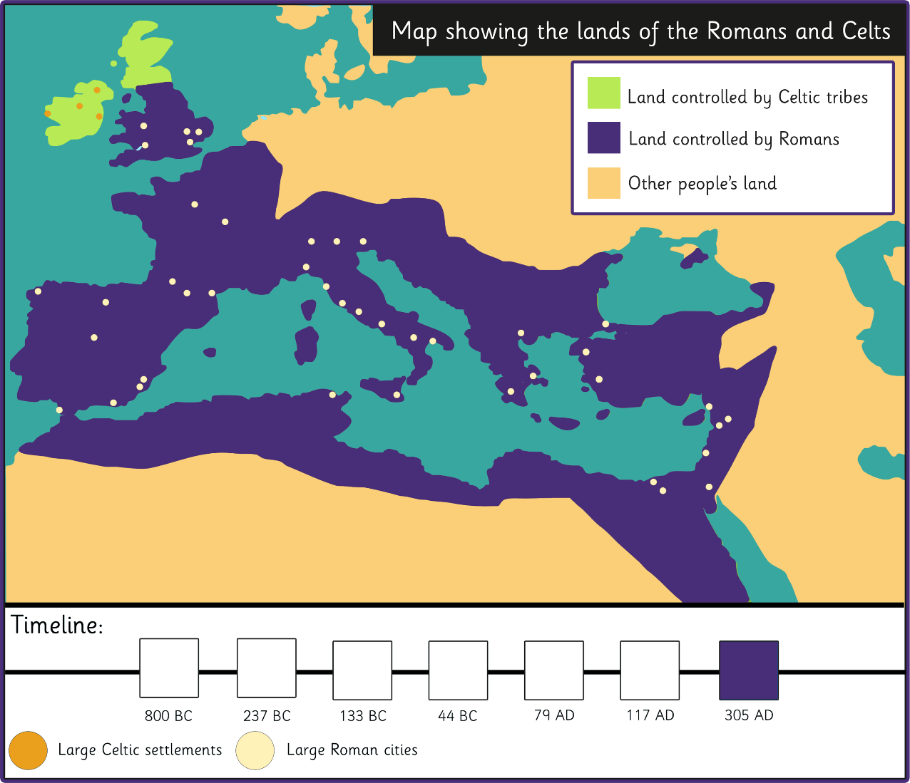
The Spread of the Roman Empire
Where in the UK are the most important Roman cities?

Slide 20
I can explain why the Romans
wanted to invade Britain
In your book, write down a quick summary
of each of the three invasions.
Go back to the earlier slides to help you.
Do not copy them though – it must be in your own words.

Slide 21
Plenary
Let’s watch the video
https://www.youtube.com/watch?v=3X7D8yz6QFg

Slide 22
So what did THE ROMANS do for us?

