Slide 1
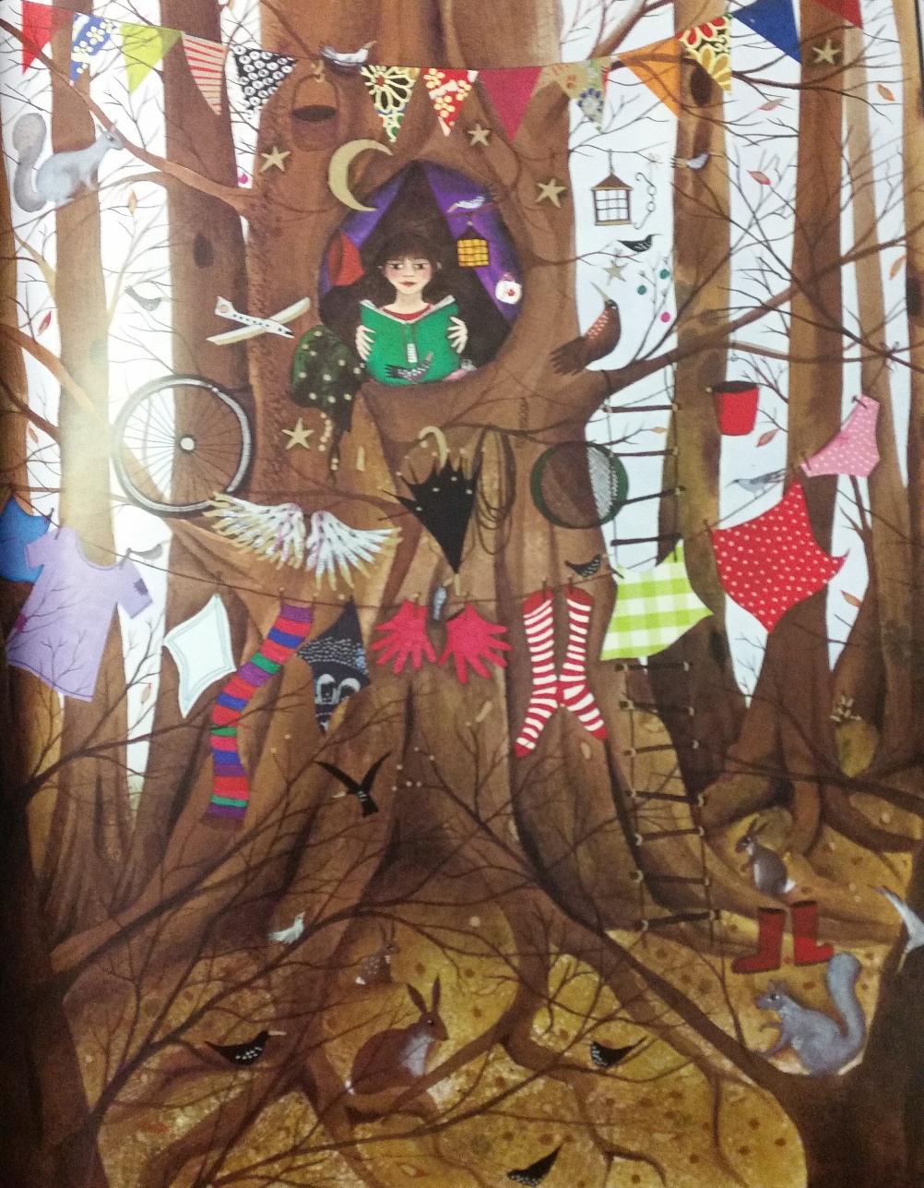
I can use pronouns and synonyms?

Slide 2
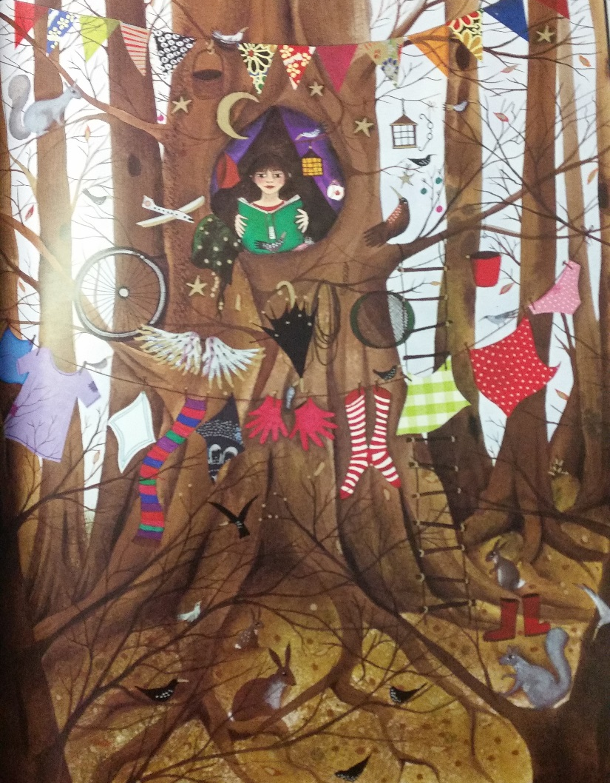
Use the colour chart provided to think of interesting colours for the items on the washing line. Write a list.

Slide 3
Let’s read

Slide 4
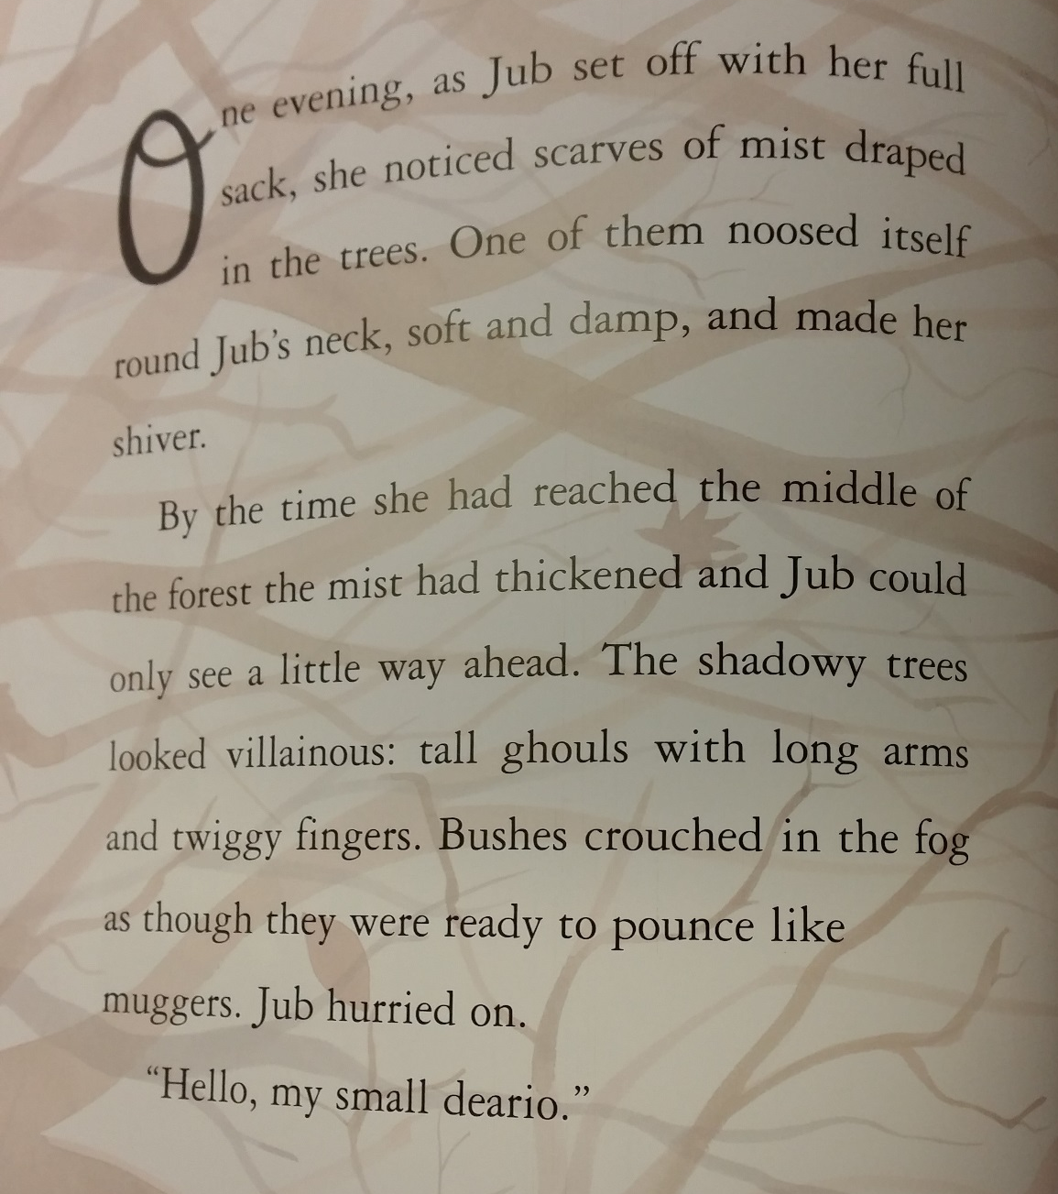
Let’s read

Slide 5
What does the author keep doing here that she shouldn’t?

Slide 6
What could she use instead?

Slide 7
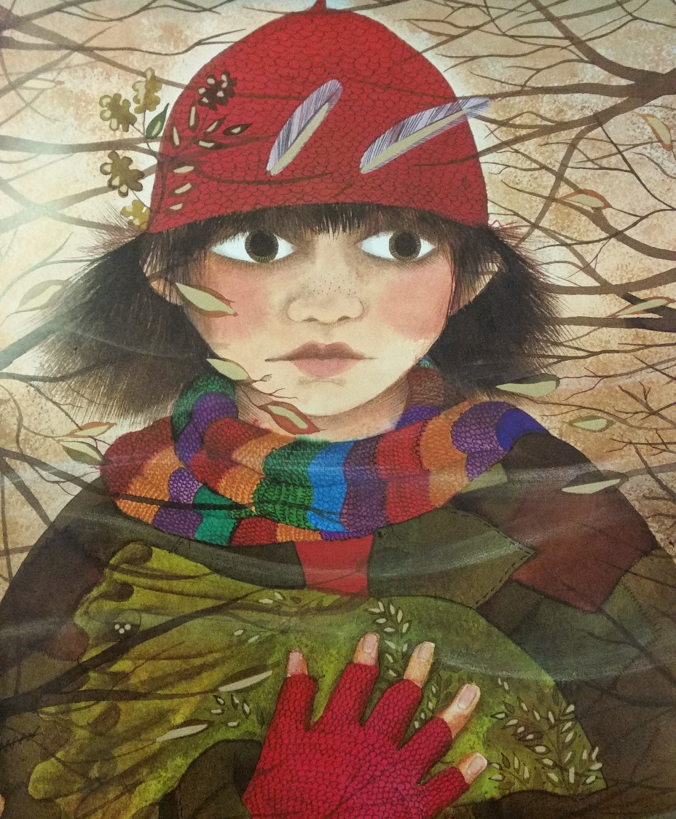
What words could she use instead?

Slide 8
Let’s try them instead of Jub.

Slide 9
Pronouns
Words used instead of someone’s name/s.
e.g. him, her, he, she, they, herself, himself, I.

Slide 10
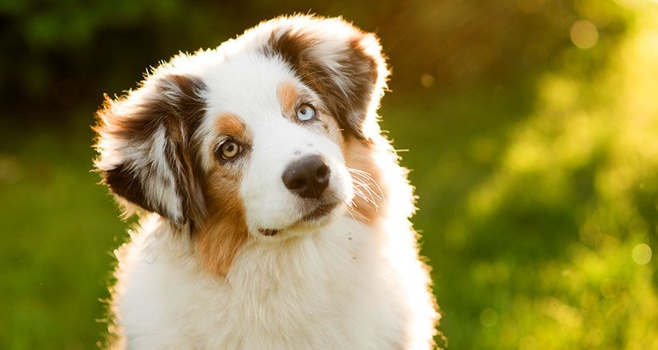
Synonyms
Other words can also be used to describe things e.g.
the pet
the pooch
the pup
the fluffy beast
the jolly animal
the dog

Slide 11
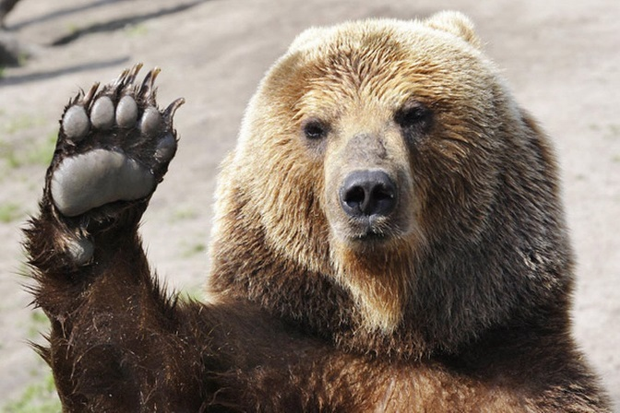
Synonyms
Other words can also be used to describe things e.g.
the bear

Slide 12
Let’s watch
https://www.youtube.com/watch?v=3bGUy-_DJqo

Slide 13
I can use pronouns and synonyms
Retell the story of what just happened. You can only use the word Mowgli once and Baloo once!
Use pronouns/synonyms for Mowgli and Baloo.
https://www.youtube.com/watch?v=3bGUy-_DJqo

Slide 14
Plenary
Read your work. Did you use pronouns and synonyms?
Underline the pronouns in one colour and the synonyms in another colour.

