Slide 1
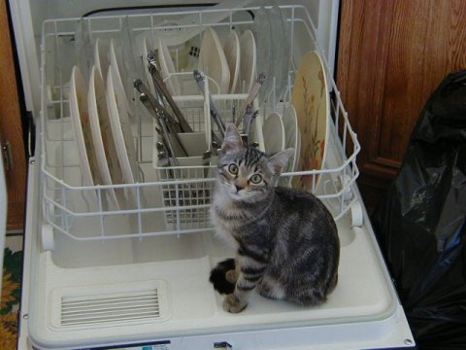
Lesson 3&4

Slide 2
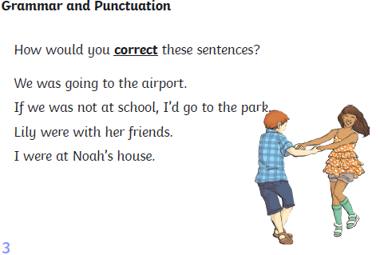

Slide 3
were
were
was
was

Slide 5
were
did
saw

Slide 6
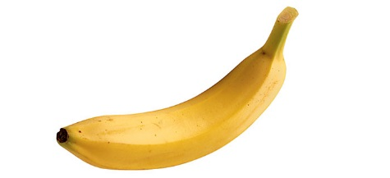
The Explanation Game
Explain the following. You can be as wacky as you like.
e.g. Why do Whales Sing?
Whales sing because they hate the noise of boats constantly sailing past them so they sing to drown out the horrendous noise.
Why are bananas curly?
Why do dogs bark?
Why don’t rainbows wobble?
Use these words: ‘because’, ‘as a result of this’ or ‘therefore’

Slide 7
What is an explanation text?

Slide 8
What is an explanation text?
This is a text that explains actions, ideas or how things work to the reader. They are not the same as instructions which tell us how to do something. Instead, they tell us why something happens.
e.g. Why does rain fall?

Slide 9
Let’s look at the exemplar text.
Circle any words you are unsure of as we read it.

Slide 10
Let’s learn the first paragraph.
How does a dishwasher work?
Dishwashers can be found in many homes around Great Britain. They are used to make your dishes sparkle (without the hard work). Do you know how a dishwasher works? If not, read on to find out.
Firstly, you load the dishwasher with plates that need cleaning. Then, you close the door and press the ‘Go’ button in order for it to start. This button is linked to a loud siren that can only be heard by cats. When they hear the alarm, all of the cats run to your house and enter the dishwasher through a secret flap at the back (that’s the banging you hear).
The cats lick all of the plates, cups and pans clean because they are hungry. Their tongues are rough, so make excellent cleaning tools. Happily, they purr to themselves as they clean, which is why you hear humming.
When the dishes are clean, the cats leave. One cat always stays behind to sprinkle the detergent and hoover up any cat hairs because no-one can ever know the secret of dishwashers.
Cats are very clever, and so they have made a deal with the government to be paid in fish every Tuesday because of their hard work. That’s how a dishwasher really works!

Slide 11
Let's picture map!

Slide 12
I can learn a text
Picture map the paragraph you have just learnt.

Slide 13
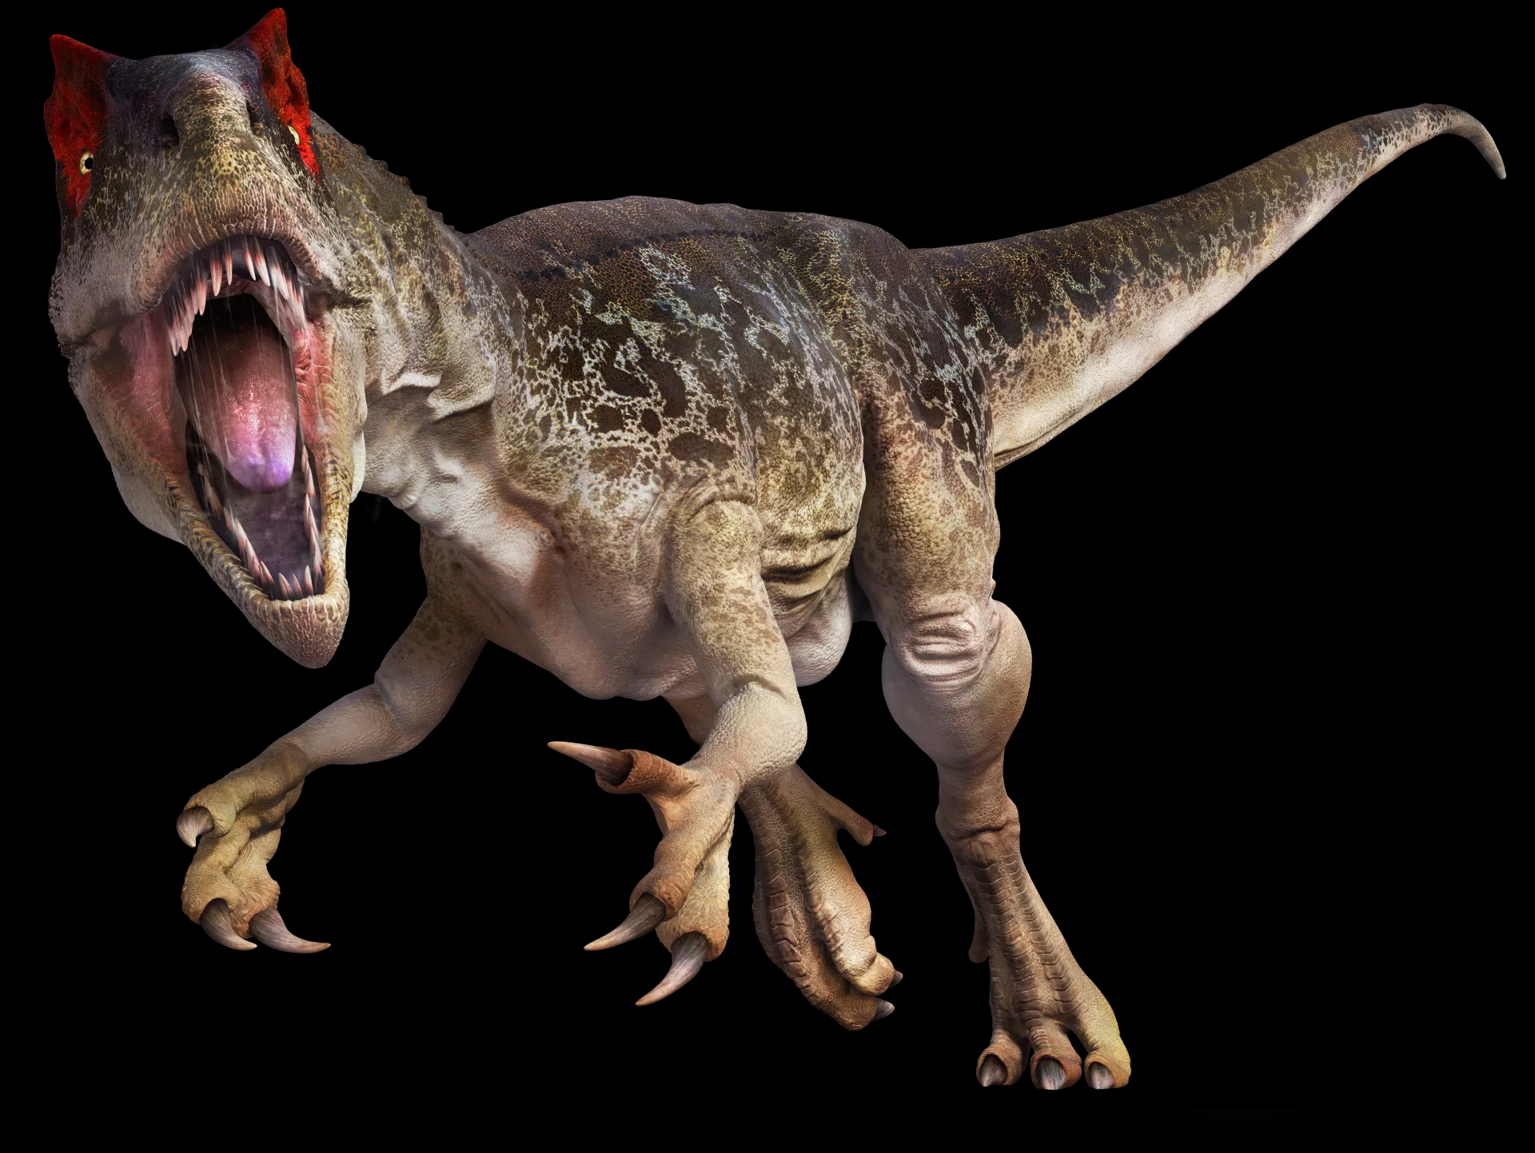
Plenary
Instruction or Explanation?
Dinosaurs went extinct because an enormous meteor collided with the Earth.

Slide 14
Plenary
Explanation
Dinosaurs went extinct because an enormous meteor collided with the Earth.

Slide 15
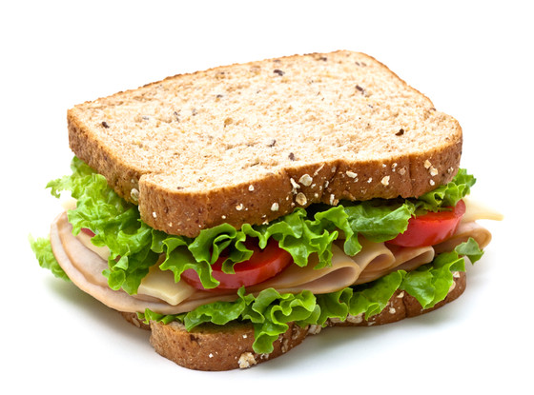
Plenary
Instruction or Explanation?
Put one slice of bread over the other to create the sandwich.

Slide 16
Plenary
Instruction
Put one slice of bread over the other to create the sandwich.

Slide 17
Plenary
Instruction or Explanation?
Waterfalls are formed when a piece of hard rock sits over a piece of soft rock and water flows over it.

Slide 18
Plenary
Explanation
Waterfalls are formed when a piece of hard rock sits over a piece of soft rock and water flows over it.

Slide 19
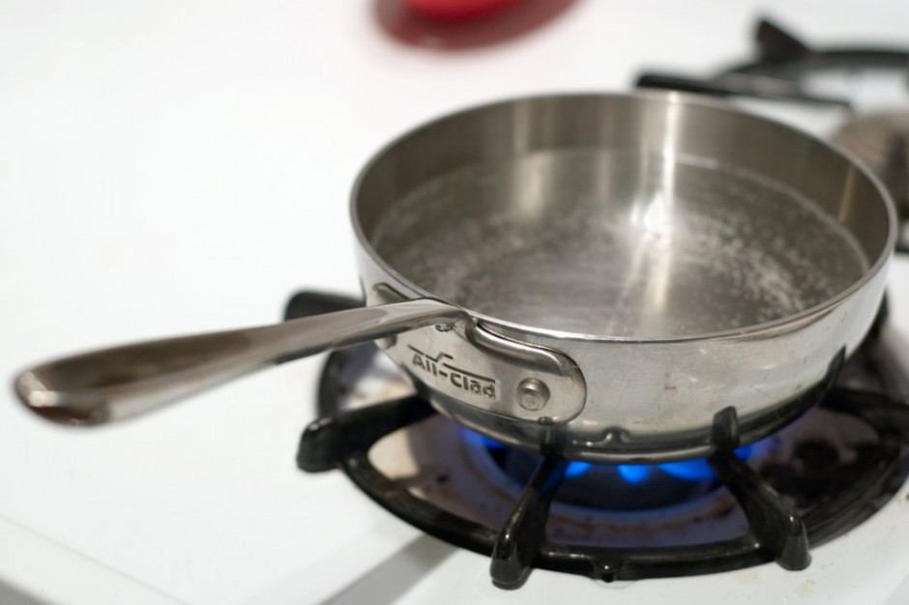
Plenary
Instruction or Explanation?
Place the pan on the hob and simmer for 30 minutes.

Slide 20
Plenary
Instruction
Place the pan on the hob and simmer for 30 minutes.

