Slide 1
What did THE ROMANS do for us?

Slide 2
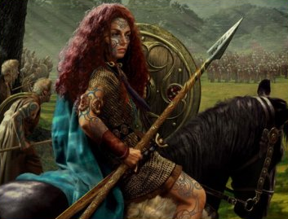
Lesson 4

Slide 3
What do AD and BC mean?

Slide 4
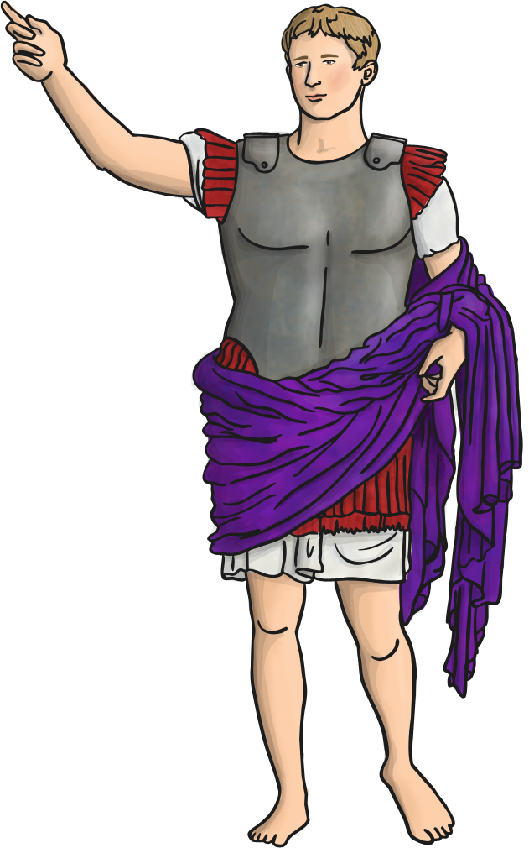
What do BC and AD mean?
BC and AD are letters often found at the end of dates written in years such as…
31BC Augustus became the Roman Emperor 79AD Eruption of Mount Vesuvius in Pompeii
BC and AD are initials that stand for:
Before Christ and Anno Domini

Slide 5
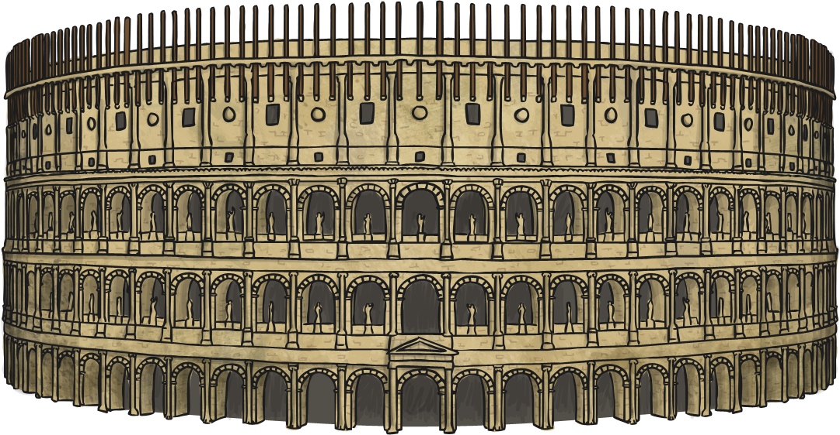
Who thought of it?
This method of dating years is called the Gregorian Calendar. It started life as the Roman Catholic Calendar, which was introduced by the Romans.

Slide 6
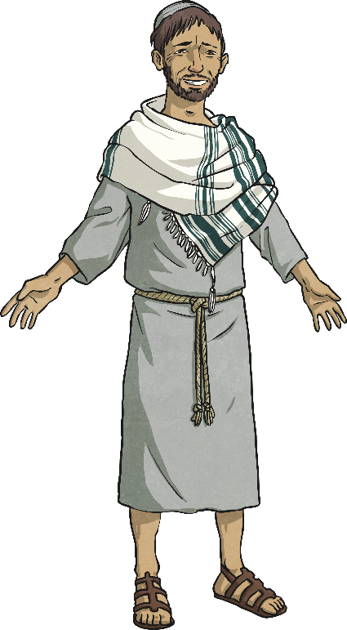
BC: Before Christ
(also called BCE Before Christ Era)
This refers to any date that is before the year Jesus was born in Christian belief.
So, really Jesus is said to be born in year 1 as the Romans had no sign for ‘0’.
Rather than say the year before was -1, we say it is 1BC.

Slide 7
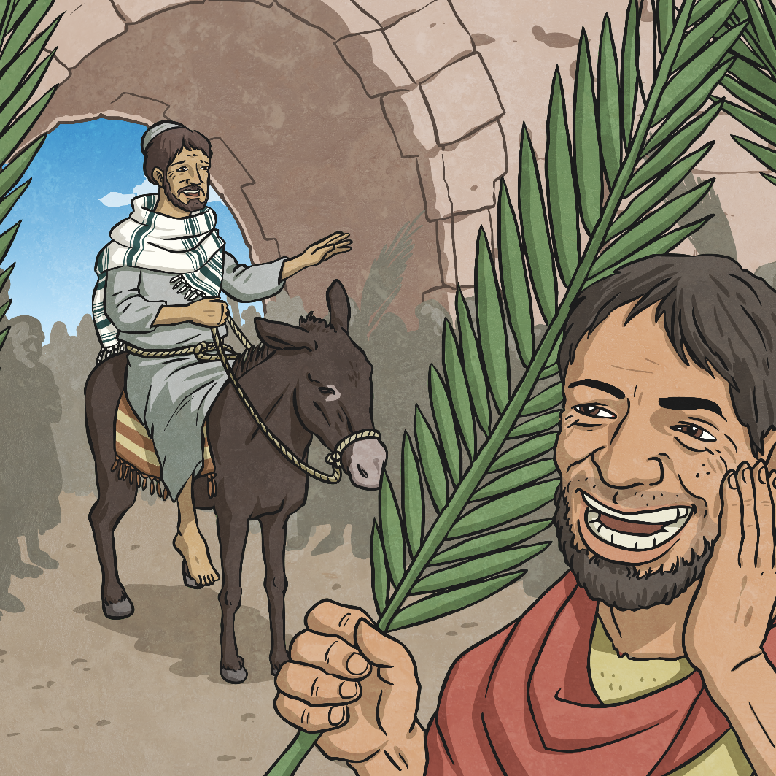
AD: Anno Domini
(also called CE – Christ Era)
Anno Domini is a Medieval Latin phrase that means,
‘In the year of our Lord’
and means anything after Jesus was born in the Christian belief.

Slide 8
Try the AD/BC Quizzes

Slide 9
Todays learning objective:
I can explain why Boudicca fought back against the Romans
Let’s find out more…

Slide 10
Let’s watch
https://www.youtube.com/watch?v=ZvwLjoHY0nM

Slide 11
Let’s watch
https://www.bbc.com/teach/class-clips-video/history-ks2-the-roman-invasion-animation/zmyhf4j

Slide 12
Your turn.
How could have Boudicca won the battle?
Note down what you would have done if you were Boudicca!

Slide 13
Watch the Bolshy Boucida song from Horrible Histories https://www.bbc.co.uk/cbbc/watch/bolshy-boudica-song

Slide 14
Let’s listen…

Slide 15
I can explain why Boudicca fought back against the Romans
Have a go at writing a song or rap about Boudicca!
Be creative!

Slide 16
Plenary
Have a go at performing your song!

Slide 17
So what did THE ROMANS do for us?

