Slide 1
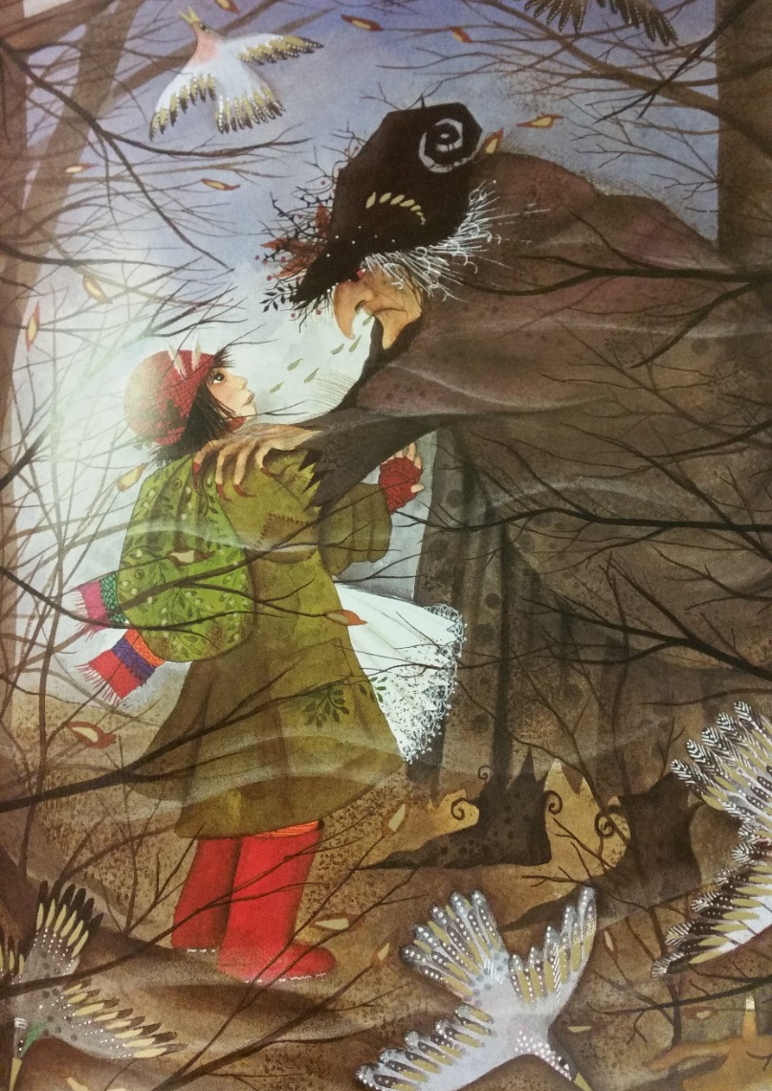
I can use speech punctuation correctly

Slide 2
What punctuation do we use for speech?
speech

Slide 3
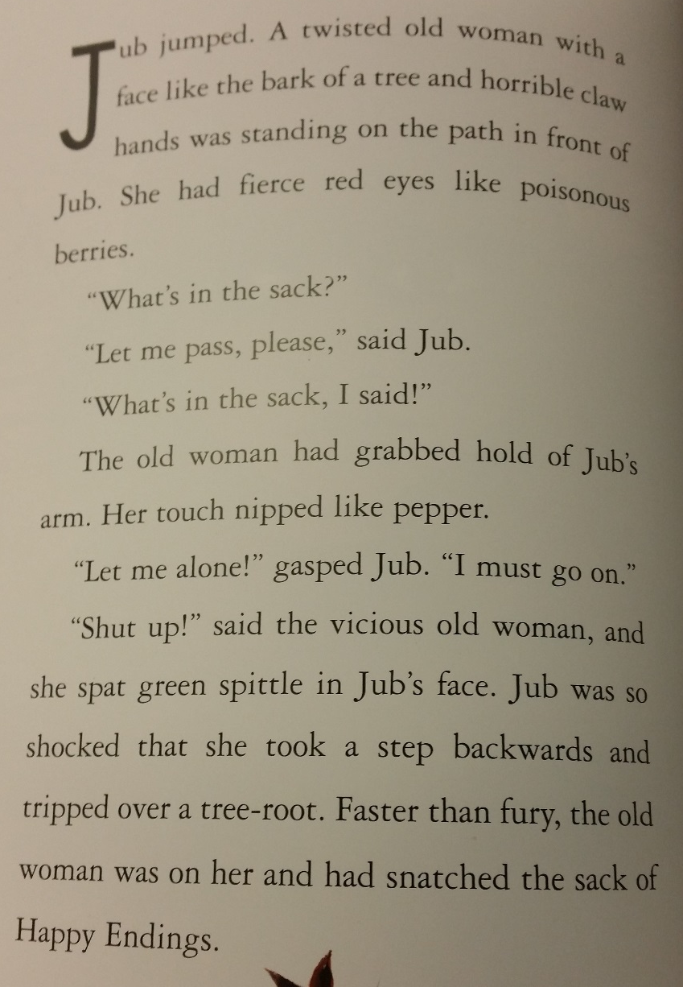
Let’s read the next page. Take special notice of the speech punctuation.

Slide 4
What punctuation do we have? Where is it?

Slide 5
I can use speech punctuation correctly
Choose your task!
Medium: Add the punctuation into existing conversation.
Hot: Convert the phone conversation between Jub and the Witch into direct speech using the correct speech punctuation.
Spicy: Think of your own conversation between Jub and Witch using the correct speech punctuation. What might she say to her after she snatched the bag?

Slide 6
Plenary
Which is correct?
1) “The Witch said,” hello
2) “Give me your bag!” “If you don’t I will kill you!” said the Witch.
3) “No. I’ll never do that,” said Jub.

Slide 7
Plenary
Which is correct?
1) “The Witch said,” hello
2) “Give me your bag!” “If you don’t I will kill you!” said the Witch.
3) “No. I’ll never do that,” said Jub. ✓

