Slide 1
What did THE ROMANS do for us?

Slide 2
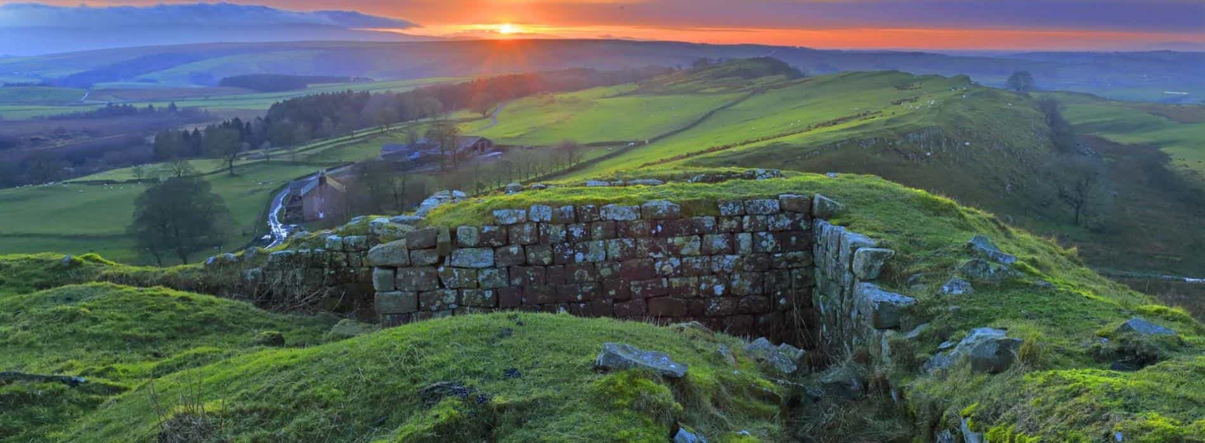
Lesson 5

Slide 3
What are primary and secondary sources?

Slide 4
Click here to find out!
https://kids.britannica.com/kids/article/primary-source/629043

Slide 5
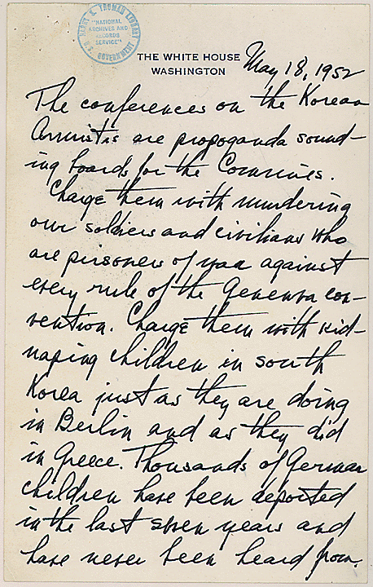
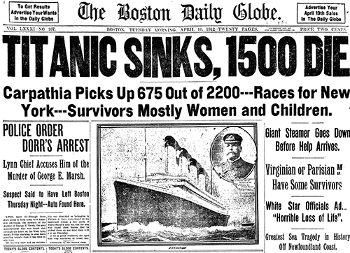
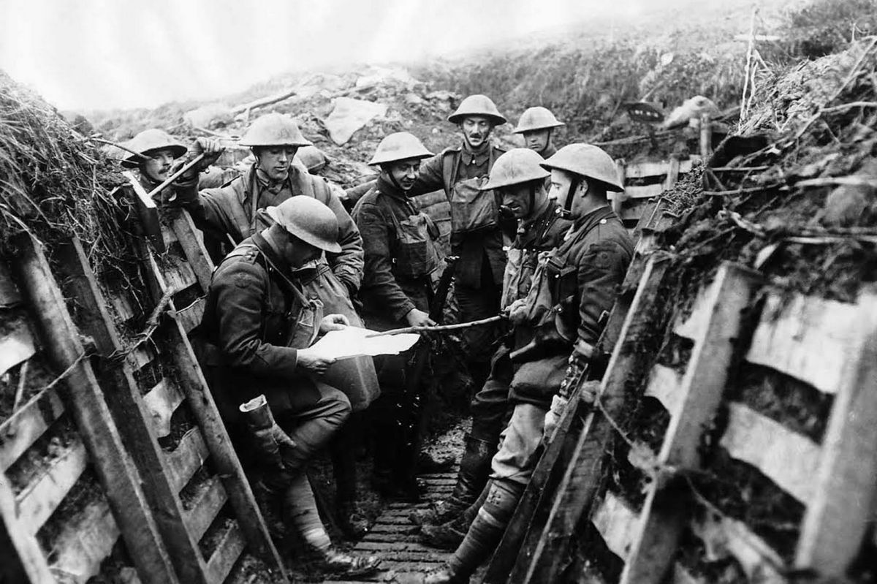
Newspaper article written about the Titanic sinking
Diary entry about a bomb explosion near a boy’s house written on the night of the explosion in world war I.
Which are the primary and secondary sources here?
A fact book about Boudicca.
Photo taken in the trenches of world war I

Slide 6
I can explain why Hadrian
built a wall
Let’s find out why!

Slide 7
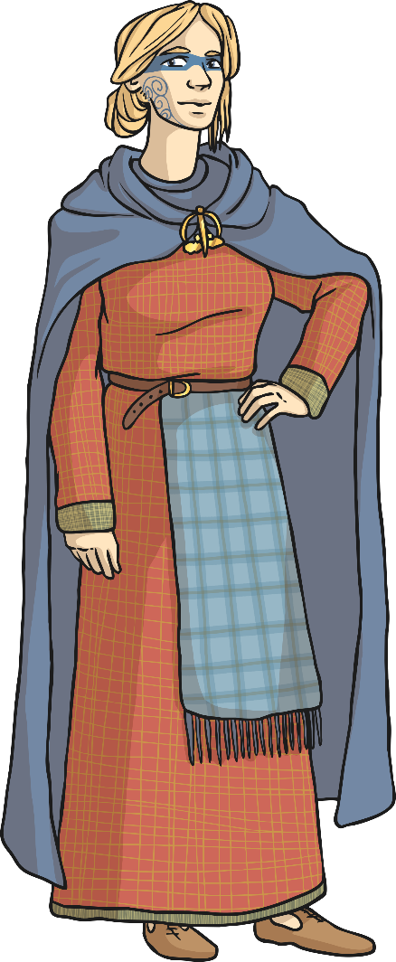
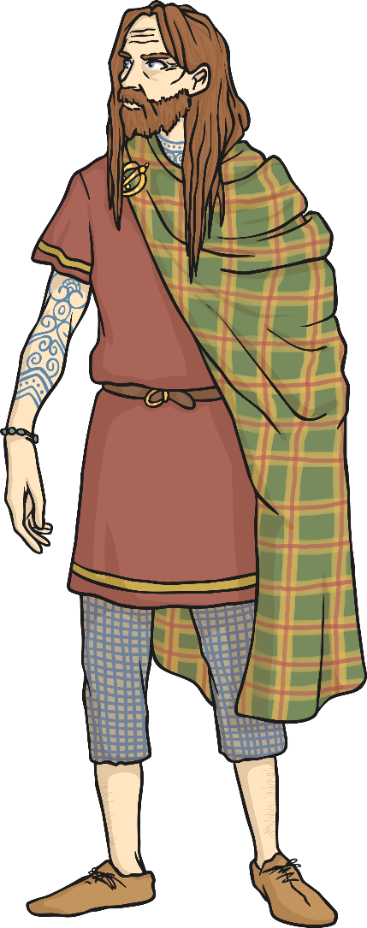
I can explain why Hadrian built a wall
The Picts
Scotland was known as Caledonia during the Roman times and many Caledonian tribes fought battles against the Romans who tried to take their land. In 84AD the different tribes all banded together to form a group that the Romans called ‘The Picts’ after the Romans defeated them in a big battle. However, the Romans did not go on to take Scotland as the Roman army was called back home to deal with other issues. This meant that Scotland never became a part of the Roman Empire.
According to the Romans, the Picts were a feisty, formidable force who kept raiding their territory in Britain. The Romans wanted a way to separate their land from the Picts.
Scotland
England
Wales

Slide 8
I can explain why Hadrian built a wall
Hadrian’s Wall
The solution for dealing with frequent attacks from the Picts came in the form of a great wall.
The Roman Emperor Hadrian is best known for building this wall across Northern Britain which helped the Romans defend their occupied land.
The wall also meant that the Romans could control who was entering and leaving Roman territory and charge taxes to those who wanted to come in.

Slide 9
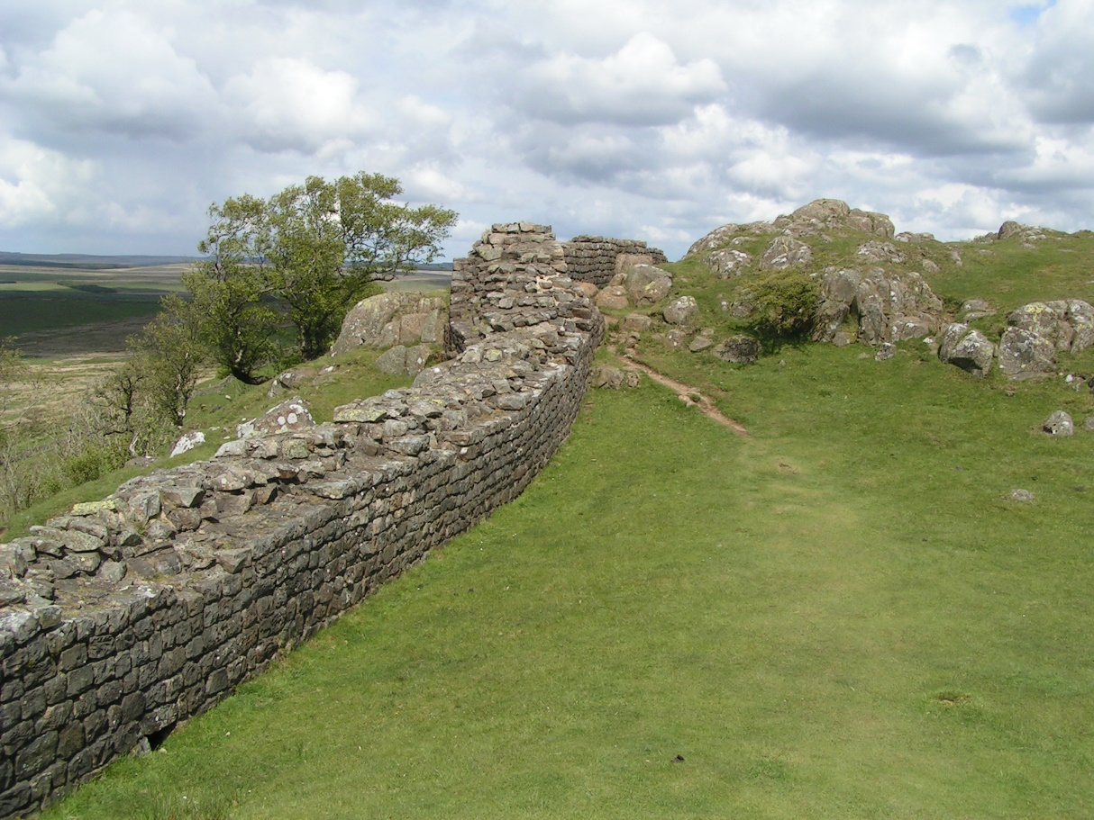
I can explain why Hadrian built a wall
Building the Wall
The wall was built by three Roman legions (15,000 men) using mostly stone. It was 117.5km long (or 80 Roman miles), up to 6m high and 3m wide. This meant that two Roman soldiers could perform sentry duty side-by-side.

Slide 10
I can explain why Hadrian built a wall
Along the Wall
The wall ran from Bowness-on-Solway on the West Coast to Wallsend on the East Coast. It passed through Carlisle, Gilsand, Chollerford and Corbridge amongst many other places.
Find these places using https://www.google.com/maps
Can you find out the names of some other places that the wall passed through? What counties are they in? what else can you find out about them?
Write down what you find out.

Slide 11
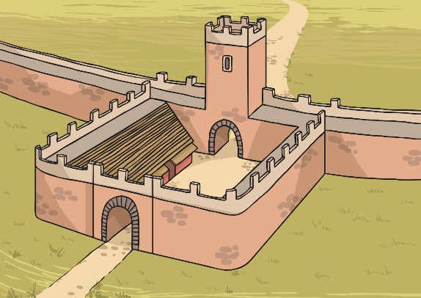
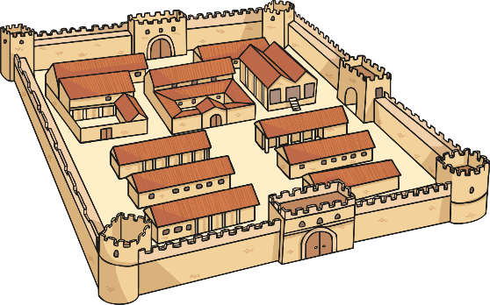
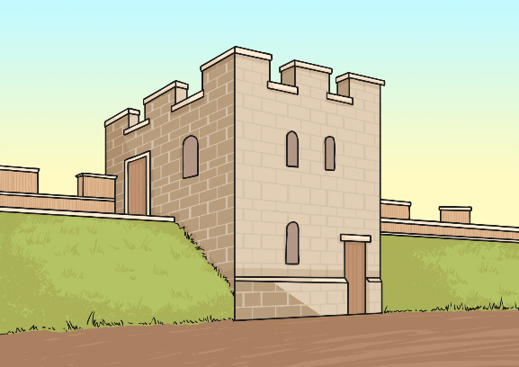
I can explain why Hadrian built a wall
Not Just a Wall
Major forts were built along the wall every 8km. These forts could accommodate between 500 to 1000 Roman soldiers!
There was a mile-castle containing 20 soldiers every Roman mile (1.5km).
There was a turret guarded by soldiers built every 500m.
500m
1.5km

Slide 12
I can explain why Hadrian
built a wall
Your task:
Make a model of a part of Hadrian’s Wall. You could use anything: Lego, food boxes and cans, by cutting up a large cardboard box – anything! Use the diagram at the bottom of the last page to help you.Stick a photo in your books or upload it to your portfolio.
Write a couple of sentences explaining why Hadrian built the wall.

Slide 13
So what did THE ROMANS do for us?

