Slide 1
Lesson 5

Slide 2
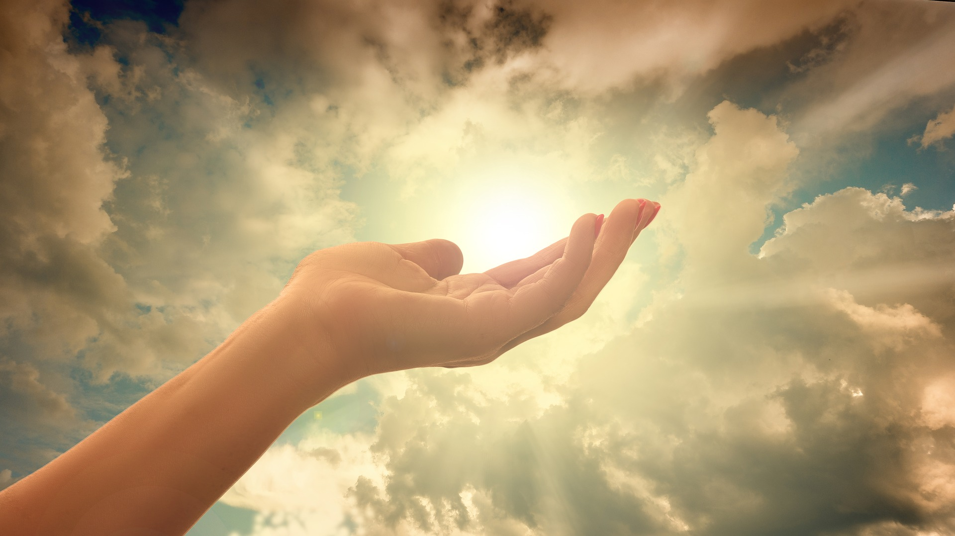
Christian Meditation

Slide 3
Opening Prayer
Jesus open our ears to hear your voice
Open our eyes to see your face
Open our mouths to speak your words
Open our hearts to your love
Open our hearts to your love

Slide 5
Blessing Song
We call on you O God
and on Jesus Christ your Son
through the power of the Spirit
that makes us truly one.
We ask you to bless us
and lead us in your ways
as you guide us on our journey
everyday.

Slide 6
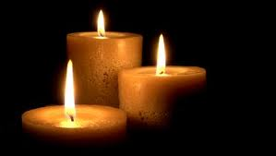

Slide 7
Can you think of times when the parish community comes together?

Slide 8
When a member of the parish community dies, they gather together to celebrate that person’s life and to thank God for it.

Slide 9
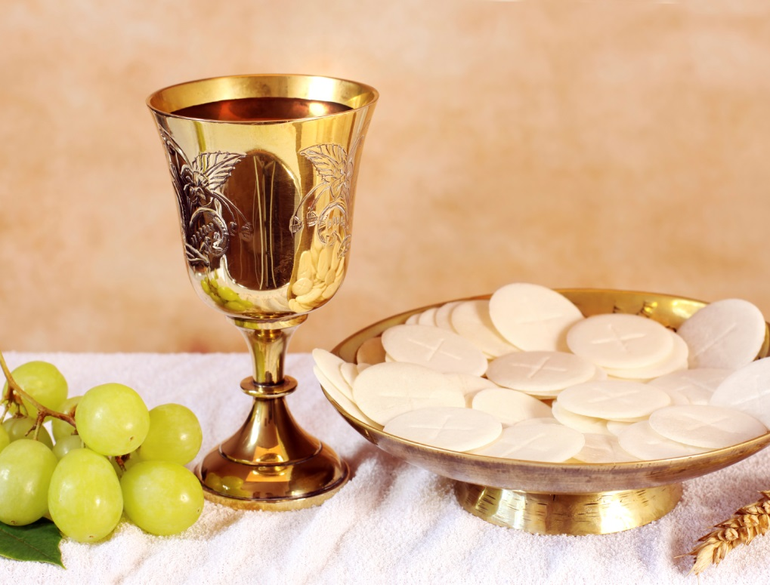
The parish community supports it members at the Sunday Eucharist.

Slide 10
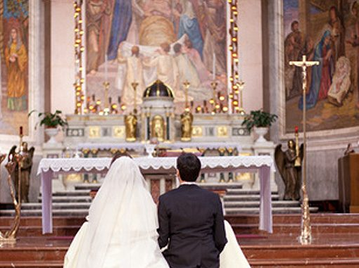
The parish community comes together to celebrate important events such as marriage.

Slide 11
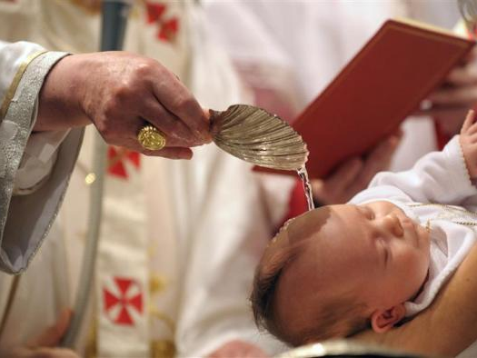
The parish community comes together to celebrate important events such as baptism when a child is welcomed into the Church.

Slide 12
I can describe some parish community celebrations, giving reasons for the actions of those involved
Stick in the meditation sticker.
Underneath, stick in one of the pictures, then write what celebration it represents, what happens and why.
Then stick the next one in etc.
The important part is giving reasons. Why does the parish community come together at that time?

