Slide 1
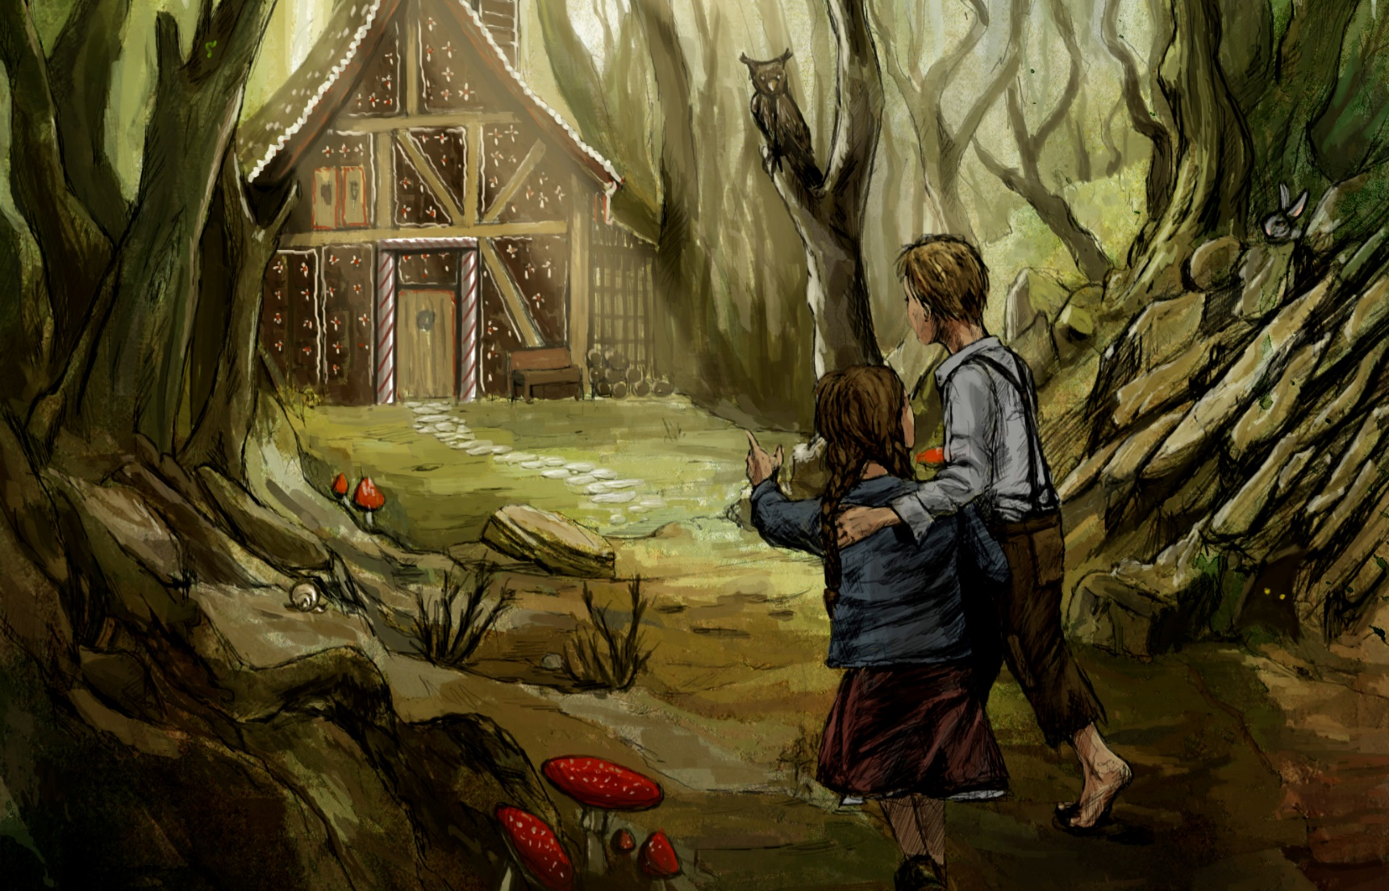
I can plan a story

Slide 2
Let’s read

Slide 3
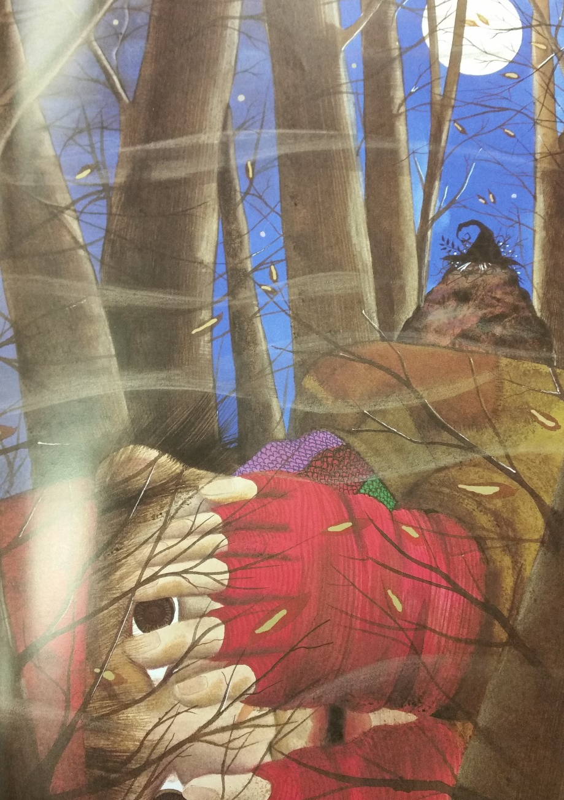
Let’s read

Slide 4
Let’s read

Slide 5
Let’s read

Slide 6
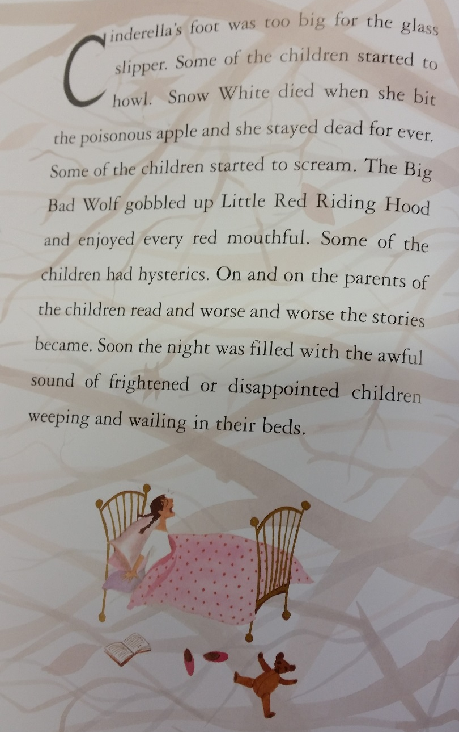
Let’s read

Slide 7
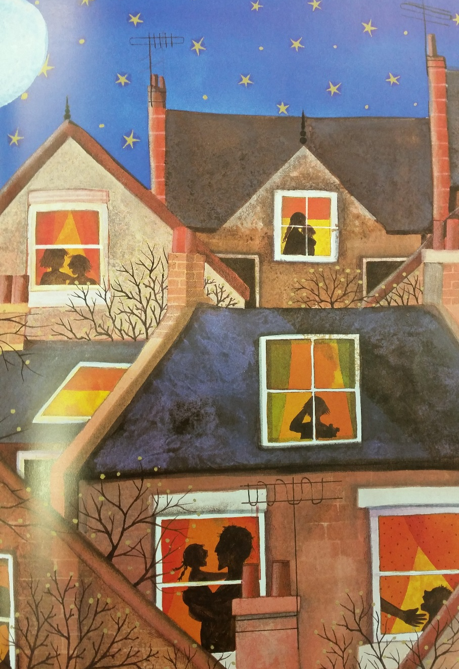
Let’s read

Slide 8
So what happened?
The witch has stolen the Happy Endings to all of the stories in the world! No-one lives happily ever after – all of the stories have sad endings!

Slide 9
Let’s read the version of Hansel and Gretel with a happy ending…

Slide 10
The Story of Hansel & Gretel
A poor woodcutter and his wife had two children named Hansel and Gretel. Their mother died when they were young. Hansel and Gretel were very sad. Soon their father remarried but their stepmother was very cruel. One day, she took the children deep into the forest and left them there. Clever Hansel had some breadcrumbs in his pocket and had dropped them on the way so that they could find their way back home. Alas! The birds ate all the crumbs and they couldn’t find the path that led back home.

Slide 11
The Story of Hansel & Gretel
Hansel and Gretel went deeper and deeper into the forest. They were hungry and tired. Finally, after walking for a long time, they saw a cottage made of chocolate, candies, and cake. “Look, Hansel! A chocolate brick!” shouted Gretel in delight and both ate it hungrily.

Slide 12
The Story of Hansel & Gretel
Now, a wicked witch lived there. When she saw Hansel and Gretel, she wanted to eat them. She grabbed the chil­dren and locked them in a cage. The witch decided to make a soup out of Hansel and eat him first. She began boiling a huge pot of water for the soup. Just then, Gretel crept out of her cage. She gave the wicked witch a mighty push from behind and the witch fell into the boiling water. She howled in pain and died instantly. Hansel and Gretel found treasure lying around the cottage. They carried it home with them. Their stepmother had died and their father wel­comed them back with tears of joy. They never went hungry again!

Slide 13
What else could happen to make it an unhappy ending?

Slide 14
The witch might not have fallen into the boiling water, but instead put Hansel and Gretel in there, made them into soup and eaten them up!

Slide 15
Let’s break Hansel and Gretel down into a plan:
Set the scene | Hansel and Gretel live with dad and evil stepmother
Problem | Stepmother takes them into the woods to lose them Hansel leaves a trail of breadcrumbs bur birds eat them up
Problem gets worse | Hansel & Gretel wander deeper into woods Find a cottage made of sweets Get grabbed by with who lives there and locked in a cage
Resolution/ending | Witch puts Hansel & Gretel in pot of boiling water, makes them into soup and eats them up

Slide 16
Your turn:
I can plan a story
Draw this table and plan a well-known fairytale with an UNHAPPY ending. Remember, this is a PLAN – notes only – no sentences!
Set the scene
Problem
Problem gets worse
Resolution/ending

