Slide 1
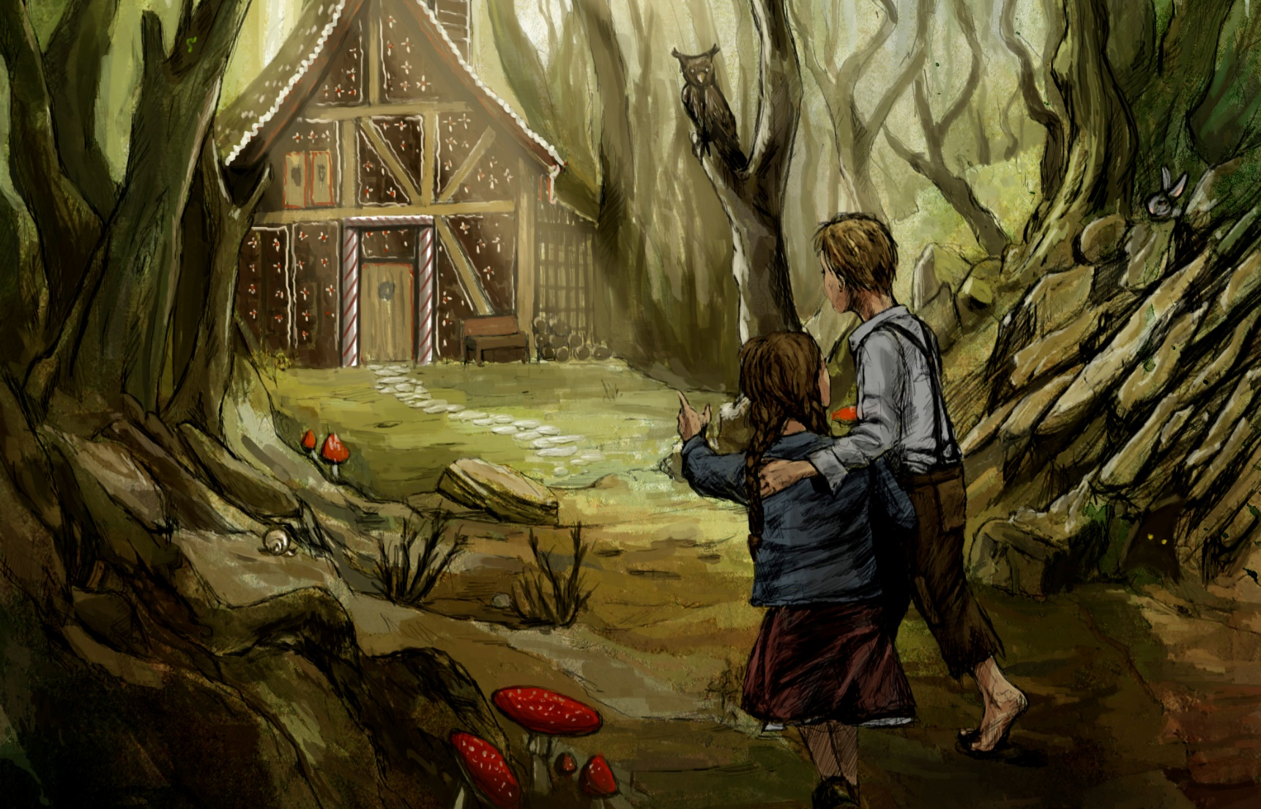
I can write a scary story

Slide 2
Different sentence openers.
Which different ways can we start a sentence?

Slide 3
Different sentence openers.
Fronted triplet
What could this be?

Slide 4
Different sentence openers.
We use three describing words at the beginning, separated by a comma:
Scared, frightened, anxious, Gretel carefully opened the door.

Slide 5
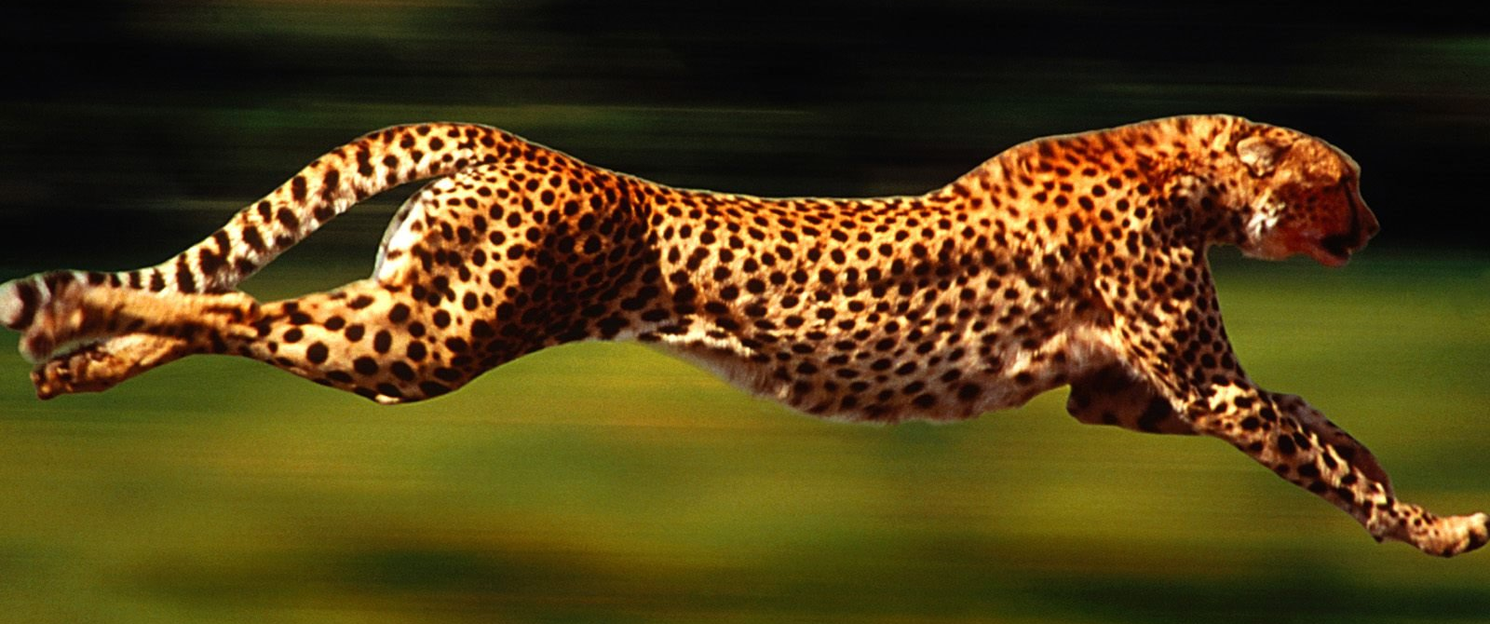
You try one:
Scared, frightened, anxious, Gretel carefully opened the door.
Cheetah

Slide 6
I can write a scary story
Write a story using your plan. Use the colour chart to help you write great descriptions.
Make sure you write in paragraphs – check for capital letters.
Remember to make it a scary, unhappy ending.
Try to get in expanded noun phrases, fronted adverbials with commas and fronted triplets!

