Slide 1
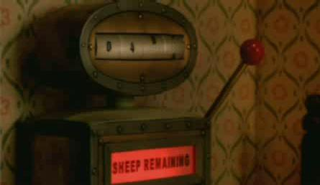

Slide 2
Starter
Write 4 sentences using causal conunctions to explain what is happening in this image.
Example: Due to the wind, the broom is flying!
Causal conjunctions:
because, as a result, consequently, therefore, as, so, due to, which is why, since

Slide 3
Who can remember the structure of an explanation text?

Slide 4
Who can remember the structure of an explanation text?
Paragraph 1 | Introduction – tells the reader what the text is about
Paragraph 2 | First part of the explanation
Paragraph 3 | Second part of the explanation
Paragraph 4 | Final part of the explanation
Paragraph 5 | Conclusion – and that’s how it works!

Slide 5
Who can remember the toolkit?

Slide 6
Toolkit
Causal conjunctions
Time adverbials
Paragraphs
Logical order
Clear title
Rhetorical question in introduction

Slide 7
We are going to show you how to write an explanation text about a Snoozatron, then you are going to be writing one about the Turbo Diner.
Let’s watch them.

Slide 8
https://www.youtube.com/watch?v=vGxRUglFFME

Slide 9
This is what the opening paragraph about a Snoozatron could look like:
How a Snoozatron Works
Snoozatrons can be found in a variety of old people’s houses throughout the world. These machines are used to help everybody get to sleep (without being uncomfortable). Do you know how a Snoozatron works? If you don’t, read this explanation to find out.

Slide 10
https://www.youtube.com/watch?v=eDmwqj6CUOY&t=11s

Slide 11
I can write the opening to an explanation text
Your task is to write your introduction about the Turbo Diner.
Use the Snoozatron example to help you. Include all of the features you can see, such as brackets.
Read it back. Check for any mistakes.

