Slide 1
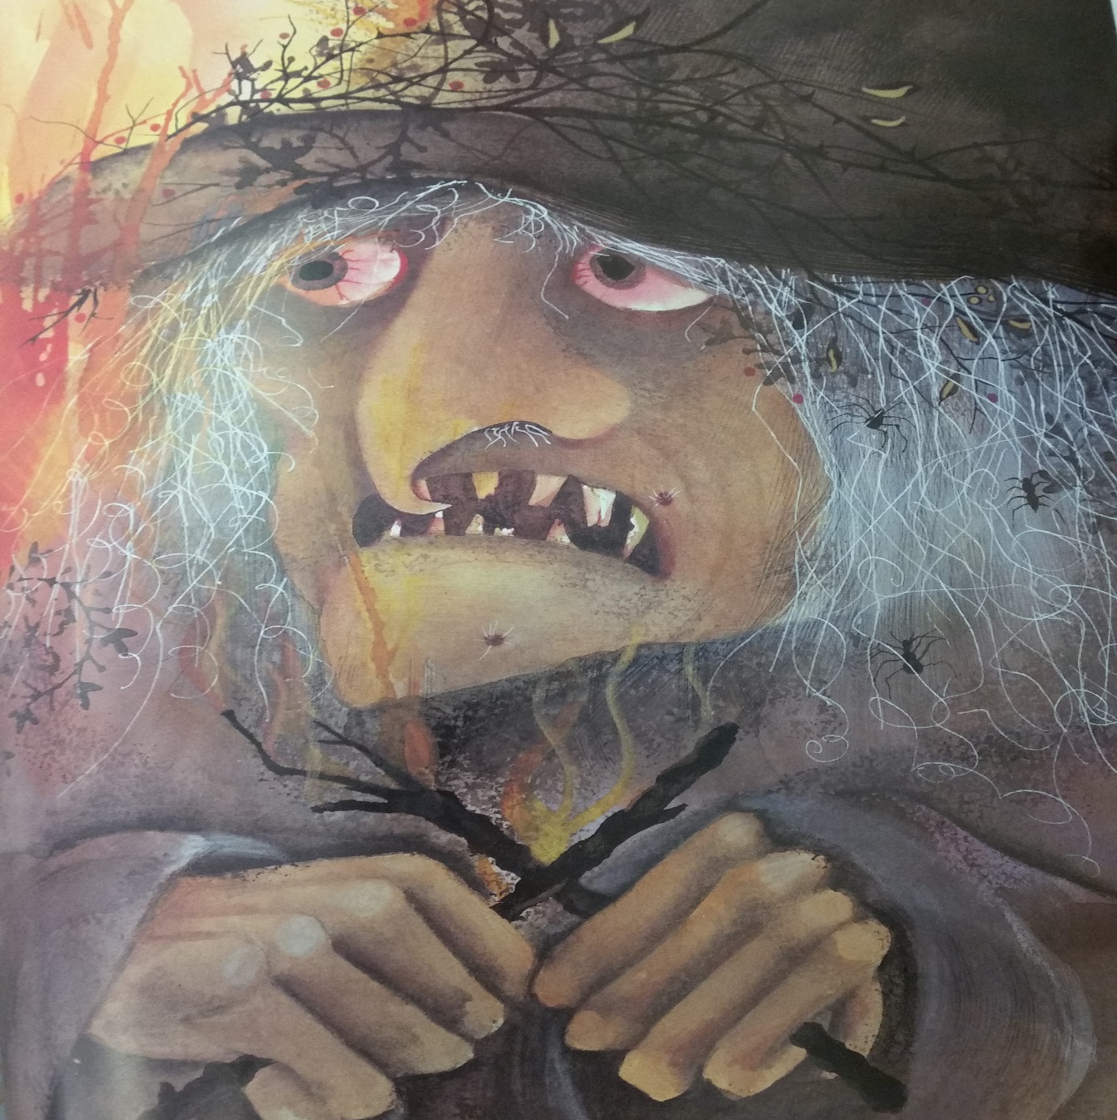
I can write a character description

Slide 2
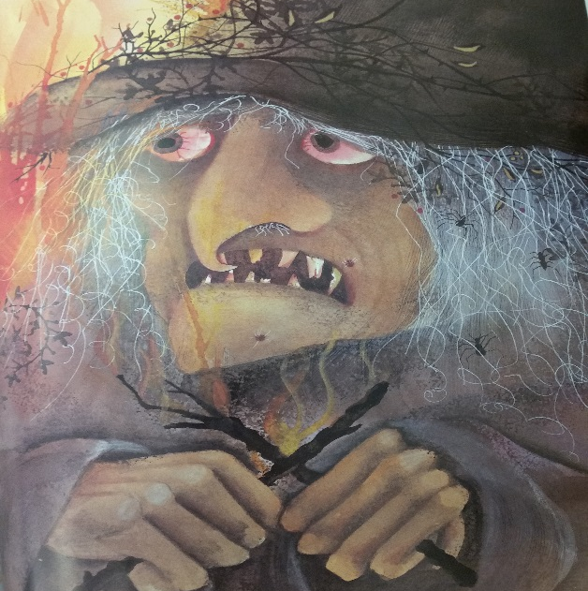
Let’s think of some synonyms for witch
old hag

Slide 3
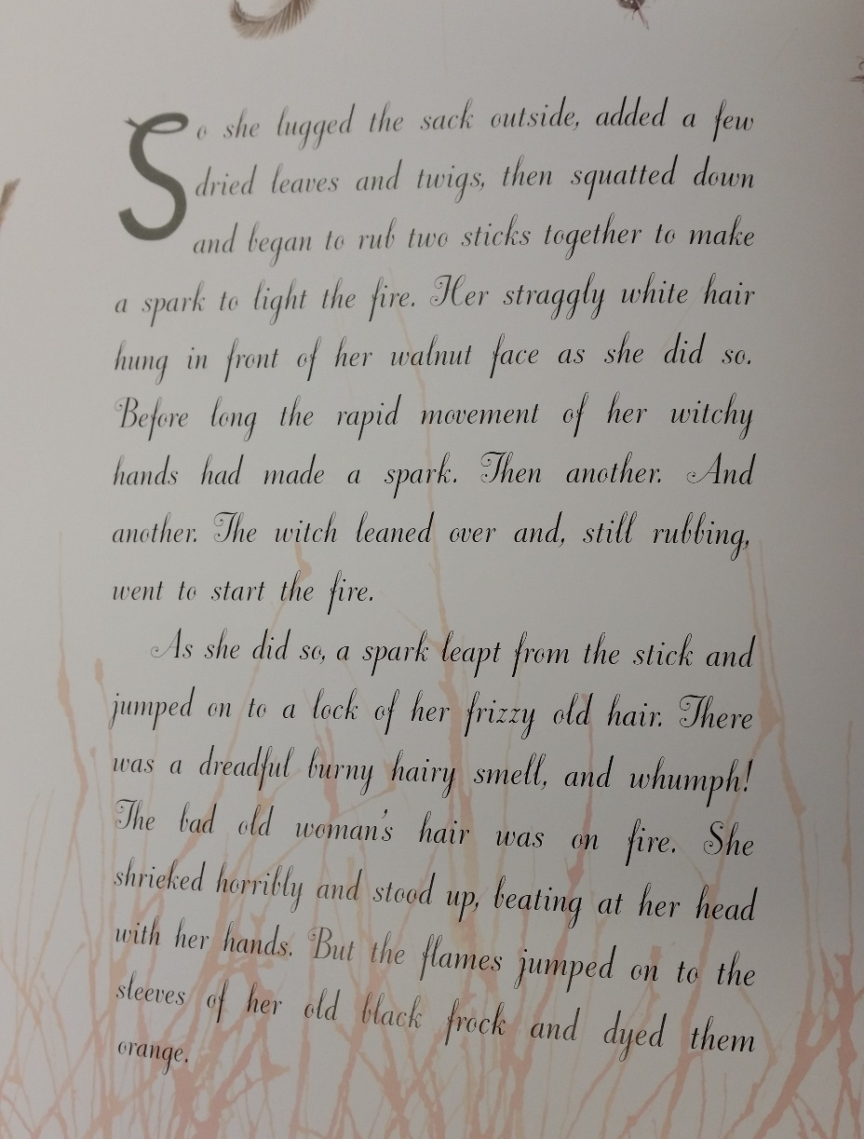
Let’s read

Slide 4
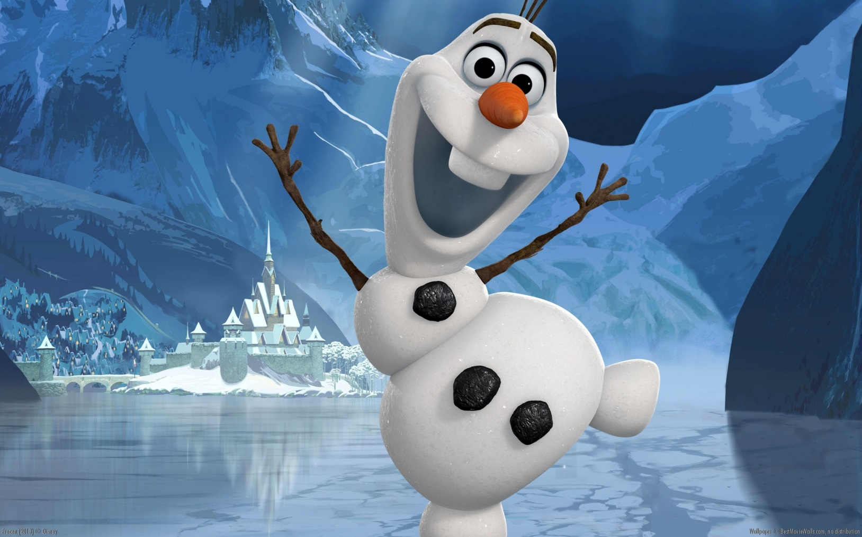
What is a character description?

Slide 5
Jolly, optimistic, gleeful, Olaf was never down. He was brimming with happiness. Despite being frozen, the icy snowman had a heart that was warm and full of love. Plonked between two round eyes was a crooked, orange carrot. A duo of battered wooden twig arm protruded from his white body. Acting like buttons, three lumps of coal, which were roughly the same size, were delicately place vertically down the magical ice-creature’s body. The smile however was something else: It beamed so wide you could fit your head inside.

Slide 6
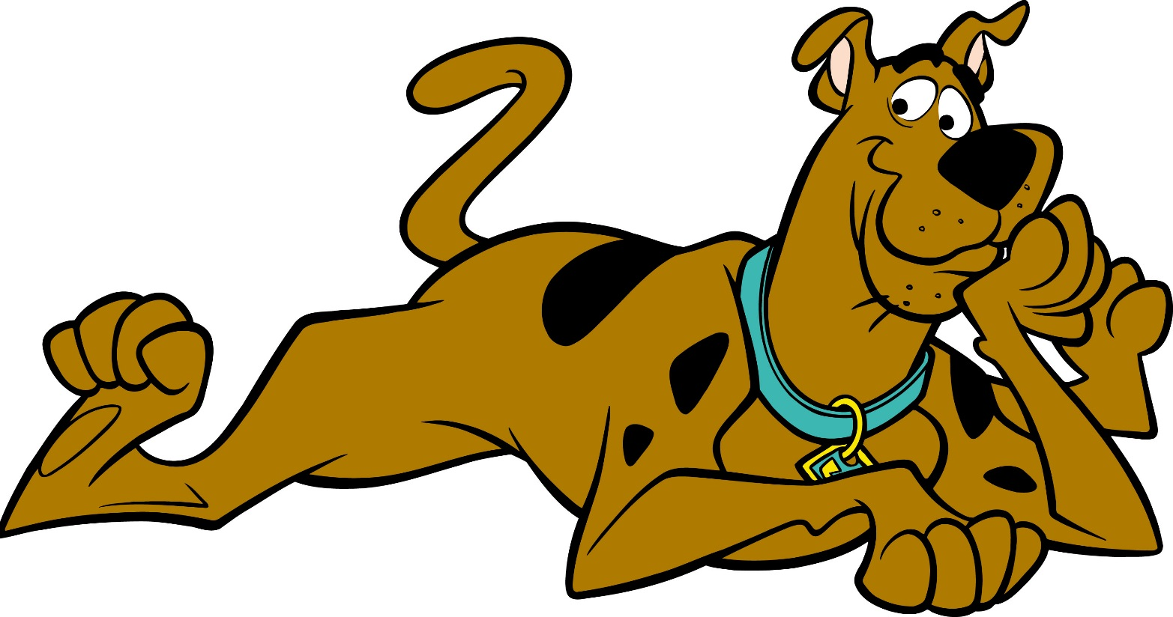
Think of some expanded noun phrases for Scooby doo

Slide 7
Scooby doo
chocolate hound with irregular black spots
ebony bristles protrude from his sagging chin
his average tail is like a cobra ready to strike
enormous feet that resemble a giant’s
ears like radar towers, never pointing in the same direction

Slide 8
Cowardly, nervous, shaky, Scooby Doo was always afraid. He was brimming with fear. Despite being a giant, chocolate hound with irregular black spots, he did not have a heart of steel. Plonked between two oval eyes was a triangular blob of a nose. Ebony bristles protruded from his sagging chin and his average tail was like a cobra ready to strike. Looking like radar towers, his ears were never pointing in the same direction. His feet, however, were something else: they resembled a giant’s!

Slide 9
I can write a character description
Write a character description about the witch – use the Olaf and Scooby Doo texts to help you.
Challenge: Use synonyms for witch.

