Slide 2
Aim
I can use the spellcheck tool.
Success Criteria
I know some of the main keyboard shortcuts.
I can find and use the different functions of the spellcheck tool.
I can add a spelling to the spelling dictionary.

Slide 3
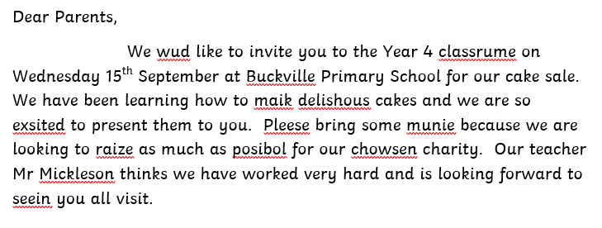
Spot the Spelling Mistake
Spelling is very important. It tells the reader how much care and effort we have put into our writing. Can you remember some spelling strategies that we use when we are writing?
Spelling is just as important in a word processing document as it is in your writing.
How can you spot the spelling mistakes in this document?
Word processing software is very helpful. If it spots a spelling mistake, it will add a wavy red line beneath the misspelt word.
How would we normally check the spelling of a word in our writing?
year

Slide 4
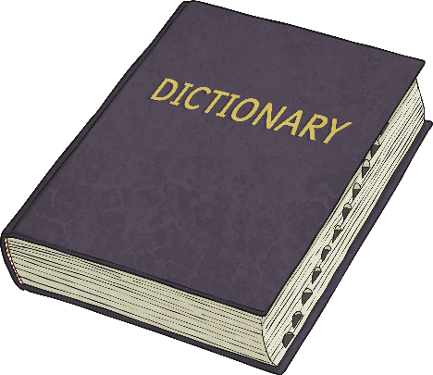
Spellcheck vs Dictionary
If you weren’t working on a computer, you would use a dictionary to check how to spell words.
Dictionaries are very useful but when we are using word processing software, it is often more efficient to use the spellchecking tool.
Which do you think is quicker?
vs

Slide 5
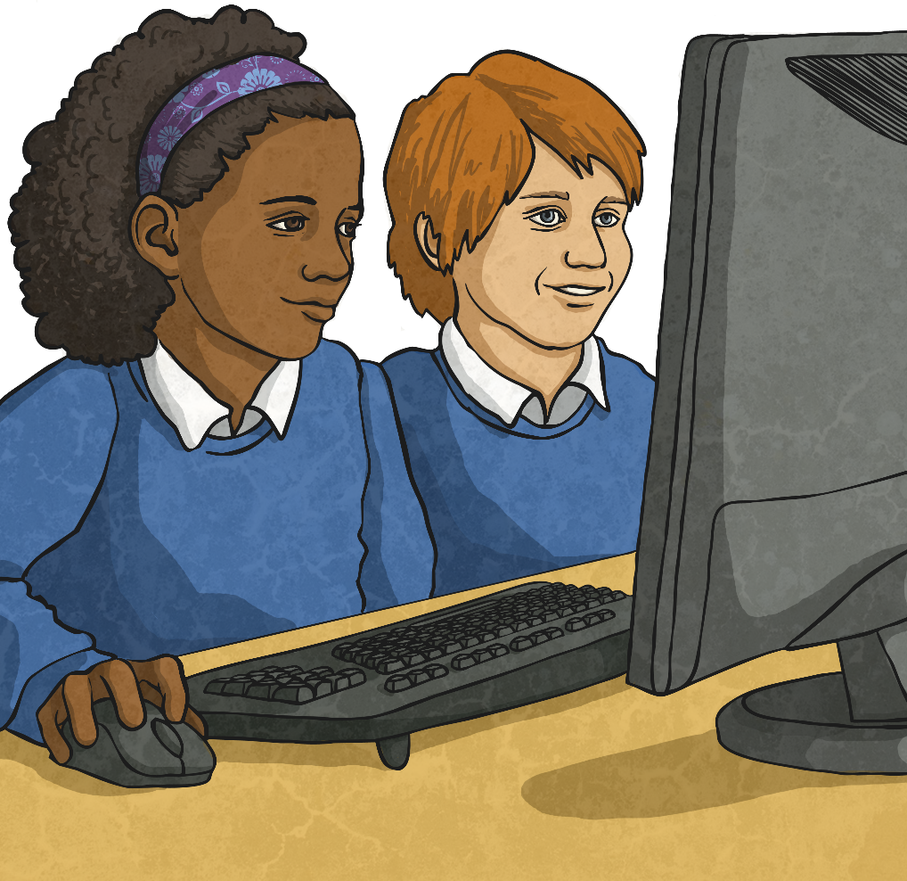
Spellchecking Tools
Microsoft Word
Google Docs

Slide 6
Spellchecking Tools
Microsoft Word
You can Ignore the spellchecker if you think the word is spelt correctly – this could be a name or a special word that the software doesn’t recognise. Click Ignore All if you think this might happen lots of times.
If you want the dictionary to stop telling you that this word is wrong (for example, if it is your name), you can Add the word to the program’s dictionary.
If you find the correct spelling, select the word and click Change.
The spellchecker gives you a choice of what the correct spelling could be.
Minimise the PowerPoint presentation and open Parents Middle Ability document to try spellchecking some words.

Slide 7
Spellchecking Tools
Google Docs
The spellchecker gives you a choice of what the correct spelling could be.
If you find the correct spelling, select the word and click Change.
If you want the dictionary to stop telling you that this word is wrong (for example, if it is your name), you can Add the word to the program’s dictionary.
You can Ignore the spellchecker if you think the word is spelt correctly – this could be a name or a special word that the software doesn’t recognise. Use the drop-down menu to select Ignore all if you think that this might happen lots of times.
Minimise the PowerPoint presentation and open Parents Middle Ability document to try spellchecking some words.

Slide 8
Spellchecking Tools
Which one of these words does not need to be changed?
Which button would you use?
year
These words are names, and may not be spelt incorrectly. Use the ‘Ignore’ or the ‘Ignore All’ button for this.

Slide 9
Invite the Parents
A child has written a letter to all the parents inviting them to a cake sale. Unfortunately, it is full of spelling mistakes.
Open the Letter to Parents document in your word processing software package and use the spellchecking tool to correct the spellings.

Slide 10
Spellchecker Pros and Cons
On a whiteboard, make a list with your partner of pros (advantages) and cons (disadvantages) of the spellchecker tool that you have used.
Did you think of these?
Advantages
Disadvantages
Spellcheckers are quicker than using a dictionary.
Spellcheckers only give you a list of possible words; you still have to know which is the correct spelling.
Spellcheckers let you know if you have made a typing mistake.
The spellchecker can’t tell you if you’ve used the incorrect homophone e.g. our or hour.
Spellcheckers help to make sure that your work looks professional.
The spellchecker doesn’t recognise many people’s surnames and sometimes local place names.
It is still very important that we learn to spell. A spellchecker tool is not a replacement for a good knowledge of spelling strategies.

Slide 11
Aim
I can use the spellcheck tool.
Success Criteria
I know some of the main keyboard shortcuts.
I can find and use the different functions of the spellcheck tool.
I can add a spelling to the spelling dictionary.

