Slide 1
Giving and Receiving
Year 4

Slide 2
Lesson 1

Slide 3
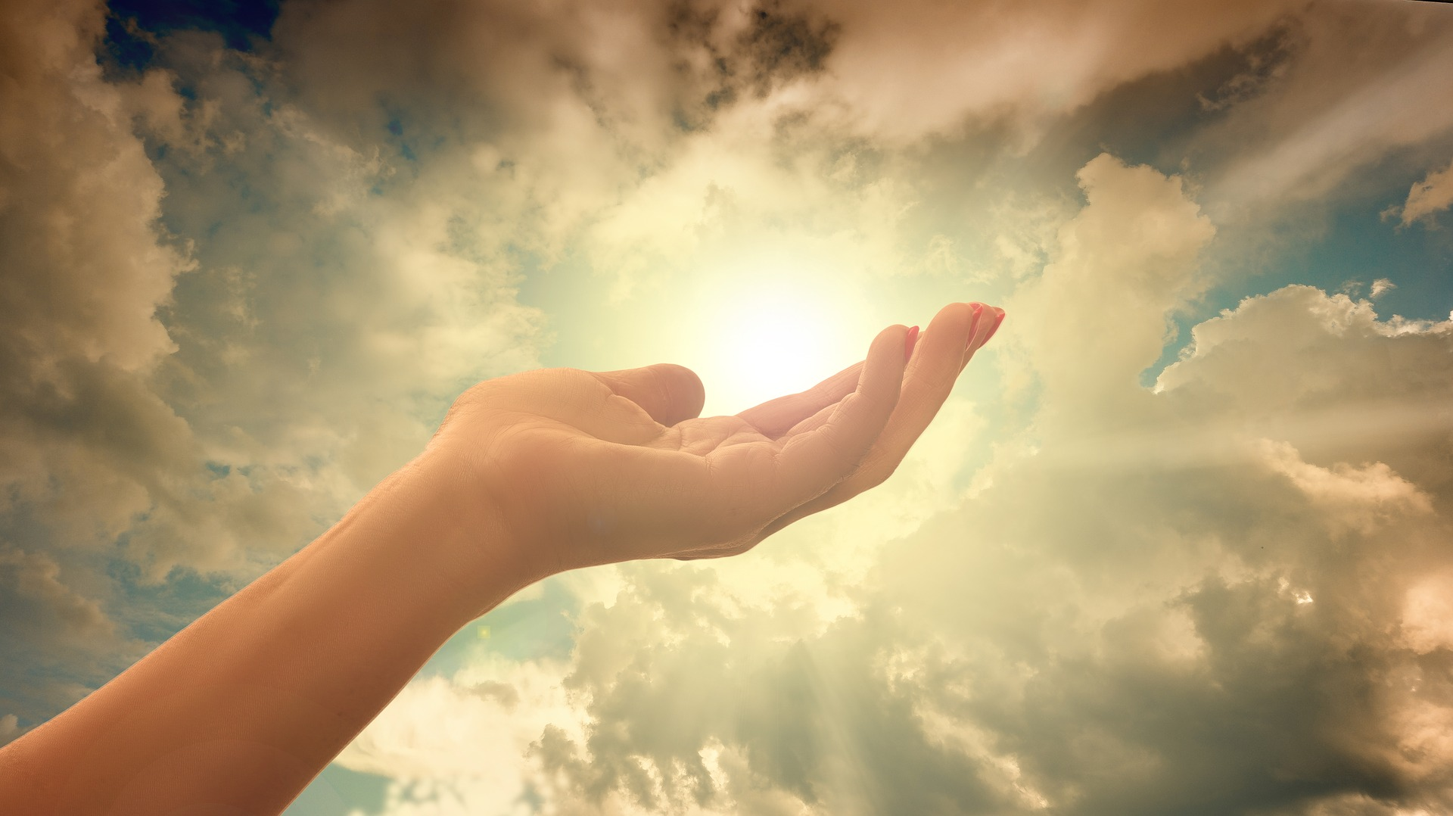
Christian Meditation

Slide 4
Opening Prayer
Jesus open our ears to hear your voice
Open our eyes to see your face
Open our mouths to speak your words
Open our hearts to your love
Open our hearts to your love

Slide 6
Blessing Song
We call on you O God
and on Jesus Christ your Son
through the power of the Spirit
that makes us truly one.
We ask you to bless us
and lead us in your ways
as you guide us on our journey
everyday.

Slide 7
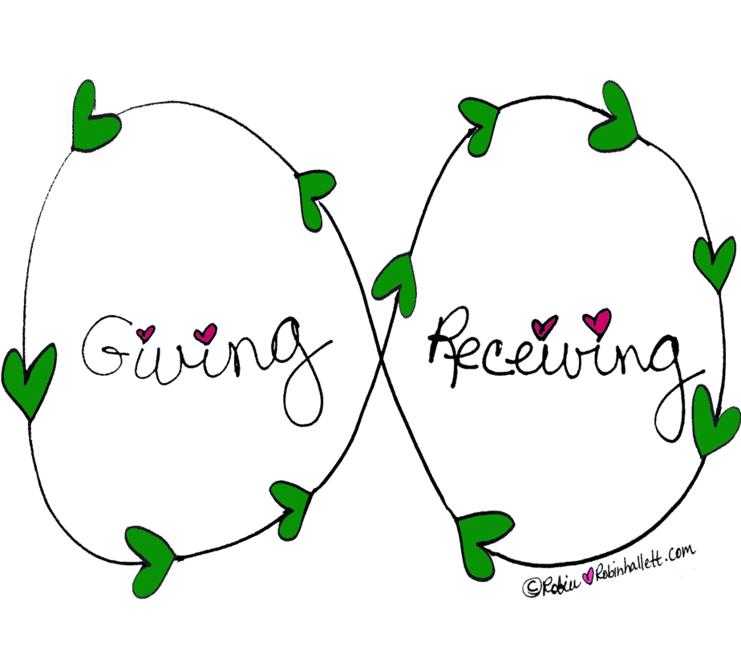
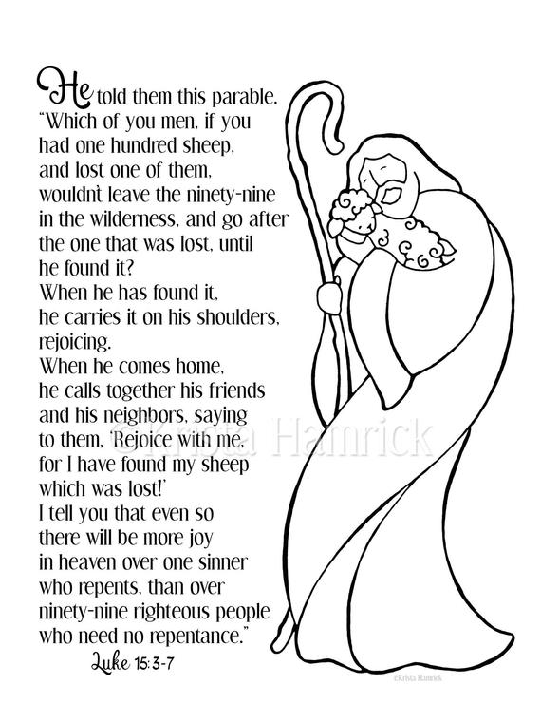
Stick your title page and resources on a new clean page so that it looks like this:

Slide 8
On a new clean page, stick in the Big Question so that it looks like this:
What’s more important - giving or receiving?
Write your answer underneath.

Slide 9
Write in your books: Tuesday 26th January
I can talk about giving and receiving

Slide 10
Giving and receiving everyday
Complete this task – you should write at least half a page. If you are in school, stick the header in your book.
Being thoughtful for life, for people and gifts, is a vital part of our relationships with one another. When praise and appreciation are experienced, we are enabled to relate on a deeper level.
Q Think about a time when you were thanked. How was the gratitude expressed? How did you feel?
Q How are relationships deepened in everyday life?

