Slide 1
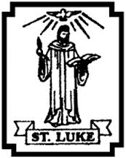
Lesson 2

Slide 2
Lectio Divina – stick in the sticker, then the scripture. Which part stands out to you – why?

Slide 3
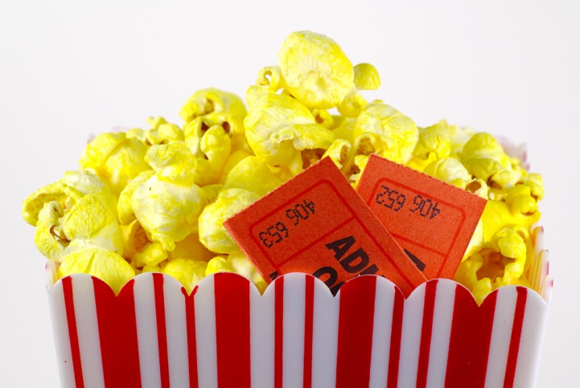
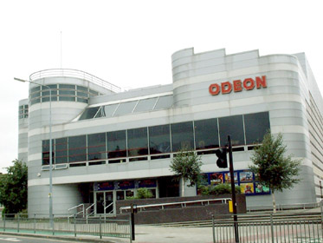
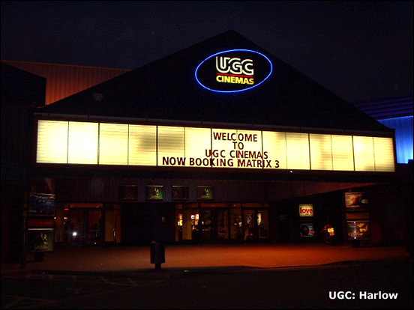
When you go to the movies to watch a film what happens first to know that the film is about to begin?

Slide 4
The Introductory rite
The beginning of the Introductory rite is very similar :
Greeting
Outside a church on Sunday people of different ages and different races are arriving in cars, on foot, perhaps off a bus.
Inside the church, the welcomers greet people and offer them hymn books or mass books. Other people will be preparing everything for the celebration: candles, water and wine, hosts, books for the readers and the priests. The musicians will be tuning up or running through a piece of music.
In the sacristy the altar servers will be gathering and the priest and deacon will be putting on their vestments.

Slide 5
The Introductory rite
When everything is ready they all sing the Gathering Song and the procession of altar servers, readers, deacon and priest enters the church.
The priest and deacon kiss the altar because it is the symbol of Jesus and it is with Jesus and by the power of the Holy Spirit that the Church offers this Eucharist to God the Father.
The first words the priest says remind everyone of this: In the name of the Father and of the Son and of the Holy Spirit. The priest says ‘The Lord be with you”.
The congregation replies “And also with you.” or “And with your spirit.”

Slide 6
The Introductory Rite
Why do you think it is necessary to have an introduction at the beginning of the Eucharist?
What is carried in procession at the start of the Eucharist and why do you think these symbols are used? Why does the priest kiss the altar?
Who does the priest represent? What part do the people play?
What does the Sign of the Cross signify at the start of the Eucharist?
Can you identify what is given and what is received during the Introductory Rite?

Slide 7
Watch this priest explain the Introductory Rites
https://www.youtube.com/watch?v=RqHuRDVX1AA

Slide 8
Thursday 28th January I can give reaons for the symbols and actions of the Introductory Rites
Start a booklet all about the Introductory Rites – use the video to help you
Your task is to describe these symbols and actions and say what they mean:
Priest (What does he do? Who does he represent?)
Opening Song (Why do we sing?)
Priest kisses the altar (Why?)
Sign of the cross (What does it represent? Why do we do it?)
Greeting (Why?)
Penitential Rite (What is it? Why do we say it?)
The Gloria (What is it? Why do we say it?)
The Collect (Prayer – why?)

