Slide 1


Slide 3

6 $×$ 1 $=$ 6 $×$ 2 $=$ 6 $×$ 3 $=$
6 $×$ 10 $=$ 6 $×$ 20 $=$ 6 $×$ 30 $=$
2) 60 $−$ 12 $=$
150 $−$ 10 $=$
Double these numbers
6 12 24
4) Halve these numbers
28 280

Slide 4
6 $×$ 1 $=$ 6 $×$ 2 $=$ 6 $×$ 3 $=$
6 $×$ 10 $=$ 6 $×$ 20 $=$ 6 $×$ 30 $=$
2) 60 $−$ 12 $=$
150 $−$ 10 $=$
Double these numbers
6 12 24
4) Halve these numbers
28 280
6
12
18
60
120
180
48
140
12
24
48
14
140

Slide 6


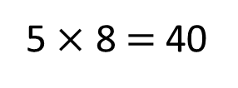

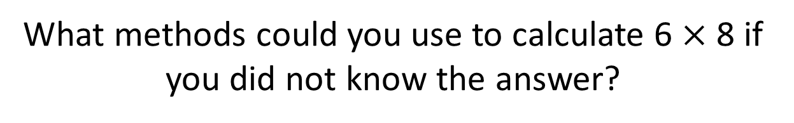
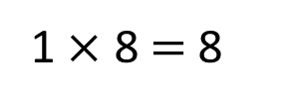
$× =$
6
8
48
What methods could you use to calculate 6 $×$ 8 if you did not know the answer?
Have a think
I partitioned 6 into 5 and 1
8
5
5 $×$ 8 $=$ 40
6
1
1 $×$ 8 $=$ 8

Slide 7

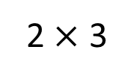
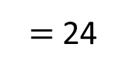
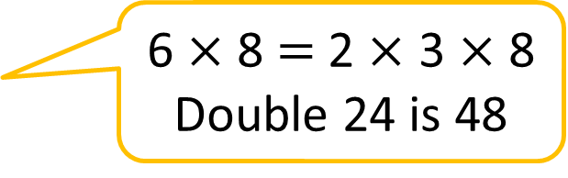
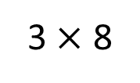
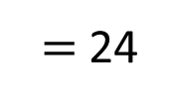
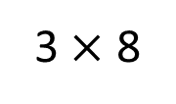
$× =$
6
8
48
What methods could you use to calculate 6 $×$ 8 if you did not know the answer?
6 $×$ 8 $=$ 2 $×$ 3 $×$ 8
Double 24 is 48
2 $×$ 3
3 $×$ 8
$=$ 24
3 $×$ 8
$=$ 24

Slide 8

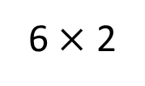
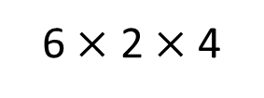
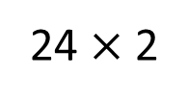
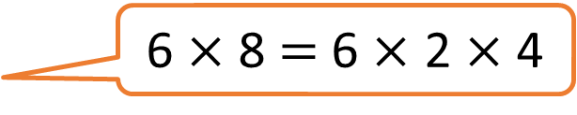
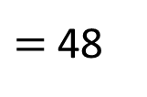
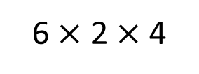
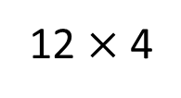
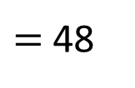
$× =$
6
8
48
What methods could you use to calculate 6 $×$ 8 if you did not know the answer?
6 $×$ 8 $=$ 6 $×$ 2 $×$ 4
6 $×$ 2 $×$ 4
12 $×$ 4
$=$ 48
6 $×$ 2
6 $×$ 2 $×$ 4
24 $×$ 2
$=$ 48

Slide 9

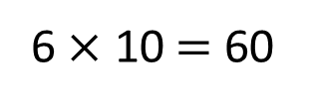
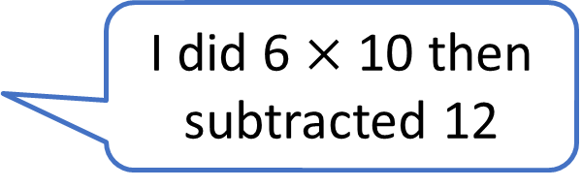
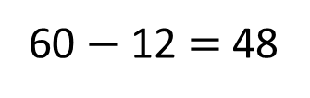
$× =$
6
8
48
What methods could you use to calculate 6 $×$ 8 if you did not know the answer?
I did 6 $×$ 10 then subtracted 12
10
6 $×$ 10 $=$ 60
60 $−$ 12 $=$ 48
6

Slide 10

$× =$
6
8
48
What methods could you use to calculate 6 $×$ 8 if you did not know the answer?
Double, then double, then double again
6
double
6
6
double
6
6
6
6
double
6
6
6
6
6
6
6
6
12
6
24
48

Slide 11

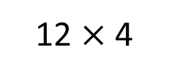
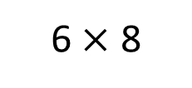
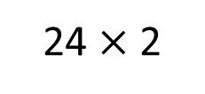
$× =$
6
8
48
What methods could you use to calculate 6 $×$ 8 if you did not know the answer?
If you double one factor and halve one factor the product stays the same
12
6
8
6 $×$ 8
4
12 $×$ 4
6
8
24 $×$ 2

Slide 12
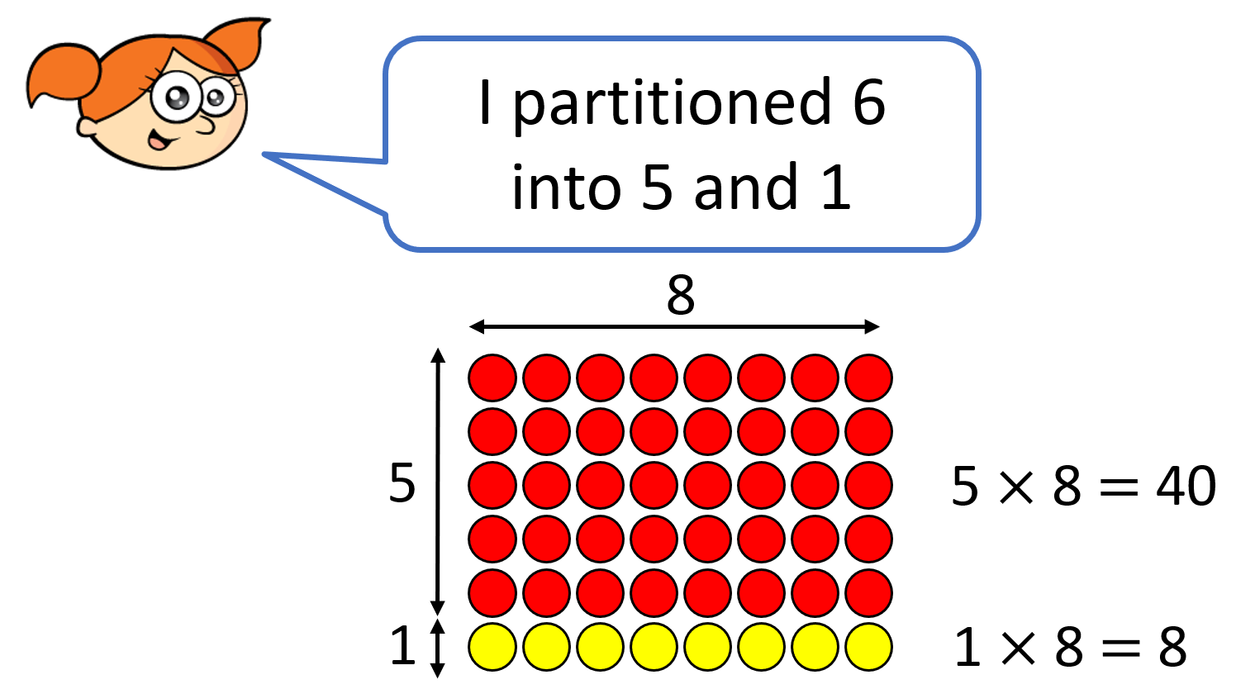
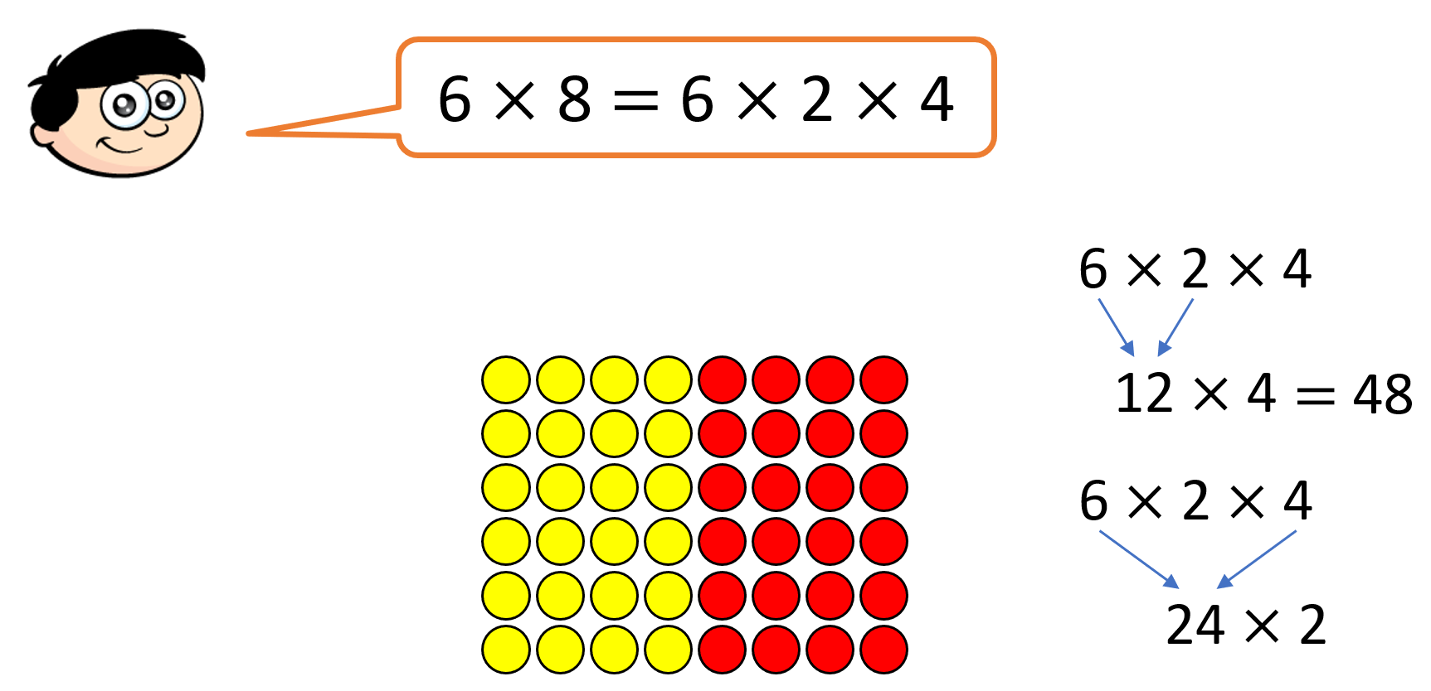
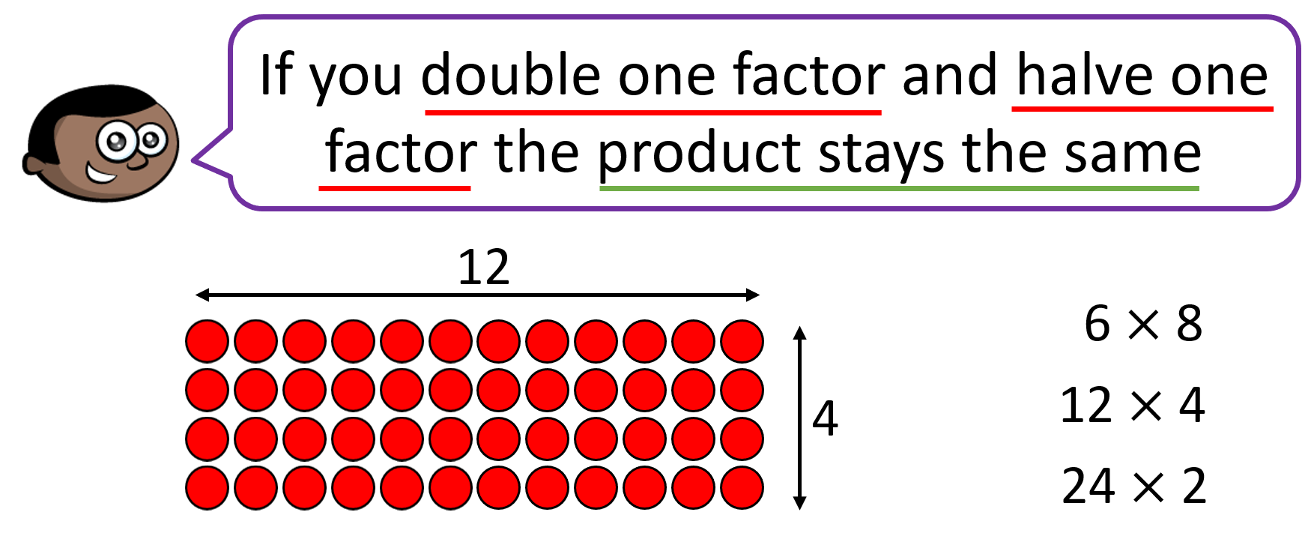
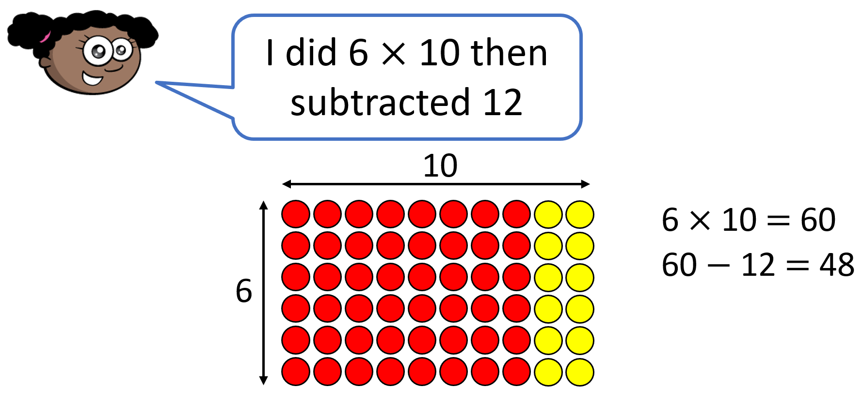

$× =$
5
28
140
Have a think

Slide 13
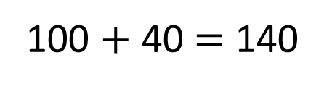
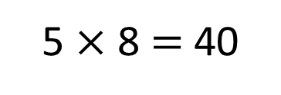
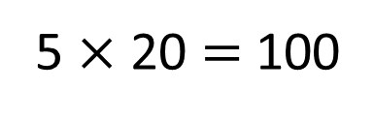
$× =$
5
28
140
20 8
5 $×$ 20 $=$ 100
5 $×$ 8 $=$ 40
100 $+$ 40 $=$ 140

Slide 14
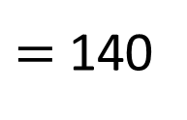
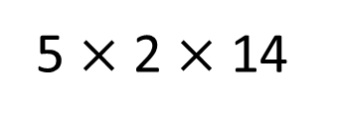
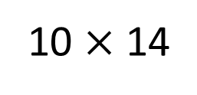
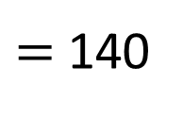
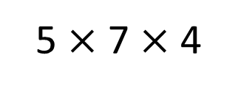
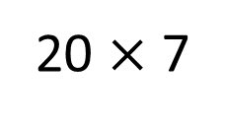
$× =$
5
28
140
5 $×$ 2 $×$ 14
10 $×$ 14
$=$ 140
5 $×$ 7 $×$ 4
20 $×$ 7
$=$ 140

Slide 15
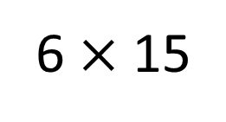
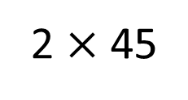
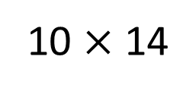

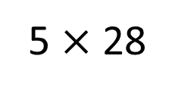


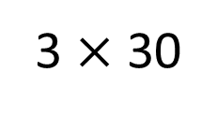

$× =$
5
28
140
5 $×$ 28
10 $×$ 14
6 $×$ 15
Have a think
$÷$ 2
$÷$ 3
$×$ 2
$×$ 3
3 $×$ 30
2 $×$ 45

Slide 16
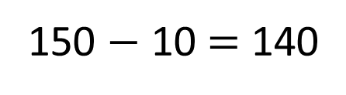
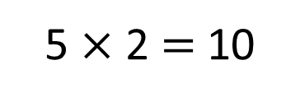
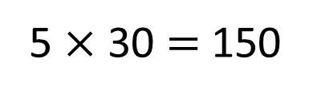
$× =$
5
28
140
5 $×$ 30 $=$ 150
5 $×$ 2 $=$ 10
150 $−$ 10 $=$ 140

Slide 17

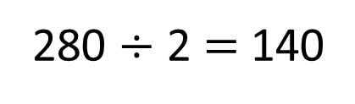
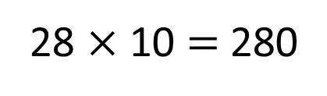
$× =$
5
28
140
I also know that to multiply by 5 you could multiply by 10 first and then half
28
28 $×$ 10 $=$ 280
140
5
10
280
280 $÷$ 2 $=$ 140
140
5

Slide 18
Have a go at the rest of the worksheet

