Slide 1


Slide 3
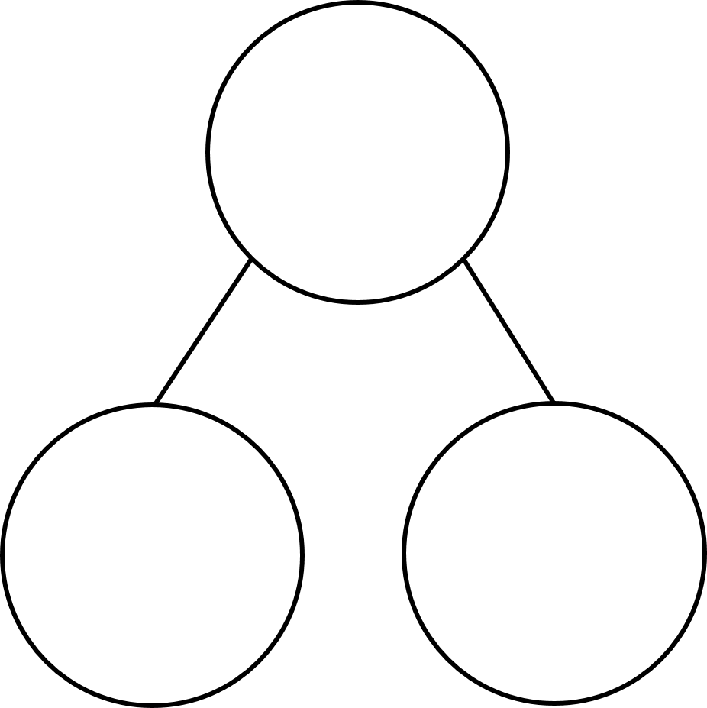

3 $×$ 1 $=$ 3 $×$ 10 $=$
3 $×$ 2 $=$ 3 $×$ 20 $=$
3 $×$ 3 $=$ 3 $×$ 30 $=$
3 $×$ 4 $=$ 3 $×$ 40 $=$
2) Complete the part-whole models
3 $+$ 3 $+$ 3 $=$ 5 $+$ 2 $+$ 2 $=$
5 $+$ 4 $=$ 5 $+$ 1 $+$ 1 $+$ 1 $+$ 1 $=$
10 $−$ 1 $=$
23
34
3

Slide 4

3 $×$ 1 $=$ 3 $×$ 10 $=$
3 $×$ 2 $=$ 3 $×$ 20 $=$
3 $×$ 3 $=$ 3 $×$ 30 $=$
3 $×$ 4 $=$ 3 $×$ 40 $=$
2) Complete the part-whole models
3 $+$ 3 $+$ 3 $=$ 5 $+$ 2 $+$ 2 $=$
5 $+$ 4 $=$ 5 $+$ 1 $+$ 1 $+$ 1 $+$ 1 $=$
10 $−$ 1 $=$
3
30
6
60
9
90
12
120
23
30
34
20
3
4
9
9
9
9
9

Slide 6


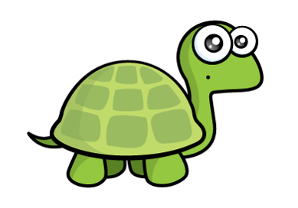
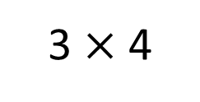
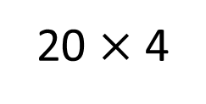

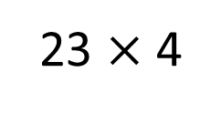
$× =$
23 $×$ 4
23
4
92
20 $×$ 4
3 $×$ 4
80
12
Remember that multiplication is commutative
Tens | Ones
Tens | Ones

Slide 7

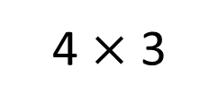
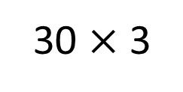
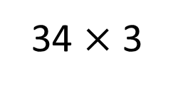
34 $×$ 3
$× =$
34
3
102
30 $×$ 3
4 $×$ 3
90
12
Tens | Ones
Tens | Ones
Have a think

Slide 8
Have a go at question 1 on the worksheet

Slide 9
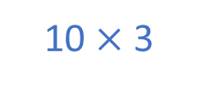

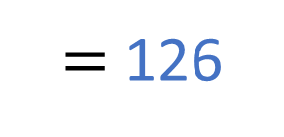

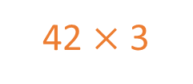
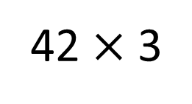
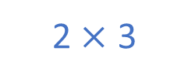
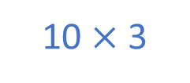
42 $×$ 3
$=$ 126
10 $×$ 3
10 $×$ 3
10 $×$ 3
10 $×$ 3
2 $×$ 3
30
60
90
120
126
42 $×$ 3

Slide 10

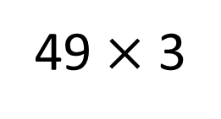
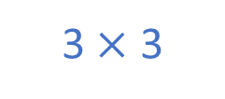
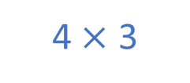
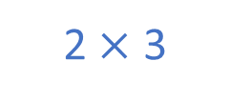
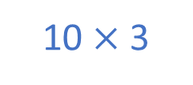

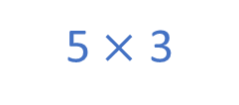

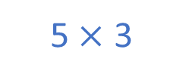

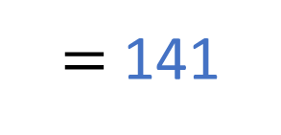
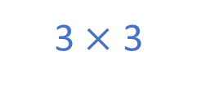
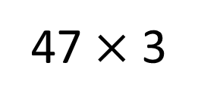

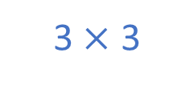
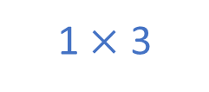

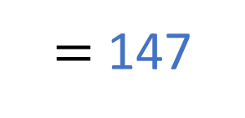
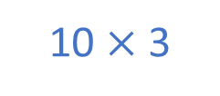



47 $×$ 3
$=$ 141
Have a think
10 $×$ 3
10 $×$ 3
10 $×$ 3
10 $×$ 3
5 $×$ 3
2 $×$ 3
1 $×$ 3
1 $×$ 3
30
60
90
120
135
141
49 $×$ 3
$=$ 147
10 $×$ 3
10 $×$ 3
10 $×$ 3
10 $×$ 3
10 $×$ 3
5 $×$ 3
4 $×$ 3
3 $×$ 3
3 $×$ 3
3 $×$ 3
1 $×$ 3
30
60
90
120
147

Slide 11
Have a go at questions
2 - 3 on the worksheet

Slide 12


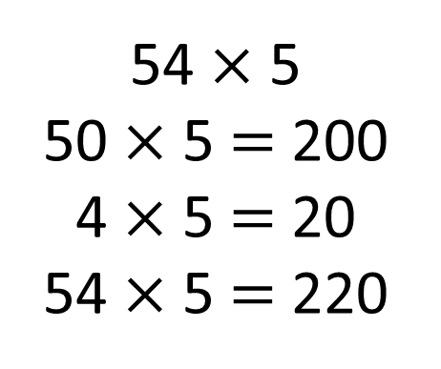
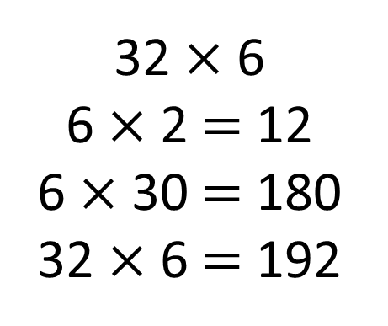
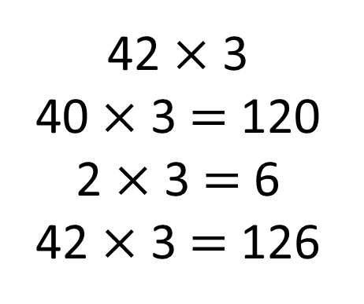
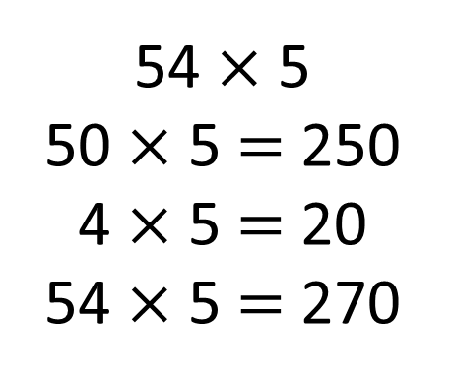
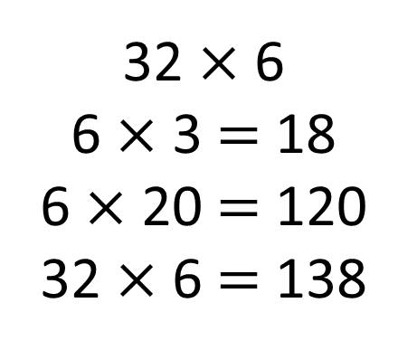
Can you find which of Tiny’s calculations are correct and which are incorrect?
32 $×$ 6
6 $×$ 3 $=$ 18
6 $×$ 20 $=$ 120
32 $×$ 6 $=$ 138
32 $×$ 6
6 $×$ 2 $=$ 12
6 $×$ 30 $=$ 180
32 $×$ 6 $=$ 192
42 $×$ 3
40 $×$ 3 $=$ 120
2 $×$ 3 $=$ 6
42 $×$ 3 $=$ 126
54 $×$ 5
50 $×$ 5 $=$ 200
4 $×$ 5 $=$ 20
54 $×$ 5 $=$ 220
54 $×$ 5
50 $×$ 5 $=$ 250
4 $×$ 5 $=$ 20
54 $×$ 5 $=$ 270
Have a think

Slide 13
Have a go at the rest of the worksheet

