Slide 1


Slide 3
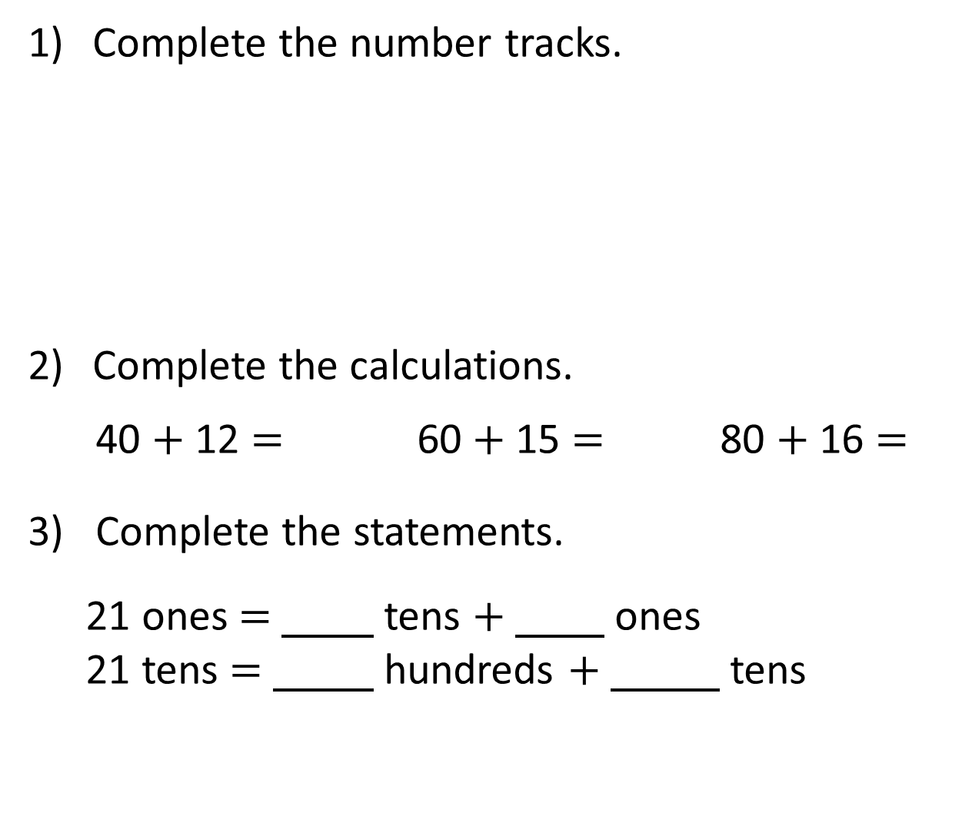
Complete the number tracks.
Complete the calculations.
40 $+$ 12 $=$ 60 $+$ 15 $=$ 80 $+$ 16 $=$
3) Complete the statements.
21 ones $=$ tens $+$ ones
21 tens $=$ hundreds $+$ tens
2 |  |  |  | 10 |  | 14 | 16
20 |  |  | 80 | 100 |  |  |  | 180

Slide 4
Complete the number tracks.
Complete the calculations.
40 $+$ 12 $=$ 60 $+$ 15 $=$ 80 $+$ 16 $=$
3) Complete the statements.
21 ones $=$ tens $+$ ones
21 tens $=$ hundreds $+$ tens
2 |  |  |  | 10 |  | 14 | 16
4
6
8
12
18
20
20 |  |  | 80 | 100 |  |  |  | 180
40
60
120
140
160
200
52
75
96
2
1
2
1

Slide 6
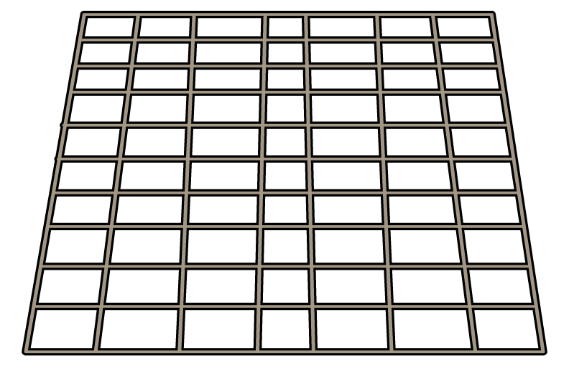


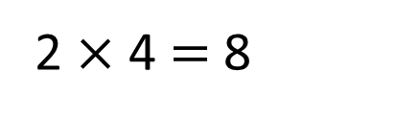

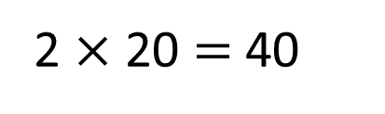
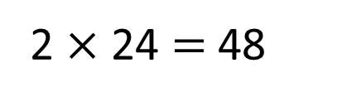
Each tray has 24 rolls.
How many rolls are there in total?
2 $×$ 20 $=$ 40
2 $×$ 4 $=$ 8
2 $×$ 24 $=$ 48
T O
2
4
There are 48 rolls in total.
$×$
2
4
8

Slide 7
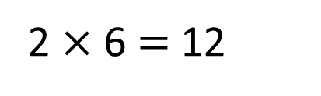
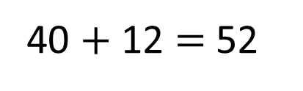
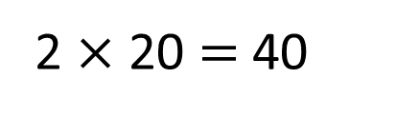
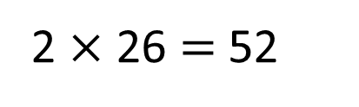
Each tray has 26 rolls.
How many rolls are there in total?
2 $×$ 20 $=$ 40
2 $×$ 6 $=$ 12
40 $+$ 12 $=$ 52
2 $×$ 26 $=$ 52
There are 52 rolls in total.

Slide 8
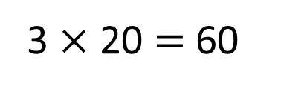
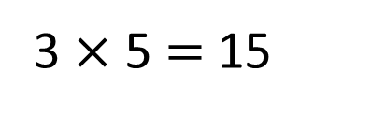
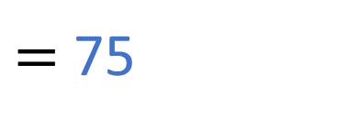
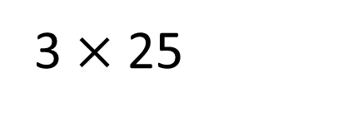
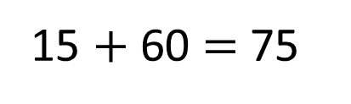
3 $×$ 25
$=$ 75
T | O
3 $×$ 5 $=$ 15
3 $×$ 20 $=$ 60
15 $+$ 60 $=$ 75

Slide 9
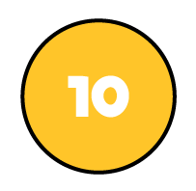


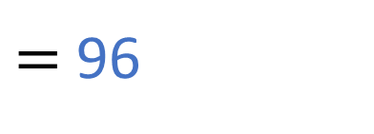
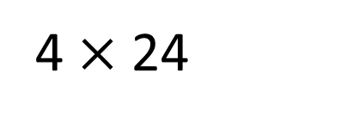
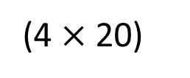
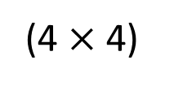

4 $×$ 24
$=$ 96
T | O
T O
2
4
$×$
4
1 6
(4 $×$ 4)
8 0
(4 $×$ 20)
9 6
Have a think

Slide 10
Have a go at question
1 - 2 on the worksheet

Slide 11
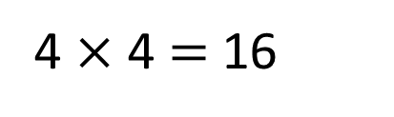
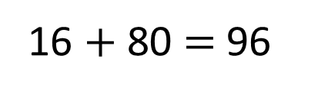
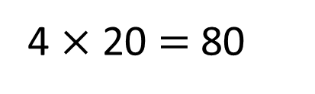

4 $×$ 24
$=$ 96
T O
T | O
T O
2
4
2
4
4 $×$ 4 $=$ 16
4
$×$
4
$×$
4 $×$ 20 $=$ 80
9
6
1 6
(4 $×$ 4)
8 0
1
(4 $×$ 20)
16 $+$ 80 $=$ 96
9 6

Slide 12

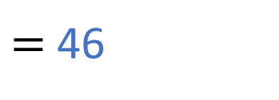
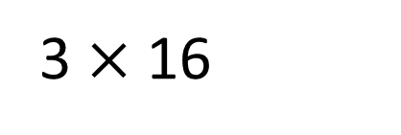
3 $×$ 16
$=$ 46
Have a think
T | O
T O
1
6
$×$
3
4
6
1

Slide 13

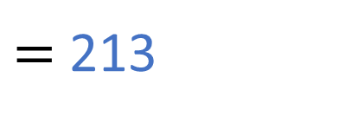
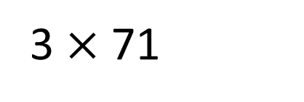
3 $×$ 71
$=$ 213
Have a think
T | O
T O
7
1
$×$
3
2
1
3
2

Slide 14
Have a go at the rest of the questions on the worksheet

