Slide 1
Can I read as a reader?

Slide 2
Let’s perform!

Slide 3
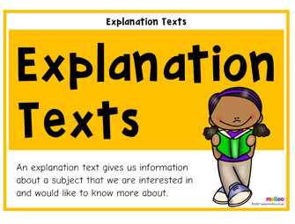
Here’s the text
How does the author make the reader feel?

Slide 4
Here’s the text
How does the writer influence the reader?

Slide 5
Here’s the text
What is the writer’s viewpoint? How do you know?

Slide 6
Activity – complete the grid, discussing in your groups how the text impacts the reader.

Slide 7
Let’s discuss your ideas

Slide 8
What would be in a tool kit for an explanation text?

