Slide 2
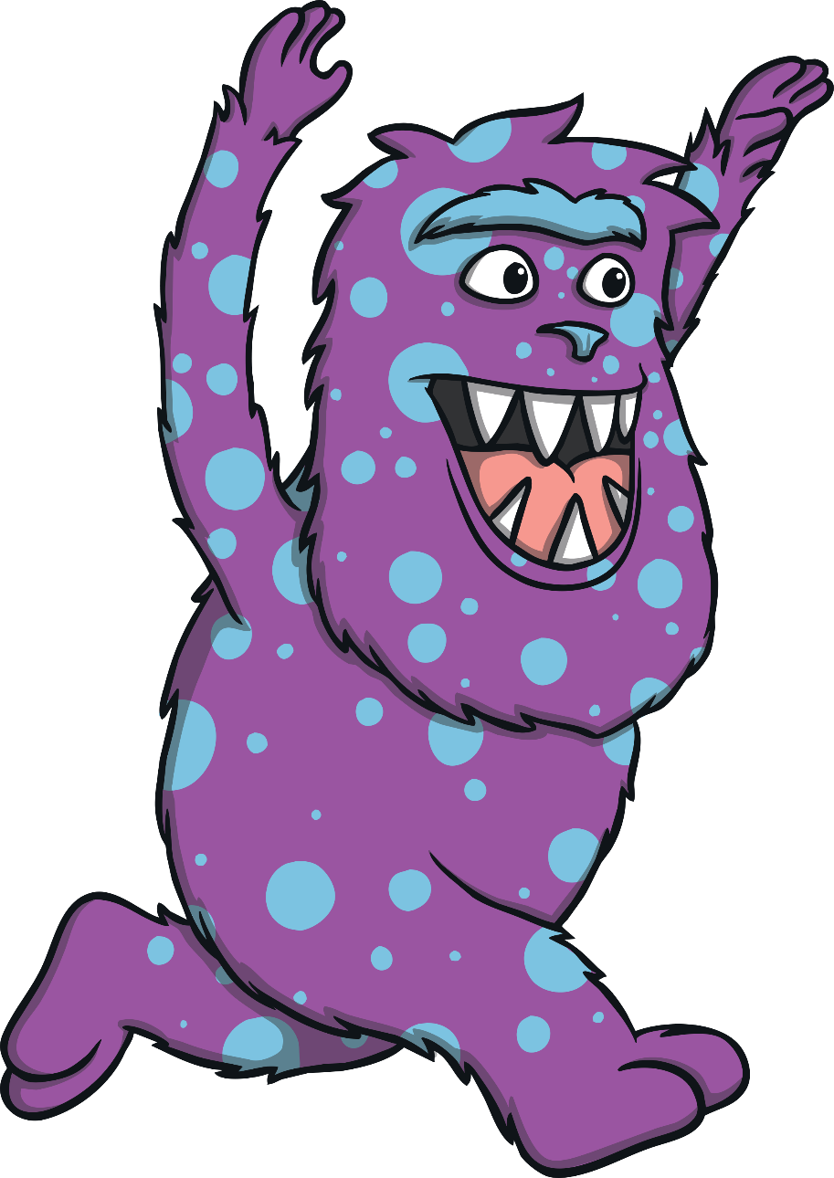
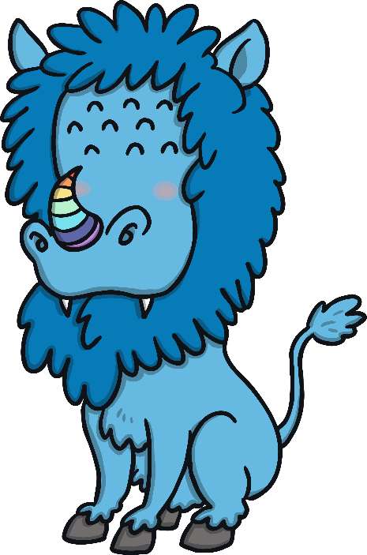
Made-Up Monsters
Monsters are imaginary creatures.
This means that we can create our own monsters!
We can use our own ideas to make up the monsters.
We can choose what our monsters look like and add any features we want.

Slide 3
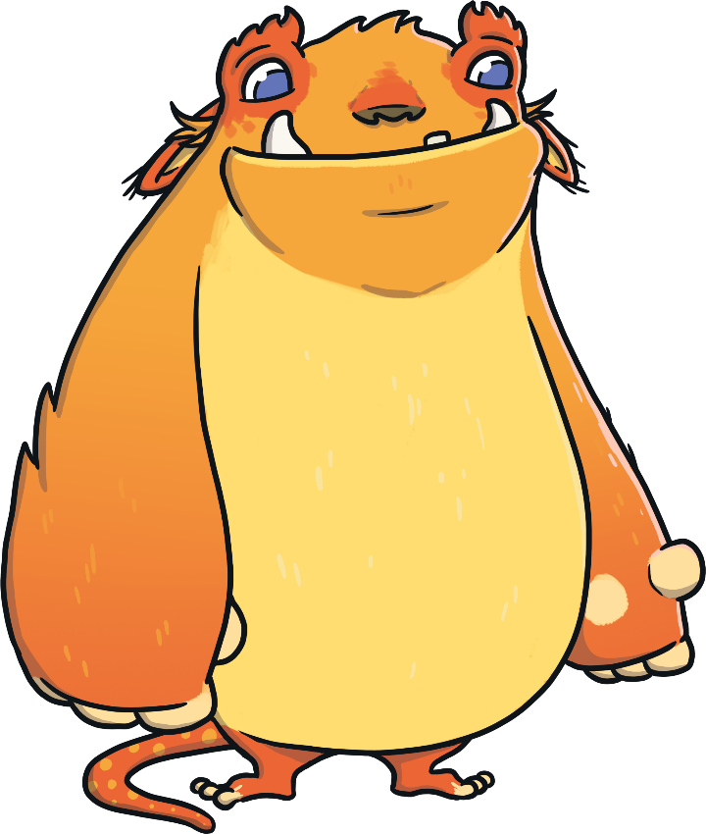
What Is a Feature?
This monster has two eyes.
What other features can you see on this monster?
Talk to your partner.
two eyes
wide mouth
white tusks
floppy ears
black nose
orange fur
yellow tummy
big paws
tiny feet
spotty tail

Slide 4
Creating a Monster
Let’s make a monster together.
First, we need to choose a shape for our monster’s body.

Slide 5
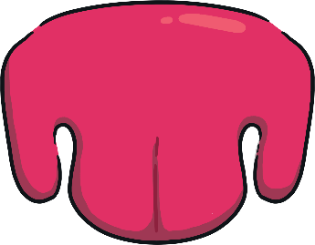
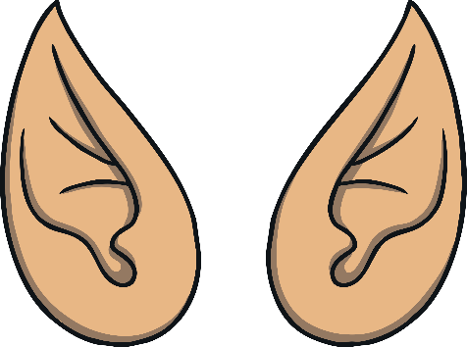
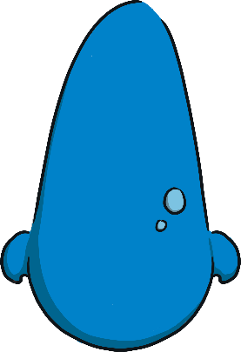
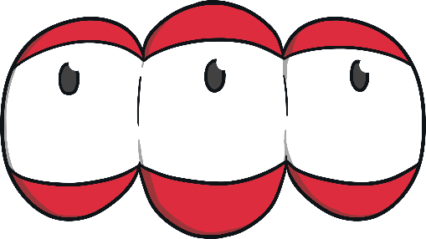
Creating a Monster
Let’s add a head and a face.
How many eyes does it have?
How big is its nose?
What do its ears look like?
What shape is its mouth?
Does it have tusks?

Slide 6
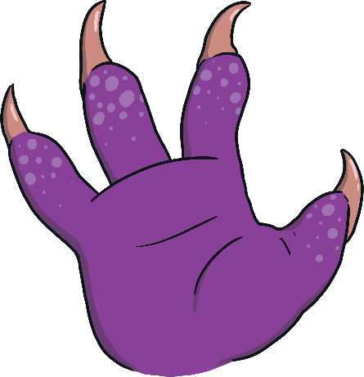
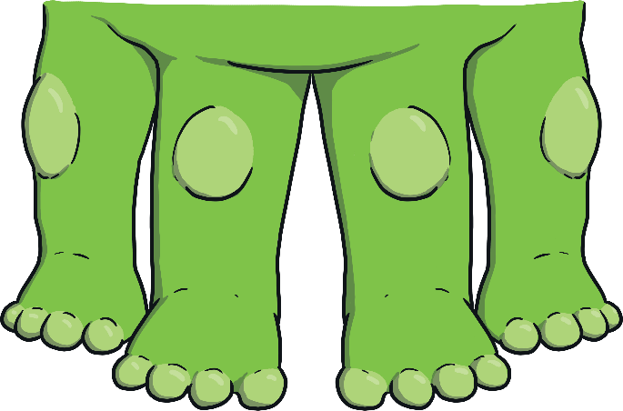
Creating a Monster
Does the monster have arms or legs?
Does it have paws or claws?
Does it have tentacles?

Slide 7
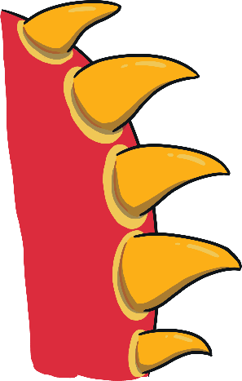
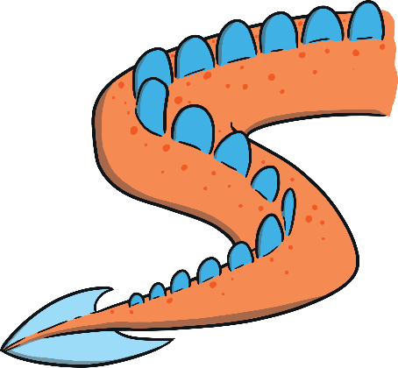
Creating a Monster
Let’s think about the other features a monster might have.
Shall we add wings?
Does it have horns?
Has it got a tail?
What about spikes?

Slide 8
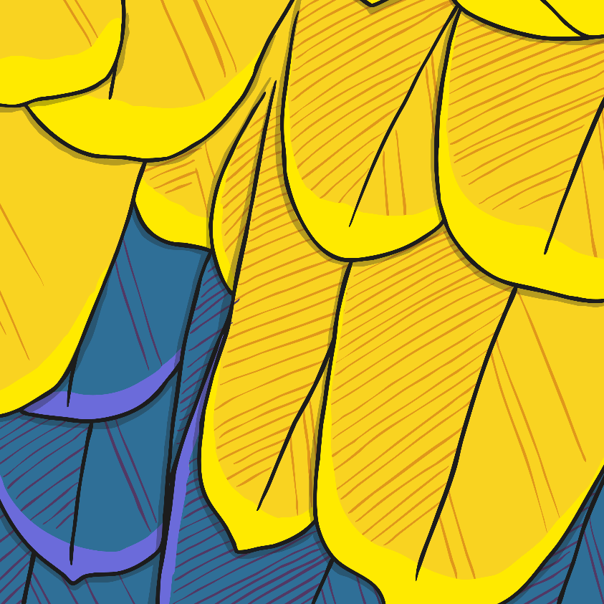
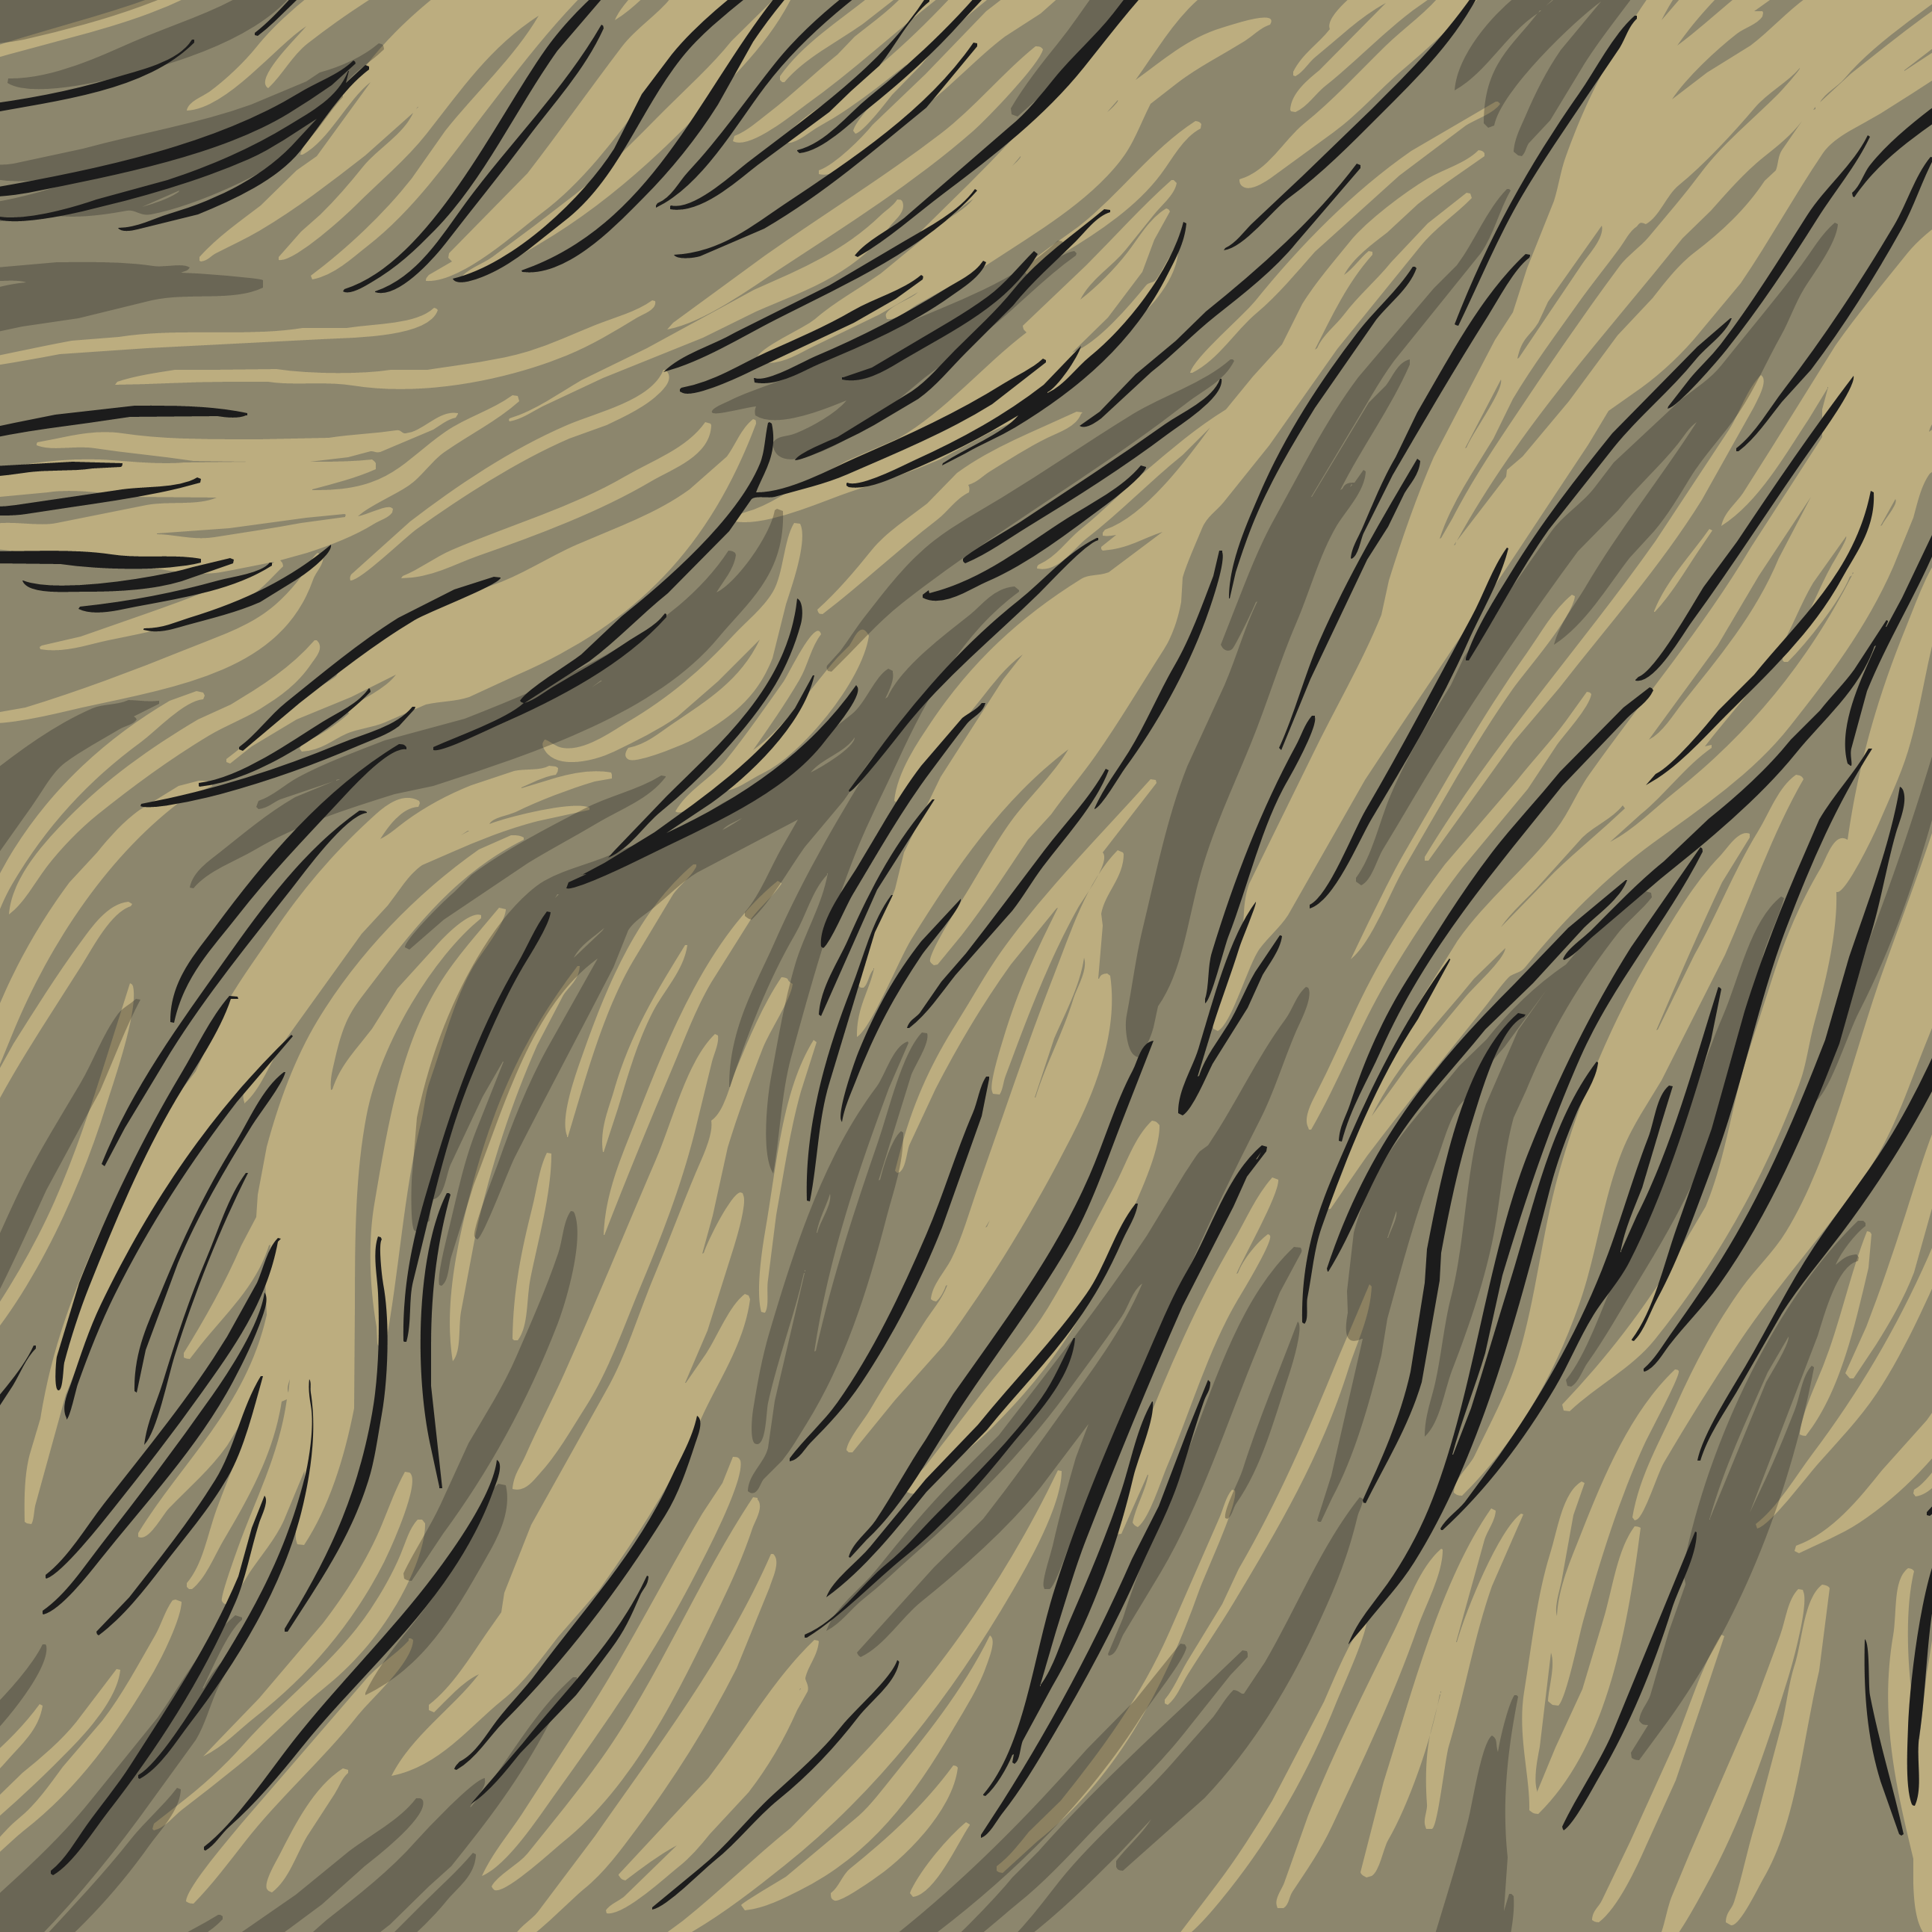
Creating a Monster
What is covering the monster’s body?
Does it have fur?
Has it got scaly skin?
Is it covered in feathers?

Slide 9
Creating a Monster
What colour shall we make the monster?
Does it have any patches of other colours?
Does it have any spots, stripes or patterns?

Slide 10
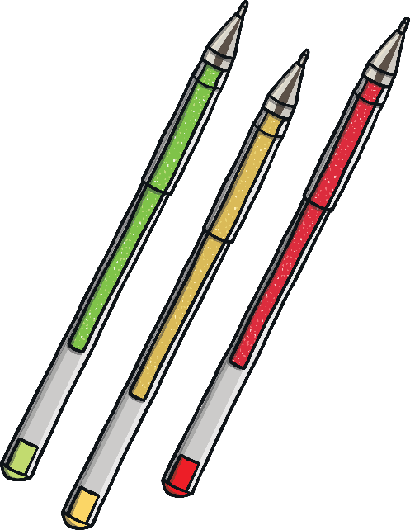
Draw Your Monster
Now it’s your turn to create your very own monster!
Decide on the size and shape of your monster.
Then, add the features.
Finally, choose the colours to complete your creation.

Slide 11
Describing a Monster
Let’s think about how we would describe our new monster.
What words or phrases could we use to describe it?
What adjectives would help us?
Think about these things:
size
colour
personality
shape
features
adjective – a describing word, e.g. huge, kind, green, excited

Slide 12
Describing a Monster
Let’s try to put some of our ideas into sentences.
Here’s an example of one sentence that could describe a monster:
The huge monster had a long green tail with a pointy spike at the end.
Talk to your partner. Think of a sentence to describe something about the monster we have made together.

Slide 13
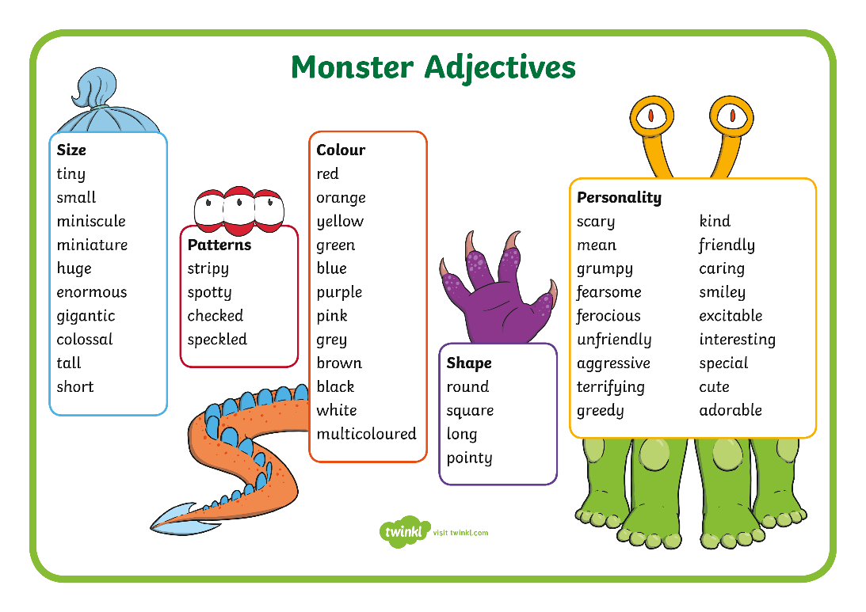
Write Your Monster Description
Now, think about how you would describe your own monster.
Write down some words and phrases that you could use.
Then, write your own sentences to describe the monster you have created.

Slide 14
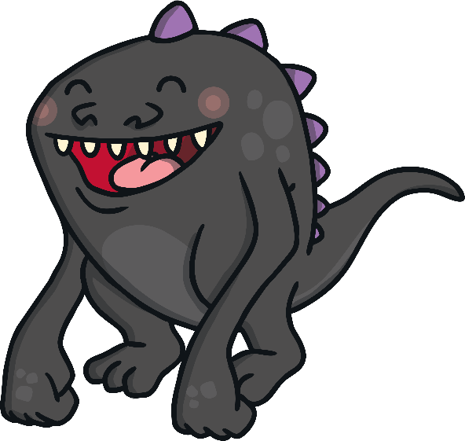
Mystery Monster!
We are now going to play ‘Mystery Monster’!
Turn your drawing over so that no one can see it.
Take your drawing and writing and find another table to work on. Make sure you are sitting with different people who have not seen your monster yet.
Put all your drawings in the middle of the table and mix them up. Then, turn them over so everyone can see them. Don’t tell anyone which is yours!
Take it in turns to read your own monster descriptions out loud.
Can your friends work out which monster is yours by listening to your description?
?
?
?

