Slide 1


Slide 2
Review

Slide 3
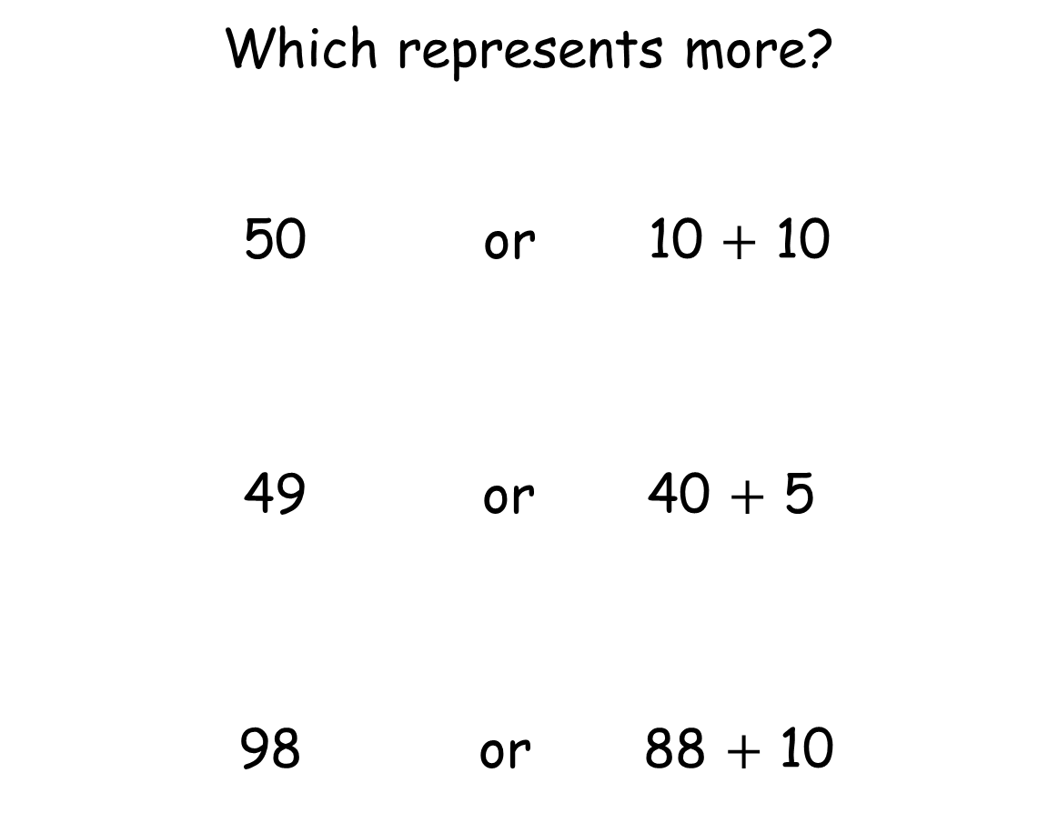
Which represents more?
50 or 10 $+$ 10
49 or 40 $+$ 5
98 or 88 $+$ 10

Slide 4
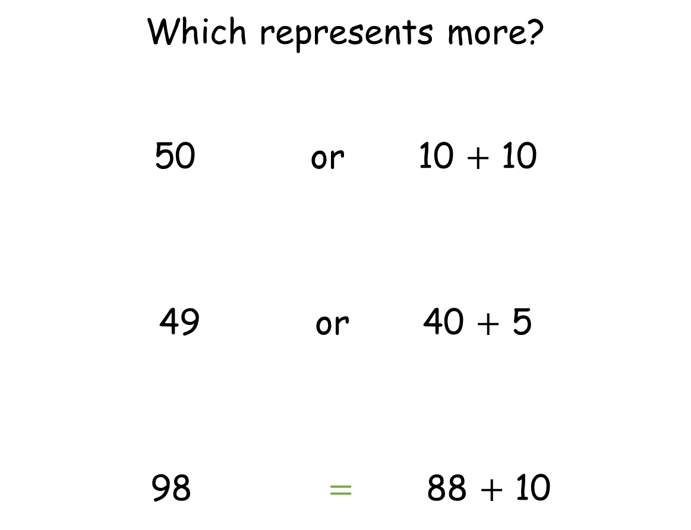
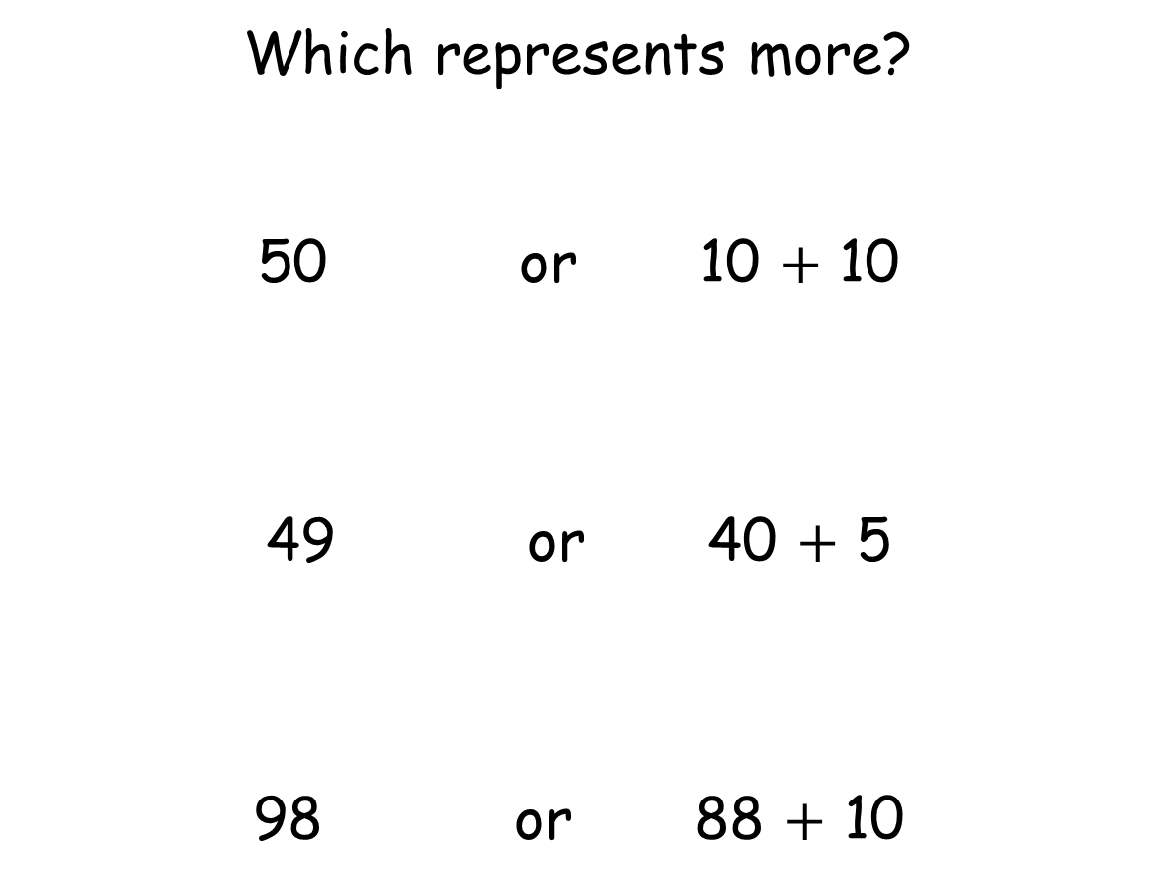
Which represents more?
50 or 10 $+$ 10
49 or 40 $+$ 5
98 $=$ 88 $+$ 10
Which represents more?
50 or 10 $+$ 10
49 or 40 $+$ 5
98 or 88 $+$ 10

Slide 5
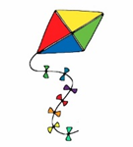
Release the kite

Slide 6
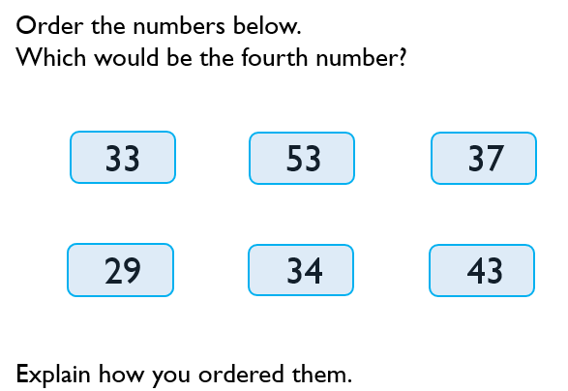

Slide 8
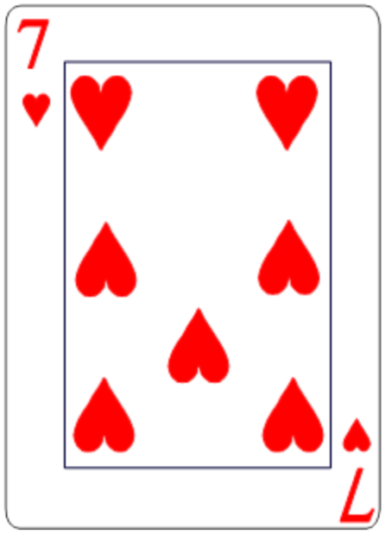
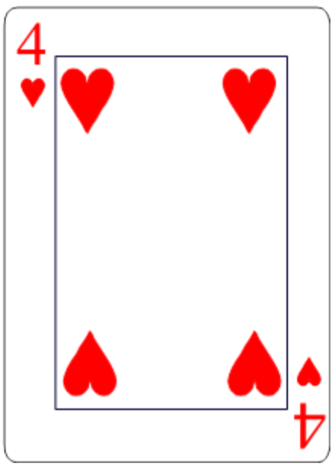


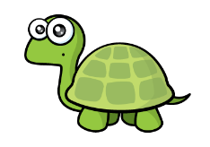


Slide 10
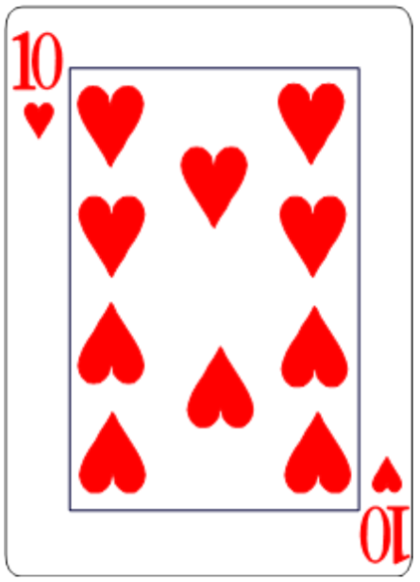
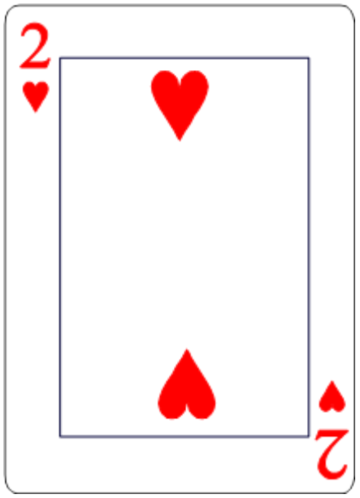

$$<$$
$$<$$

Slide 11
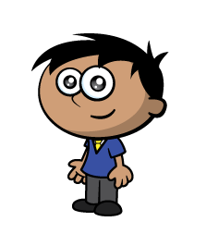
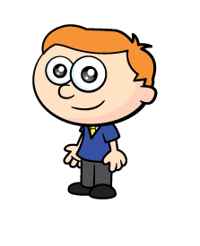

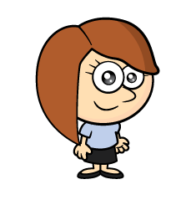
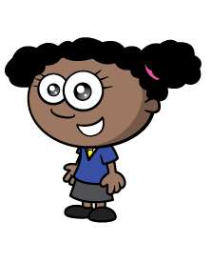

Slide 12

1
1
1
1

Slide 13
1
2
3
4
5
3
6
1
5
2
1
2
3
4
2
6
4
1
5

Slide 14
5
3
2
6
$$<$$

Slide 15

5
3
2
6
$$>$$

Slide 16
5
3
2
6

Slide 17



$$<$$
$$>$$
$$<$$

Slide 18


$$<$$
$$<$$
Have a think

Slide 19



5
3
2
6
$$<$$
$$<$$
$$<$$
Isn’t there another way?

Slide 20



5
3
2
6
$$<$$
$$>$$
$$>$$
$$>$$

Slide 21
5 balls each
Ones
Tens

Slide 22


5 balls each
23
$$>$$
5
40

Slide 23



5 balls each
$$>$$
$$<$$
23
$$<$$
5
$$<$$
31
40
32
30
Have a think

Slide 24




$$<$$
$$>$$
$$=$$

Slide 25
Stick and write questions 1,2 and 3 in your books
Stick the questions 4 and 5 in books and answer the questions
Go Deeper Q6
Challenge Q7

