Slide 1
Lesson 6
I understand what Lamb of God means

Slide 2
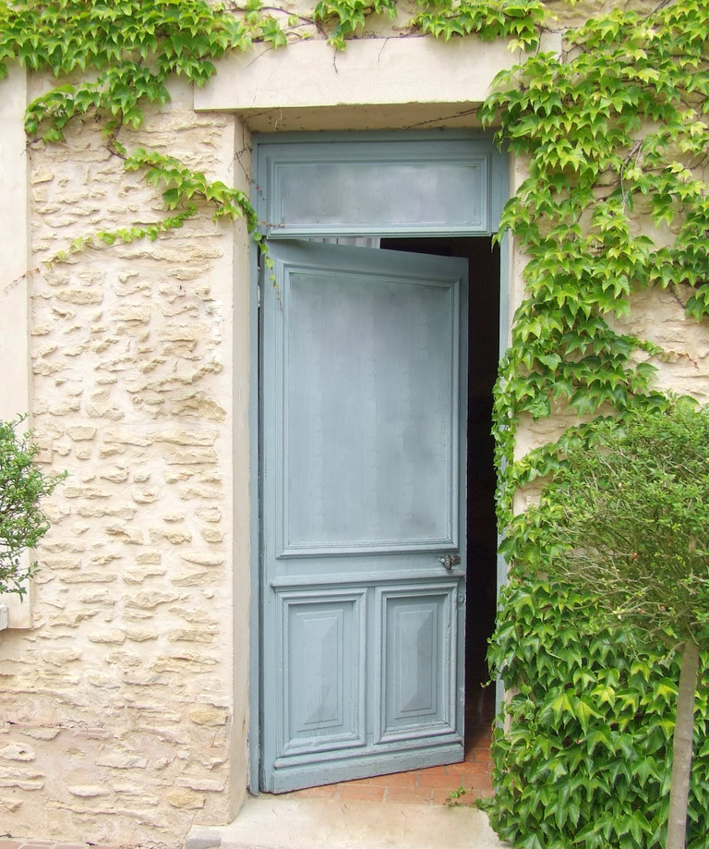
Lectio Divina: which part speaks to you and why?
The Supper of the Lamb
So Jesus went with them. He was not far from the house when the centurion sent friends to say to him:
"Lord, don't trouble yourself, for I do not deserve to have you come under my roof.”
Luke 7: 6
(NRSV)

Slide 3
The Communion rite (Continued)
The main focus of this lesson is the Prayer
Lamb of God
The Holy Communion
The Prayer after the Communion

Slide 4
Lamb of God
The lamb of God part of the Mass is about the giving and receiving of the Holy Communion and the Prayer after the Communion
The priest invites people to come to Communion. He lifts up the sacred host and says:
Behold the Lamb of God,
behold him who takes away the sins of the world. Blessed are those called to the supper of the Lamb.
The people respond:
Lord, I am not worthy
that you should enter under my roof, but only say the word
and my soul shall be healed.
DOES ANYONE KNOW WHERE THIS COMES FROM?

Slide 5
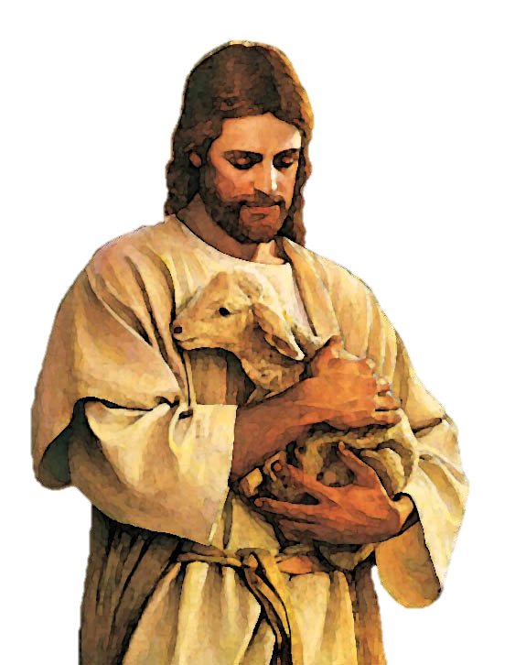
‘Lamb of God’
The next day John saw Jesus coming toward him and said,
"Look, the Lamb of God, who takes away the sin of the world!
John 1: 29
(NRSV)

Slide 6
The Supper of the Lamb
So Jesus went with them. He was not far from the house when the centurion sent friends to say to him:
"Lord, don't trouble yourself, for I do not deserve to have you come under my roof.”
Luke 7: 6
(NRSV)

Slide 7
The Body and blood of Christ
After the Lamb of God, The Priest then receives the Body and Blood of Christ.
It is then given to the Extraordinary Ministers of the Holy Communion.

Slide 8
The body and blood of Christ
The people process to the altar to receive Holy Communion or a blessing. The priest or the Extraordinary Ministers raise the host to each person saying, ‘The Body of Christ’.
Each person replies ‘Amen’(which means ‘I agree’) and receives the host. Then sometimes the people receive the chalice and the priest or Extraordinary Minister says, ‘The Blood of Christ’ and each person replies ‘Amen’ and drinks from the chalice.

Slide 9
Prayer after Communion
The priest invites the people to pray that, having received Jesus in Holy Communion, they will have the strength to live in communion that is to ‘give and take’ every day.

Slide 10
The Communion Rite
Who said in John’s Gospel; ‘Behold the Lamb of God’ and when?
What is the supper of the Lamb?
Of what might people want to be healed?
What does the priest say when the raises the Host and the chalice?
How do you think people can live in communion with one another?

Slide 11
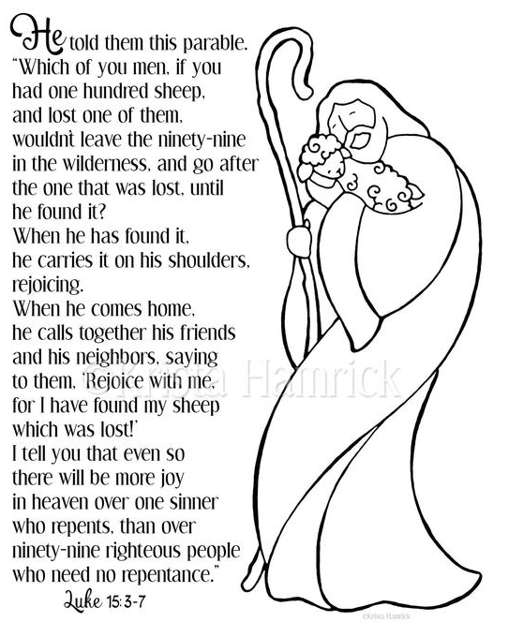
How does this link to Holy Communion?

Slide 12
Communion means “together”.
Just as the shepherd went after the one sheep, even though all the others were safe, so the parish looks after each and every one of its parishioners, just as God looks after each and every one of His children.

Slide 13
I understand what Lamb of God means
In your book, you now need to write about
The Lamb of God and where it comes from
Body and Blood of Christ
The Prayer after Communion – link to the Lost Sheep Parable

Slide 14
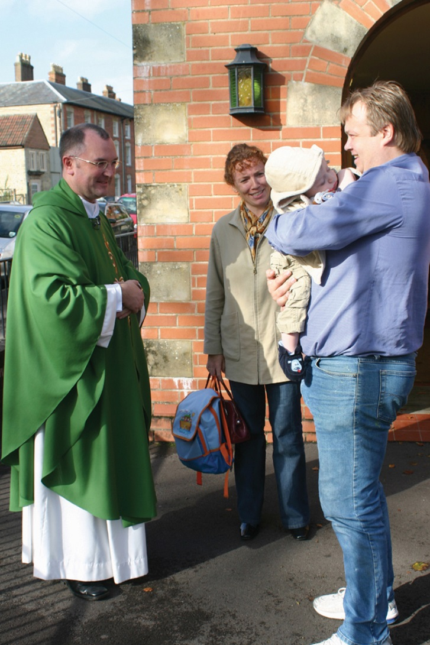
When do you think this part of the Mass will happen?

