Slide 1
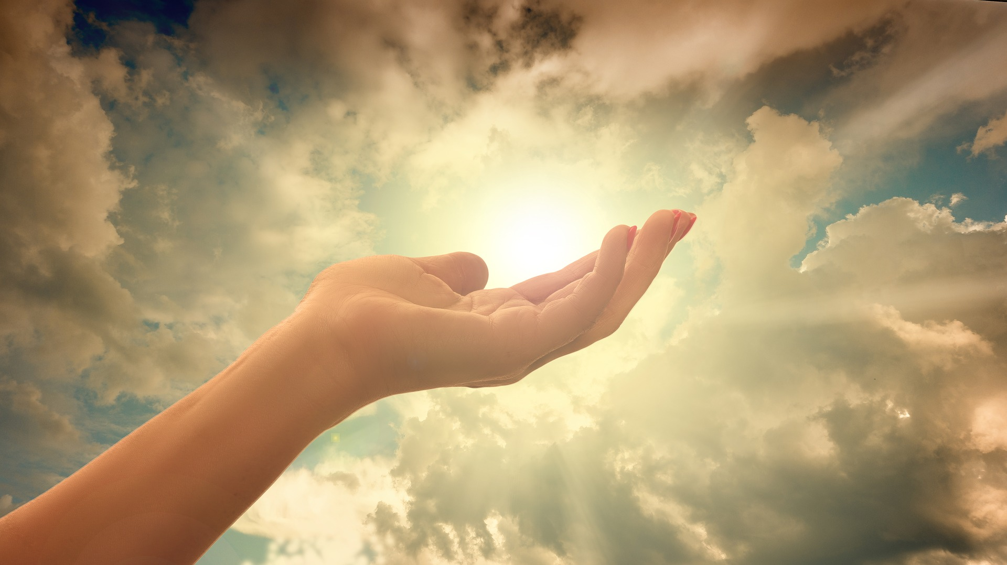
Christian Meditation

Slide 2
Opening Prayer
Jesus open our ears to hear your voice
Open our eyes to see your face
Open our mouths to speak your words
Open our hearts to your love
Open our hearts to your love

Slide 4
Blessing Song
We call on you O God
and on Jesus Christ your Son
through the power of the Spirit
that makes us truly one.
We ask you to bless us
and lead us in your ways
as you guide us on our journey
everyday.

Slide 5
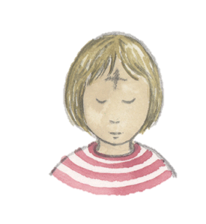
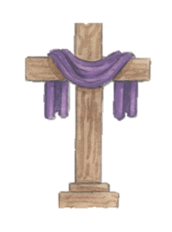
Our new unit is about Self Discipline

Slide 6
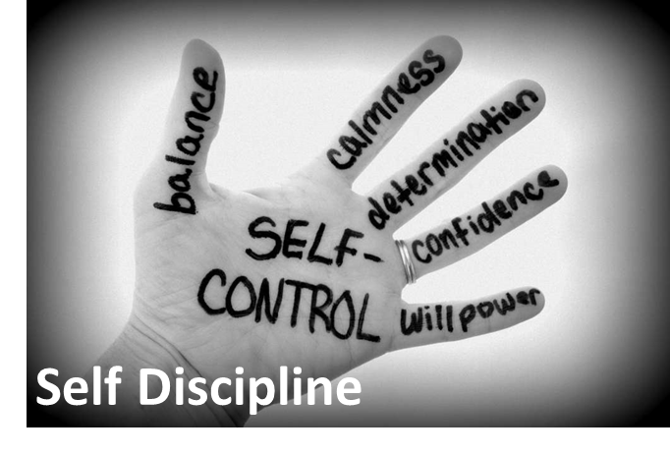
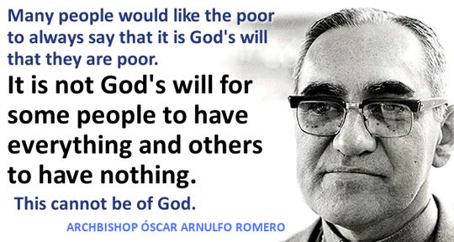
Stick your title page and resources on a new clean page so that it looks like this:

Slide 7
On a new clean page, stick in the Big Question so that it looks like this:
Write your answer underneath.

Slide 8
Write in your books: Tuesday 2nd March
I can talk about self discipline

Slide 9
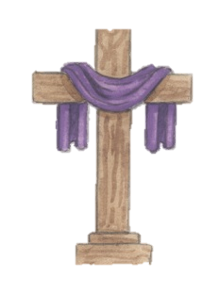
Self Discipline
Think about a time when you were determined to do something.
How did it make you feel?
What did you put in place to achieve your final goal?

Slide 10
Training for Town Sports Day
Samantha was really very good at high jump. she had come first at the school’s sports day and had been chosen to represent the school at the All Schools’ Sports Day in her home town. She knew that there was going to be plenty of competition. Mrs Carter, her teacher, offered to give her some help and so did her Dad, who was a member of the local athletics club. Mrs carter coached Samantha at lunch time three times a week, which was fine with Samantha as she only played around at lunch time. it was no bother.

Slide 11
Training for Town Sports day
Samantha’s Dad said they could use the athletics club’s sport ground on Saturday mornings and use the actual high jump that would be used for the town sports and they could start this Saturday. There were only six Saturdays before the event. Samantha was not very keen because she usually went shopping on Saturday with her friend Chloe.
She told her Dad that she did not want to practise on Saturday. she thought it was enough to do it in school some lunch times.

Slide 12
Training for Town Sports Day
What do you think Samantha’s Dad said?
What do you think was Chloe’s advice?
What happened at the sports day?
How do you think Samantha felt?
Have you ever had the experience of having to give up something and be very disciplined for a good reason? What happened and why?
How do you think self-discipline helps people to grow and make the best use of their potential?

Slide 13
I can say what I already know about self discipline
Think about a particular skill you have. It might be sports, swimming, football, running or a computer skills, or be good at making things – knitting, baking, drawing, painting, growing things. Then make a plan of how you would like to reach your full potential in that skill. In the plan answer the following questions:
Where will I start? What will I do?
Who and what would help me?
What might I have to change in my daily life?
What would I need to believe in order to be self-disciplined?
When will I begin?
What effect will my skill have on others?
How do I feel about it?

