Slide 1
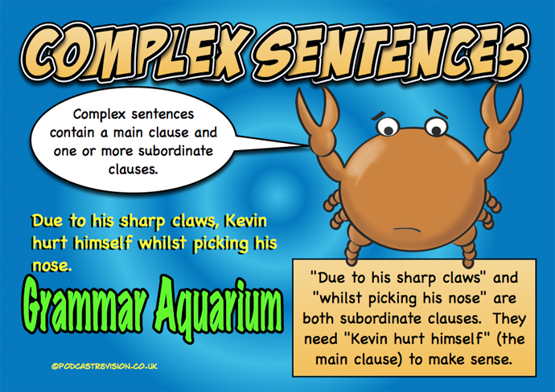
Can I identify complex sentences?

Slide 2
Does anyone know what a sentence needs to be a sentence?

Slide 3
-a noun and a verb (a clause)
-a capital letter and a full stop.
-It has to make sense on its own.

Slide 4
There are 3 types of sentence. Does anyone know what they are?

Slide 5
Simple
Compound
Complex

Slide 6
Complex sentences.
Has two clauses:
1) Main clause
2) Subordinate clause

Slide 7
Complex sentences.
Main clause- makes sense on its own
e.g. The bear ate.

Slide 8
Complex sentences.
Main clause- makes sense on its own
e.g. The bear ate
Subordinate clause- needs the main clause to make sense.
e.g. even though it wasn’t hungry.

Slide 9
Complex sentences.
e.g. The bear ate even though it wasn’t hungry.
You can flip the clauses around too!
Even though it wasn’t hungry, the bear ate.

Slide 10
Complex sentences are joined with subordinating conjunctions

Slide 11
Complex sentences are joined with subordinating conjunctions

Slide 12
Complex sentences are joined with subordinating conjunctions

Slide 13
Complex sentences are joined with subordinating conjunctions

Slide 14
Can I identify a complex sentence?
Join the main clause to a subordinate clause using a subordinating conjunction. Choose from the sheet.

