Slide 1
Science
Living Things and Their Habitats
Year One

Slide 3
Aim
I can generate questions to use in a classification key.
I can identify vertebrates by observing their similarities and differences.
Success Criteria
I can generate questions about animals.
I can use questions to sort animals in a key.
I can see similarities and differences between vertebrates.
I can use these to identify vertebrate groups.

Slide 4
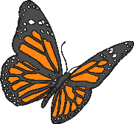
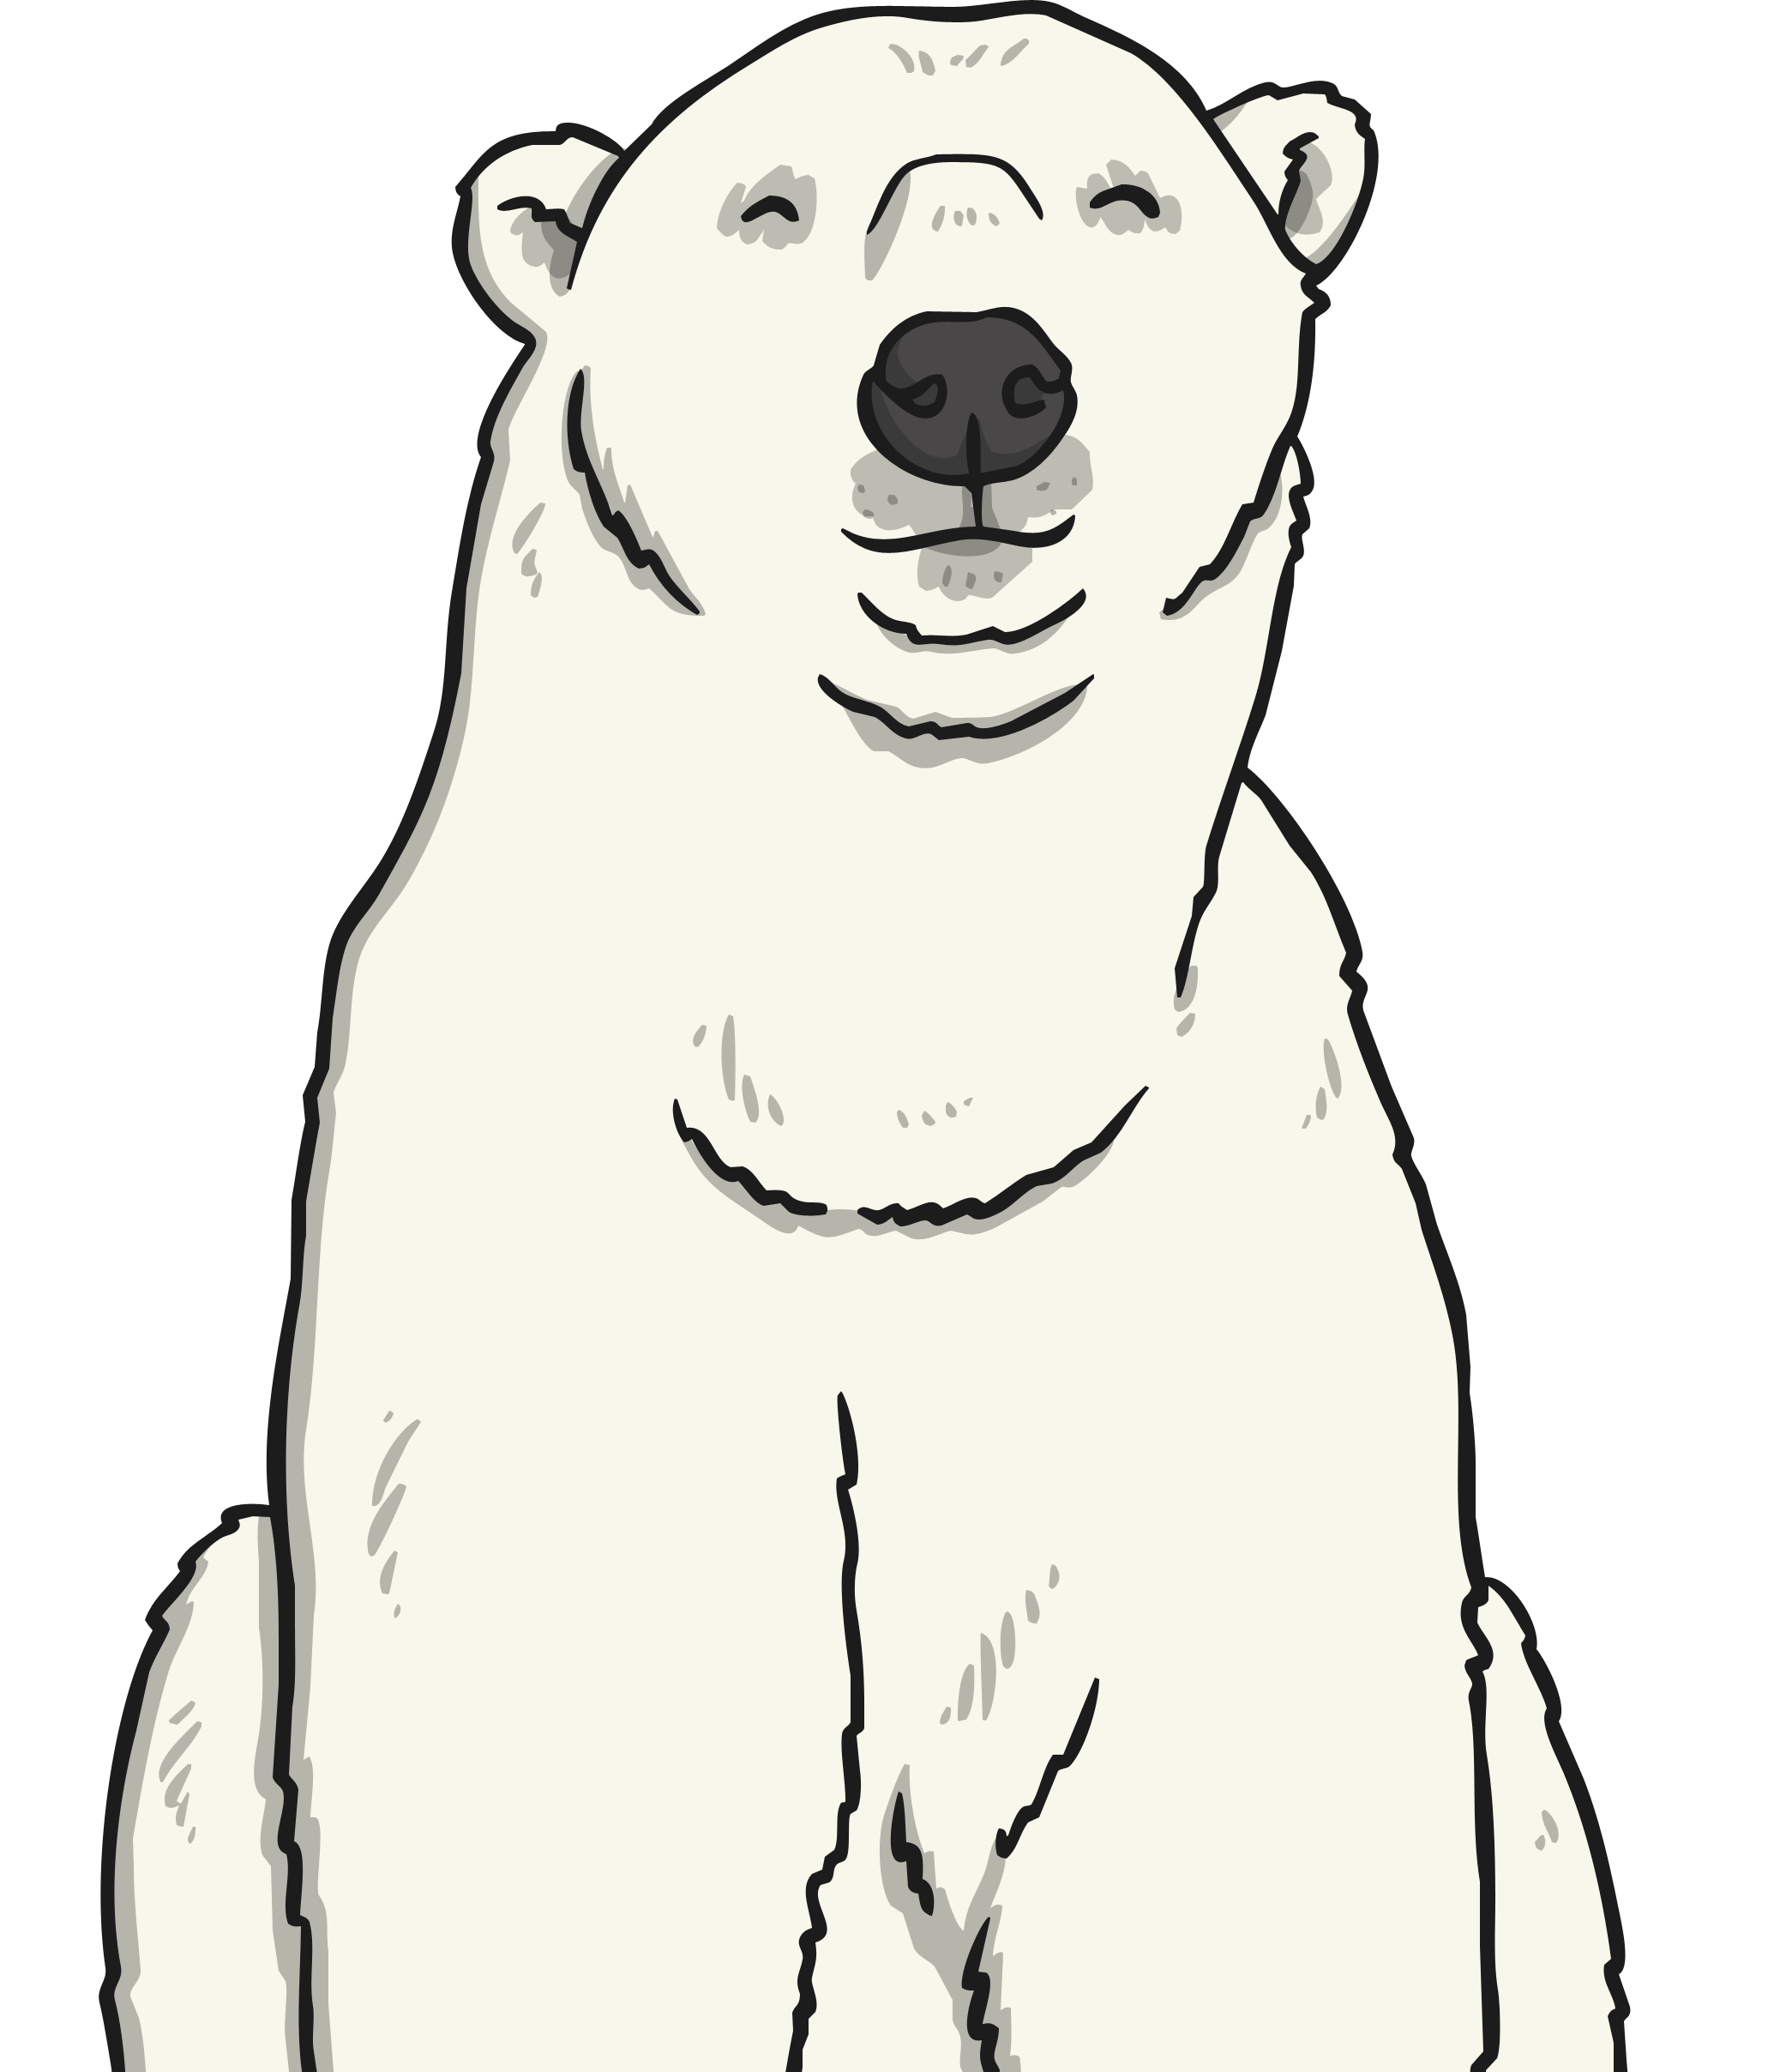
Classification
Scientists think that there are 7.77 million species of animals in the world, living on the land, in the sky and in the sea.
We have discovered and named about 1.4 million of these…which means that over 6 million species of animal are yet to be discovered!
We have already discovered:
5500 species of mammal
10 400 species of bird
10 000 species of reptile
7300 species of amphibian
33 000 species of fish
1 305 000 kinds of invertebrate
Which kind of creature are we?

Slide 5
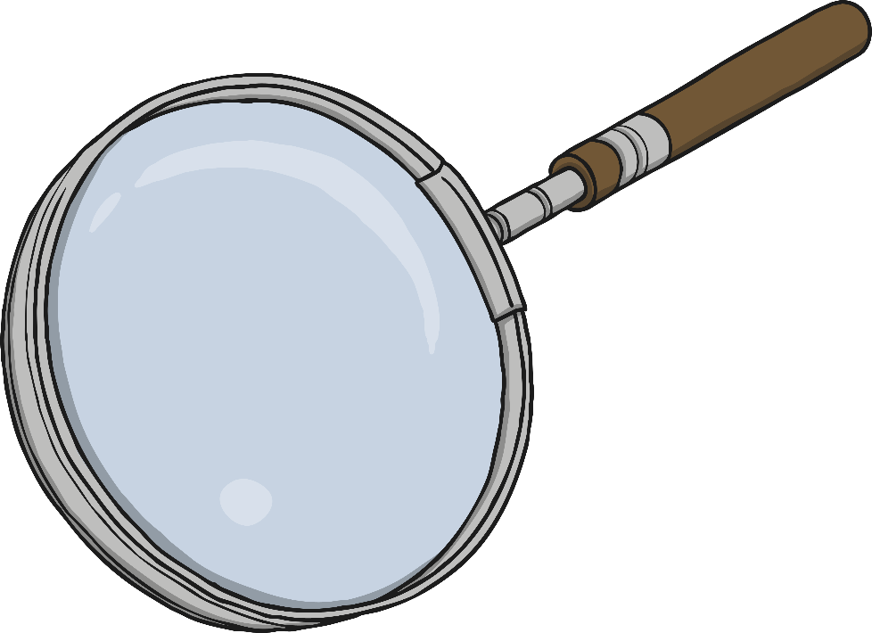
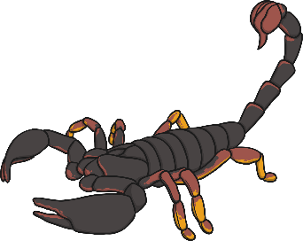
Classification
When scientists discover a new animal, they give it a name and record everything they know about it.
What kind of information do you think they will record?

Slide 6
Classification
Hadogenes troglodytes (Peters, 1861)
Common names: Often known as South African rock scorpion or the flat rock scorpion.
Distribution: Africa (Botswana, Mozambique, South Africa, Zimbabwe).
Habitat: Lives in dry bushveld habitats in rocky areas.
Appearance: These scorpions have very elongated, flattened bodies and powerful claws.
Venom: This species has a mild venom. It will rarely sting, and usually defends itself by using the powerful claws.
Latin name
Who discovered it and when

Slide 7
Classification
With so many living things to make records of, and so many yet to discover, it is important that we have a system to organise and make sense of the information we have about them.
We organise living things into groups based on their similarities and differences, so that we can learn more about what makes each species unique. The differences between living things is sometimes called variation.

Slide 8
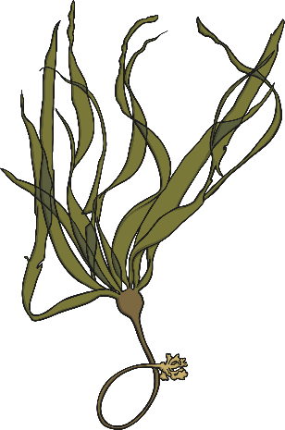
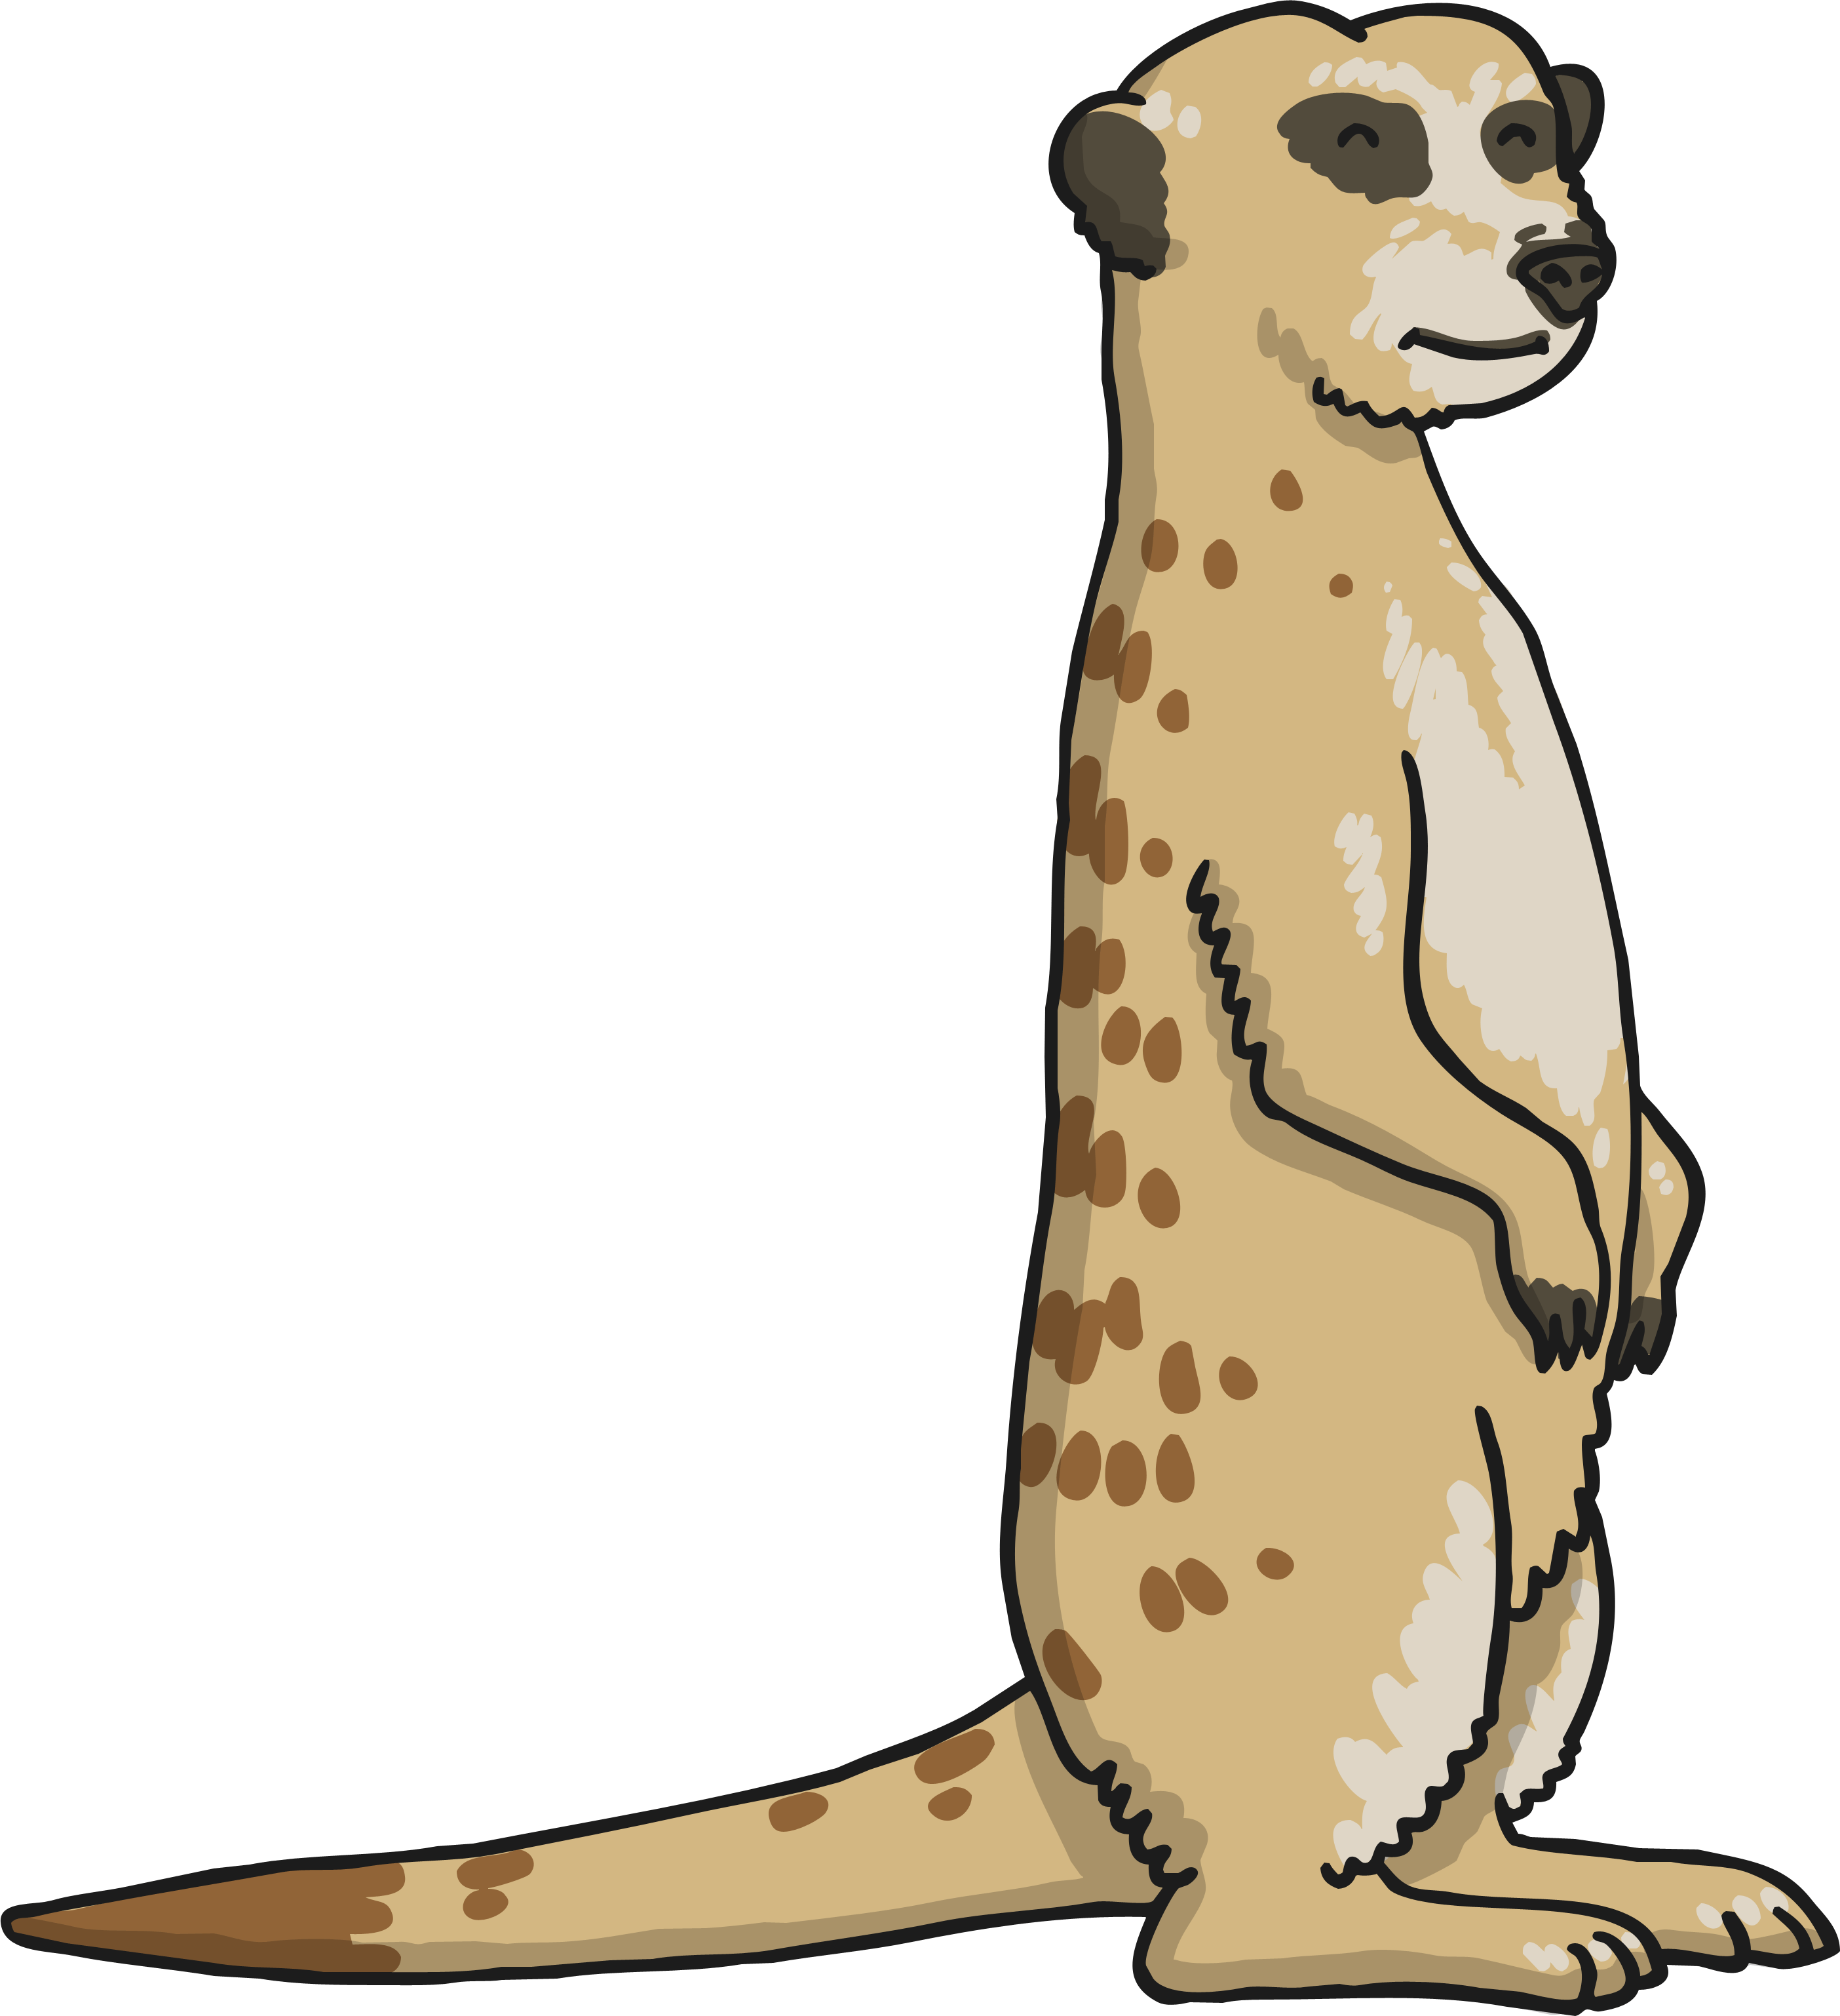
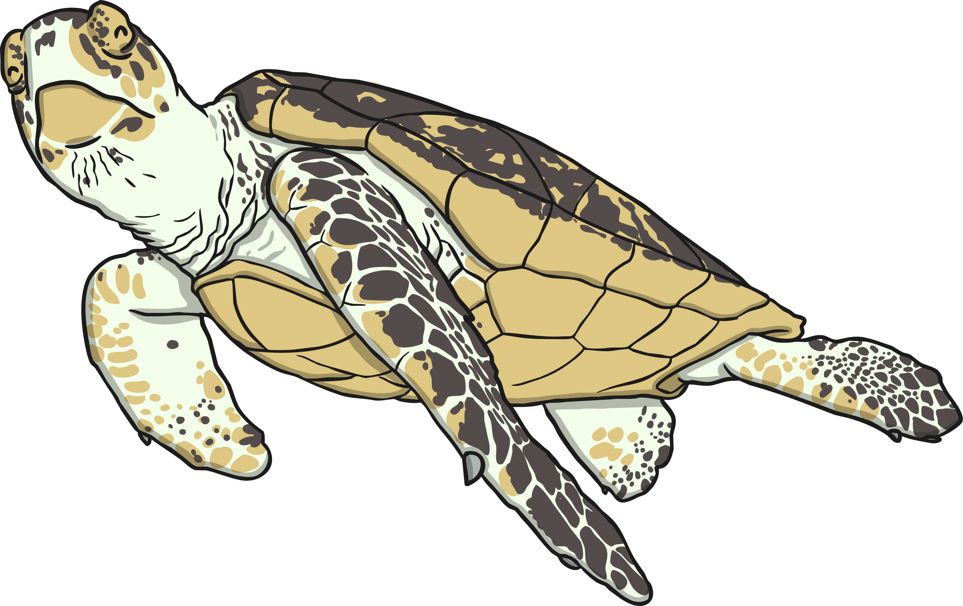
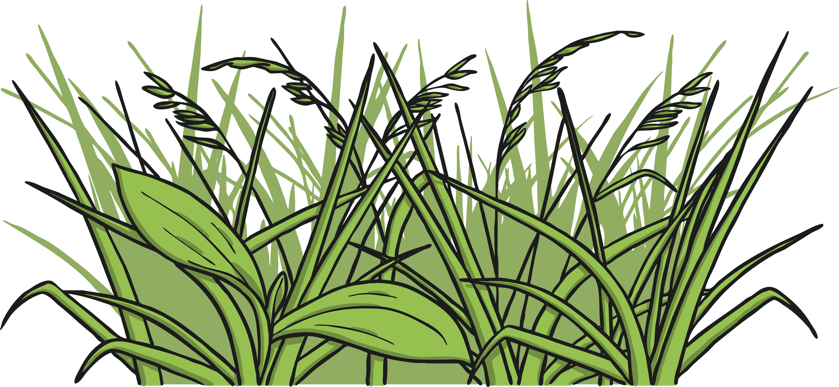
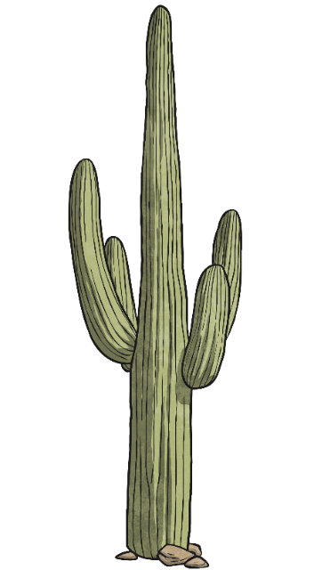
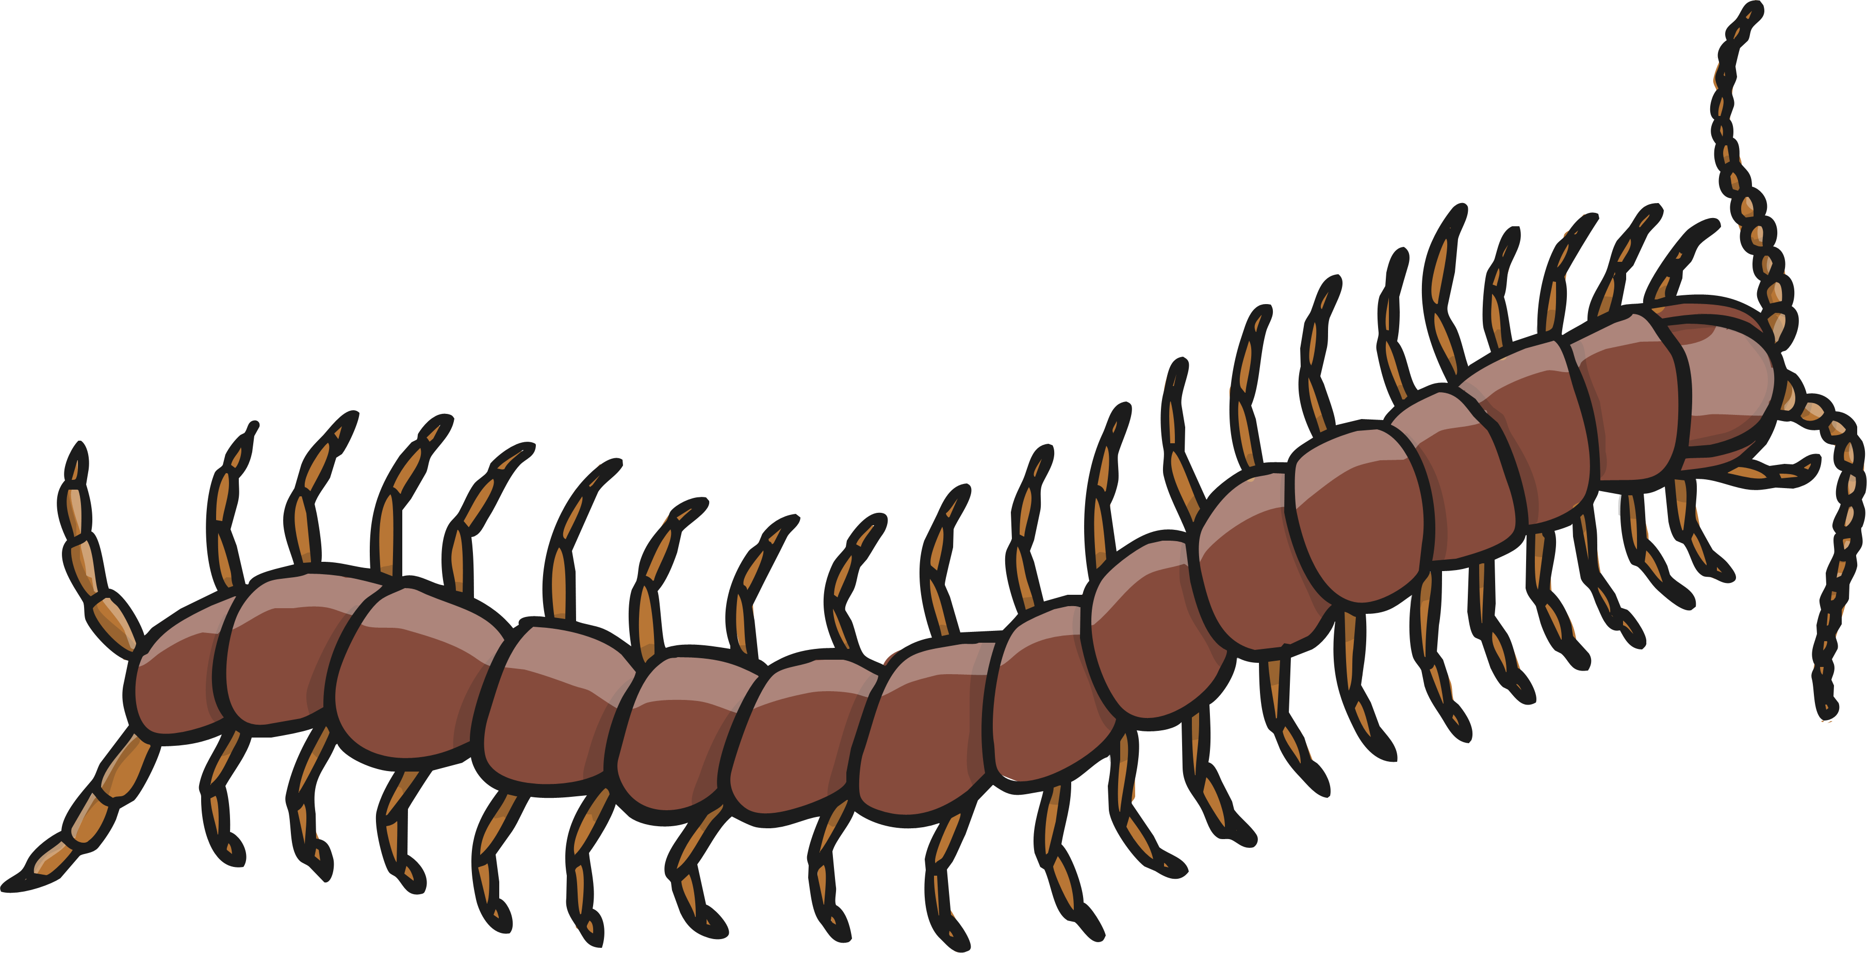
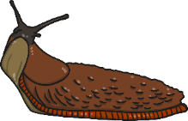
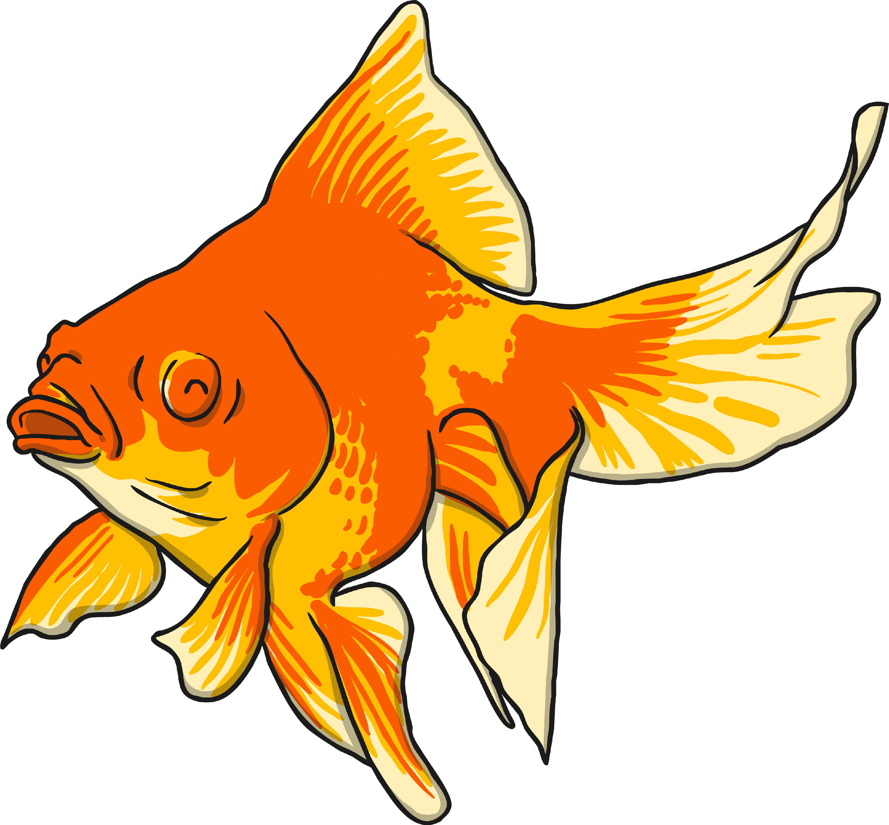
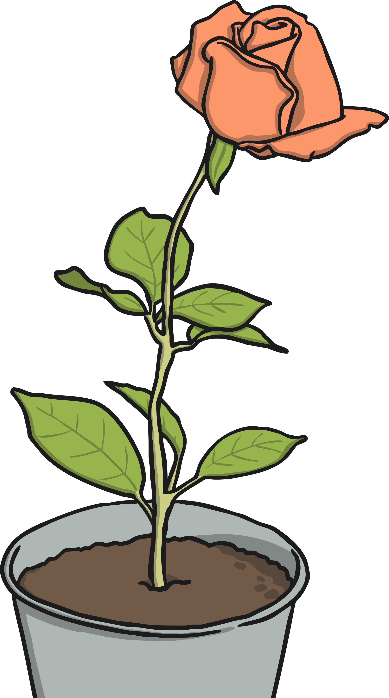
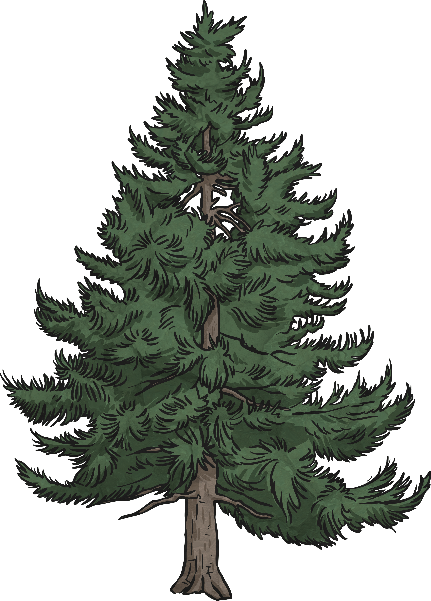
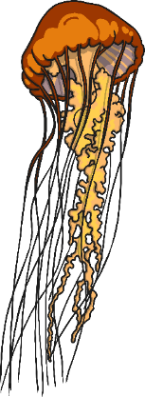
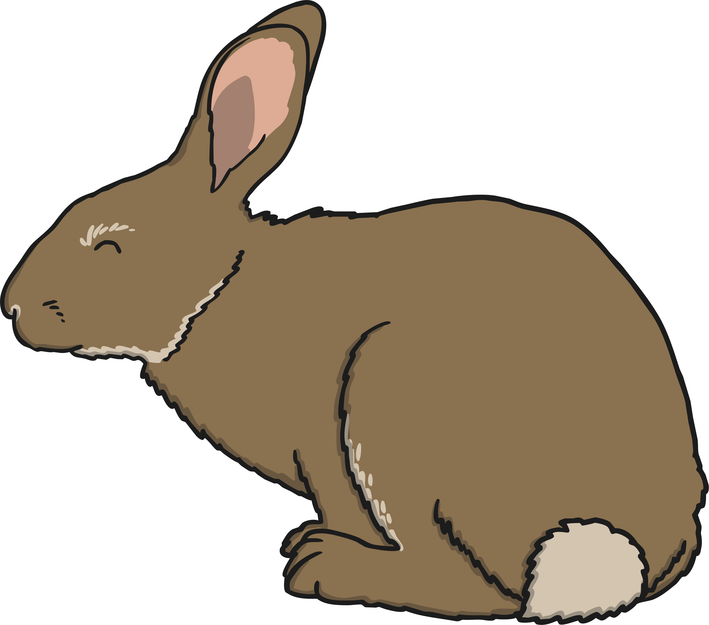
Classification
Plants
Animals
It is easy to sort most of the living things we can see in the world into two groups: plants and animals.
Plants and animals share life processes, but they do them very differently. Can you remember some of the differences between plants and animals?

Slide 9
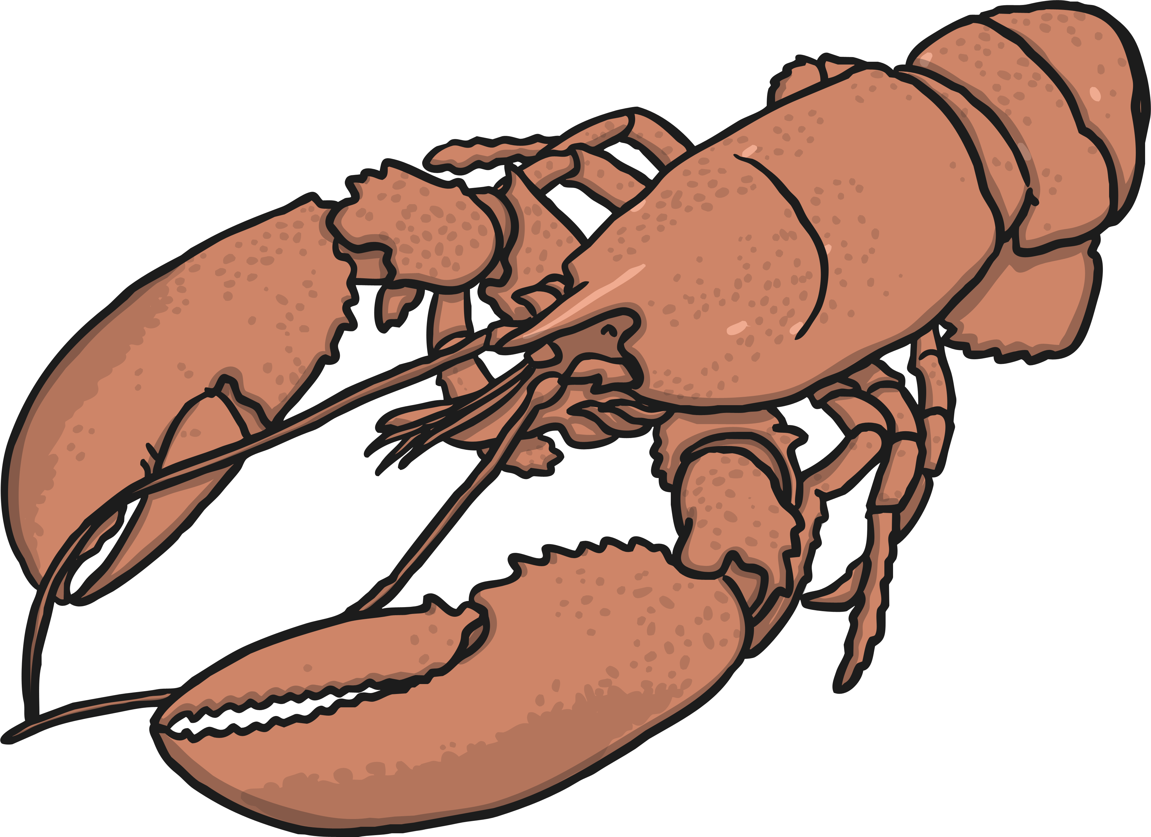
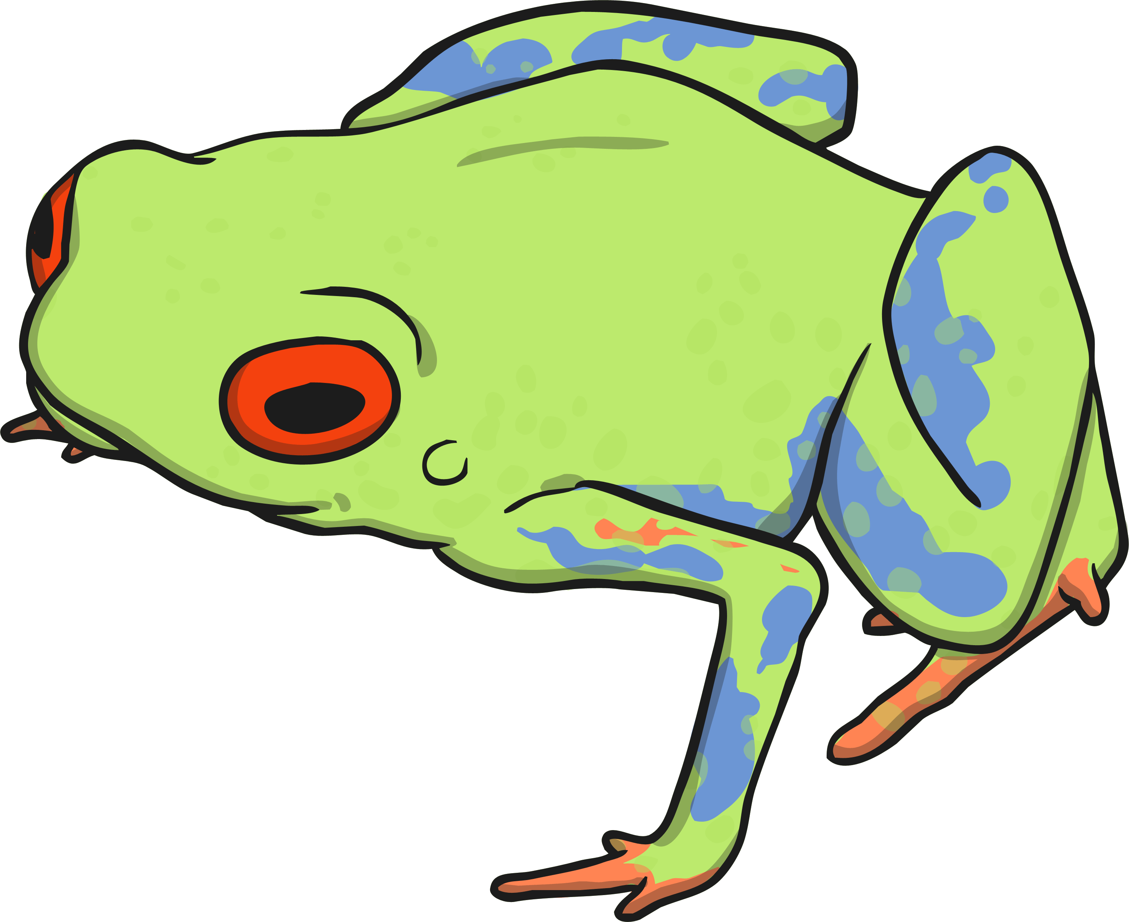
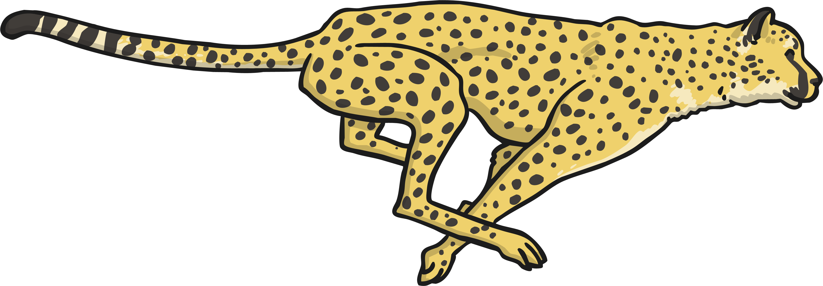
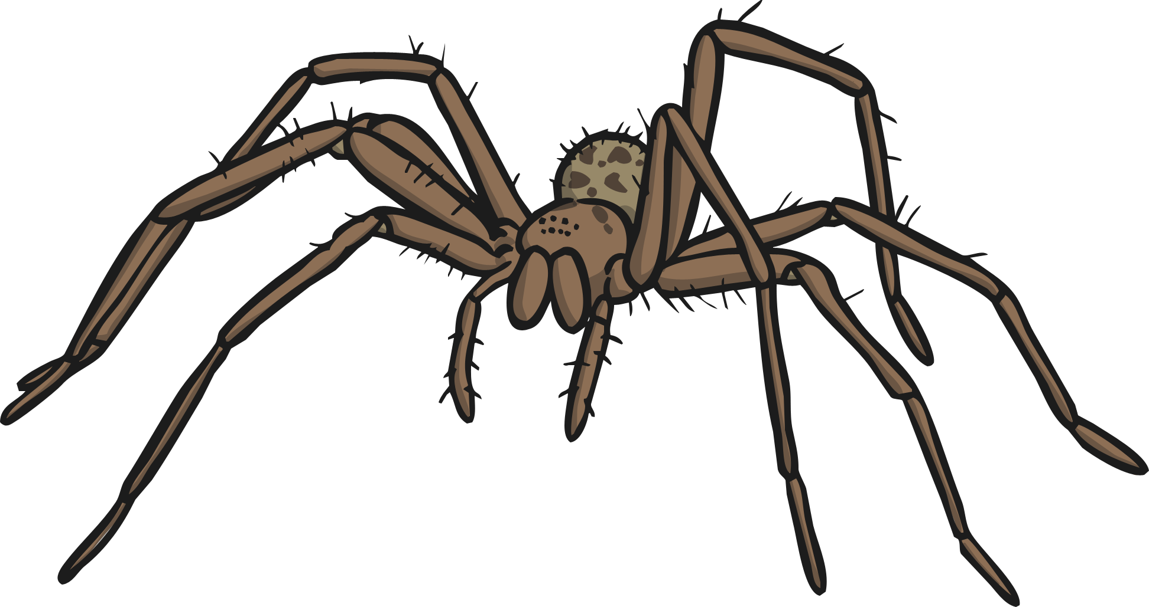
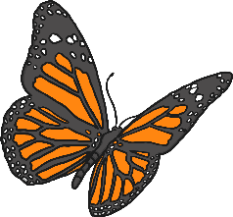
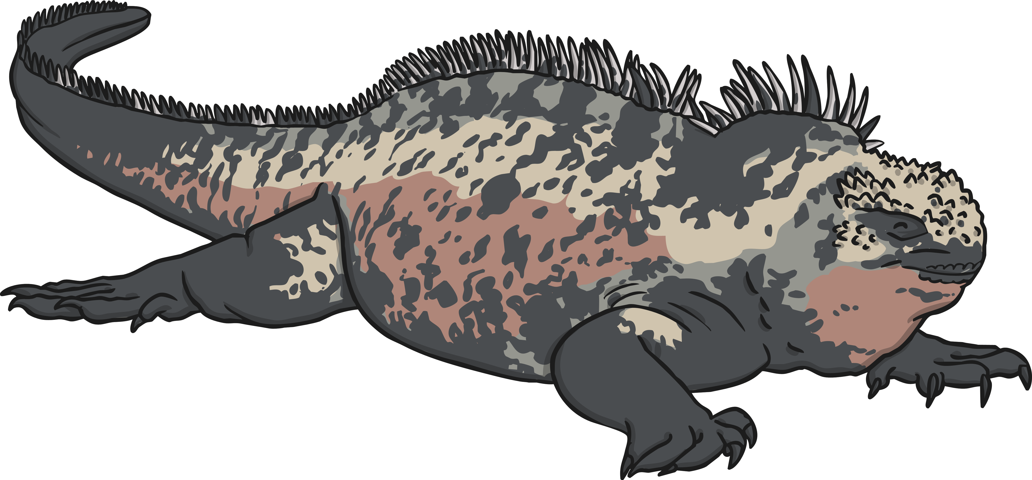
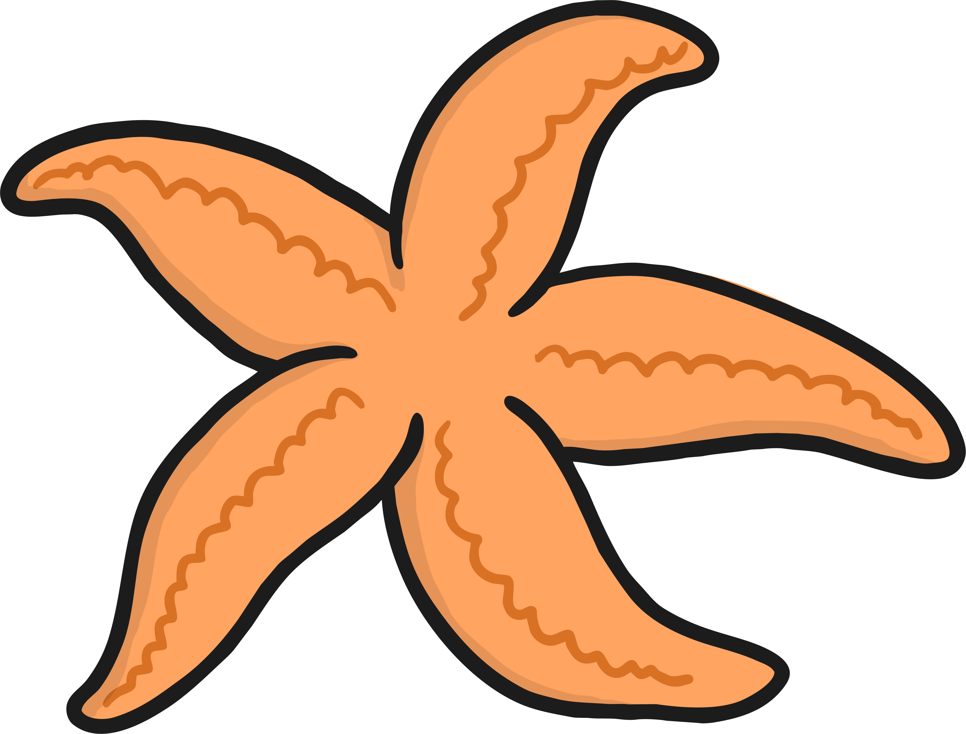
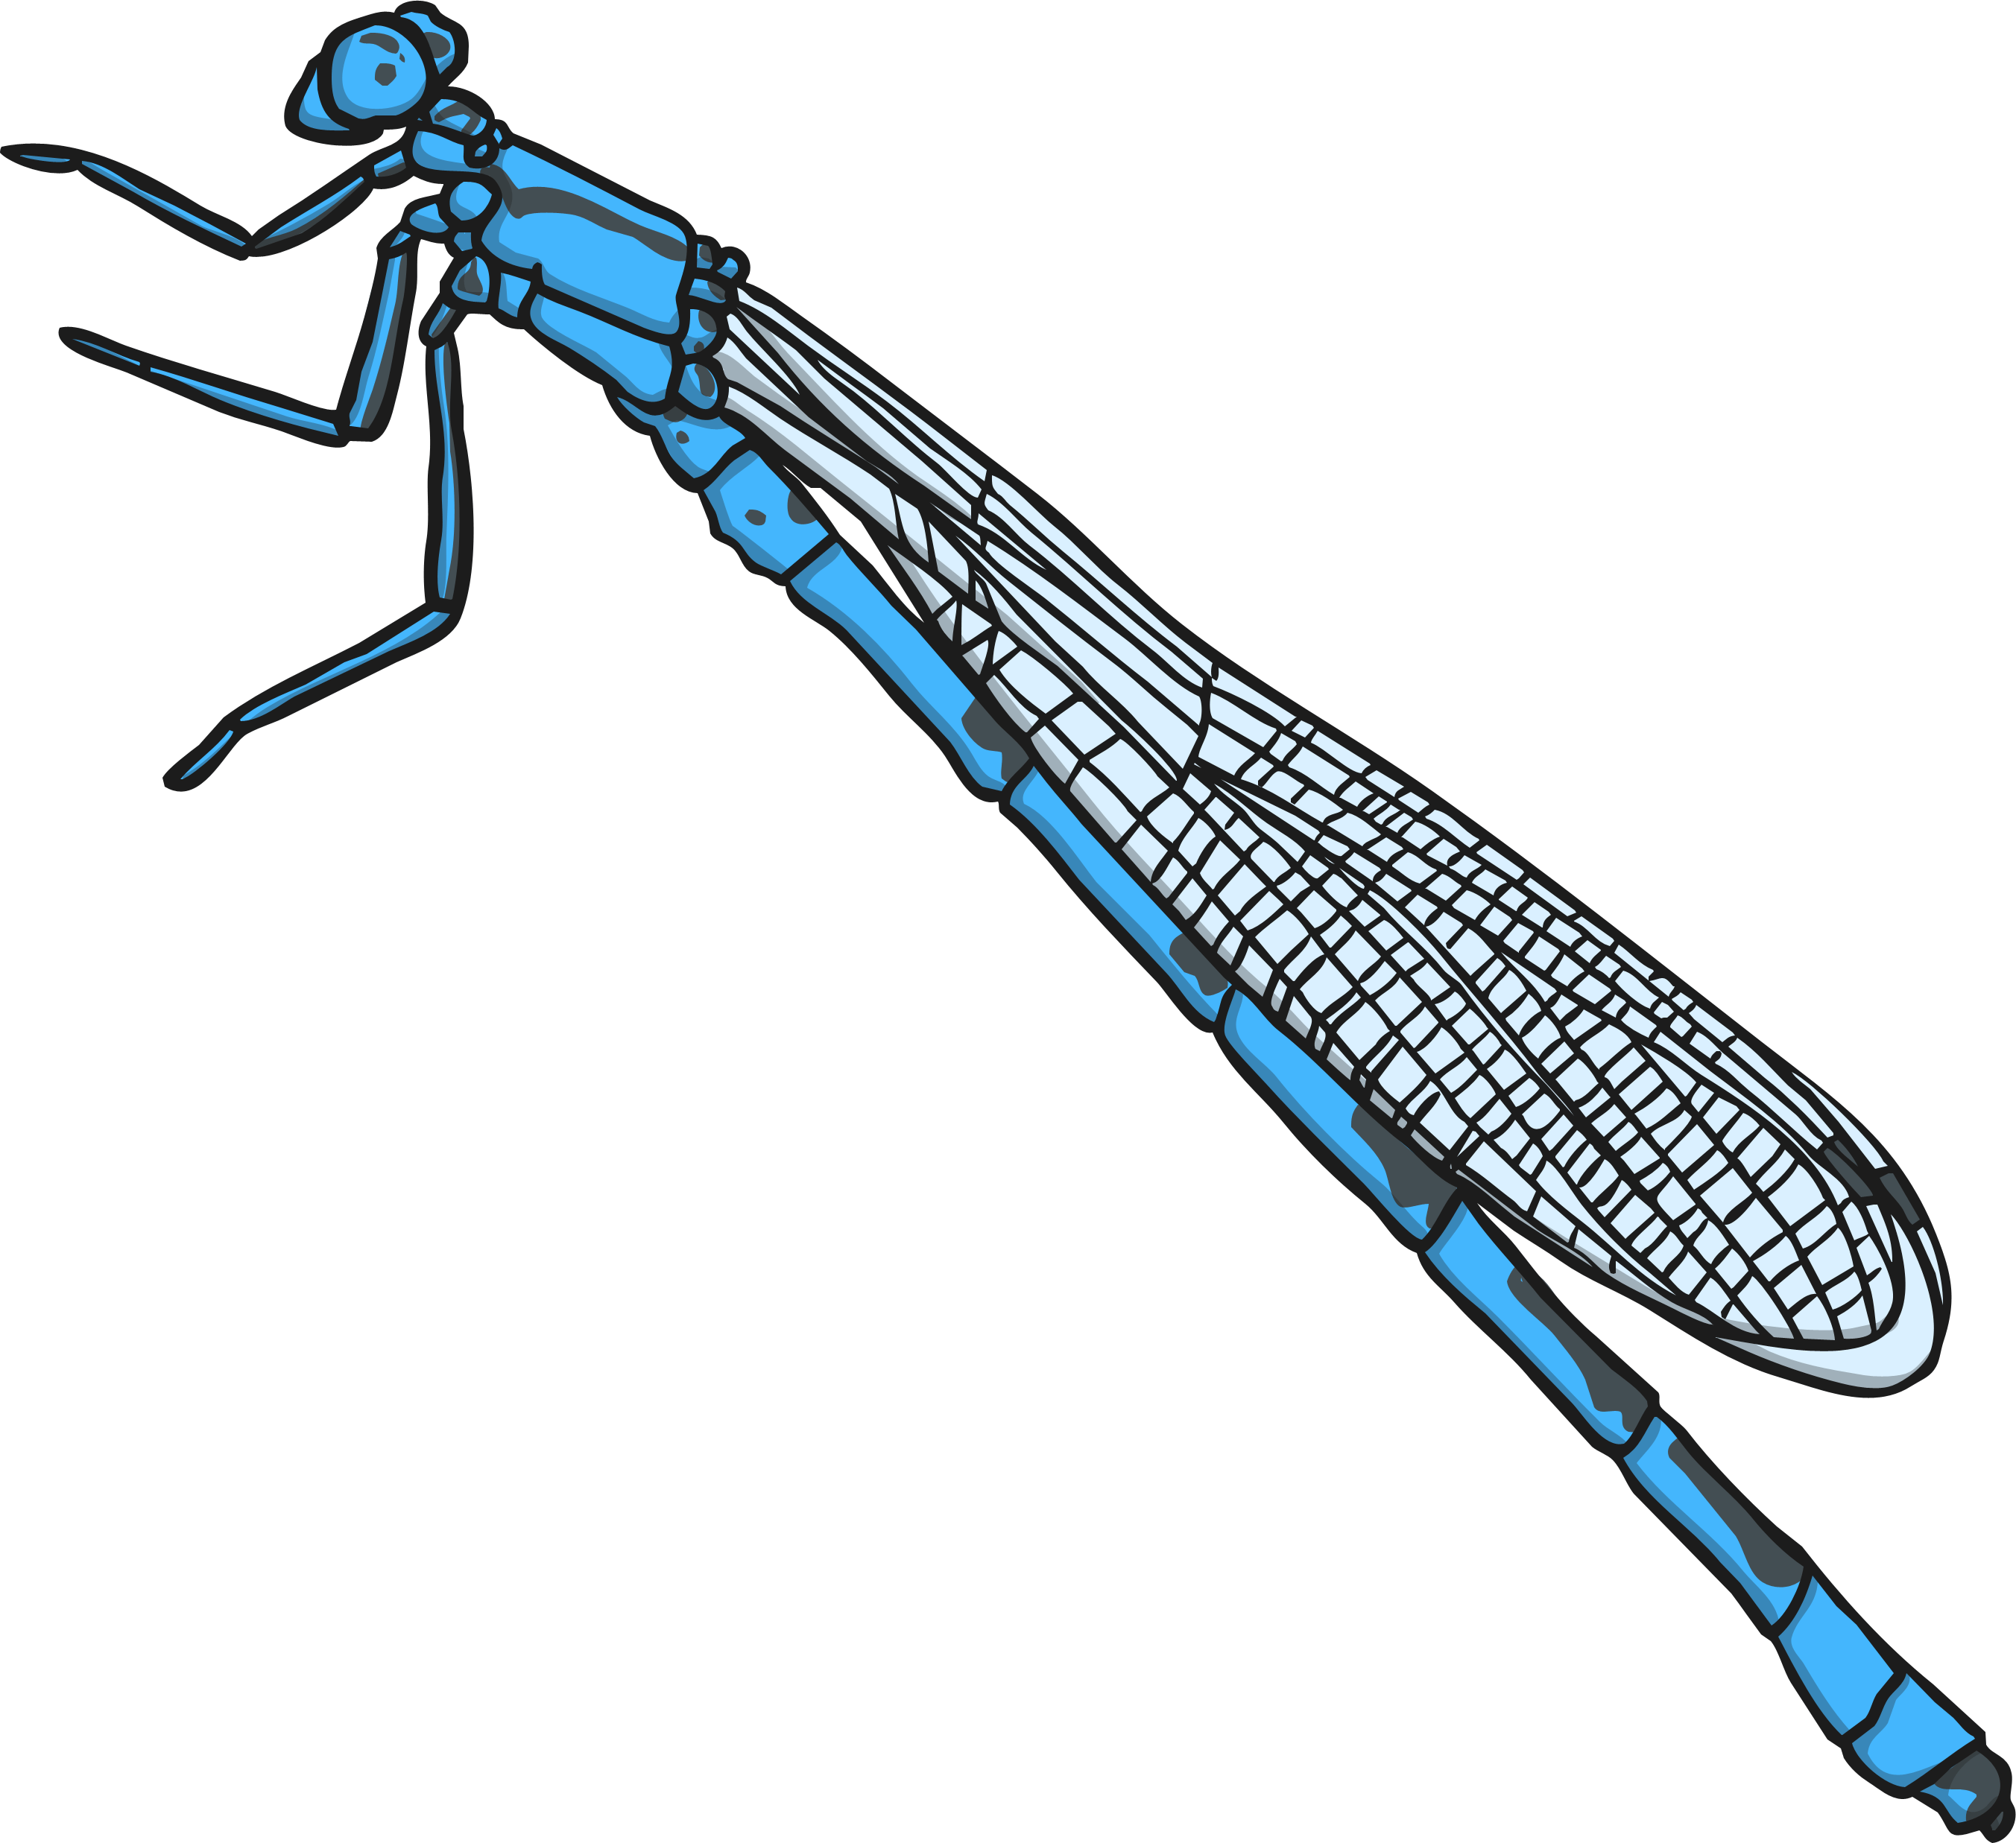
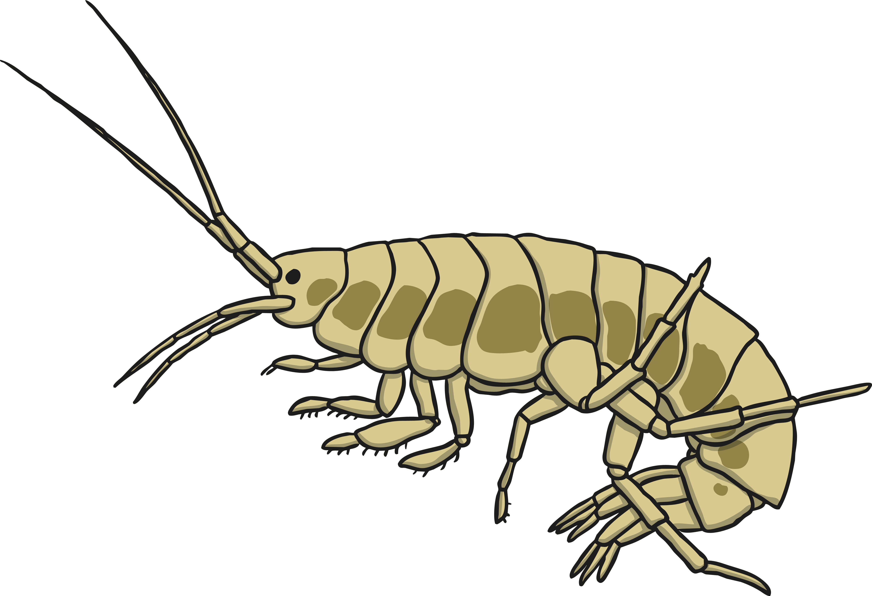
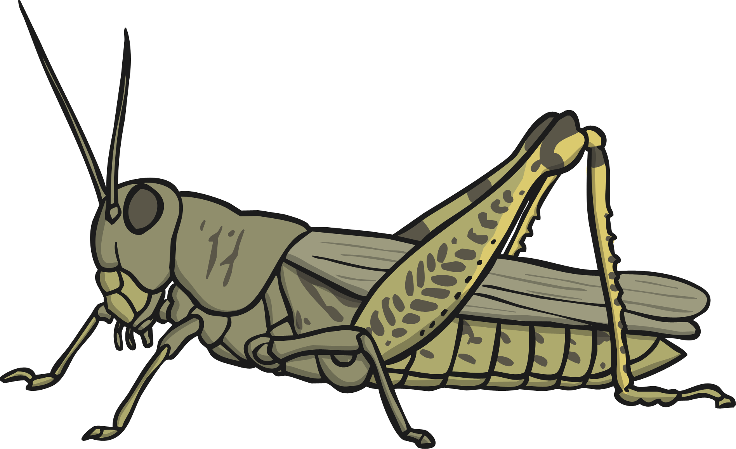
Animal Groups
vertebrates
invertebrates
When looking at animals, scientists usually split them into two groups: vertebrates (animals with a backbone) and invertebrates (animals without a backbone).

Slide 10
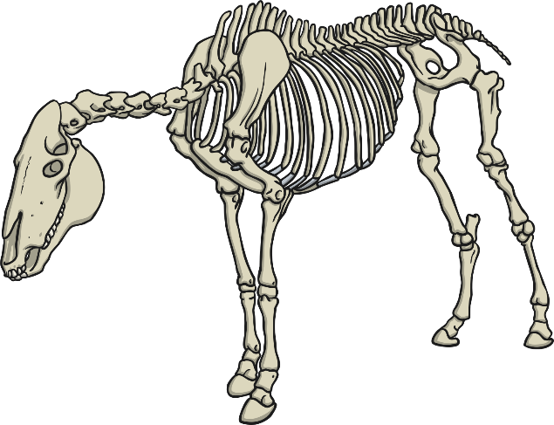
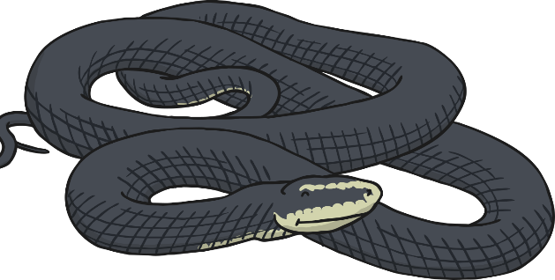
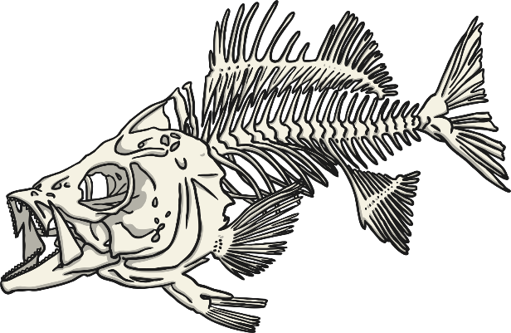
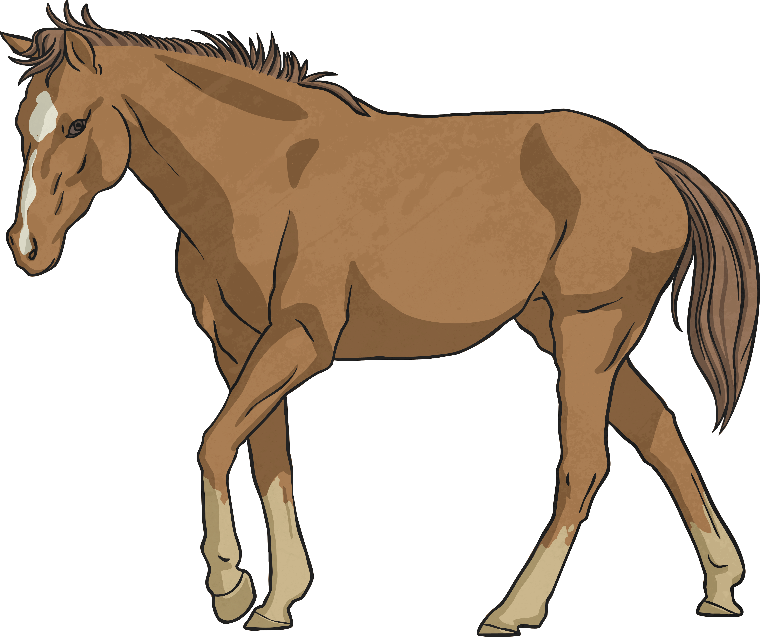
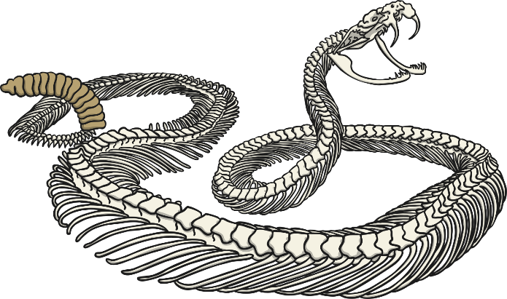
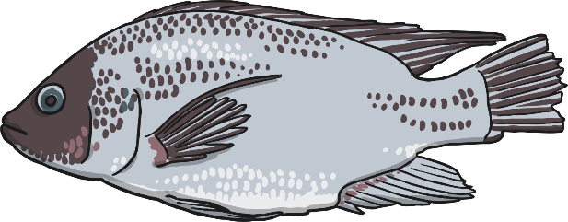
Animal Groups: Vertebrates
Vertebrates are animals with a backbone. They have a hard skeleton made of bone. It holds their body up and gives them shape.

Slide 11
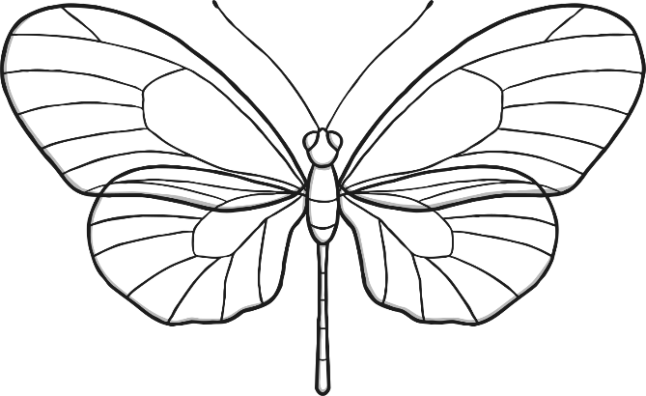
Animal Groups: Invertebrates
Invertebrates do not have a backbone, or a skeleton made of bones. Many have a hard shell outside their bodies to protect them. Others have soft, flexible bodies.

Slide 12
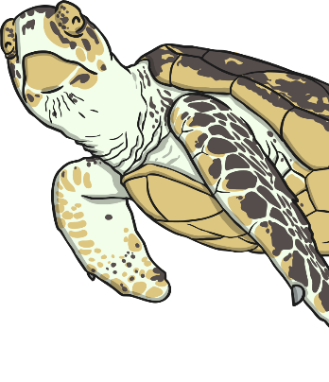
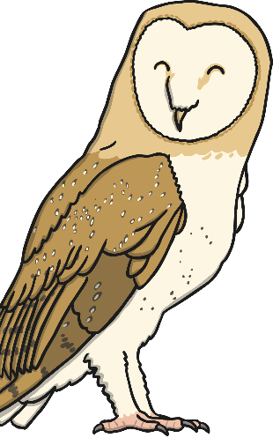
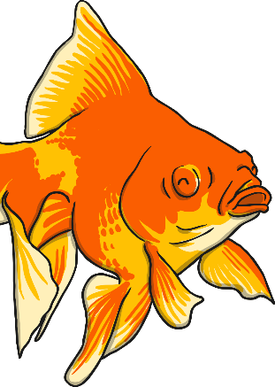
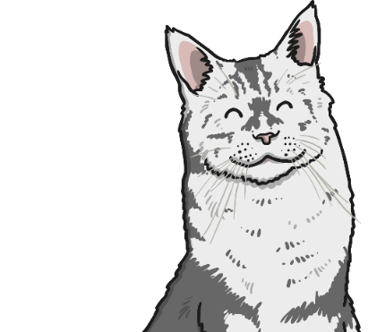
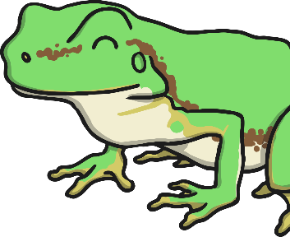
Animal Groups
Vertebrates can be separated into five broad groups:
mammal
fish
reptile
bird
amphibian

Slide 13
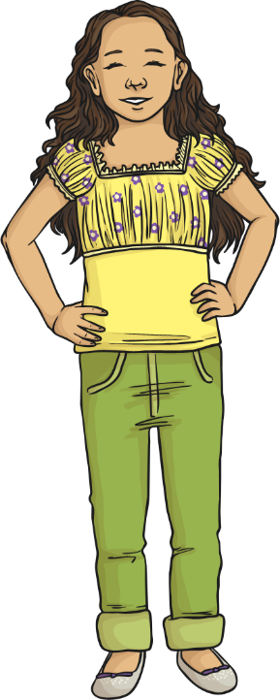
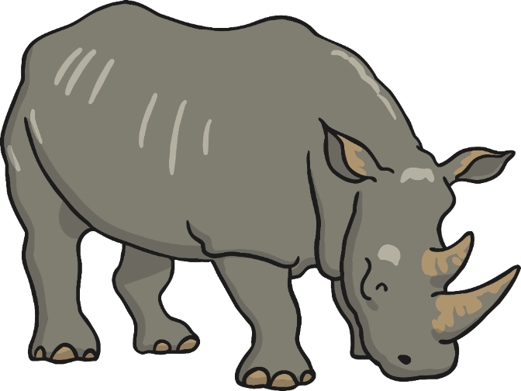
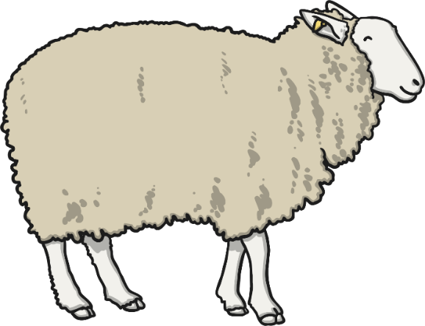
Mammals
Mammals have warm blood, and have hair or fur on their bodies.
Mammal babies are born alive.
The mothers feed their babies milk.
human
rhinoceros
(rhino)
What do animals of this kind have in common?
Can you think of any differences between them?
cat
sheep

Slide 14
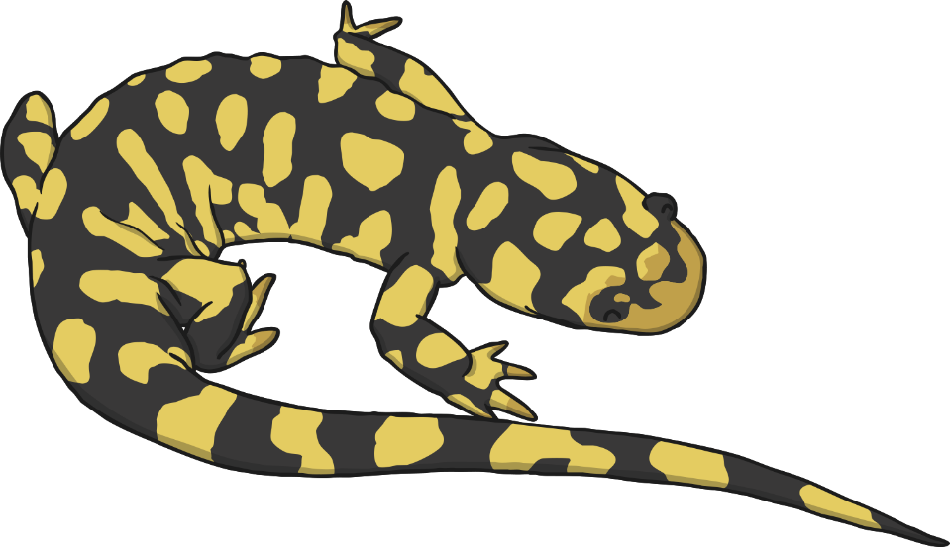
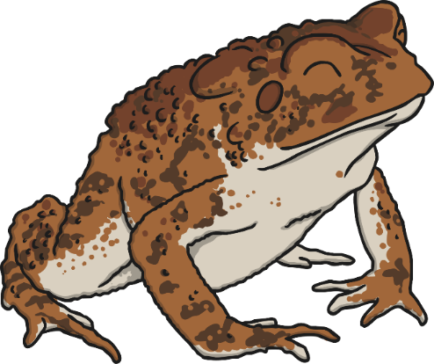
Amphibians
Amphibians live on land and in water.
They are cold-blooded.
They have gills when they are young.
They have smooth skin.
They lay their eggs in water.
salamander
frog
What do animals of this kind have in common?
Can you think of any differences between them?
toad

Slide 15
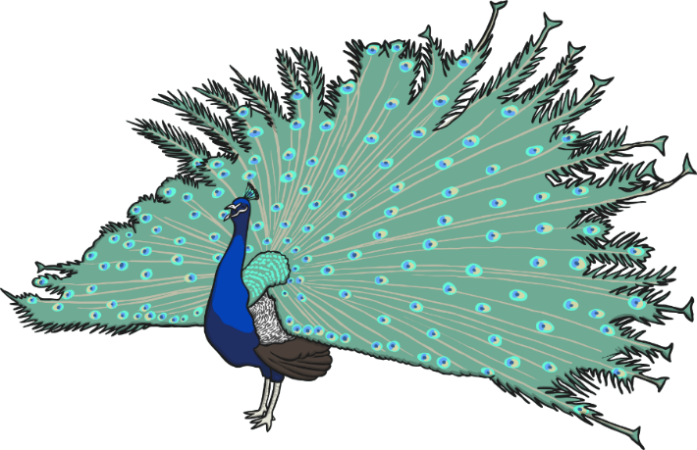
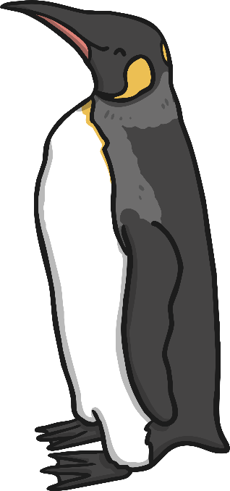
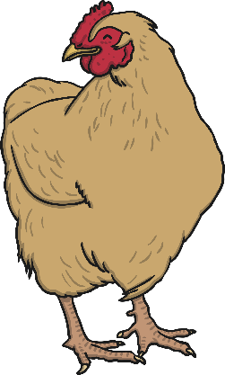
Birds
Birds have a beak, wings, feathers and 2 legs.
They lay eggs on land.
They have warm blood.
peacock
penguin
owl
What do animals of this kind have in common?
Can you think of any differences between them?
chicken

Slide 16
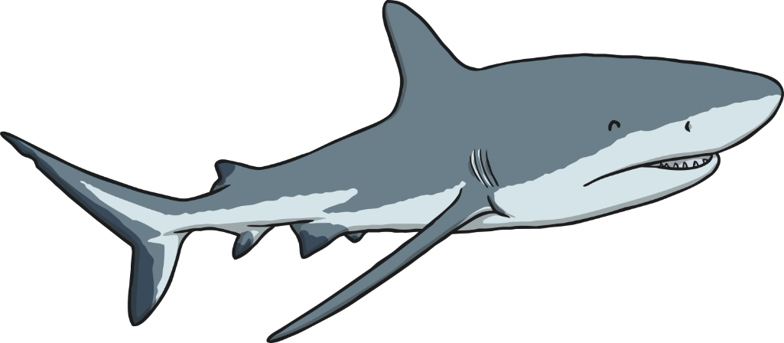
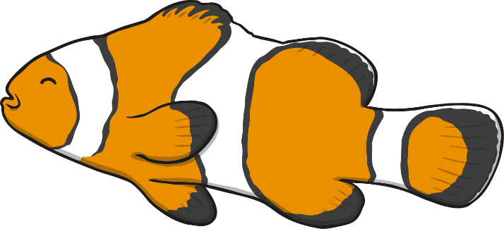
Fish
Fish live in water.
They have fins instead of legs and gills instead of lungs.
They lay their eggs in water.
They have cold blood and scaly skin.
shark
clown fish
What do animals of this kind have in common?
Can you think of any differences between them?
goldfish

Slide 17
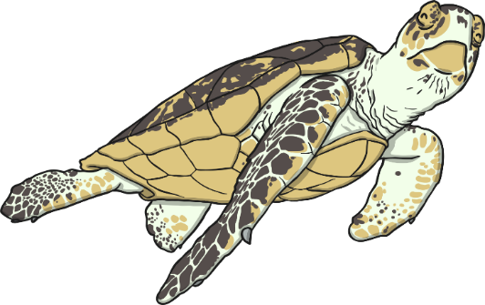
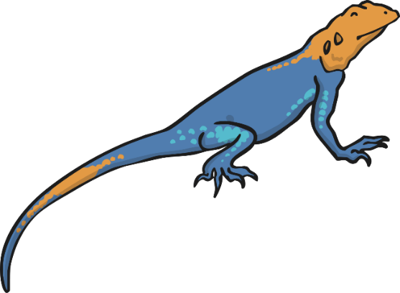
Reptiles
Some reptiles live on land, and some in water. They have lungs that breathe air.
They have scales and are cold-blooded.
They lay their eggs on land.
snake
turtle
lizard
What do animals of this kind have in common?
Can you think of any differences between them?
alligator

Slide 18
I can classify vertebrates Now complete the Vertebrates Activity Sheet

Slide 19
Classification Keys
The activity you have just done uses a kind of classification key.
Classification keys are a way of identifying living things through a series of questions based on their similarities and differences.
For example: ‘Does it lay eggs?’

Slide 20
Classification Keys
Each question has a yes or no answer and leads you one step closer to the name of a living thing.
Does it lay eggs?
Yes
No
Can it fly?
mammal
Yes
No
bird
amphibian

Slide 21
Classification Keys
The questions start out very general at the beginning of the key as they help you sort the animals into broad groups.
Does it lay eggs?
Yes
No
bird
mammal
Does it have a long, thin beak?
Yes
No

Slide 22
Now complete the Key Questions Sheet
Have a go at making up your own questions for a classification key.

Slide 23
Twenty Questions
Split into two teams or you can play this game with your mum, dad or older brother or sister. Choose a volunteer from the first team.
The volunteer chooses an animal.
The other team can ask the volunteer up to twenty questions about the animal but the volunteer can only answer with a ‘yes or no’.
If the other team are able to guess the animal within 20 questions, they win a point.
If they can’t, the volunteer’s team wins a point.
Next, the other team chooses a volunteer.
The team with the most points after three rounds wins.

Slide 24
Aim
I can generate questions to use in a classification key.
I can identify vertebrates by observing their similarities and differences.
Success Criteria
I can generate questions about animals.
I can use questions to sort animals in a key.
I can see similarities and differences between vertebrates.
I can use these to identify vertebrate groups.

