Slide 1
What did THE ROMANS do for us?

Slide 2
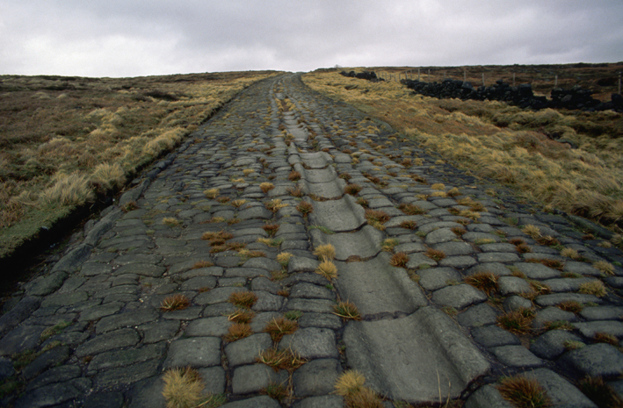
Lesson 6

Slide 3
I can explain the impact Romans had on Britain
Any ideas?

Slide 4
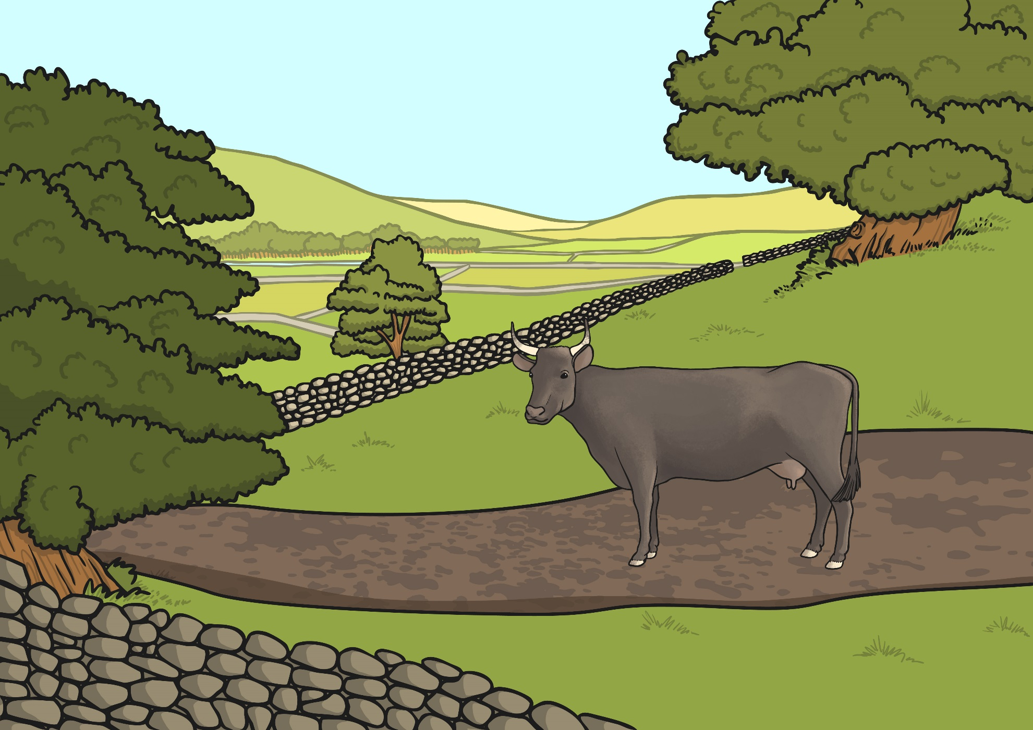
Before the Roman Roads
Before the Romans arrived, Britain had no proper roads. The Celts rode horses, walked and travelled in carts pulled by oxen along paths and tracks. These paths and tracks connected local farms and hamlets, and there were some longer routes for trade. These tracks were often in very poor condition.
If the Romans had not built the roads, how do you think this would change our lives today?
Why do you think the Romans wanted to build new roads?
Can you think of 3 possible reasons?

Slide 5
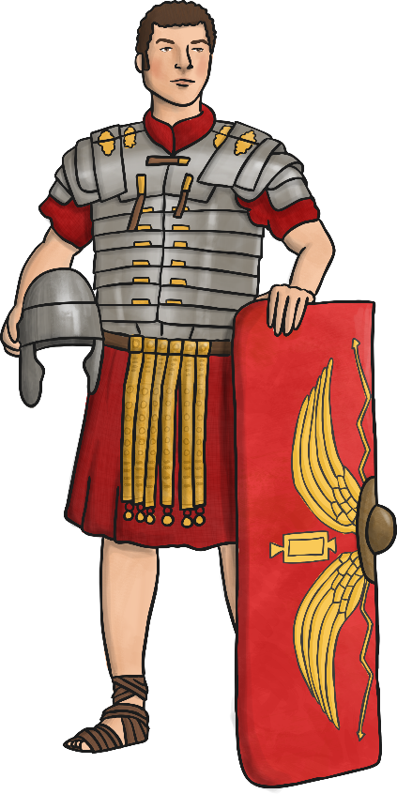
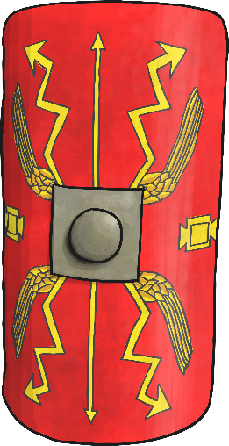
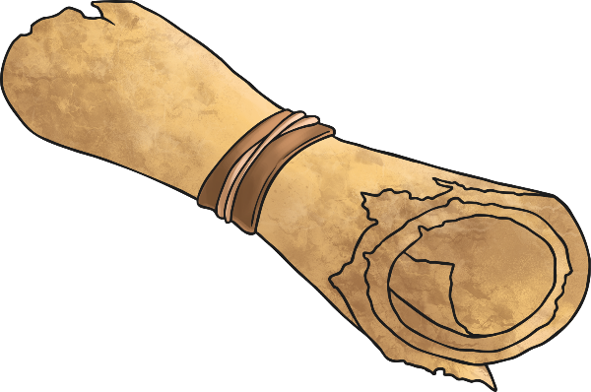
Roman Roads Why did the Romans want better roads?
Did you think of any of these reasons?
Troops could be quickly moved from one place to another.
Supplies could be sent to different areas of the country.
Better links between places was good for trading.
The Emperor had more control if messages could be sent quickly.

Slide 6
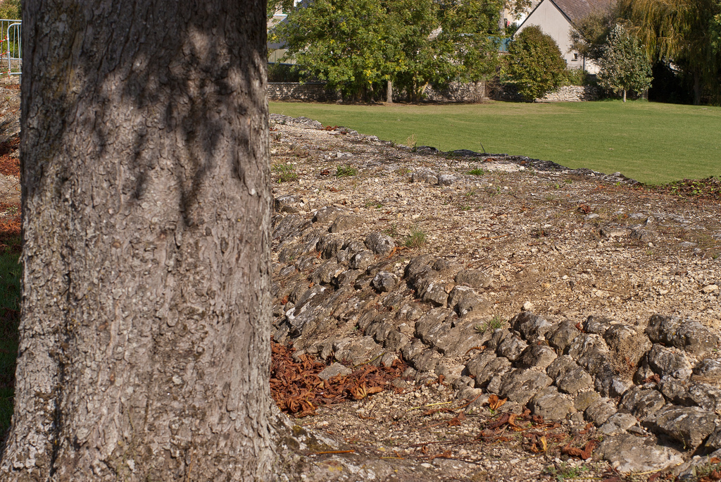
Roman Roads
The Romans were famous for their long, straight roads. You can still see some Roman roads today, two thousand years after they were built.

Slide 7
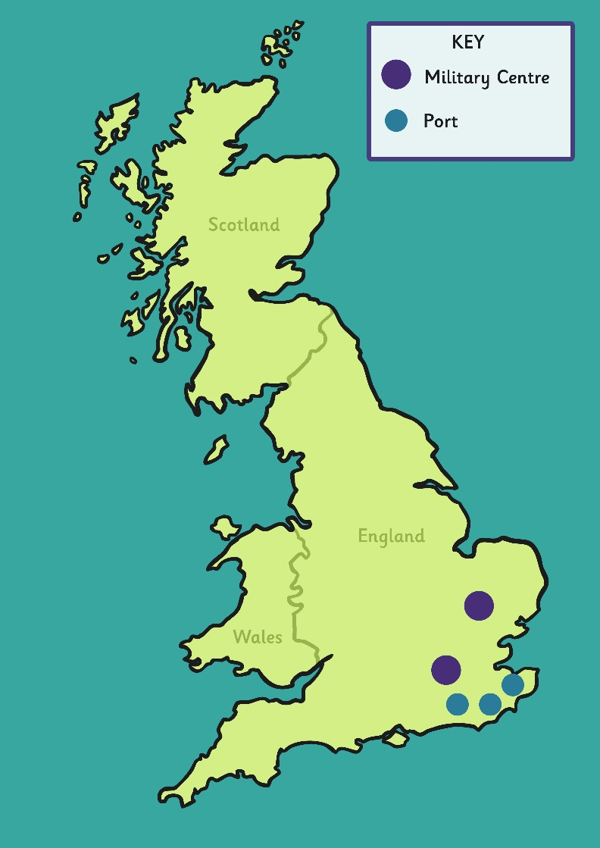
The First Roman Roads
Military centres were places that the Roman armies would have live whilst they weren't in battle.
What are ports?
Why was it important for the Romans to link the military centres to the ports?
The first roads linked ports with military centres.
Colchester
Use maps (an atlas or Google maps) to locate the places.
London
Richborough
Dover
Lympne

Slide 8
I can explain the impact Romans had on Britain
Let’s watch.
https://www.bbc.co.uk/education/clips/zdgrkqt

Slide 9
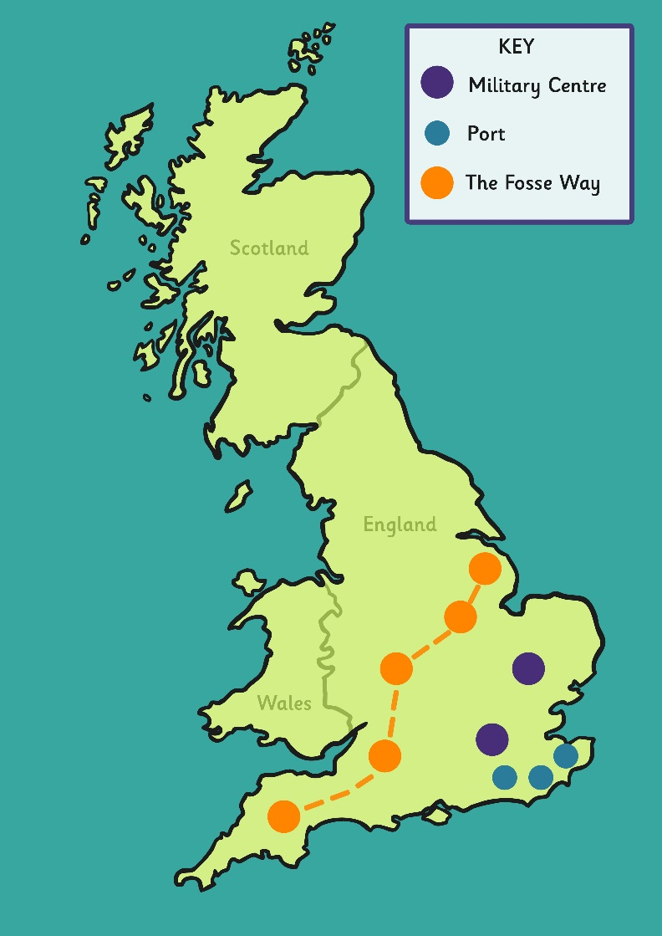
The First Roman Roads
The Fosse Way was the first great Roman road in Britain. It ran from Exeter to Lincoln, passing through Bath, Gloucester and Leicester.
Can you find The Fosse Way on your map?
The first roads linked ports with military centres.
Lincoln
Leicester
Colchester
Gloucester
Richborough
Bath
Dover
Exeter
London
Lympne

Slide 10
More Roman Roads
Over the years, the Romans continued to build more roads, linking to many places throughout Britain.
Eventually around 2,000 miles of Roman roads had been built.
The first roads linked ports with military centres.
York
Lincoln
Carlisle
Leicester
Chester
Colchester
Other Routes
Chester to York
London to Lincoln to York
Chester to Carlisle
Gloucester
Richborough
Bath
Dover
Exeter
London
Lympne

Slide 11
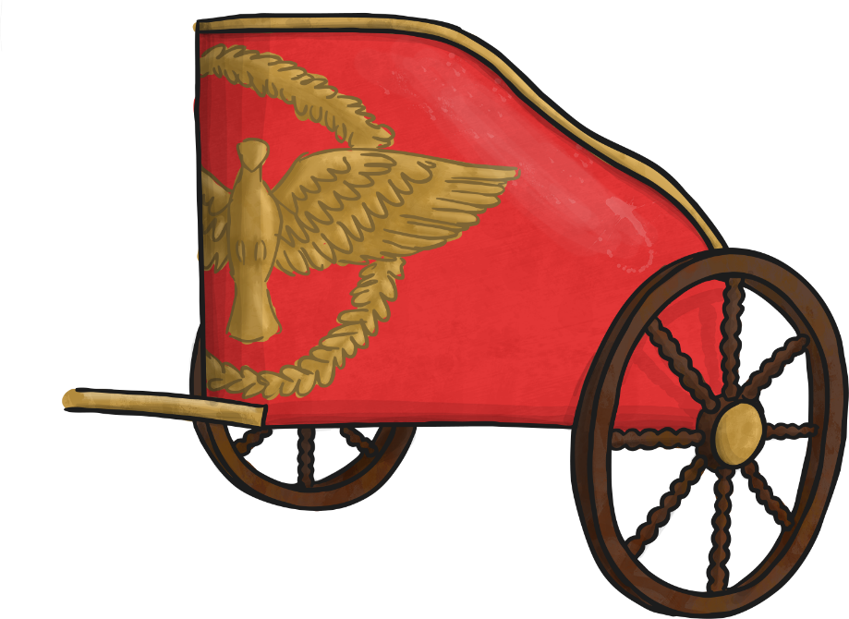
I can explain the impact Romans had on Britain
Mapping Roman Roads
Activity
Use an atlas to locate the start and finish points of the Romans roads on your sheet.
Mark and label the places on your map and then draw and label the road.
Use a different colour for each road.

Slide 12
Plenary- let’s watch
https://www.bbc.co.uk/education/clips/z3kkd2p
https://www.bbc.co.uk/education/clips/zq49wmn

Slide 13
So what did THE ROMANS do for us?

