Slide 1
Lesson 7
I can understand the Concluding Rite

Slide 2
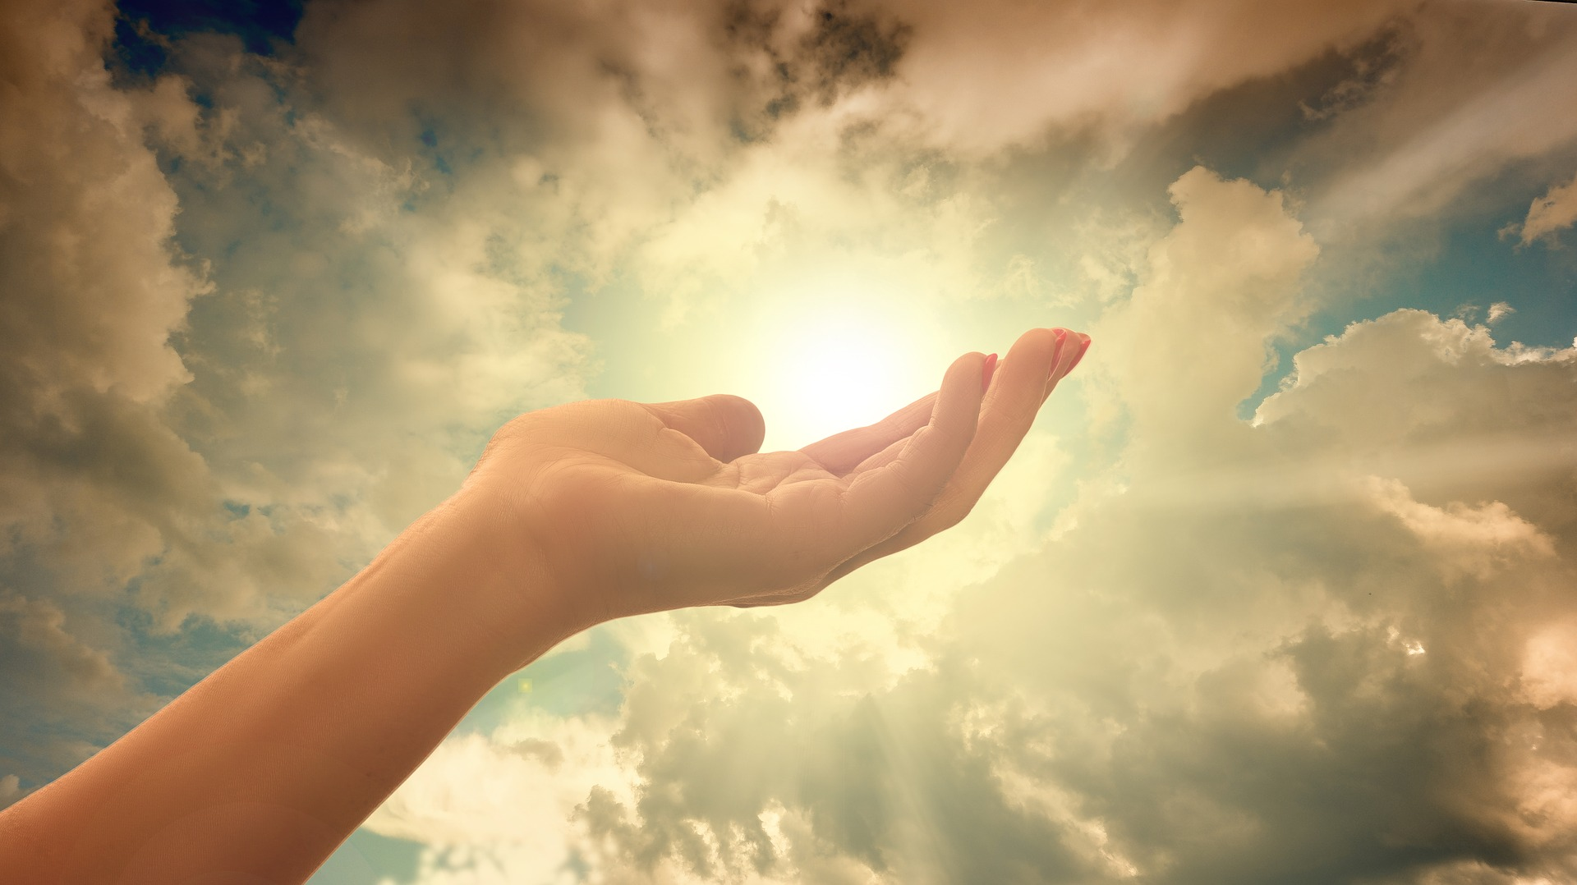
Christian Meditation

Slide 3
Opening Prayer
Jesus open our ears to hear your voice
Open our eyes to see your face
Open our mouths to speak your words
Open our hearts to your love
Open our hearts to your love

Slide 5
Blessing Song
We call on you O God
and on Jesus Christ your Son
through the power of the Spirit
that makes us truly one.
We ask you to bless us
and lead us in your ways
as you guide us on our journey
everyday.

Slide 6
Before we move on, write a brief reflection on our meditation time today.
How did it make you feel?
What did you get out of it?

Slide 7
The Concluding Rite
If there are any announcements about parish life they are made now.
The priest prays a final blessing. Then he says,
“Go in the peace of Christ”
“The Mass is ended, go in peace”
“Go in peace to love and serve the Lord.”
It is a reminder that everyone is called to live the communion they have celebrated every day and in every place.
Everyone responds,
“Thanks be to God.”

Slide 8
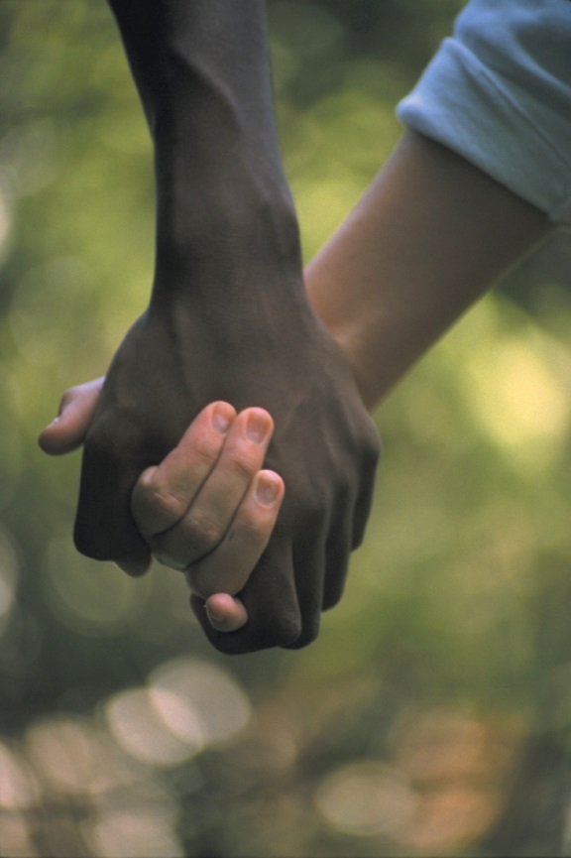
Something to think about at the end of Mass
Be Real About Loving
Pray regularly.
Share what you have with people in need.
Always make people feel welcome
Dear Friends
We all have been given lovely gifts.
When you give, give with a loving heart.
If you have a job to do, do it really well.
If you are helping someone, do it happily.
Be real in your love for each other.
Do not just pretend to be good.
Love and care for each other
as good brothers and sisters.
Be whole-hearted and enthusiastic in all you do.
Be joyful.
When things get hard, keep on going.
Based on Romans 12: 8-11

Slide 9
The Concluding Rite
What happens during the Concluding Rite?
Which Sending Forth do you like best and why?
What does it mean to ‘glorify the Lord by your life’?
What does it mean to ‘give with a loving heart’?
What did you like best in Paul’s letter to the Christians living in Rome and why?
What would you find difficult?
What would our home, school or community be like if everyone followed Paul’s words?

Slide 10
I can understand the Concluding Rite
In your Book, write about the concluding rite:
How does the Mass end?
What do the parishioners say at the end of the Mass?
Use Mass cards to support your writing and write in detail.

