Slide 1
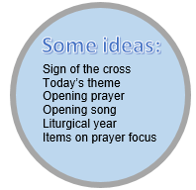
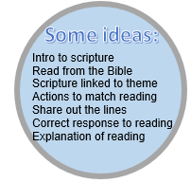
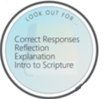
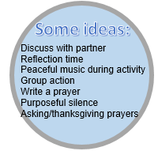
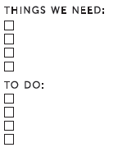
OUR TARGET LAST TIME WAS:

Slide 2
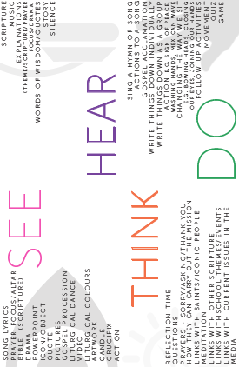
Must:
Sign of cross
Introduce theme of today’s liturgy
Should:
Begin with opening prayer
Song/hymn linking to theme
Make reference to time of liturgical year (e.g Lent) and explain items on prayer focus
Could:
Group action (sign of peace, make cross on head etc)
Image for pupils to think about/focus on (printed or on screen)
Must:
Use correct intro to scripture
Choose scripture that links to the theme
Use correct response to scripture
Should:
Read directly from the Bible (if appropriate)
Provide an explanation of what the scripture means/is teaching us
Could:
Split the reading up between children
Have actions to go with the scripture
Call and repeat (short scripture)
OUR TARGET LAST TIME WAS:
Liturgical colour material
Candle
Crucifix
Bible open at scripture
Item linking to theme
Pictures/words by children
Must:
Reflect on the reading
Should:
Activity to consolidate what we have heard (paper chain, write a prayer on template, wordsearch etc)
Use calming music to create prayerful atmosphere
Group action (e.g sign of peace)
Could:
Make use of purposeful silence
Use partner talk for discussion
Ask a question around the room and take responses/place written responses around prayer focus
Asking/ thanksgiving prayers linking to theme (correct responses)
Think about seating
Dim lights
Select music
Prepare felt tips/paper
Ask teacher to print templates (e.g leaf, gift)
Must:
Have a mission linking to theme
End with the sign of the cross
Should:
End with a closing prayer linking to theme
Make the mission tangible (give them something to remind them of their mission)
Have a closing song linking to theme
Could:
Get the children to write individual missions
Have a follow-up activity available on prayer area/take home

