Slide 3
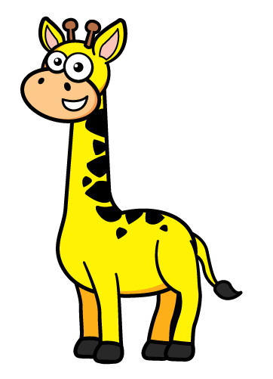
These words help us compare heights:
short
tall
height
same
shorter
tallest
shortest
taller

Slide 4
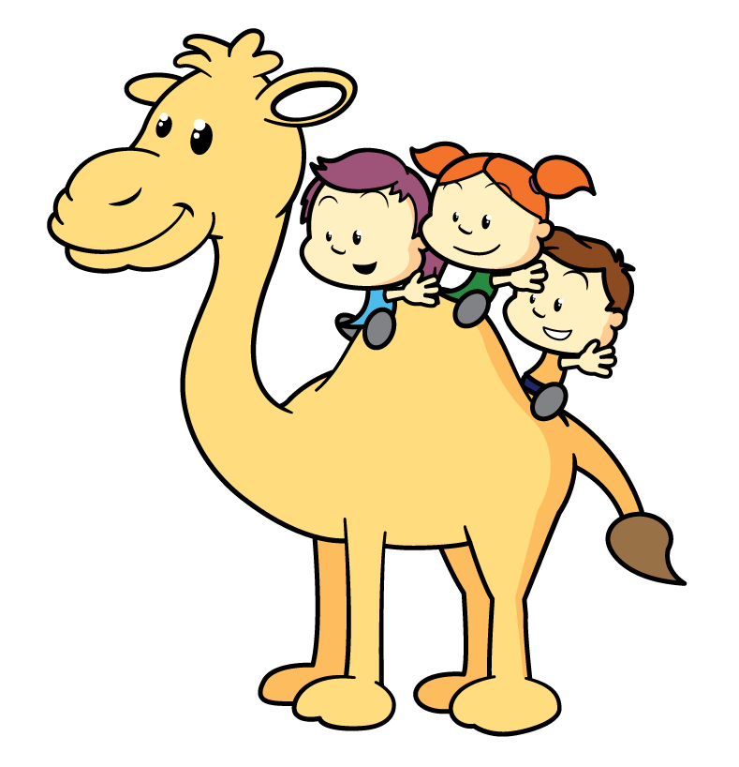
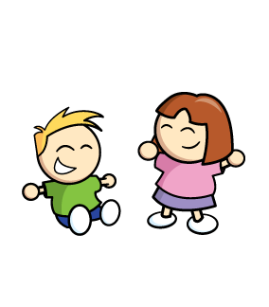
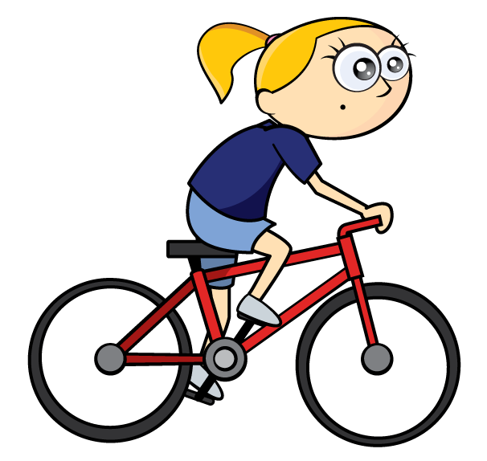
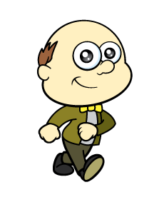
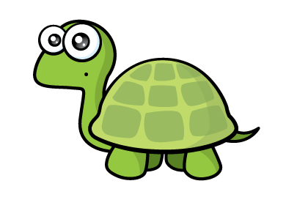
Who is tallest?
I can see who is tallest!
Remember to stand up straight.

Slide 5
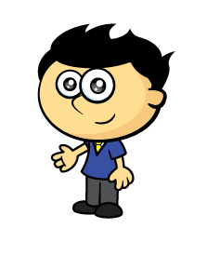
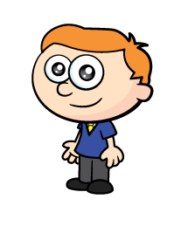
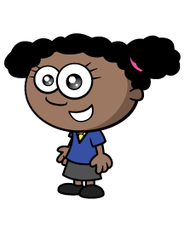
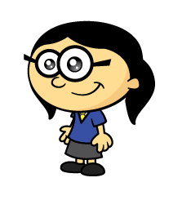
Who is the tallest?
Have a think
How can we compare?
Remember to stand up side by side.

Slide 6
Who is the shortest?
Have a think
How can we compare?
Remember to stand up side by side.

Slide 7
Have a think
How tall are you?
Can you find someone taller?
Can you find someone shorter?

Slide 8
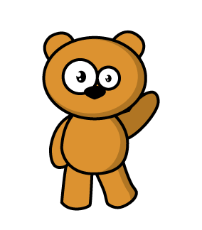
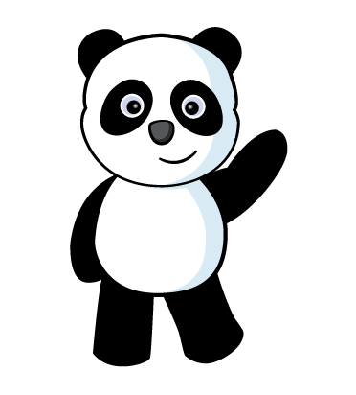
Have a think
Let’s compare!
I can see they are the SAME height.
Panda is shorter than
the brown bear.

Slide 9
Can you find 3 things shorter than you?

Slide 10
Can you find 3 things taller than you?

Slide 11
Can you find 3 things the same height as you?

