Slide 3
These words help us
compare lengths.
short
length
same
long
shortest
longer
shorter
longest

Slide 4
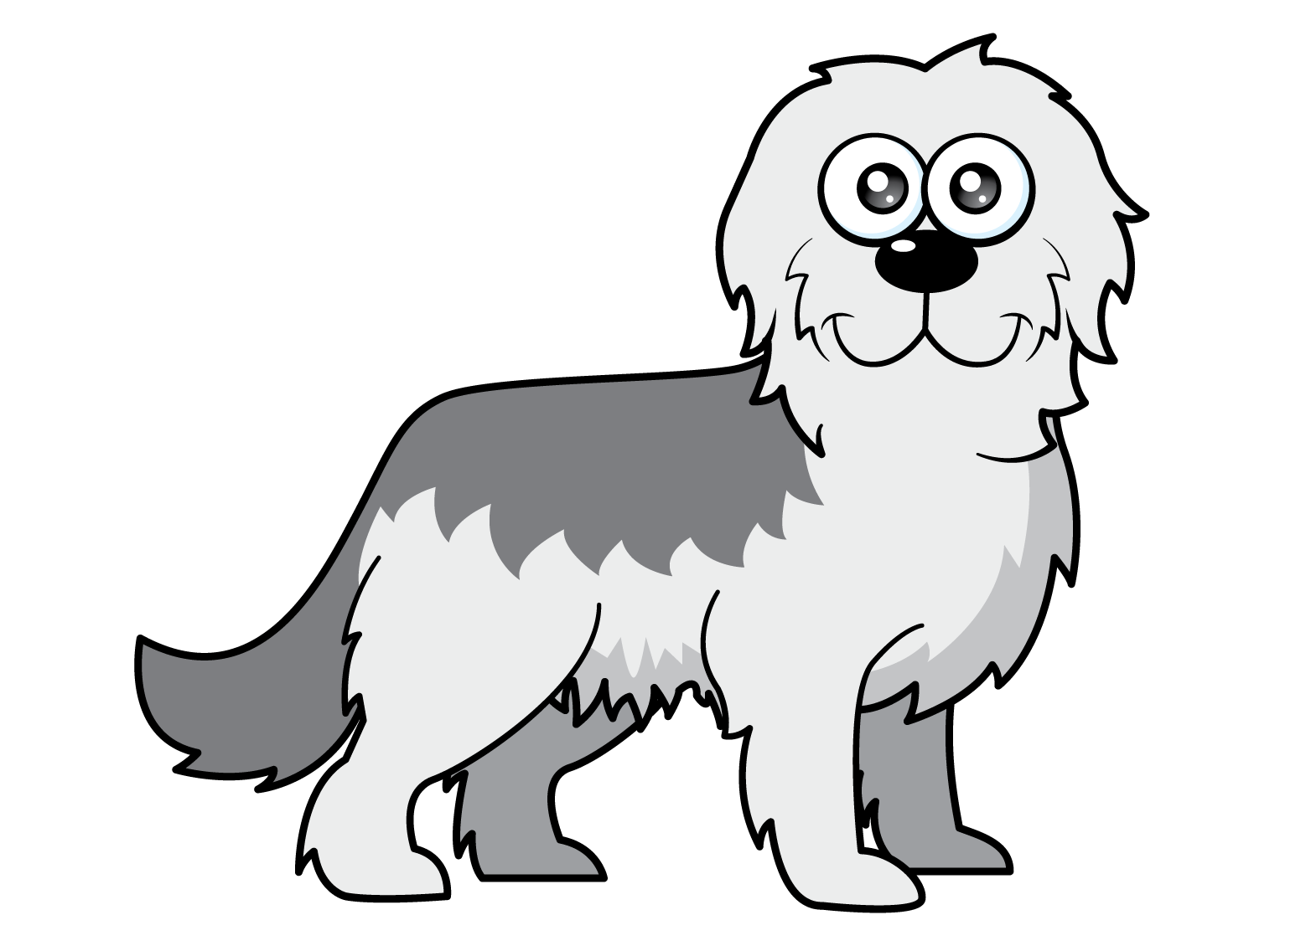
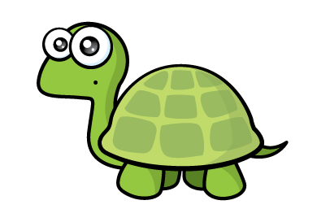
Which is the longest?
Have a think
I can’t tell which is longest!
How can we measure?

Slide 5
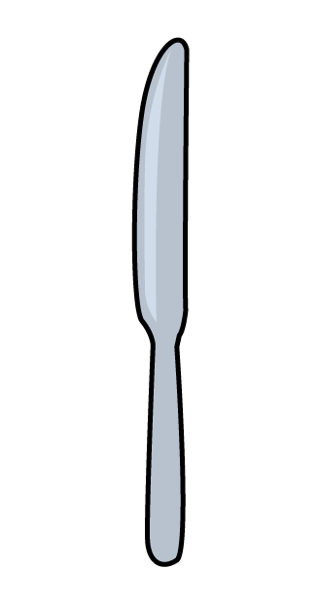
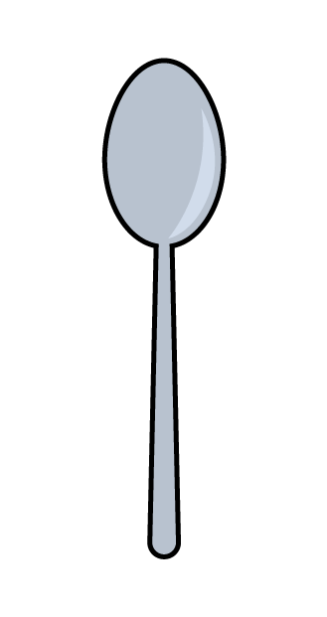
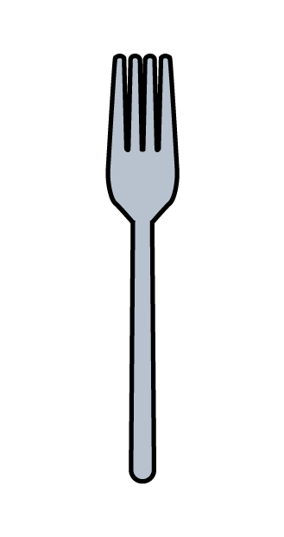
Which is the longest?
Have a think
How can we compare?
Remember to line them up carefully.

Slide 6
Which is the shortest?
Have a think
How can we compare?
Remember to line them up carefully.

Slide 7
Can you find 3 things longer than your spoon?

Slide 8
Can you find 3 things shorter than your spoon?

Slide 9
Let’s compare fingers!
Have a think
I don’t have any fingers…
Which of your fingers is the longest?
Which of your fingers is the shortest?
Do you have 2 fingers the same length?

