Slide 1


Slide 3
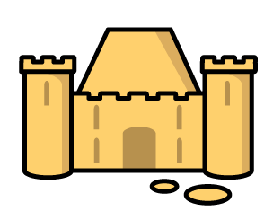

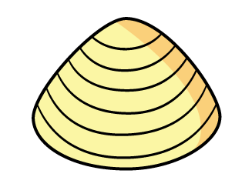
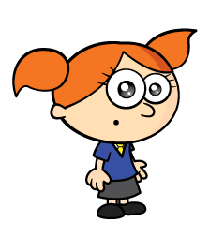
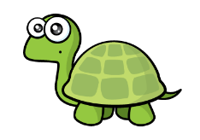
Have a think
The shells have to be the same size.
The castle is 5 shells long.

Slide 4
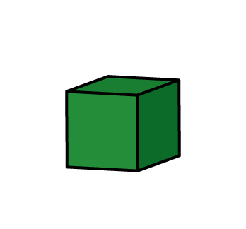
Have a think
Tiny, you cannot leave spaces.
The castle is 5 blocks long.

Slide 5
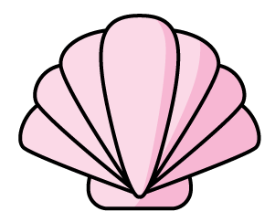
The sandcastle is 6 long.

Slide 6
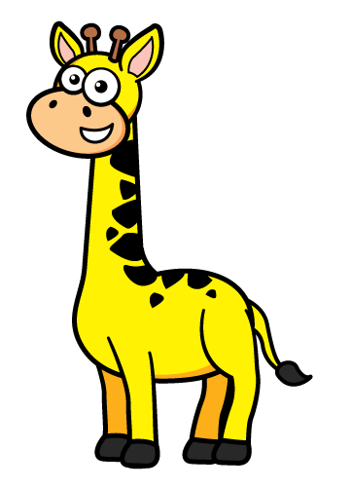
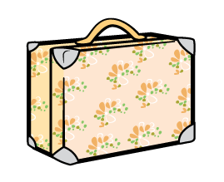
The giraffe is tall.
4

Slide 7
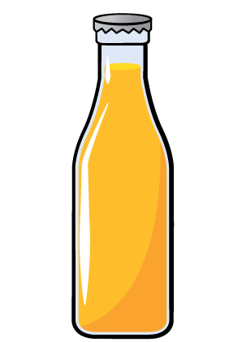
The giraffe is tall.
4
7
The giraffe is tall.

Slide 8
What objects can you find to measure with?

Slide 9
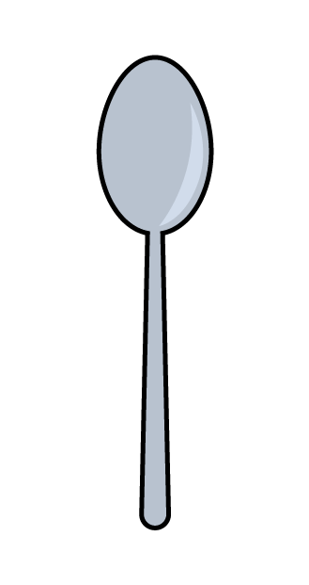
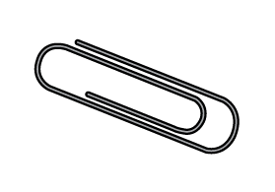
Have a think
The spoon is long.
6

Slide 10
Have a think
How long is the spoon?
26
The spoon is shorter than 3 .
The spoon is 2 and 6 long.

Slide 11
Can you use blocks to measure your spoon?

Slide 12
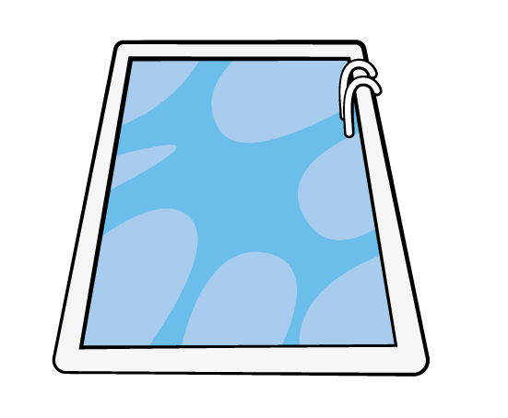
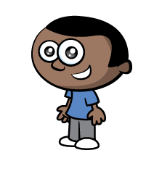
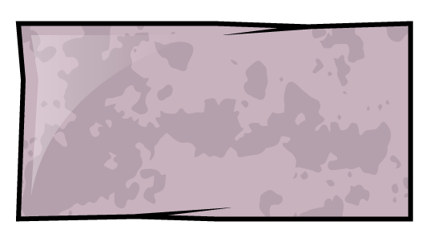
How long is the pool?
I will use
to measure!
I will use
to measure!

Slide 13
How long is the pool?
48, 49…..
I have so much more to measure.
The pool is 28
long.

Slide 14
What can you measure?
What will you use to measure with?

