Slide 1
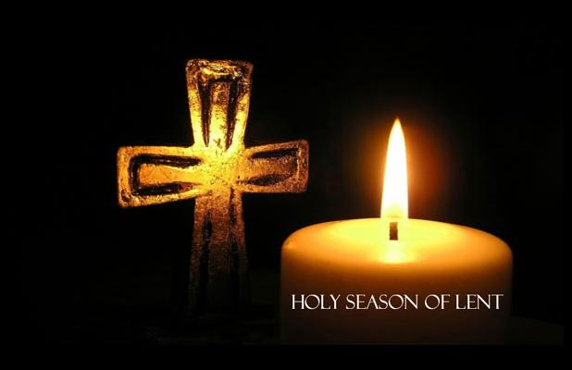
Daily Lenten Candle Prayers

Slide 2
First week of Lent
Theme of our prayer this week:
God asks us to care for others, the way we want them to care for us.

Slide 3
Monday
God says, “You must love other people, the same way you love yourself.”

Slide 4
Tuesday
People do not only need to feed their bodies, but must also feed their spirits by listening to what God wants.

Slide 5
Wednesday
Forgive the things I have done wrong and forget them because you are so kind.
(Psalm 50)

Slide 6
Thursday
When I call you, you answer me, Lord.

Slide 7
Friday
Shake off all the things you do wrong and make yourself a new heart and a new spirit.

Slide 8
Second week of Lent
Theme of our prayer this week:
God asks us to think about what we do and say to other people.

Slide 9
Monday
The seed is the work of God. Christ is the sower.
Whoever finds this seed will remain forever.

Slide 10
Tuesday
Shake off the things that are bad and make a new heart and spirit for yourself.

Slide 11
Wednesday
Glory and praise to you,
O Christ.
You are the Word of God.

Slide 12
Thursday
Praise to you, O Christ. You are the king of everlasting glory.

Slide 13
Friday
God loved the world so much that He gave us His Son.

Slide 14
Third week of Lent
Theme of our prayer this week:
God love us and wants us to be strong enough to say sorry when we hurt others.

Slide 15
Monday
Send us your light and your truth, so that they can be our guide.

Slide 16
Tuesday
Lord, teach me how to walk in your truth.

Slide 17
Wednesday
Your words hold the message of eternal life.

Slide 18
Thursday
Let us praise the Lord with words and songs.

Slide 19
Friday
God says to his people, “Come back and find me. Find the words to say you are sorry and come back to me, for I love you with all my heart.”

Slide 20
Fourth week of Lent
Theme of our prayer this week:
God love us and wants us to be sure, that he will always be there for us.

Slide 21
Monday
I thank you, Lord, for you have changed my sadness into joy.

Slide 22
Tuesday
Praise and honour to you, Lord Jesus. Give me again the joy of your help.

Slide 23
Wednesday
The Lord is kind and full of compassion.

Slide 24
Thursday
The Lord is the one who lights my way and gives me help.

Slide 25
Friday
The Lord is close to those who are very sad.

Slide 26
Fifth week of Lent
Theme of our prayer this week:
God will always take care of us.

Slide 27
Monday
God says “I am very happy when people change their ways when they have done things wrong.”

Slide 28
Tuesday
O Lord, listen to my prayer and hear me when I ask you for help.

Slide 29
Wednesday
You are blest, the God of our people.
(Daniel 3:52-56)

Slide 30
Thursday
The Lord will remember his promise forever.

Slide 31
Friday
Your words are full of life, O Lord.

