Slide 1


Slide 2
Review

Slide 3
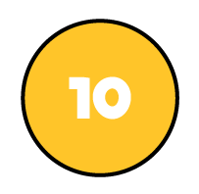


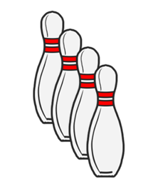
Which represents more?
or
or
or

Slide 4
Which represents more?
or
or
or

Slide 5
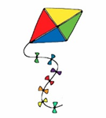
Release the kite

Slide 6
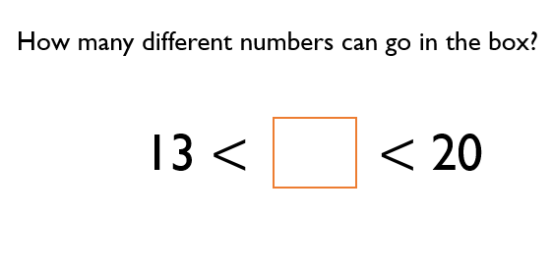

Slide 8



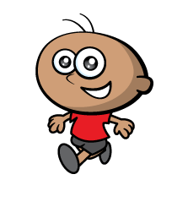
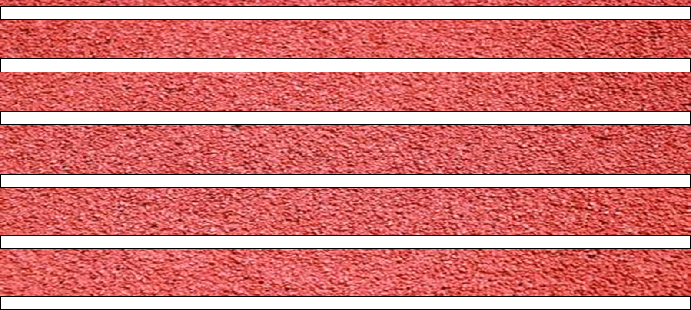

0
3
1
2
Ready…
Steady…
GO!

Slide 9
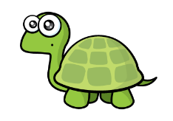



55
35
Tommy won!
Have a think

Slide 10


55
35

Slide 11
60
27
Have a think

Slide 12
81
49
Have a think

Slide 13
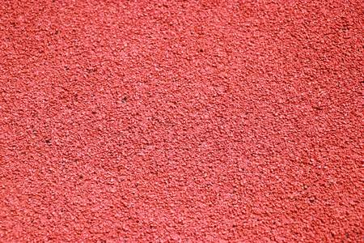
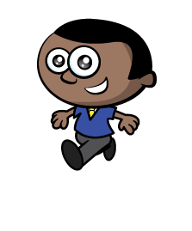

Ready…
Steady…
GO!
Have a go

Slide 14



22
10
5
$$>$$

Slide 15

75
5
70
$$=$$
Have a think

Slide 16
Have a go at questions 1
Write question 2, 3 and 4 in your books
Go Deeper Q6
Challenge Q8

Slide 17






3rd
2nd
1st
48
$<$
?
$<$
53
49
50
51
52

Slide 18
Have a go at the rest of the worksheet

