Slide 2
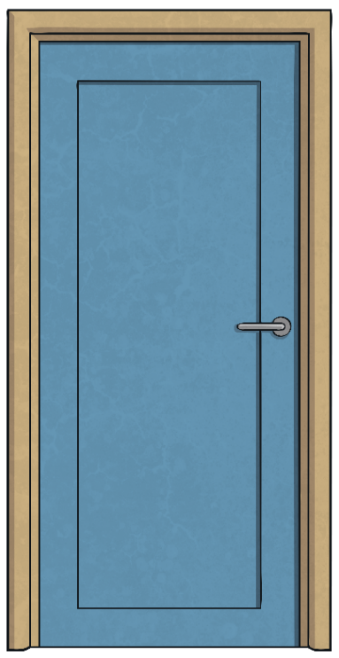
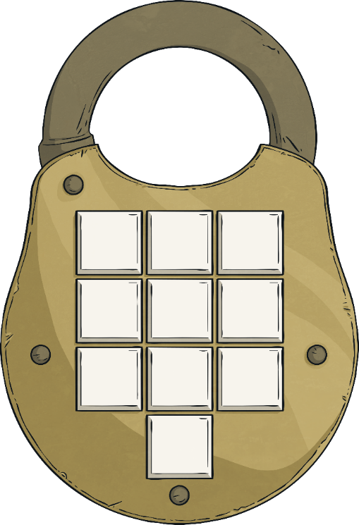
Lost in the Library
Solve the clues and puzzles to discover the passcode number needed to unlock the door to find your way out of the library.
The clues could be anywhere, so you need to keep your eyes peeled and your mind sharp!
You are having a wonderful time reading and exploring books in the library. You found some really interesting books.
As the time to leave approaches, you realise all the librarians have left the library. You try the door and it is locked!
Luckily, an adult in your group has a plan of the library with a set of clues that will give the code to open the door.
?
?
?
?
?
?
?
?
?
?

Slide 3
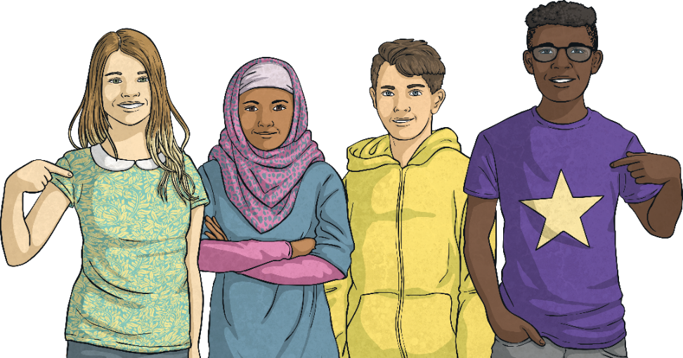
Lost in the Library
The Rules
You can work in small groups.
When you find a clue, work together to solve the puzzle.
Write your answer down on your answer sheet.
Once you have discovered the passcode number for the door, check it with your teacher to discover if you can escape the library!

Slide 4
Lost in the Library
?
Click on a to check your answers.
When you have all the digits for the code, you can press the button to unlock the door and escape the library!
Unlock
Digit 1
Digit 2
Digit 3
3
5
0
?
?
?
Unlock
Unlock
Unlock
Unlock
Unlock
Unlock
Unlock
Unlock
Unlock
Unlock
Unlock
Digit 4
Digit 5
Digit 6
?
1
4
?
?
8
Digit 7
Digit 8
Digit 9
7
4
?
6
?
It’s still locked.
?
It’s still locked.
It’s still locked.
It’s still locked.
It’s still locked.
It’s still locked.
It’s still locked.
It’s still locked.
It’s still locked.
Digit 10
?
5

Slide 5
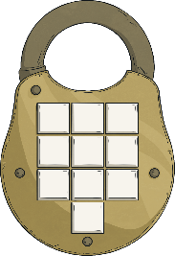
Clues for Digit 1
A book on fractions provides the first clue. A page in the book contains some fractions.
There are a number of pairs of equivalent fractions and one fraction will be left over.
The numerator in the fraction left over provides the first clue.
$$\frac{\text{2}}{\text{3}}$$
$$\frac{\text{2}}{\text{3}}$$
$$\frac{\text{6}}{\text{9}}$$
$$\frac{\text{1}}{\text{2}}$$
$$\frac{\text{4}}{\text{8}}$$
$$\text{=}$$
$$\frac{\text{4}}{\text{8}}$$
$$\frac{\text{1}}{\text{2}}$$
$$\text{=}$$
$$\frac{\text{12}}{\text{16}}$$
$$\frac{\text{2}}{\text{5}}$$
$$\frac{\text{4}}{\text{10}}$$
$$\frac{\text{3}}{\text{4}}$$
$$\frac{\text{12}}{\text{16}}$$
$$\frac{\text{2}}{\text{12}}$$
$$\text{=}$$
$$\frac{\text{4}}{\text{10}}$$
$$\text{=}$$
$$\frac{\text{6}}{\text{16}}$$
$$\frac{\text{3}}{\text{4}}$$
$$\frac{\text{2}}{\text{5}}$$
$$\frac{\text{3}}{\text{8}}$$
$$\frac{\text{6}}{\text{16}}$$
$$\frac{\text{1}}{\text{6}}$$
$$\frac{\text{1}}{\text{6}}$$
$$\text{=}$$
$$\frac{\text{2}}{\text{12}}$$
$$\text{=}$$
$$\frac{\text{3}}{\text{8}}$$
$$\frac{\text{3}}{\text{10}}$$
$$\frac{\text{3}}{\text{10}}$$
$$\frac{\text{6}}{\text{9}}$$
Reveal answer
3
The first digit of the code is

Slide 6
Clues for Digit 2
In a dictionary, a set of verbs are listed. Convert each word using the suffix –able or –ible
The number of words using the suffix –able provides the second clue.
accessible
access
enjoyable
enjoy
comfortable
comfort
desirable
desire
likeable
like
responsible
response
horrible
horror
usable
use
-able
-ible
5
3
Reveal answer
5
The second digit of the code is

Slide 7
Clues for Digit 3
A second page in the book on fractions gives the third clue:
There are some mixed numbers. To find the required digit, convert the mixed numbers to improper fractions, convert to equivalent fractions with the same denominator, add together and convert back to a mixed number.
The digit that appears in the ones place of the whole number gives the third clue.
$$\frac{\text{129}}{\text{12}}$$
$$\text{2}$$
$$\frac{\text{32}}{\text{12}}$$
$$\frac{\text{8}}{\text{3}}$$
$$\frac{\text{2}}{\text{3}}$$
$$\text{+}$$
$$\frac{\text{46}}{\text{12}}$$
$$\frac{\text{23}}{\text{6}}$$
$$\text{3}$$
$$\frac{\text{5}}{\text{6}}$$
=
$$\text{+}$$
=
$$\frac{\text{17}}{\text{4}}$$
$$\frac{\text{51}}{\text{12}}$$
$$\text{4}$$
$$\frac{\text{1}}{\text{4}}$$
$$\frac{\text{9}}{\text{12}}$$
$$\frac{\text{3}}{\text{4}}$$
10
or
10
Reveal answer
0
The third digit of the code is

Slide 8
Clues for Digit 4
A grammar book provides the fourth clue.
How many of the following words are modal verbs?
live
carry
could
could
went
can
can
must
must
try
might
might
want
may
may
mould
sight
would
would
walk
ought to
ought to
will
will
Reveal answer
8
The fourth digit of the code is

