Slide 1
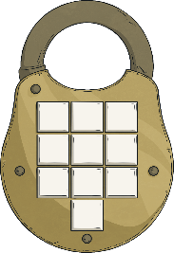
Clues for Digit 5
The library has a shelf of books that have been purchased at a discount.
Alongside is a set of fractions. Match the percentage discounts to the fractions. One percentage has no matching fraction.
15% off £5
15% off £5
25% off £2.80
30% off £3.50
20% off £3.35
$$\frac{\text{3}}{\text{10}}$$
$$\frac{\text{1}}{\text{4}}$$
$$\frac{\text{1}}{\text{5}}$$
75% off £3.99
$$\frac{\text{3}}{\text{4}}$$
50% off £4.50
$$\frac{\text{1}}{\text{2}}$$
$$\frac{\text{1}}{\text{4}}\text{,} \frac{\text{3}}{\text{10}}\text{,} \frac{\text{1}}{\text{5}}\text{,} \frac{\text{3}}{\text{4}}\text{,} \frac{\text{1}}{\text{2}}$$
Find the digit in the tens place of the percentage with no matching fraction.
Reveal answer
1
The fifth digit of the code is

Slide 2
Clues for Digit 6
Perhaps
The sixth clue is in an adventure story. How many adverbs of possibility are in this paragraph?
The children explored the library carefully, looking for clues that would help them escape. They knew they had to find the clues quickly, so they would not be stuck in the library all night.
they should split up and work in small groups on as individuals. They searched each shelf systematically. They would find the clues soon!
Perhaps
probably
probably
obviously
obviously
surely
The number of adverbs of possibility is the sixth clue.
surely
Reveal answer
4
The sixth digit of the code is

Slide 3
Clues for Digit 7
Clue number 7 is found on a poster in the library, which shows a pyramid with the following numbers. Look at the relationship between the three decimal fractions in the bottom left hand corner, and use that to complete the pyramid.
21.8
10.92
10.88
4.67
6.25
4.63
Find the common digit in the shaded boxes for the seventh clue.
3.02
1.65
4.6
0.03
Reveal answer
6
The seventh digit of the code is

Slide 4
Clues for Digit 8
Clue number 8 is found in a notebook which has a set of words and a set of prefixes.
happy
complete
Match each word to the correct prefix:
correct
fair
in
spell
lead
in
mis
un-
in
un
un
in-
dis-
dis
mis-
mis
Add the number of words using the prefix un- and in- and subtract the number of words using the dis- prefix. The answer gives the eighth clue.
obey
visible
un- in-
dis-
5
–
1
=
4
Reveal answer
4
The eighth digit of the code is

Slide 5
Clues for Digit 9
The ninth clue appears on a computer screen, which shows a line graph.
The chart shows the temperature in the library overnight.
7
Find the number of hours between the two times when the temperature was 17°C.
Reveal answer
7
The ninth digit of the code is

Slide 6
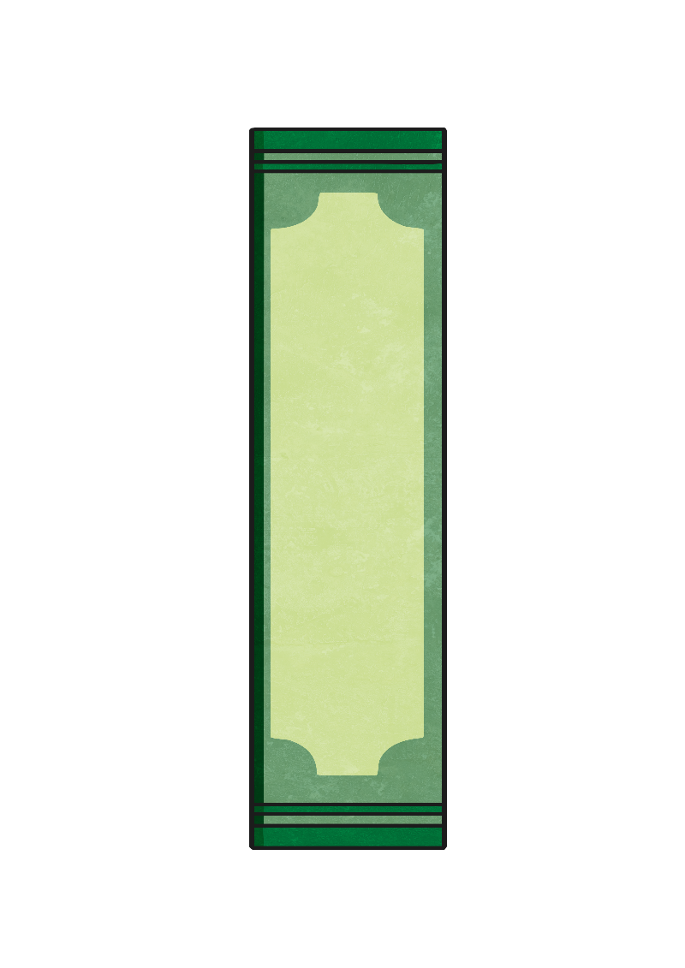
Clues for Digit 10
The final clue is found on a bookmark with a list of anagrams. (Anagrams are words where the letters are mixed up, usually to make a new word or words.)
Solve these anagrams. The first letter of each answer gives the last number.
wolf
ladies
serve
auctioned
fowl
sailed
cautioned
ideals
verse
education
flow
ideals
verse
education
flow
Reveal answer
5
The tenth digit of the code is

Slide 7
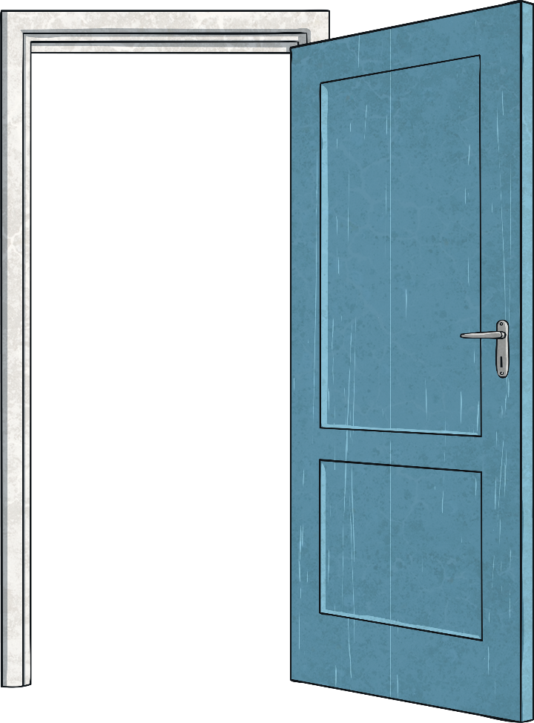
You unlocked the door!

