Slide 1
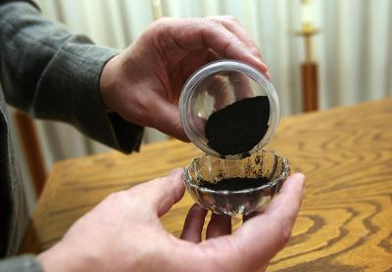
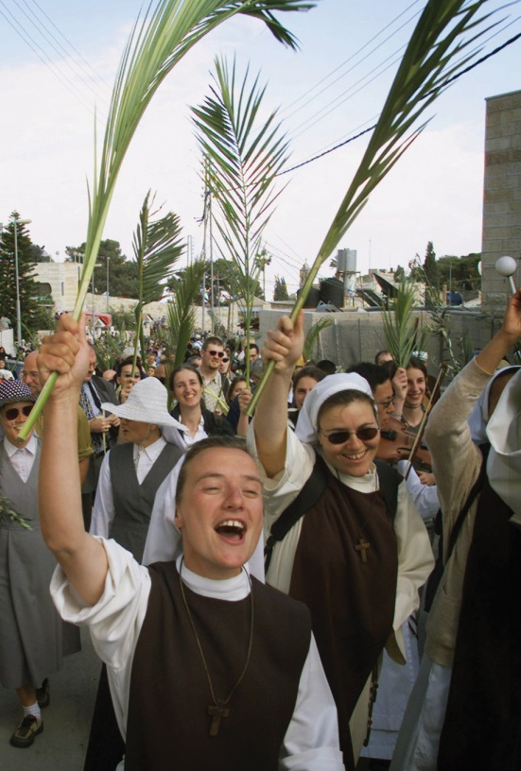
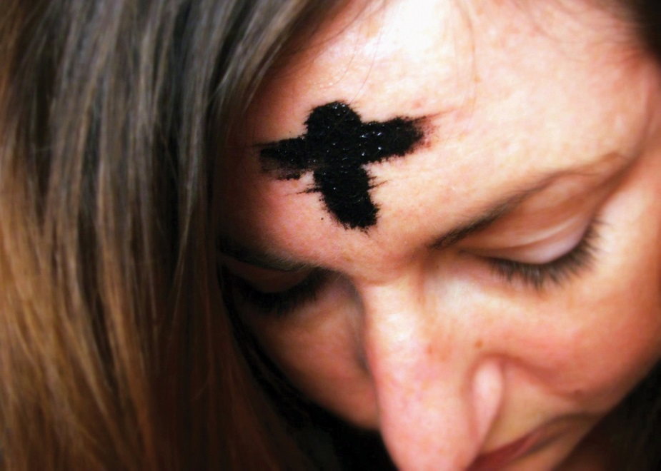
What do all these pictures have in common?

Slide 2
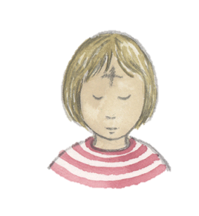
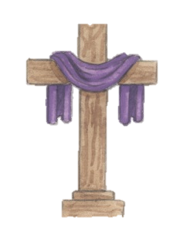
Lectio Divina: stick in your sticker, write the scripture reference and then a brief reflection – how did these words speak to you?
You will have to work hard and sweat to make the soil produce anything, until you go back to the soil from which you were formed. You were made from soil, and you will become soil again.
Genesis 3:19

Slide 3
Lesson 2
Big question: Is self-discipline important in life?
I can explain how Lent is an opportunity to grow

Slide 4
Lent: the opportunity to grow spiritually
Lent is time set aside to focus on spiritual growth which prepares Christians for Christ’s Resurrection on Easter Sunday. They strive to be more faithful to the Gospel by living in God’s way. It is a time when Christians practise self- discipline in order to grow in God’s way.
Lent begins on Ash Wednesday when Christians go to church to receive ashes. The ashes are made from burnt blessed palms used in the Palm Sunday celebration of the previous year. The ashes are blessed with Holy Water. While the ashes symbolise penance and contrition, they are also a reminder that God is loving and merciful to those who call on Him.

Slide 5
During Lent we:
Spend more time with God in prayer
Fast – give something up
Give alms – give to those in need

Slide 6
Ash Wednesday
Ash Wednesday is the first day of Lent, the six weeks (forty days) set aside to prepare for Easter.
During Lent, Christians try to make changes to their lives in order to become more like Jesus and live a new life of Easter joy. They search for ways in which they can live “good” lives and turn away from what is not “right”. What people do during Lent helps them grow in holiness; growing in God’s way.
Christians go to church on Ash Wednesday to receive ashes.

Slide 7
Ashes
The palms left over from last year’s Palm/Passion Sunday are burned leaving the ashes. The priest blesses the ashes and prays:
“Lord God, bless all who ask for your forgiveness. Bless all those who receive these ashes. May they keep this Lenten season in preparation for the joy of Easter.”
The priest sprinkles the ashes with holy water and then makes a cross with the ashes on the forehead of everyone who comes in procession to the altar: he says,
“Turn away from sin and be faithful to the Gospel.”
The Church family tries to do something extra during the 40 days of Lent:

Slide 8
Lent, the opportunity to grow Spiritually
When does Lent begin?
What is Lent a time for?
What happens on Ash Wednesday?
What does the priest say when he places the ashes on a person’s forehead?
Why do you think Lent is celebrated every year?
What do you think you can do in Lent in order to live in God’s way?

Slide 9
I can explain how Lent is an opportunity to grow
Write a guide for someone who is not Christian, explaining what happens during Lent and why Lent is important. Give as much detail as you can and include examples of what you have done in the past or what you are doing this Lent or what you have heard other people doing during Lent.

Slide 10
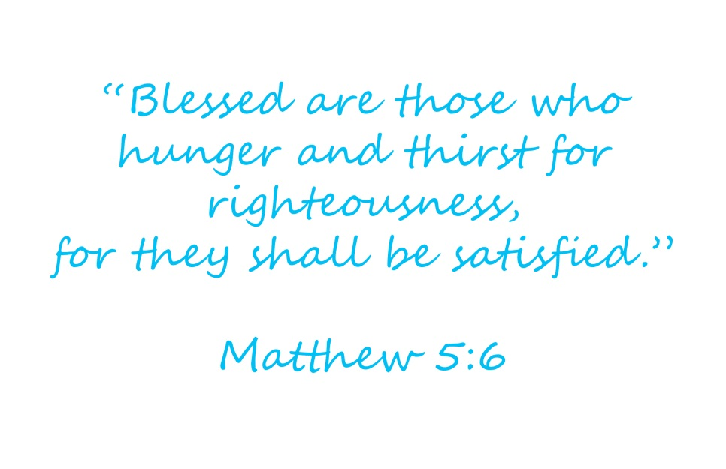
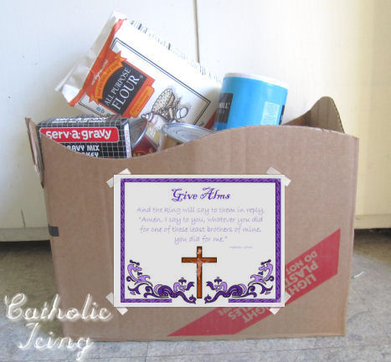
What are these people doing How does It relate to Lent

