Slide 1
Tonal Shading Drawing Using Tone

Slide 2
Learning Objective
To be able to understand how to create tone using pencil.
Success Criteria
To use shading to create light, medium and dark tones.
To use cross hatching to achieve tone.
To identify what successful tonal shading looks like.

Slide 3
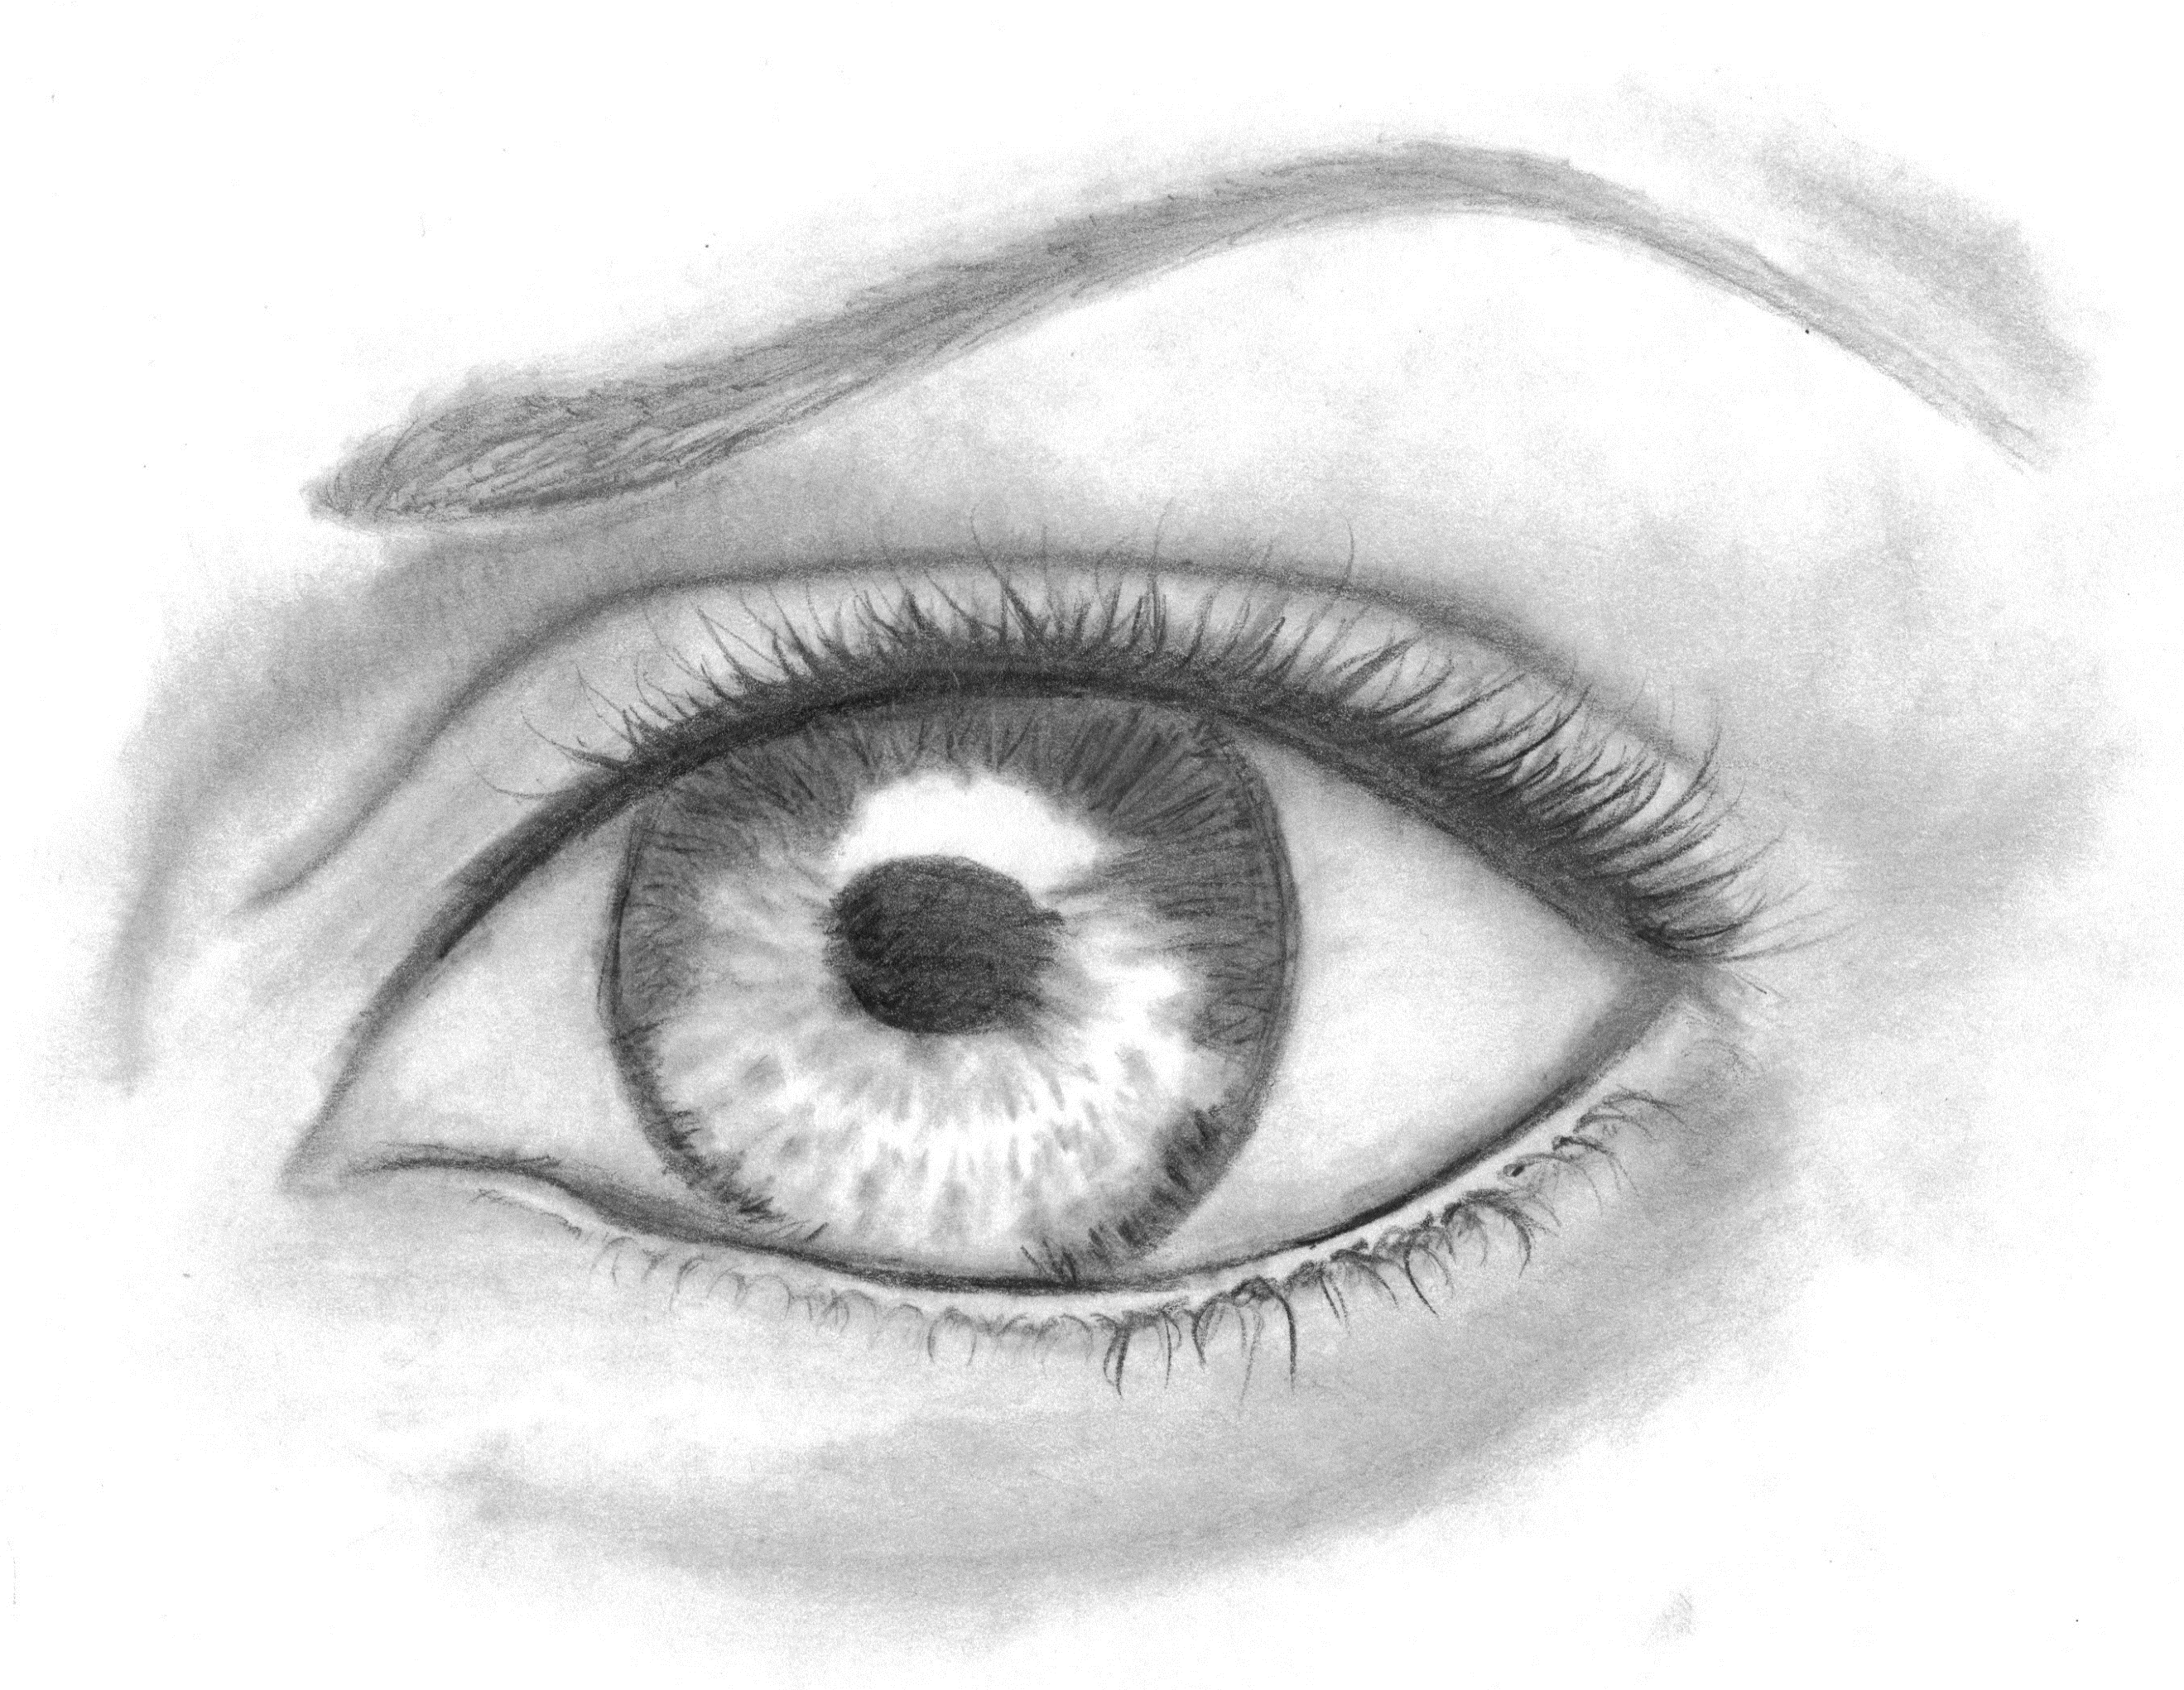
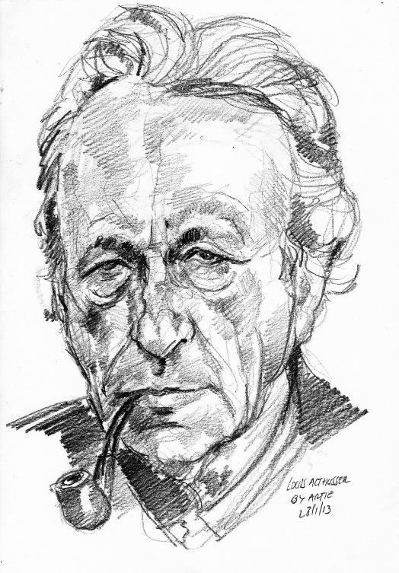
What Is Tone?
Photo courtesy of Tye-Die-Eyes (@deviantart.com) - granted under creative commons licence – attribution
Photo courtesy of Arturo Espinosa (@flickr.com) - granted under creative commons licence – attribution

Slide 4
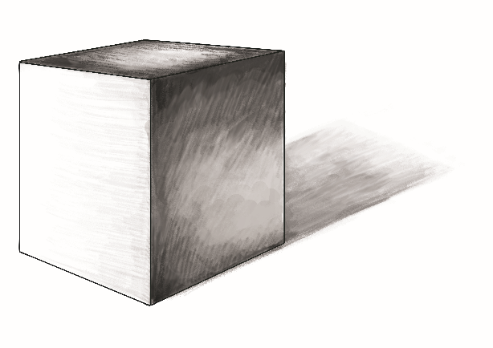
What is Tone?
Artists use tone to create observational drawings. An observational drawing could be a portrait, architecture (buildings) or still life (bowl of fruit).
Artists use layers of shading to achieve light, medium and dark tones. You may also use cross-hatching to achieve tone. Cross-hatching is when an artists uses layers of line to create highlights and shadows within a drawing.
You achieve a light tone with a light pressure on the pencil, so you achieve a darker tone with a heavier pressure.
Key Terms
tone, light, medium, dark, shadow, highlight

Slide 5
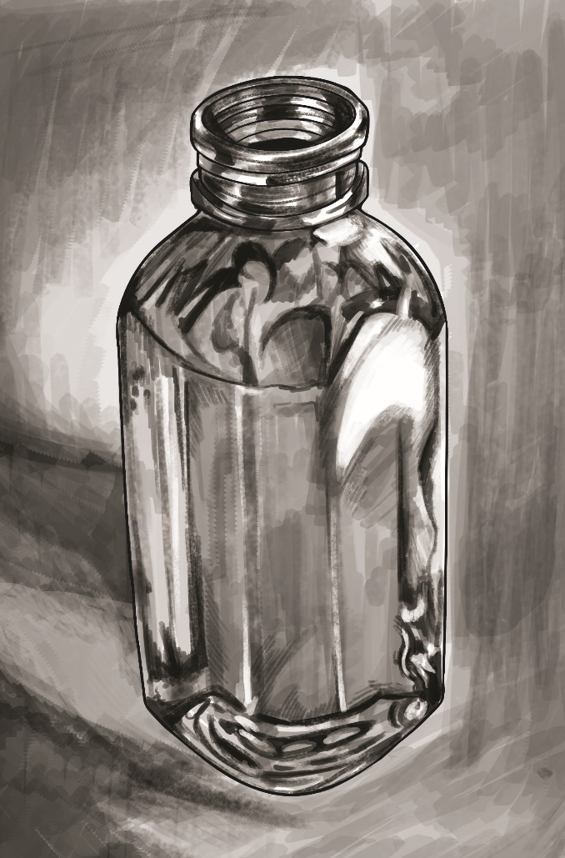
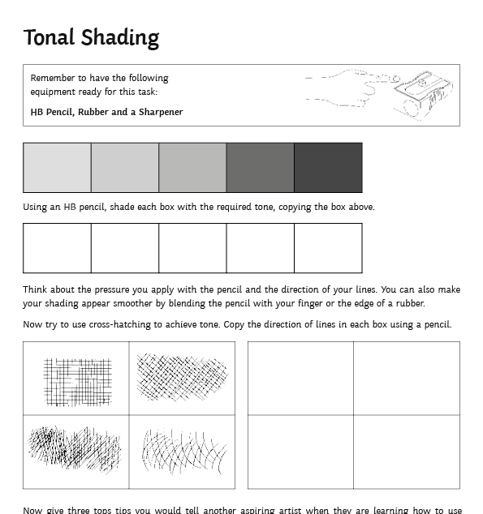
Activity – Using Tone
Artists use a variety of pencils when drawing. There are harder pencils and softer pencils, which can help you blend light, medium and dark tones.
It is also essential to have a good quality eraser and sharpener to hand. A eraser can be used to create highlights in a drawing.
The most important tool for an artist to use is their eyes. You should look up at what you are drawing at least three times every minute!
You should also think about the direction of your lines and draw in the same direction when using tone. When you start to draw objects, your lines should follow the shape of what you are drawing.
Now you try!

Slide 6
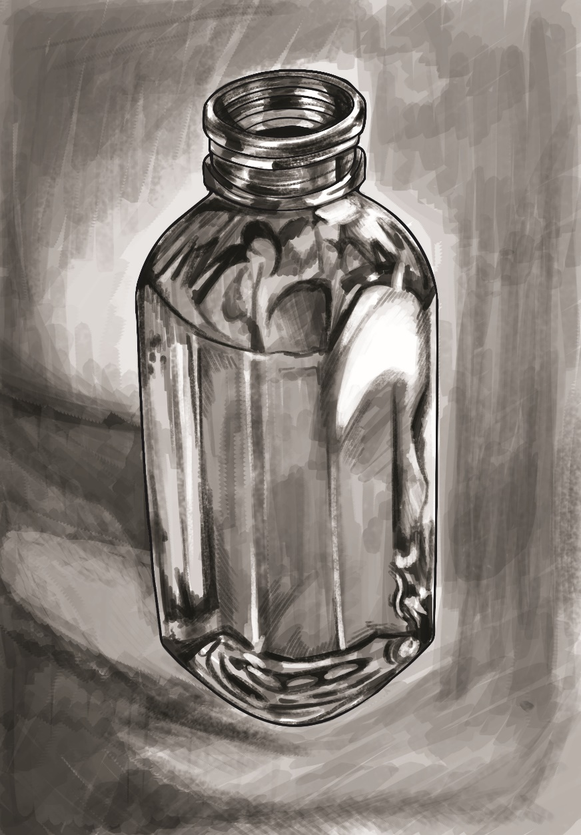
Tonal Shading
heavy shadow
light source
reflected light
highlight
cast shadow
light shadow

Slide 7
What have you learnt today?
In pairs, swap your activity sheets (peer assessment).
Look at each other’s work and write down two good things they have done today that meet the success criteria.
Success Criteria
To use shading to create light, medium and dark tones.
To use cross hatching to achieve tone.
To identify what successful tonal shading looks like.
Now give your partner one point to improve upon. Be clear and specific.
Remember: it’s nice to be nice!
Pause for Thought:
Think about how your partner has achieved the success criteria today.

