Slide 1
Science
Living Things and Their Habitats
Year One

Slide 3
Aim
I can create a classification key.
I can show the characteristics of living things in a table and a key.
Success Criteria
I can identify the characteristics of living things.
I can use the characteristics of living things to sort them using a classification key.
I can show the characteristics of living things in a table.
I can create a classification key.

Slide 4
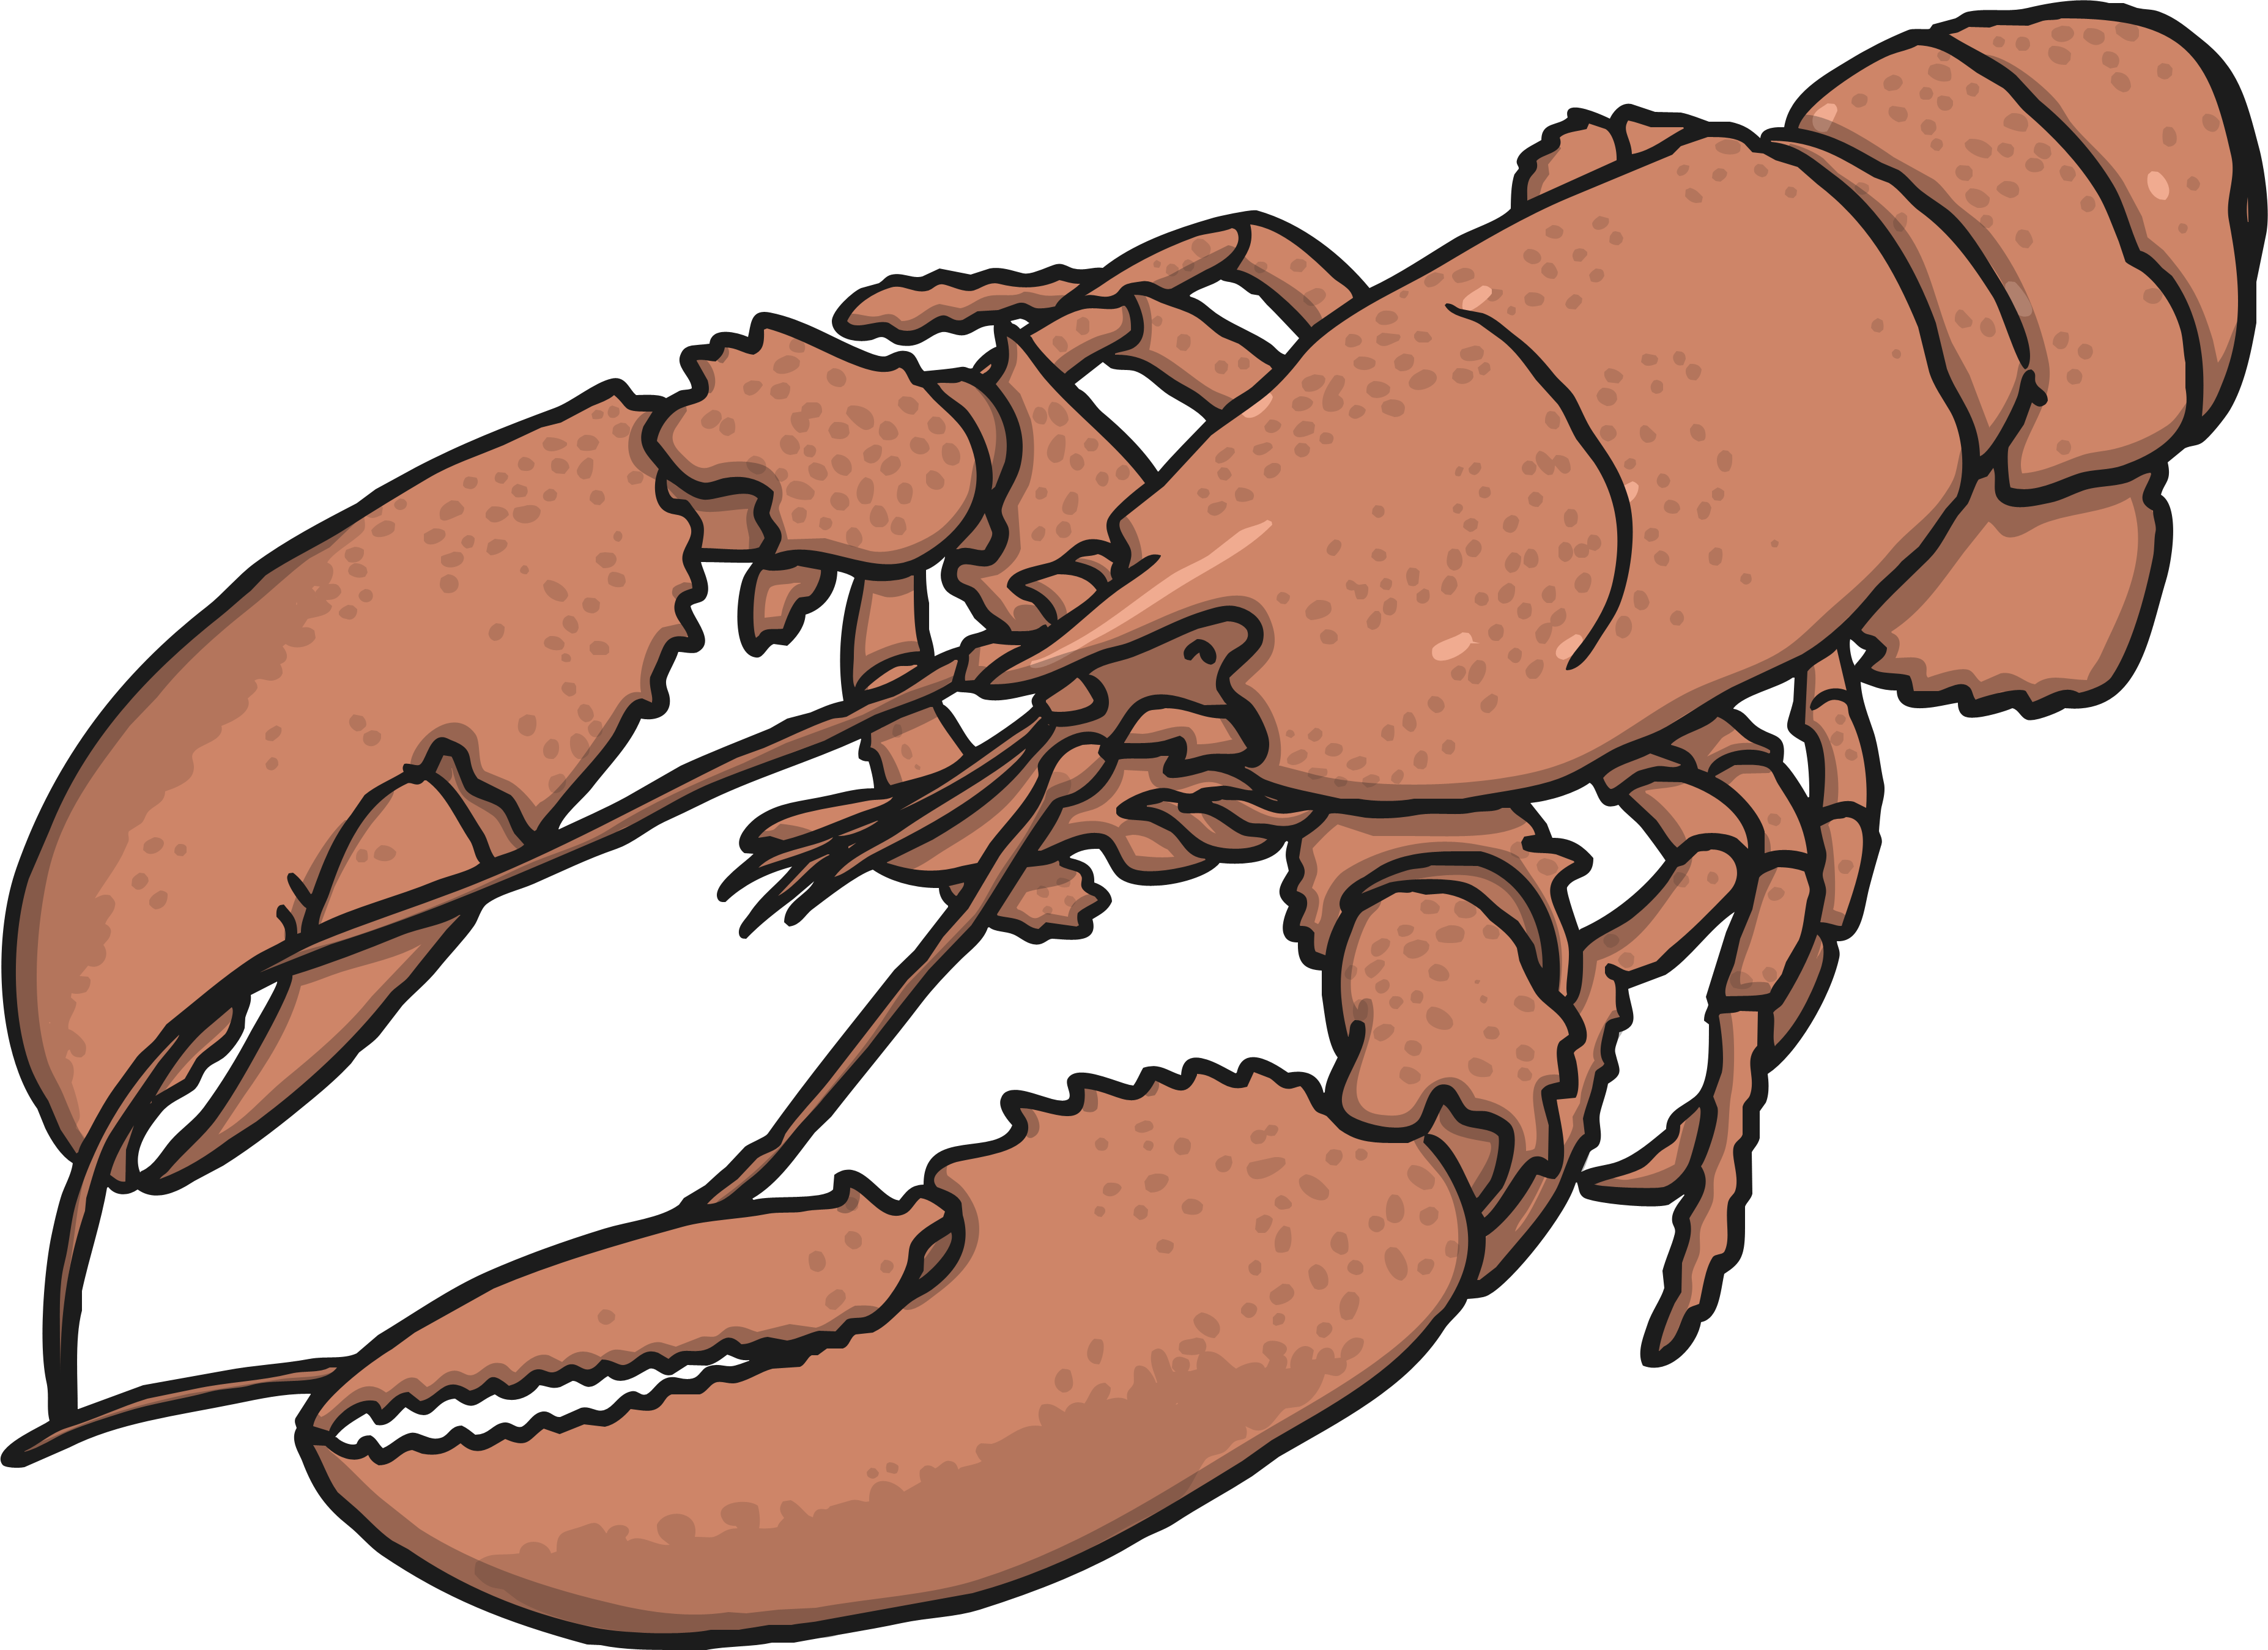
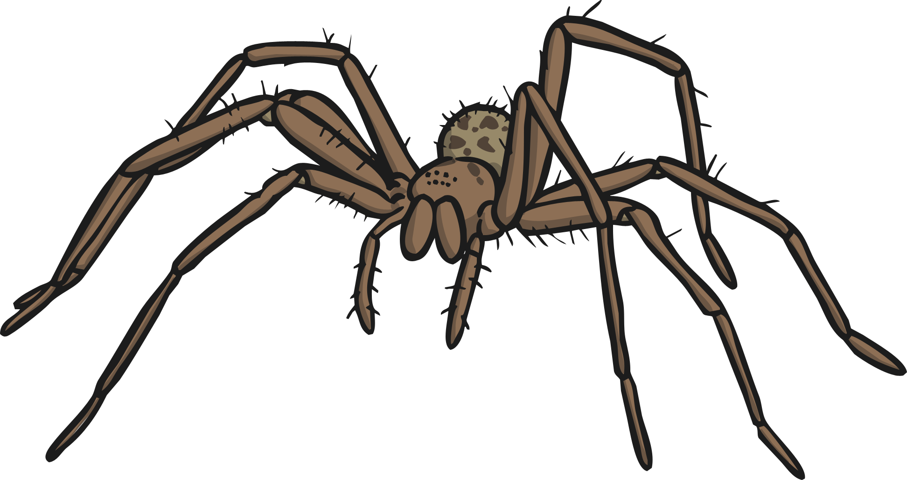
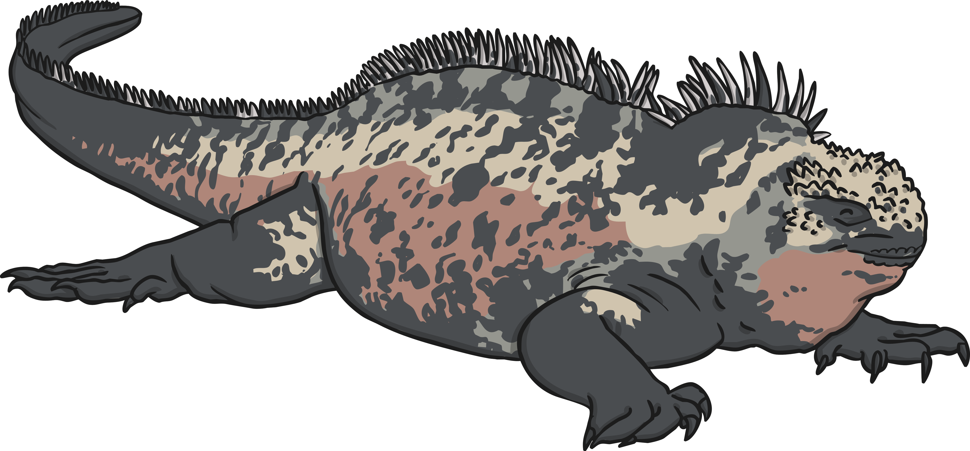
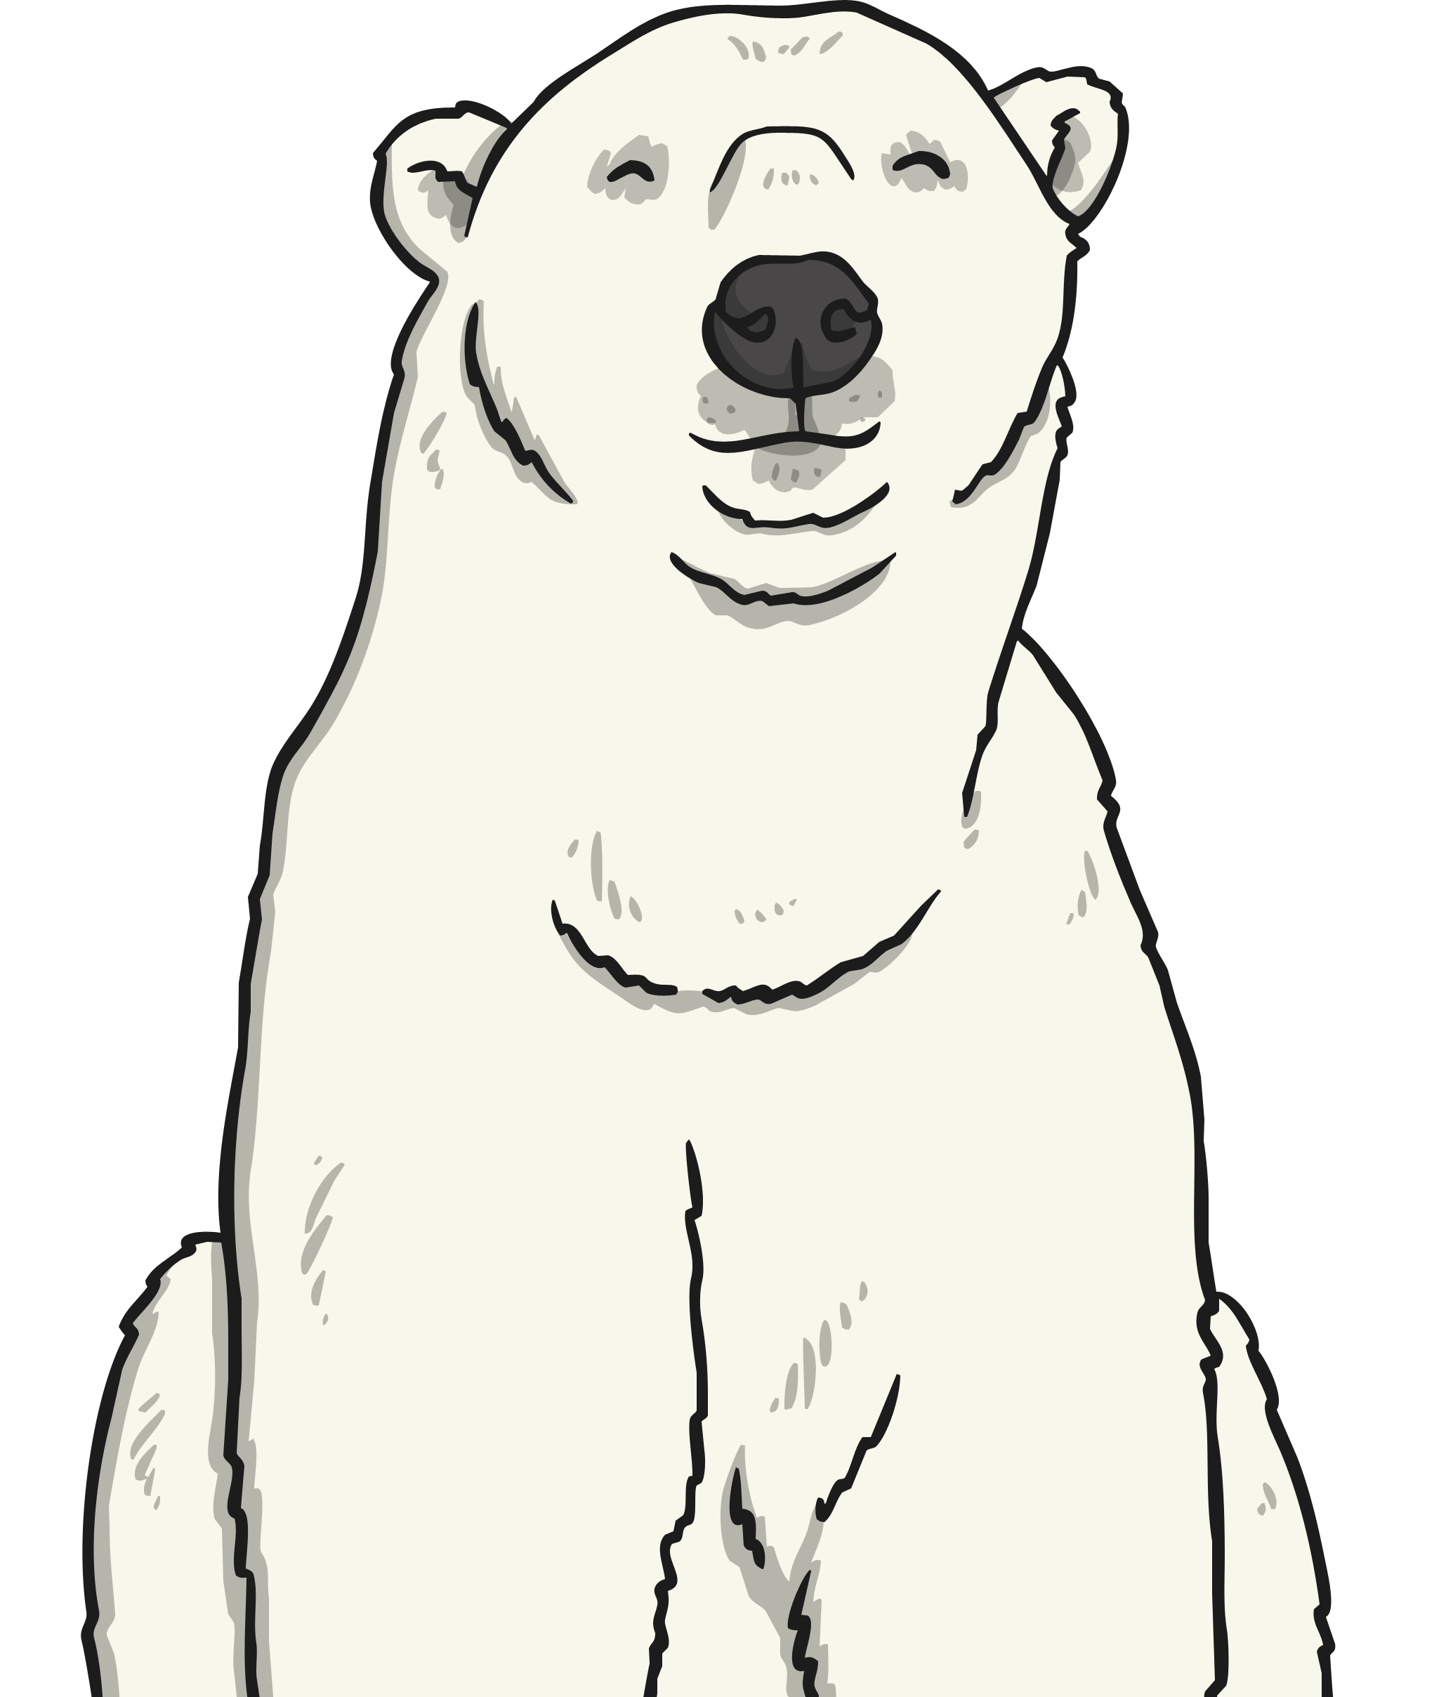
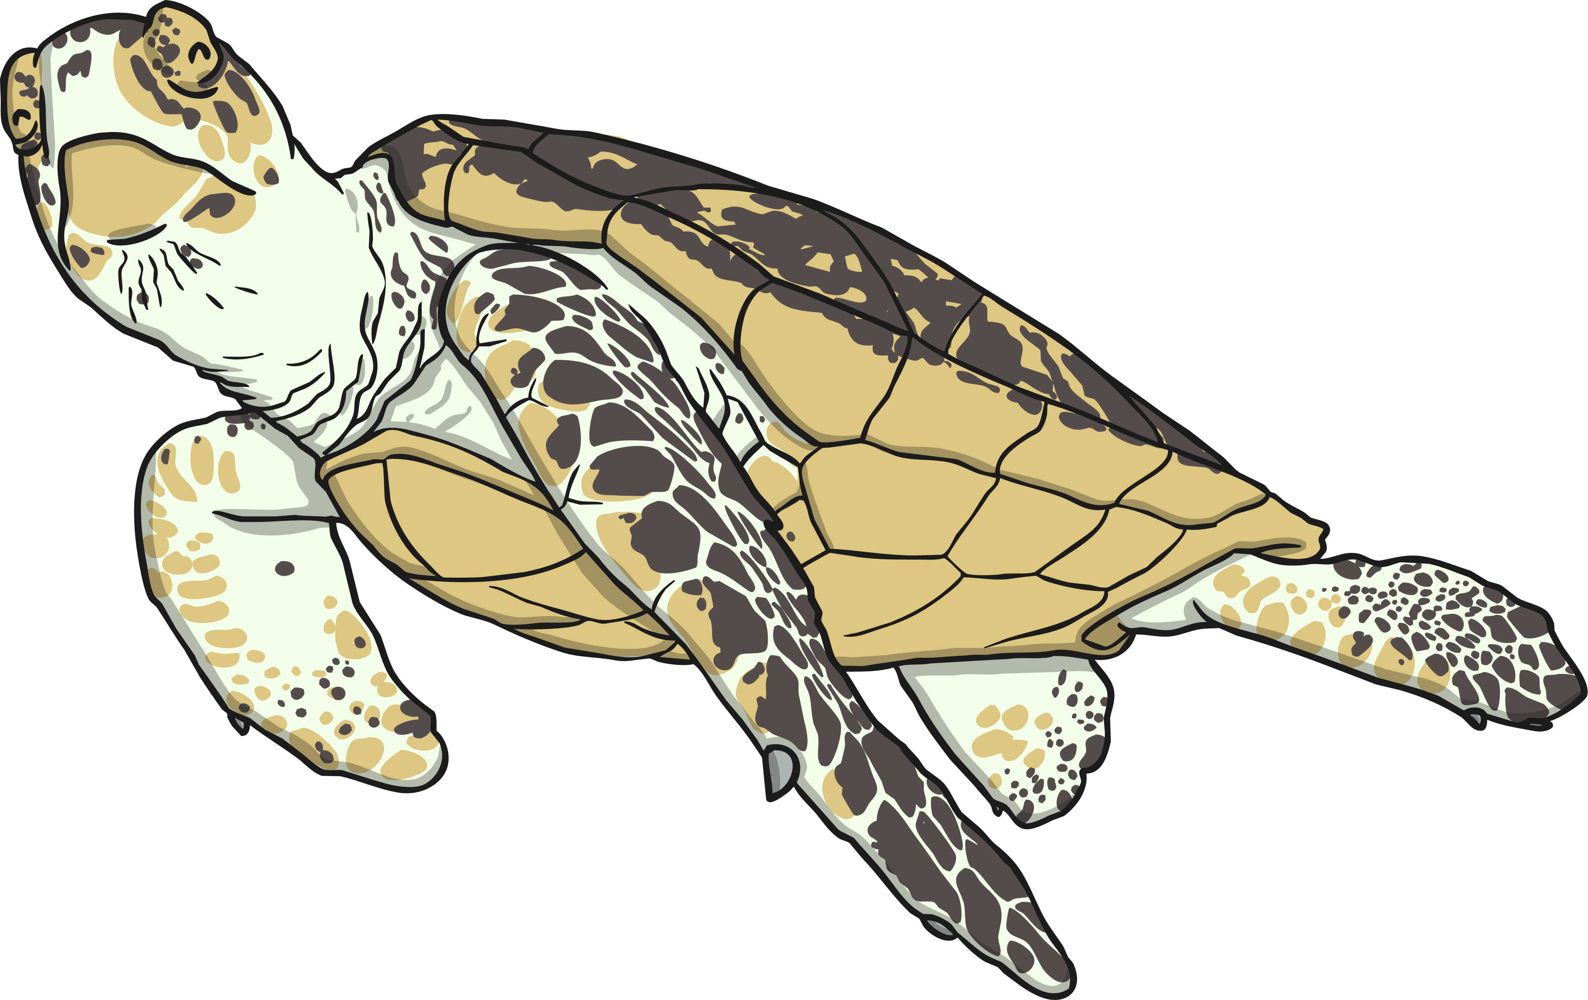
Characteristics
Today we are going to create our own branching keys to identify living things by looking at their characteristics.
The characteristics of a living thing are what make it similar or different to other living things.
All species of living thing have a unique set of characteristics.
Species with similar characteristics are put into groups. This is how we classify living things.

Slide 5
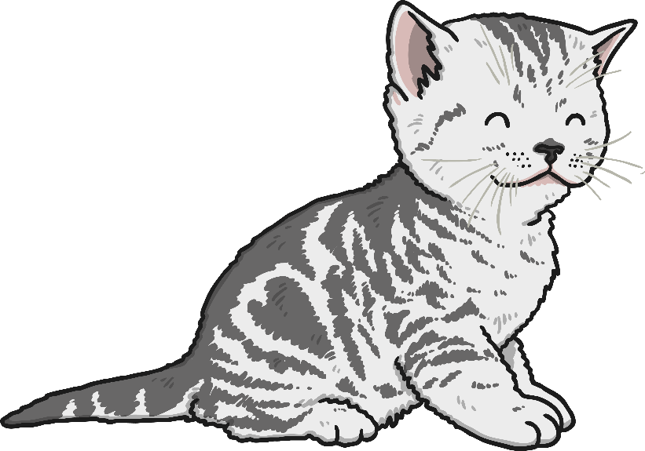
Characteristics
Is awake
Has fur
Has four legs
Is cute
Has a tail
Has whiskers
Is a carnivore
Is a baby
Likes milk
Plays with string

Slide 6
Characteristics
These are some of the characteristics of the domestic cat:
Has whiskers
Has four legs
Has fur
Is a carnivore
Has a tail
These are not characteristics of the species:
Is awake
Is cute
Likes milk
Is a baby
Plays with string
Why not?

Slide 7
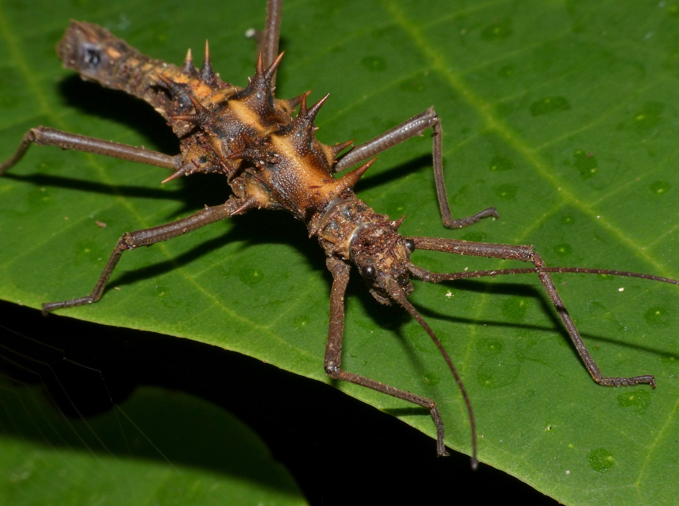
Characteristics
What are the characteristics of this living thing?
Photo courtesy of berniedup (@flickr.com) - granted under creative commons licence - attribution

Slide 8
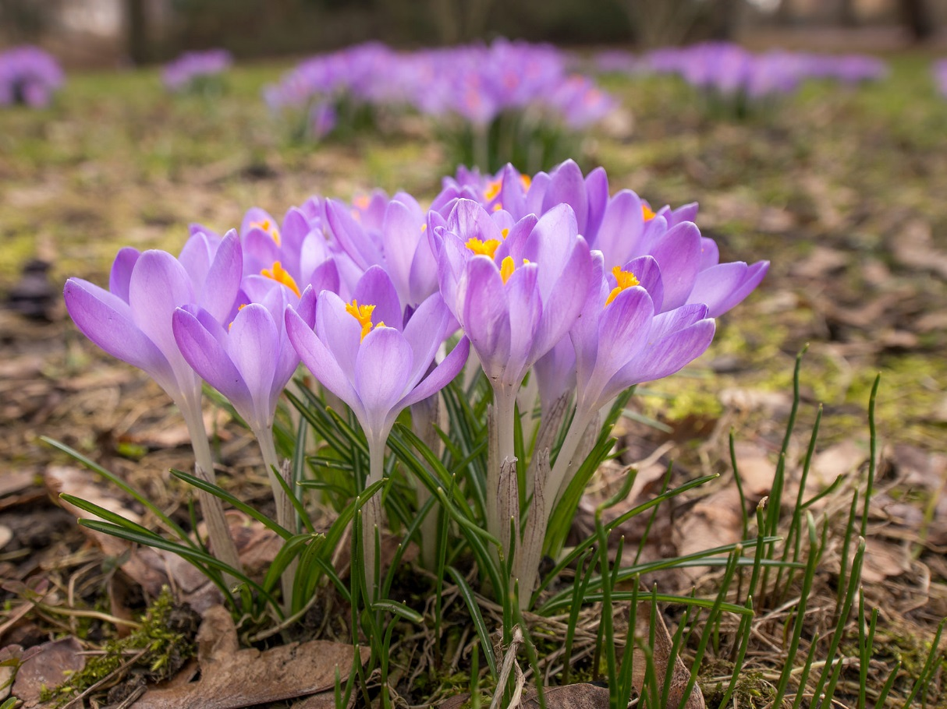
Characteristics
What are the characteristics of this living thing?
Photo courtesy of kars4kids (@flickr.com) - granted under creative commons licence - attribution

Slide 9
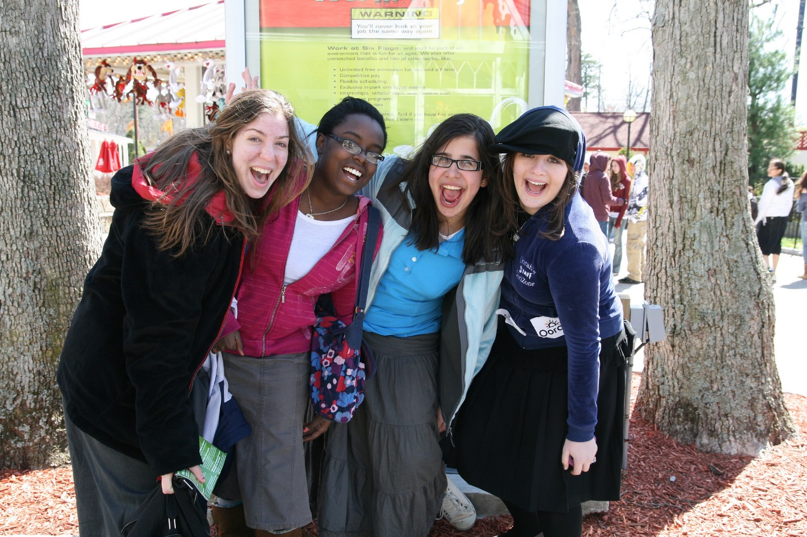
Characteristics
What are the characteristics of this living thing?
Photo courtesy of kars4kids (@flickr.com) - granted under creative commons licence - attribution

Slide 10
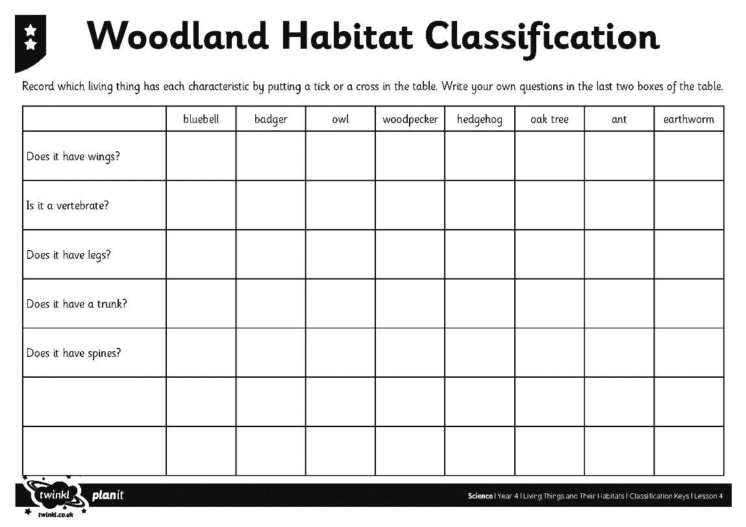
I can create and use a classification key Classification Tables
You have pictures of 8 living things.
Record which living thing has each characteristic by putting a tick or a cross in the table on your activity sheet.

Slide 11
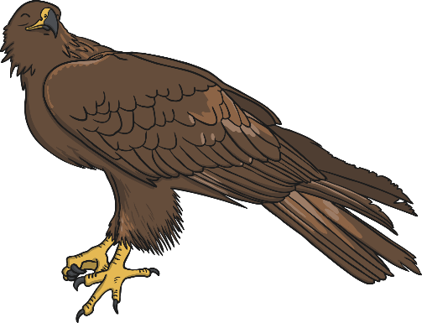
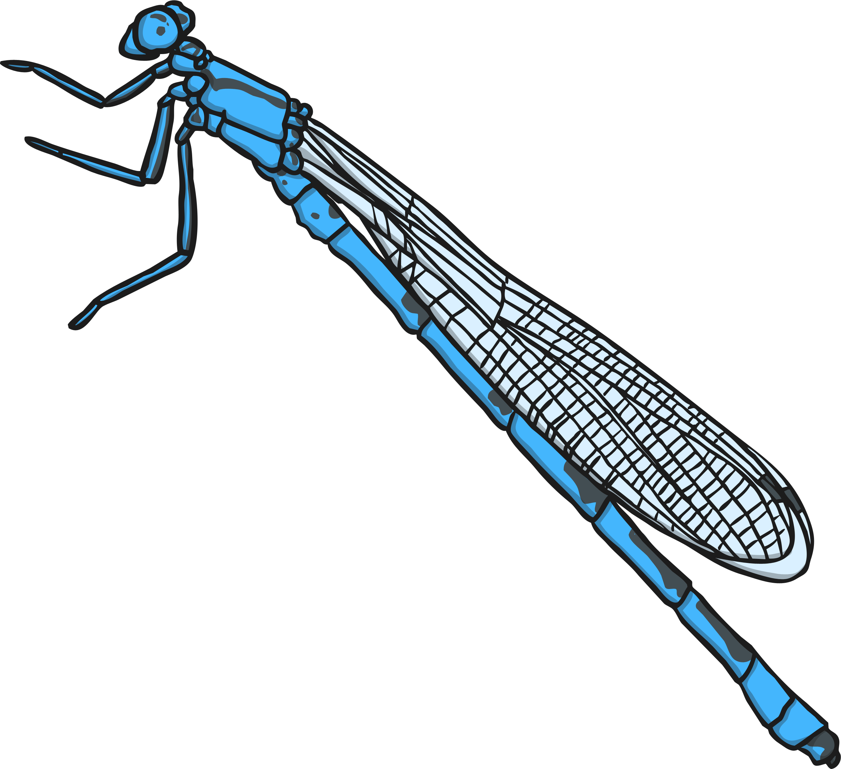
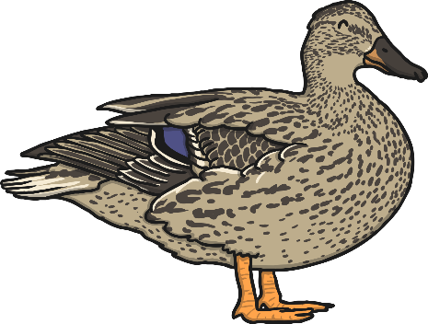
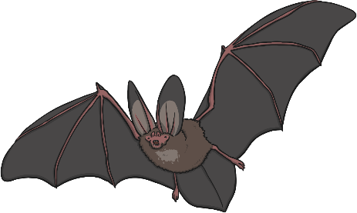
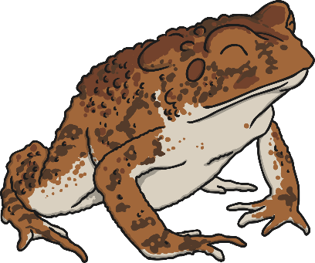
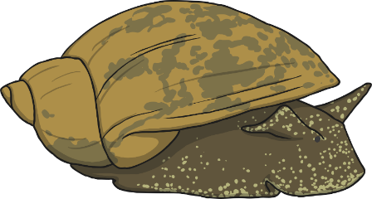
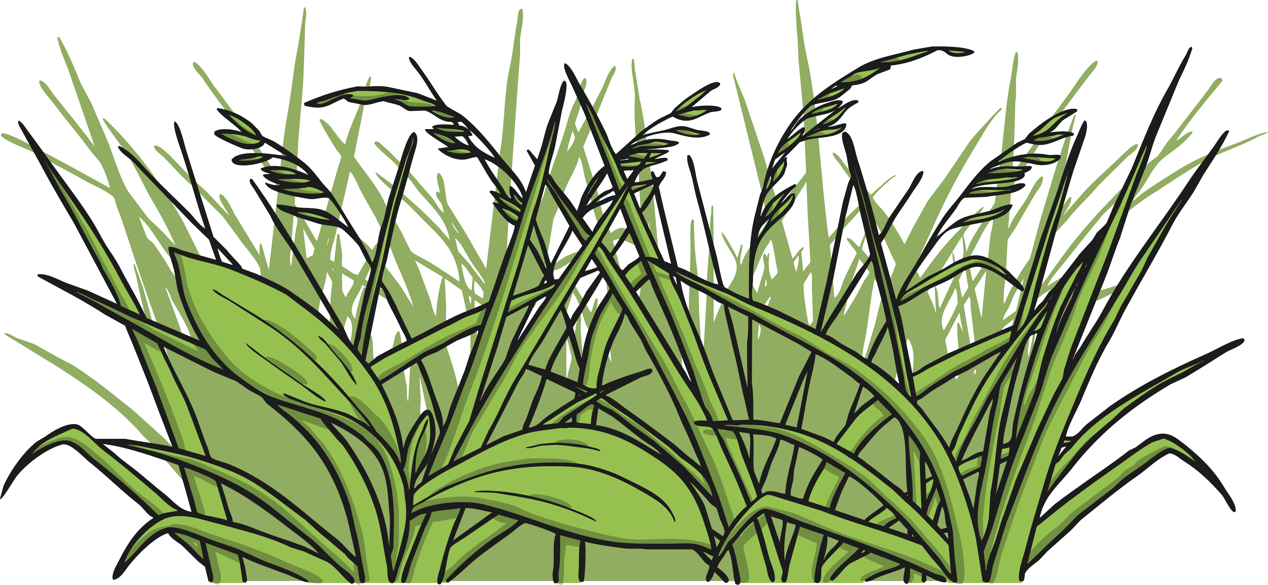
Classification Keys
You are going to create a classification key to sort your living things.
Look carefully at these living things. What question could you ask to split them into two groups?

Slide 12
Classification Keys
Is it a vertebrate?
yes
no
Choose one set of living things.
What question could you ask to split these living things into two groups?

Slide 13
Classification Keys
Does it have feathers?
yes
no
Does it have webbed feet?
yes
no
When you reach the end of the key, move on to the next group of living things. Choose a question that lets you sort them into two sets as before.

Slide 14
Classification Keys
Does it have feathers?
yes
no
Does it have webbed feet?
Does it lay eggs?
yes
no
yes
no

Slide 15
Classification Keys
Have a go at arranging your living things into classification keys by choosing questions that let you split each group into two.
Write your questions on sticky notes and draw arrows to show how you move down the key.
Use the questions on your classification tables as a starting point if you need to.
Be sure to test your key at the end to make sure that the path works correctly for each living thing.

Slide 16
Testing and Evaluating
Follow the path that leads to each living thing.
Does each path work correctly?
Do the questions used in the key describe the characteristics of the living things?
What could make this key better?
What has been done well?
Take a photo of your finished key

Slide 17
Aim
I can create a classification key.
I can show the characteristics of living things in a table and a key.
Success Criteria
I can identify the characteristics of living things.
I can use the characteristics of living things to sort them using a classification key.
I can show the characteristics of living things in a table.
I can create a classification key.

