Slide 1
I can estimate money

Slide 2
Review

Slide 3
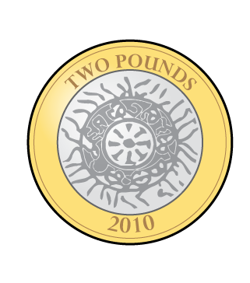
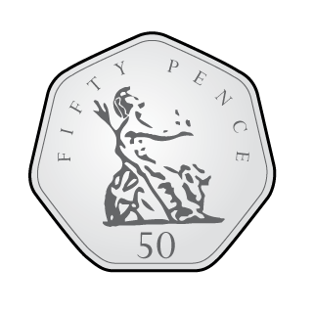
How much money is there?
Which round to 100?
49 71 18
Round to the nearest integer.
1.65
0.86

Slide 4
How much money is there?
Which round to 100?
49 71 18
Round to the nearest integer.
1.65
0.86
£2.50 $×$ 4 $=$
£10
£1
£1
£8
1
1.1
1.2
1.3
1.4
1.5
1.6
1.7
1.8
1.9
2
0
1

Slide 5
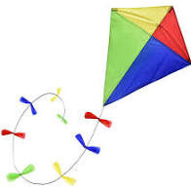
Fly the Kite

Slide 6
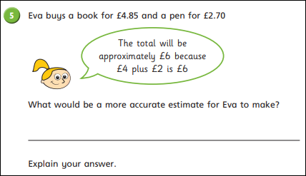

Slide 7
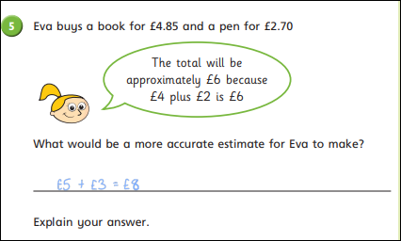

Slide 9
£1
£1.10
£1.20
£1.30
£1.40
£1.50
£1.60
£1.70
£1.80
£1.90
£2
Round these amounts of money to the nearest pound.
£1.80
£1.30
£1.50
£2
£1
£2
Have a think

Slide 10
£1
£1.10
£1.20
£1.30
£1.40
£1.50
£1.60
£1.70
£1.80
£1.90
£2
£1.08
£1.54
£1.65
Estimate the position of these amounts on the number line.
£1.65
£1.08
£1.54
Have a think

Slide 11
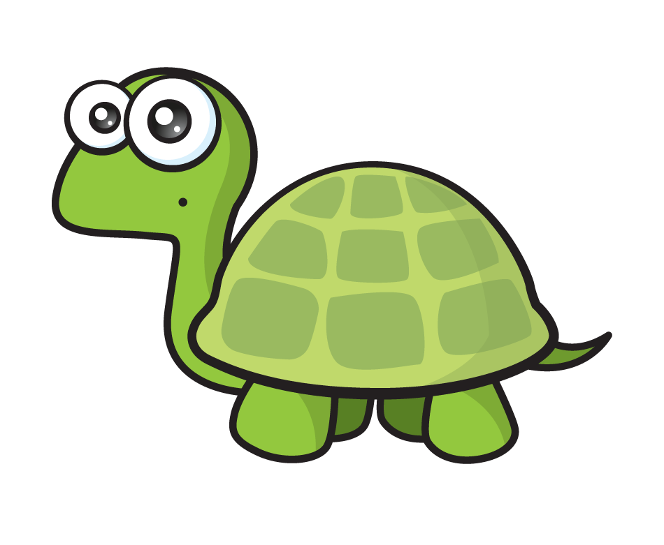
£1
£1.10
£1.20
£1.30
£1.40
£1.50
£1.60
£1.70
£1.80
£1.90
£2
£1.08
£1.54
£1.65
Round the amounts to the nearest pound.
£1.65
£1.08
£1.54
You round up if it is 5, 6, 7, 8 or 9
£2
You round to the next pound if there are 5, 6, 7, 8 or 9 tens
£2
£1
£1
£2
Have a think

Slide 12
Which of these amounts will round to £20 to the nearest pound?
£19.49
£19.71
£20.18
£21
£20.50
£19.40
£19.60
£19.80
£20
£20.20
£20.40
£19.50
£19.70
£19.90
£20.10
£20.30
£20.50
Have a think

Slide 13
Activity 1 Have a go at questions 1 - 4 on the worksheet

Slide 14
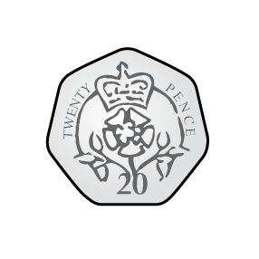
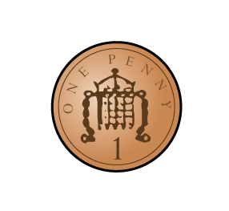
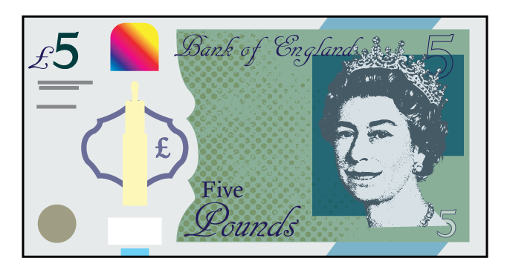
86p
£2.42
£1.95
We need to add up the cost first then see how much money you have
How?! I haven’t even finished writing the numbers yet!
Can I afford to buy all three items?
1
.
9
5
STOP! I already know he can afford it.
2
+

Slide 15
86p
£2.42
£1.95
I rounded £1.95 to £2
£2 $+$ £2 $+$ £1 $=$ £5
I rounded £2.42 to £2
I rounded 86p to £1
And Ron has over £7

Slide 16
An estimate – a sensible but
not exact answer.

Slide 17
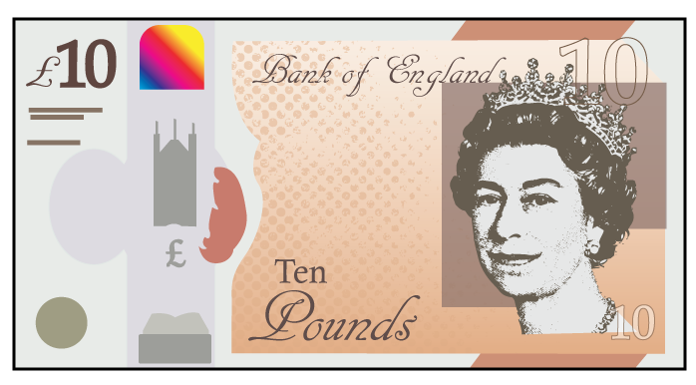
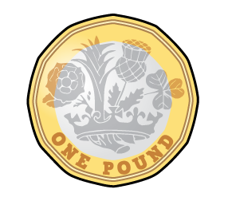
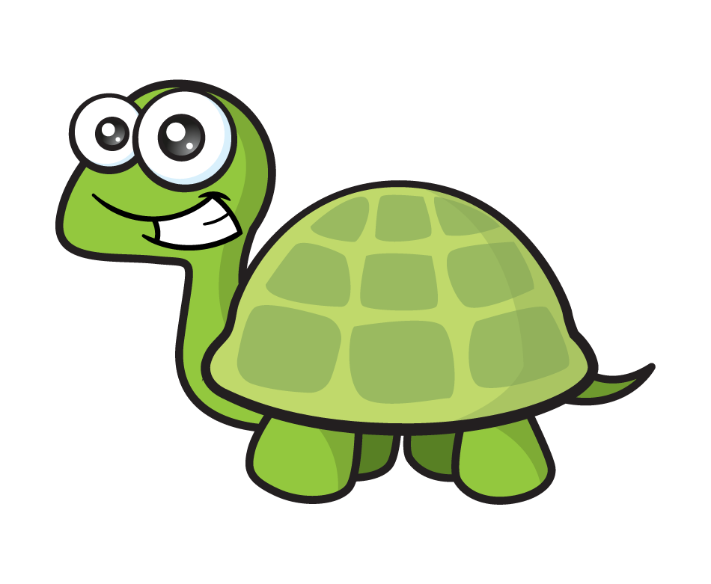
£10.00
£2.53
£2.50
£2.50
£2.50
£2.50
Can I afford to buy four teddy bears?
£2
£2.53
£3
£2.53 rounds to £3 and £3 $×$ 4 $=$ £12 so Ron does not have enough
Have a think

Slide 18
Activity 2 Have a go at the rest of the questions on the worksheet

Slide 19
Go Deeper

Slide 20
