Slide 1
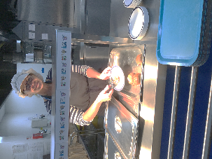
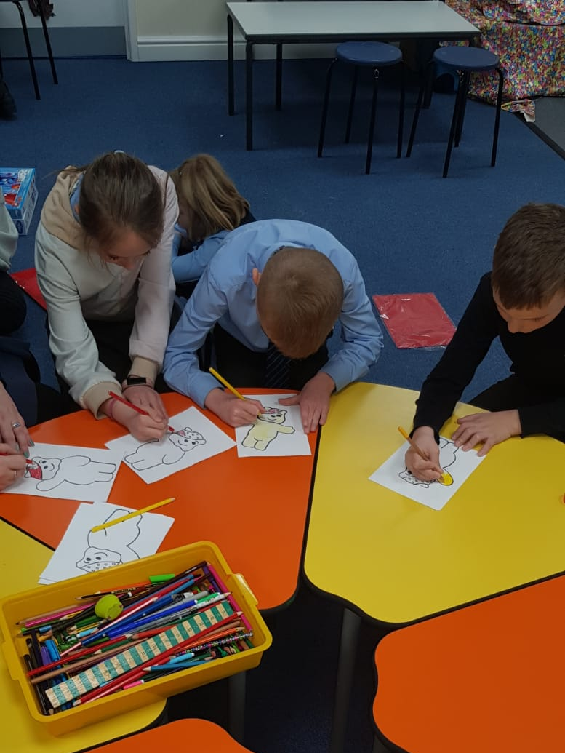
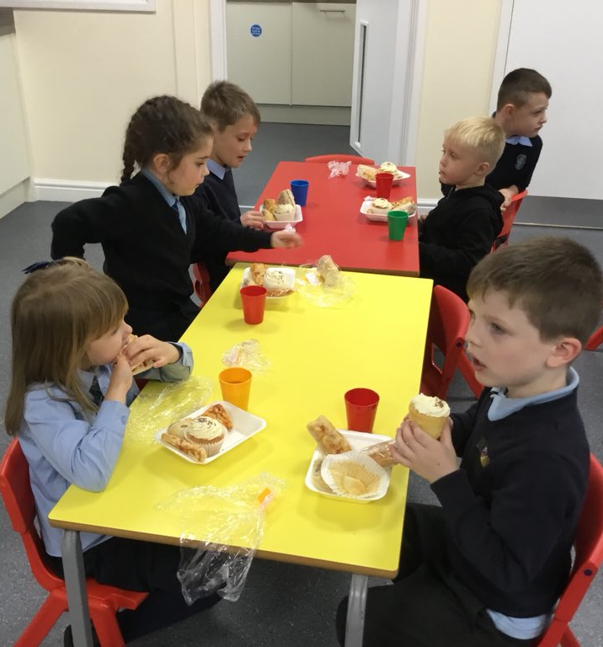
St Clare’s Primary School
Breakfast Club & After School Club
Breakfast Club
Pre-booking essential
7:45am until 8:45am
Breakfast provided from 7:45am – 8:30am
£4.50 per day
PP children can attend for free.
After School Club
Pre-booking essential
3:15pm until 5:30pm
Snacks will be provided (Eg. sandwich, yogurt, biscuit, juice)
3:15pm – 4:15pm £4.50 per day
3:15pm – 5:30pm £9.00 per day
PUPIL PREMIUM CHILDREN £2.00 3:15PM – 4:15PM
£4.50 4:15PM – 5:30PM
Sessions must be paid for in advance on ParentPay
St Clare’s can now accept workplace childcare vouchers.
Email dates required and voucher amount to
office@st-clares.leics.sch.uk
Please confirm your places by phoning the office on
01530 837747 or by emailing office@st-clares.leics.sch.uk
Please note - collection of children later than the paid
for time will result in additional charges.
Any late payments may unfortunately
result in places being withdrawn.

