Slide 1
We have sent a welcome booklet for you to fill in over the Summer with an adult. Please bring this with you on your first day to school.
We can’t wait to welcome you!
This is your new school.
It is called St Clare’s Primary School.
We can’t wait to welcome you!

Slide 2
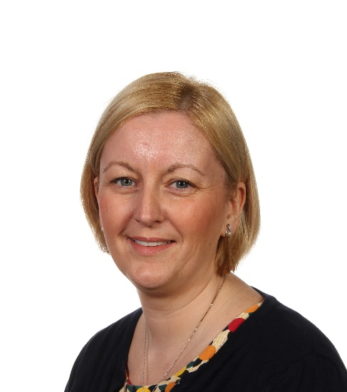
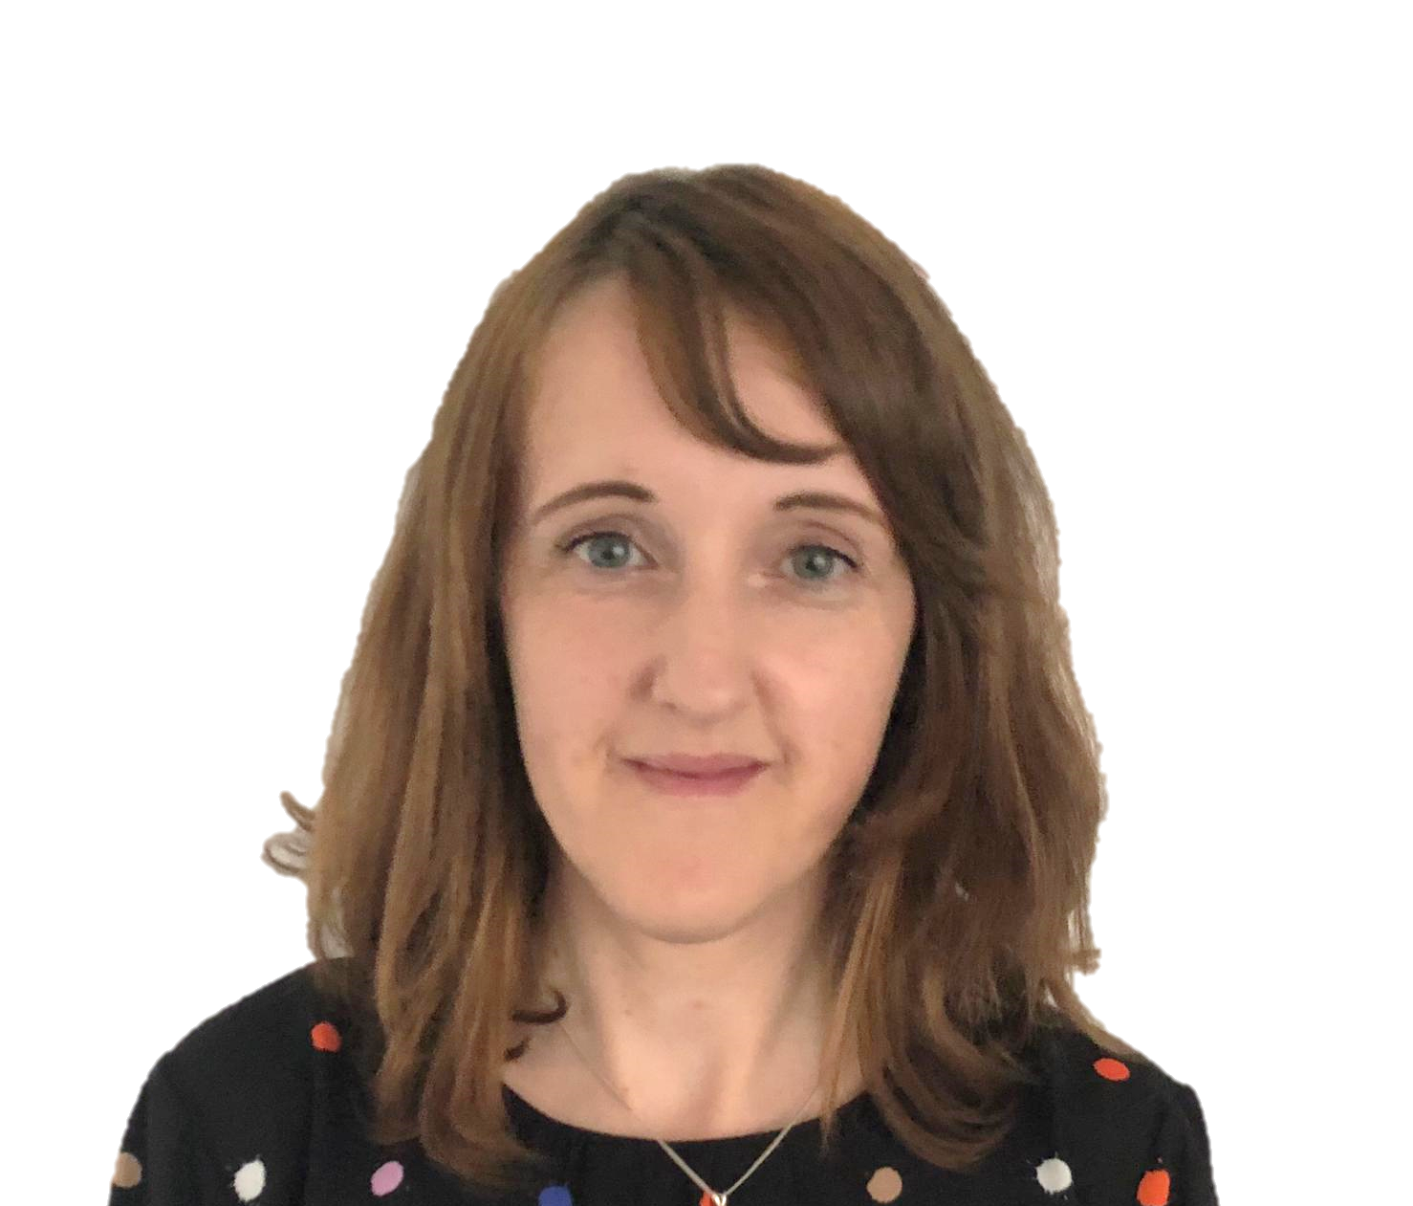
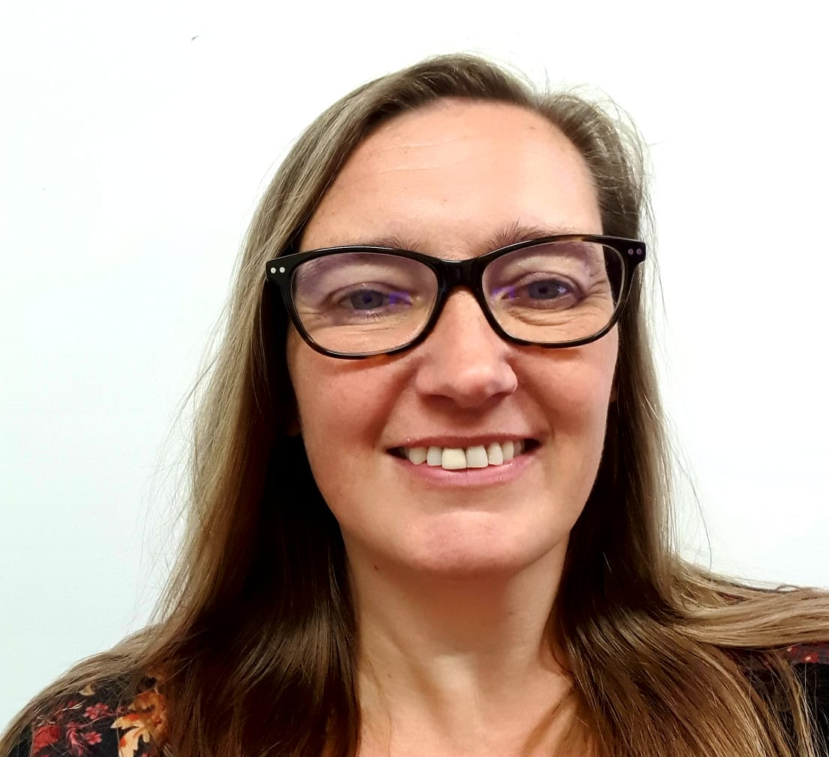
Meet the Staff
Mrs Palmer EYFS Teacher (Monday – Tuesday) | Mrs Liddle Deputy Head / EYFS Teacher (Wednesday – Friday)
Mrs Glauds EYFS Teaching Assistant | Mrs Beer Headteacher

Slide 3
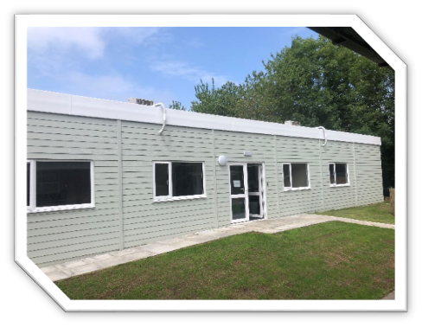
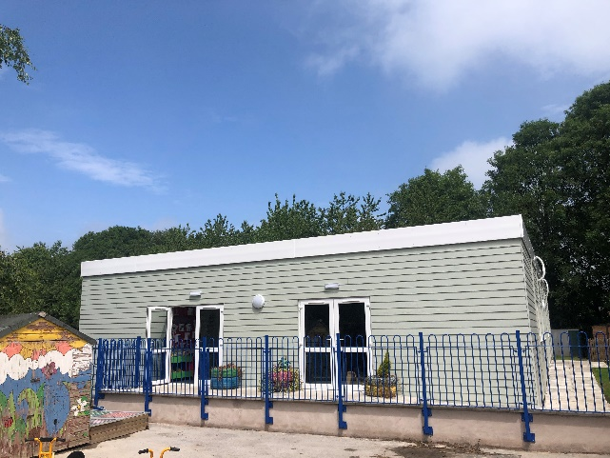
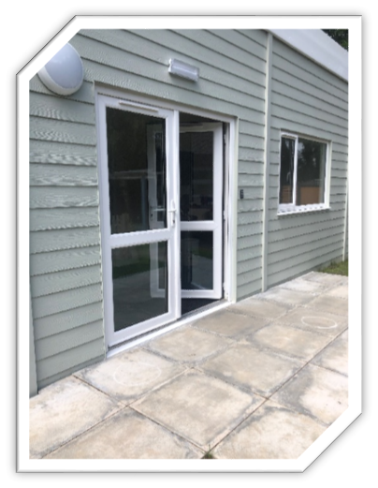
This is your classroom:
This is your classroom:
This is the door you will enter by in the mornings:

Slide 4
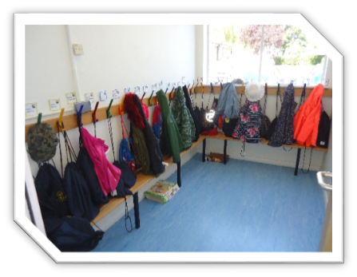
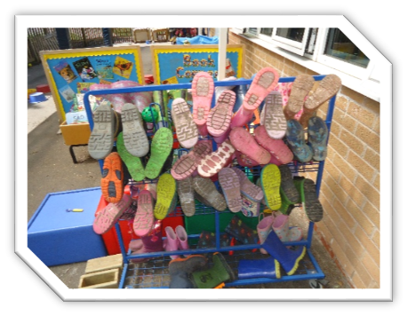
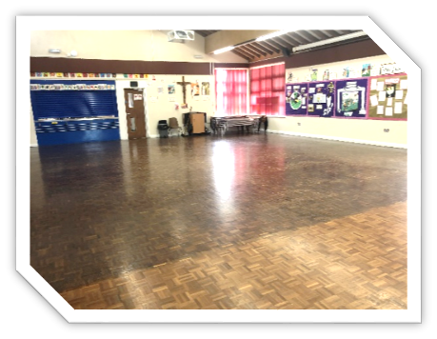
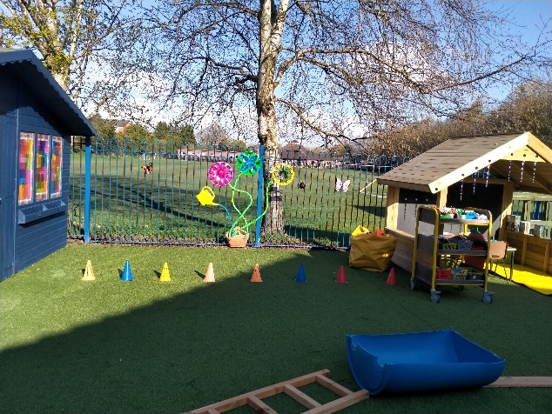
This is the cloakroom where you will hang up your coat.
This is where you will put your wellies to wear on rainy days.
This is the hall where you will eat your lunch and have P.E. lessons.
This is the outdoor area.

